Slide 1
Chapter 5:
8086 instruction set & Programming

Slide 2
Course Content
Directives
8086 Instruction-set
Arithmetic operations
logic operations and branch operations
DOS INT 21
Programming techniques- looping, counting and indexing
Additional data transfer and 16-bit instructions

Slide 3
Directives
Assume
Used to tell the assembler the name of the logical segment it should use for a specified segment.
You must tell the assembler that what to assume for any segment you use in the program.
Example, ASSUME: CODE tells the assembler that the instructions for the program are in segment named CODE.
DB – Defined Byte
Used to declare a byte type variable or to set aside one or more locations of type byte in memory.
Example, PRICES DB 49H, 98H, 29H: Declare array of 3 bytes named PRICES and initialize 3 bytes as shown.

Slide 4
DD – Define Double Word
Used to declare a variable of type doubleword or to reserve a memory location which can be accessed as doubleword.
DQ – Define Quadword
Used to tell the assembler to declare the variable as 4 words of storage in memory.
DT – Define Ten bytes
Used to tell the assembler to declare the variable which is 10 bytes in length or reserve 10 bytes of storage in memory.
DW – Define Word
Used to tell the assembler to define a variable type as word or reserve word in memory.

Slide 5
END – End the program
To tell the assembler to stop fetching the instruction and end the program execution.
ENDP – it is used to end the procedure.
ENDS – used to end the segment.
EQU – Equate
Used to give name to some value or symbol.
EVEN – Align on Even memory address
Tells the assembler to increment the location counter to the next even address if it is not already at an even address.

Slide 6
EXTRN
Used to tell the assembler that the name or labels following the directive are in some other assembly module.
GLOBAL – Declares symbols as PUBLIC or EXTRN
Used to make the symbol available to other modules.
It can be used in place of EXTRN or PUBLIC keyword.
GROUP – Group related segment
Used to tell the assembler to group the logical segments named after the directive into one logical segment.
This allows the content of all the segments to be accessed from the same group.

Slide 7
INCLUDE – include source code from file
Used to tell the assembler to insert a block of source code from the named file into the current source module. This shortens the source code.
LABEL
Used to give the name to the current value in the location counter.
The LABEL directive must be followed by a term which specifies the type you want associated with that name.
LENGTH
Used to determine the number of items in some data such as string or array.

Slide 8
NAME
Used to give a specific name to a module when the programs consisting of several modules.
OFFSET
It is an operator which tells the assembler to determine the offset or displacement of named data item or procedure from the start of the segment which contains it.
ORG – Originate
Tells the assembler to set the location counter value.
Example, ORG 7000H sets the location counter value to point to 7000H location in memory.
$ is often used to symbolically represent the value of the location counter. It is used with ORG to tell the assembler to change the location according to the current value in the location counter. E.g. ORG $+100.

Slide 9
PROC – Procedure
Used to identify the start of the procedure.
PTR – Pointer
Used to assign a specific type to a variable or a label.
It is necessary to do this in any instruction where the type of the operand is not clear.
Public
It is used to tell the assembler that the specified label or variable is accessible by other modules.
This is useful in large programs which are generally written in modules.

Slide 10
SEGMENT
Used to indicate that the start of a logical segment.
Preceding the segment directive is the name you want to give to the segment.
SHORT
Used to tell the assembler that only a 1-byte displacement is needed to code a jump instruction.
If the jump destination is after the jump instruction in the program, the assembler will automatically reserve 2 bytes for the displacement.
TYPE
Tells the assembler to determine the type of a specified variable.
The TYPE operator can be used in instruction such as ADD BX, TYPE WORD_ARRAY, where we want to increment BX to point to the next word in an array of words.

Slide 11
8086 Instruction-set
The 8086 microprocessor supports 8 types of instructions:
Data Transfer Instructions
Arithmetic Instructions
Bit Manipulation Instructions
String Instructions
Program Execution Transfer Instructions (Branch & Loop Instructions)
Processor Control Instructions
Iteration Control Instructions
Interrupt Instructions

Slide 12
Data Transfer Instructions
These instructions are used to transfer the data from the source operand to the destination operand.
Following are the list of instructions under this group:
Instruction to transfer a word
MOV: Used to copy the byte or word from the provided source to the provided destination.
PPUSH: Used to put a word at the top of the stack.
POP: Used to get a word from the top of the stack to the provided location.
PUSHA: Used to put all the registers into the stack.
POPA: Used to get words from the stack to all registers.
XCHG: Used to exchange the data from two locations.
XLAT: Used to translate a byte in AL using a table in the memory.

Slide 13
Instructions for input & output
IN: Used to read a byte or word from the provided port to the accumulator.
OUT: Used to send out a byte or word from the accumulator to the provided port.
Instructions to transfer the address
LEA: Used to load the address of operand into the provided register.
LDS: Used to load DS register and other provided register from the memory
LES: Used to load ES register and other provided register from the memory. OUT:

Slide 14
Instructions to transfer flag registers
LAHF: Used to load AH with the low byte of the flag register.
SAHF: Used to store AH register to low byte of the flag register.
PUSHF: Used to copy the flag register at the top of the stack.
POPF: Used to copy a word at the top of the stack to the flag register.

Slide 15
Arithmetic Instructions
These instructions are used to perform arithmetic operations like addition, subtraction, multiplication, division, etc.
Following is the list of instructions under this group:
Instructions to perform addition
ADD: Used to add the provided byte to byte/word to word.
ADC: Used to add with carry.
INC: Used to increment the provided byte/word by 1.
AAA: Used to adjust ASCII after addition.
DAA: Used to adjust the decimal after the addition/subtraction operation.

Slide 16
Instructions to perform subtraction
SUB: Used to subtract the byte from byte/word from word.
SBB: Used to perform subtraction with borrow.
DEC: Used to decrement the provided byte/word by 1.
NPG: Used to negate each bit of the provided byte/word and add 1/2’s
complement.
CMP: Used to compare 2 provided byte/word.
AAS: Used to adjust ASCII codes after subtraction.
DAS: Used to adjust decimal after subtraction.

Slide 17
Instruction to perform multiplication
MUL: Used to multiply unsigned byte by byte/word by word.
IMUL: Used to multiply signed byte by byte/word by word.
AAM: Used to adjust ASCII codes after multiplication.

Slide 18
Instructions to perform division
DIV: Used to divide the unsigned word by byte or unsigned double word by word.
IDIV: Used to divide the signed word by byte or signed double word by word.
AAD: Used to adjust ASCII codes after division.
CBW: Used to fill the upper byte of the word with the copies of sign bit of the lower
byte.
CWD: Used to fill the upper word of the double word with the sign bit of the lower
word.

Slide 19
Bit Manipulation Instructions
These instructions are used to perform operations where data bits are involved, i.e. operations like logical, shift, etc.
Following is the list of instructions under this group:
Instructions to perform logical operation
NOT: Used to invert each bit of a byte or word.
AND: Used for adding each bit in a byte/word with the corresponding bit in another byte/word.
OR: Used to multiply each bit in a byte/word with the corresponding bit in another
byte/word.
XOR: Used to perform Exclusive-OR operation over each bit in a byte/word with
the corresponding bit in another byte/word.
TEST: Used to add operands to update flags, without affecting operands.

Slide 20
Instructions to perform shift operations
SHL/SAL: Used to shift bits of a byte/word towards left and put zero(S) in LSBs.
SHR: Used to shift bits of a byte/word towards the right and put zero(S) in MSBs.
SAR: Used to shift bits of a byte/word towards the right and copy the old MSB into the new MSB.

Slide 21
Instructions to perform rotate operations
ROL: Used to rotate bits of byte/word towards the left, i.e. MSB to LSB and to Carry Flag [CF].
ROR: Used to rotate bits of byte/word towards the right, i.e. LSB to MSB and to Carry Flag [CF].
RCR: Used to rotate bits of byte/word towards the right, i.e. LSB to CF and CF to MSB.
RCL: Used to rotate bits of byte/word towards the left, i.e. MSB to CF and CF to LSB.

Slide 22
String Instructions
String is a group of bytes/words and their memory is always allocated in a sequential order.
Following is the list of instructions under this group:
REP: Used to repeat the given instruction till CX≠0.
REPE/REPZ: Used to repeat the given instruction until CX=0 or zero flag ZF=1.
REPNE/REPNZ: Used to repeat the given instruction until CX=0 or zero flag ZF=1.
MOVS/MOVSB/MOVSW: Used to move the byte/word from one string to another.
COMS/COMPSB/COMPSW: Used to compare two string bytes/words.

Slide 23
String Instructions cont..
INS/INSB/INSW: Used as an input string/byte/word from the I/O port to the
provided memory location.
OUTS/OUTSB/OUTSW: Used as an output string/byte/word from the provided
memory location to the I/O port.
SCAS/SCASB/SCASW: Used to scan a string and compare its byte with a byte in
AL or string word with a word in AX.
LODS/LODSB/LODSW: Used to store the string byte into AL or string word into
AX.

Slide 24
Program Execution Transfer Instructions (Branch & Loop Instructions)
These instructions are used to transfer/branch the instructions during an execution. It includes the following instructions:
Instructions to transfer the instruction during an execution without any condition:
CALL: Used to call a procedure and save their return address to the stack.
RET: Used to return from the procedure to the main program.
JMP: Used to jump to the provided address to proceed to the next instruction.

Slide 25
Instructions to transfer the instruction during an execution with some conditions:
JA/JNBE: Used to jump if above/not below/equal instruction satisfies.
JAE/JNB: Used to jump if above/not below instruction satisfies.
JBE/JNA: Used to jump if below/equal/ not above instruction satisfies.
JC: Used to jump if carry flag CF=1
JE/JZ: Used to jump if equal/zero flag ZF=1
JG/JNLE: Used to jump if greater/not less than/equal instruction satisfies.
JGE/JNL: Used to jump if greater than/equal/not less than instruction satisfies.

Slide 26
JL/JNGE: Used to jump if less than/not greater than/equal instruction satisfies.
JLE/JNG: Used to jump if less than/equal/if not greater than instruction satisfies.
JNC: Used to jump if no carry flag (CF=0)
JNE/JNZ: Used to jump if not equal/zero flag ZF=0
JNO: Used to jump if no overflow flag OF=0
JNP/JPO: Used to jump if not parity/parity odd PF=0
JNS: Used to jump if not sign SF=0
JO: Used to jump if overflow flag OF=1
JP/JPE: Used to jump if parity/parity even PF=1
JS: Used to jump if sign flag SF=1

Slide 27
Processor Control Instructions
These instructions are used to control the processor action by setting/resetting the flag values.
Following are the instructions under this group:
STC: Used to set carry flag CF to 1
CLC: Used to clear/reset carry flag CF to 0
CMC: Used to put complement at the state of carry flag CF.
STD: Used to set the direction flag DF to 1
CLD: Used to clear/reset the direction flag DF to 0
STI: Used to set the interrupt enable flag to 1, i.e., enable INTR input.
CLI: Used to clear the interrupt enable flag to 0, i.e., disable INTR input.

Slide 28
Iteration Control Instructions
These instructions are used to execute the given instructions for number of times.
Following is the list of instructions under this group:
LOOP: Used to loop a group of instructions until the condition satisfies, i.e., CX=0
LOOPE/LOOPZ: Used to loop a group of instructions till it satisfies ZF=1 & CX=0
LOOPNE/LOOPNZ: Used to loop a group of instructions till it satisfies ZF=0 & CX=0
JCXZ: Used to jump to the provided address if CX=0

Slide 29
Interrupt Instructions
These instructions are used to call the interrupt during program execution.
INT: Used to interrupt the program during execution and calling service specified.
INTO: Used to interrupt the program during execution if OF=1
IRET: Used to return from interrupt service to the main program

Slide 30
DOS INT 21
The INT instruction is somewhat like a FAR call.
– Saves CS:IP and the flags on the stack and goes to the subroutine associated with that interrupt.
Use INT 21H function calls to:
– Input characters from the keyboard.
– Output characters to the screen.
– Input or output strings.
Ex: INT xx ; the interrupt xx can be 00 – FF H

Slide 31
In x86 processors, 256 interrupts, numbered 00 to FF.
• INT 10H and INT 21H are the most widely used with various functions selected by the value in the AH register.
INT 10H subroutines are burned into the ROM BIOS. – Used to communicate with the computer's screen video.
• Manipulation of screen text/graphics can be done via INT 10H.
• Among the functions associated with INT 10H are changing character or background color, clearing the screen, and changing the location of the cursor. – Chosen by putting a specific value in register AH.

Slide 32
DOS INTERRUPT 21H
This section uses information inputted from the keyboard, and displayed on the screen.
A much more dynamic way of processing information.
When the OS is loaded, INT 21H can be invoked to perform some extremely useful functions.
Commonly referred to as DOS INT 21H function calls.

Slide 33
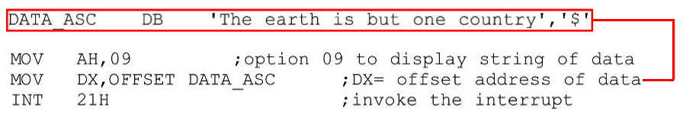
DOS INTERRUPT 21H Option 09 outputting a data string on the monitor
INT 21H can send a set of ASCII data to the monitor.
Set AH = 09 and DX = offset address of the ASCII data.
Displays ASCII data string pointed at by DX until it encounters the dollar sign "$".
The data segment and code segment, to display the message "The earth is but one country" :

Slide 34
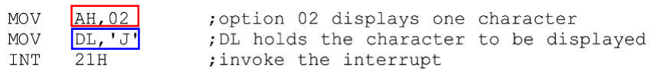
DOS INTERRUPT 21H Option 02 outputting a single character
To output only a single character, 02 is put in AH, and DL is loaded with the character to be displayed.
The following displays the letter "J" :

Slide 35

DOS INTERRUPT 21H Option 01 inputting a single character, with echo
This functions waits until a character is input from the keyboard, then echoes it to the monitor.
After the interrupt, the input character will be in AL.

Slide 36
Programming techniques- looping, counting and indexing.
Looping:
The programming technique used to instruct the microprocessor to repeat tasks is called looping. This task is accomplished by using jump instructions.
Loops are of 2 types:
Continuous(repeats a task continuously)
Conditional(repeats a task until certain data conditions are met)

Slide 37
Continuous Loop: Repeats a task continuously. A continuous loop is set up by using the unconditional jump instruction. A program with a continuous loop does not stop repeating the tasks until the system is reset.
Conditional Loop: A conditional loop is set up by a conditional jump instructions. These instructions check flags(Z,CY,P,S) and repeat the tasks if the conditions are satisfied. These loops include counting and indexing.

Slide 38
Conditional Loop And Counter
A counter is a typical application of the conditional loop.
A microprocessor needs a counter, flag to accomplish the looping task.
Counter is set up by loading an appropriate count in a register.
Counting is performed by either increment or decrement the counter.
Loop is set up by a conditional jump instruction.
End of counting is indicated by a flag.

Slide 39
Conditional Loop, Counter And Indexing:
Another type of loop which includes counter and indexing .
Indexing: Pointing of referencing objects with sequential numbers. Data bytes are stored in memory locations and those data bytes are referred to by their memory locations.
Example: Steps to add ten bytes of data stored in memory locations starting ata given location and display the sum.

Slide 40
The microprocessor needs
A counter to count 10 data bytes.
An index or a memory pointer to locate where data bytes are stored.
To transfer data from a memory location to the microprocessor(ALU)
To perform addition
Registers for temporary storage of partial answers
A flag to indicate the completion of the stack
To store or output the result.

Slide 41
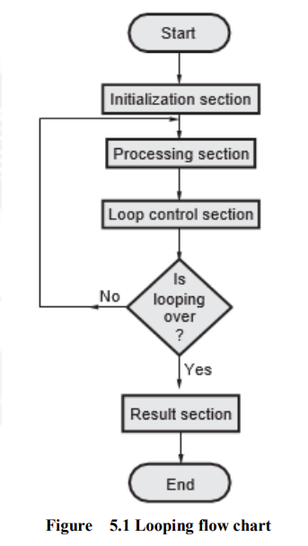

Slide 42
1. The initialization section establishes the starting values of loop counters for counting how many times loop is executed, Address registers for indexing which give pointers to memory locations and other variables.
2. The actual data manipulation occurs in the processing section. This is the section which does the work.
3. The loop control section updates counters, indices (pointers) for the next iteration.
4. The result section analyzes and stores the results.

Slide 43
Additional data transfer and 16-bit instructions.
16 BIT DATA TRANSFER TO REGISTER PAIR (LXI)
Load register pair immediate
• LXI Reg. pair, 16-bit data.
• The instruction loads 16-bit data in the register pair
designated in the operand.
• Example: LXI H, 2034H or LXI H, XYZ

Slide 44
Load H and L registers direct
LHLD 16-bit address
The instruction copies the contents of the memory location pointed out by the 16-bit address into register L and copies
the contents of the next memory location into register H.
The contents of source memory locations are not altered.
Example: LHLD 2040H

Slide 45
DATA TRANSFER FROM MEMORY TO MICROPROCESSOR
MOV R,M
R, M copies data byte from Memory to Register.
Memory location, its location is specified by the contents of the HL registers.
Example: MOV B, M
Load accumulator indirect

Slide 46
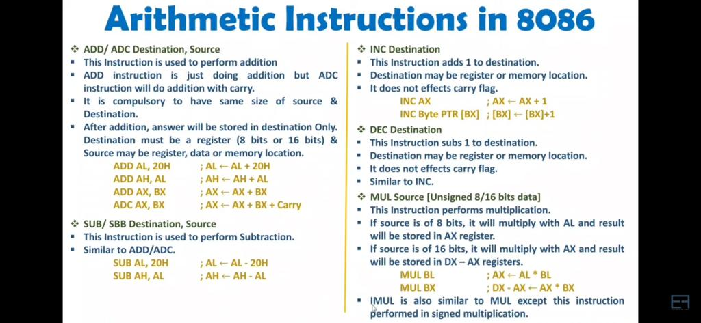

Slide 47
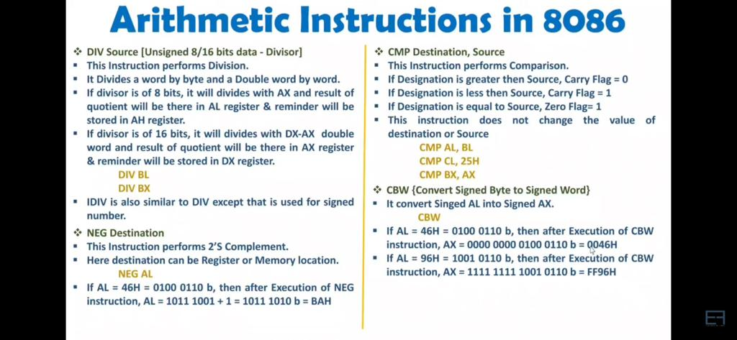

Slide 48
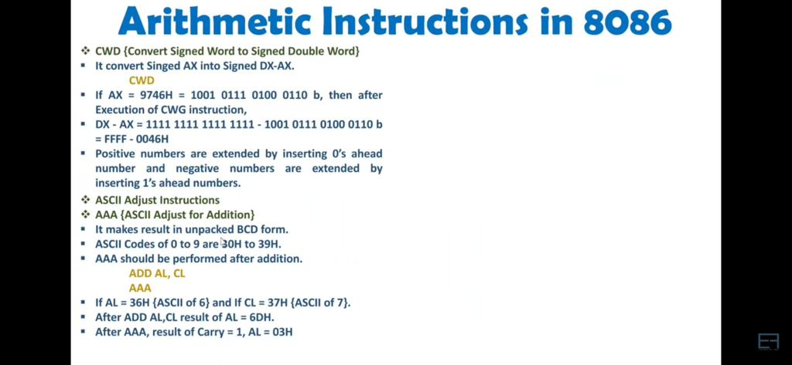

Slide 49
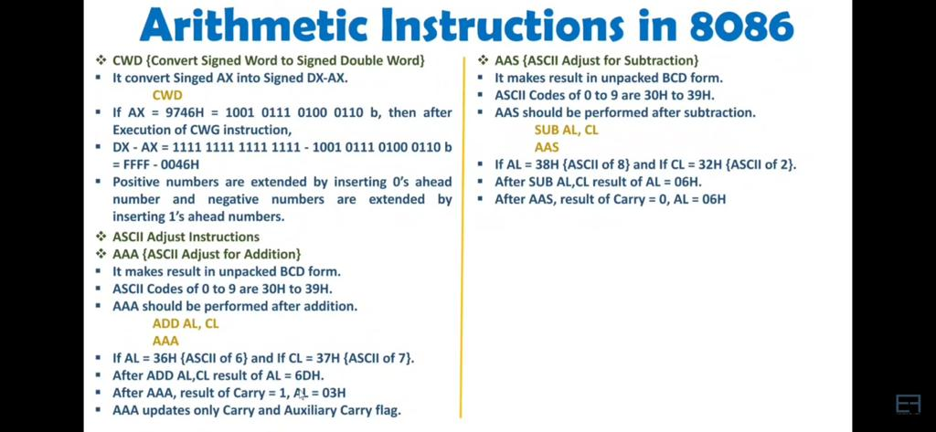

Slide 50
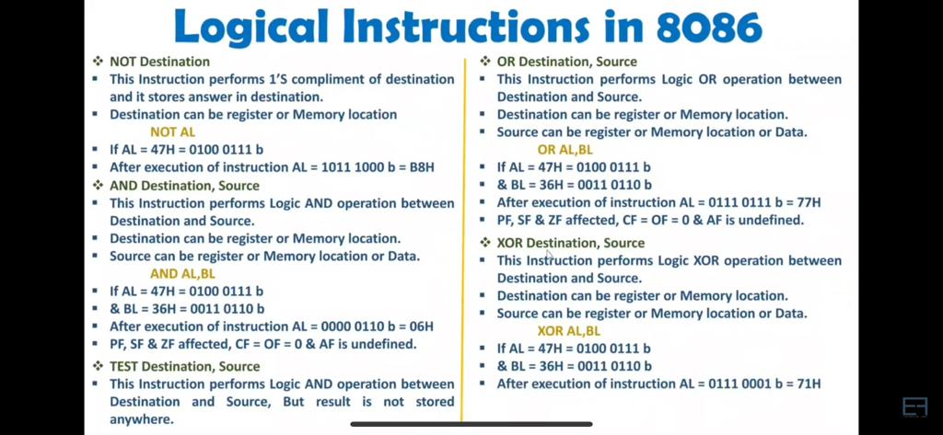

Slide 51
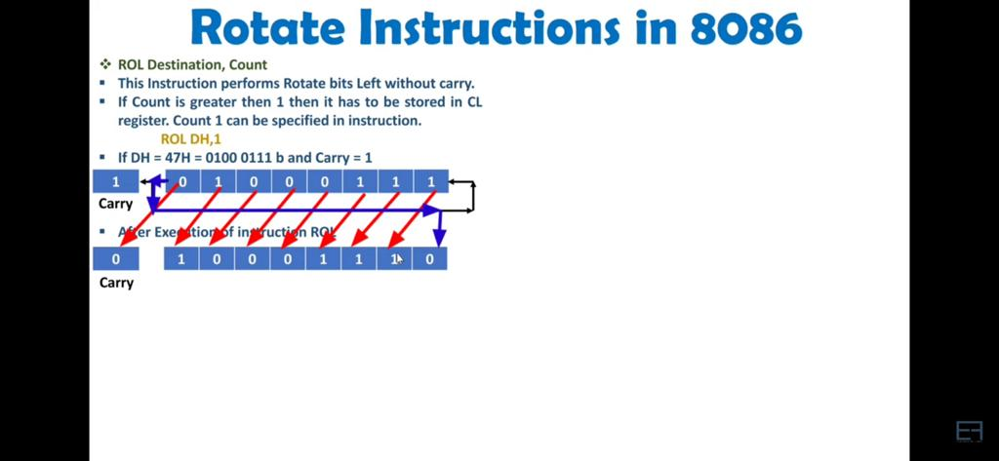

Slide 52
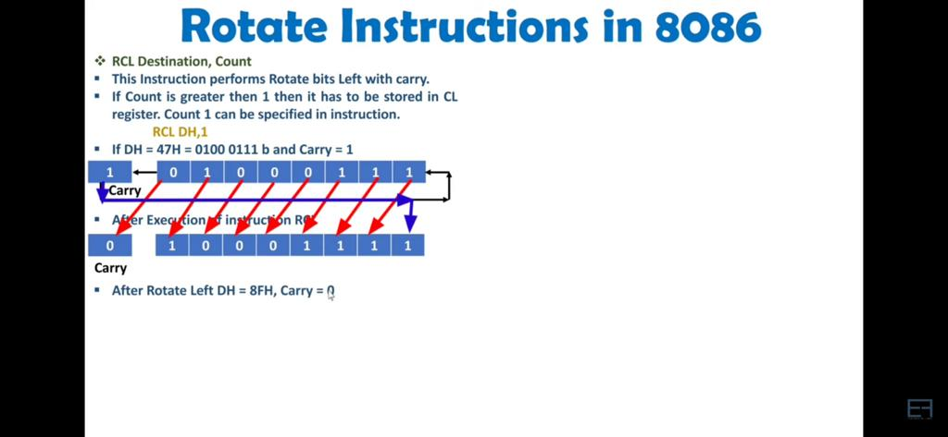

Slide 53
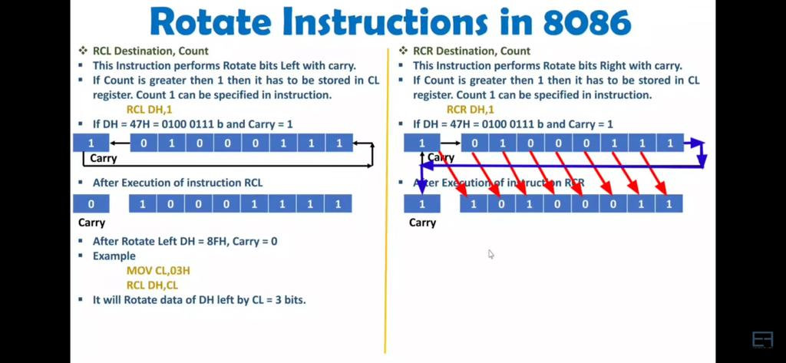

Slide 54
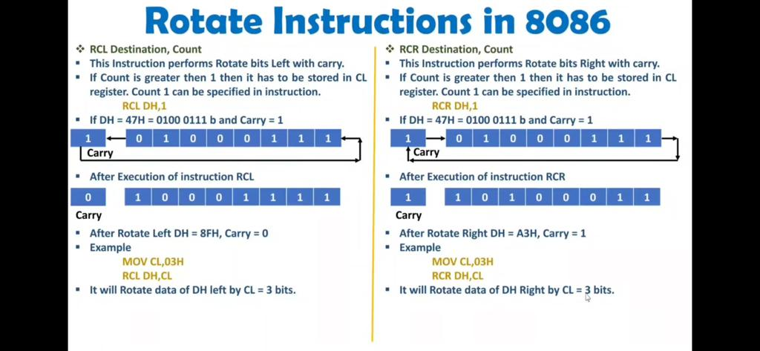

Slide 55
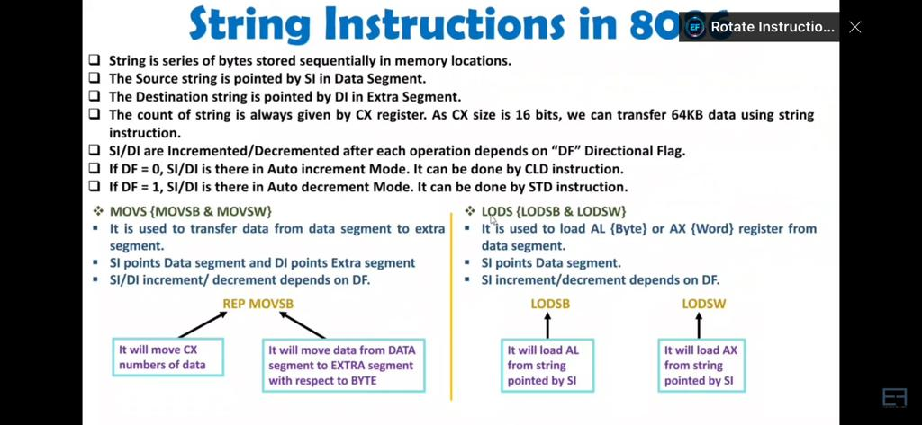

Slide 56
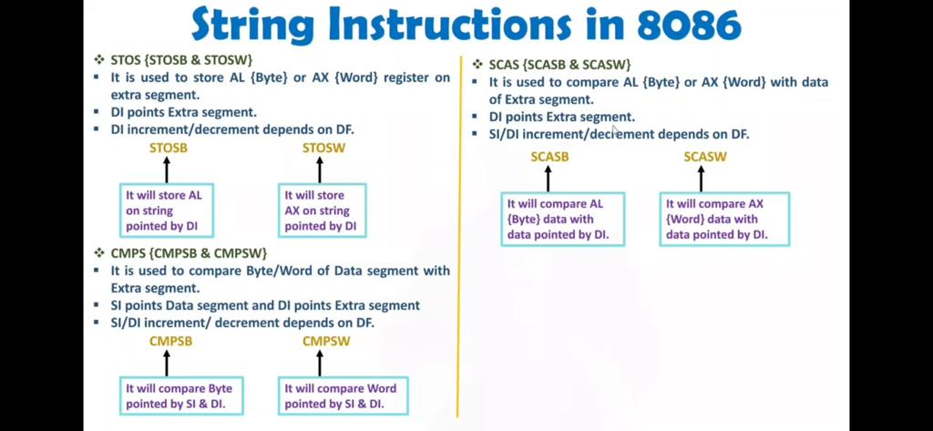

Slide 57
