Slide 1




Bioinformatics
Student name and ID:
Instructor:
Salma Nahedh Aljabr
2224*****
Dr. Sarah Alamer

Slide 2
Table of Content:
Cover slide……………………………………………………………..………………………………………………..…….
1
The impact of Bioinformatics on humanity………………………………………………….………….……...
3
Counting the length of a DNA sequence………………………………………………………………………...
4
DNA into RNA “Transcription”………………..…………………………………………………………………….…
5
Complementing a Strand of DNA…………………………………………………………………….................
6
7
RNA into Protein “Translation”……………………………………………………………………………….……...
Counting the DNA nucleotides………..………………………………………………………..…………………...
8
References……………………………………………………………………………………………………………………..
9

Slide 3
The impact of Bioinformatics on humanity:
Bioinformatics has a significant impact on humanity by providing tools and methods for analyzing and interpreting biological data, which in turn can help in:
Medical research: helps in the discovery of new drugs, identification of genetic mutations associated with diseases, and development of personalized medicine.
Environmental protection: used to analyze large amounts of environmental data, such as data on the distribution and abundance of species, to better understand the impacts of environmental change and to inform conservation efforts.
Biodiversity: used to study the evolutionary history of species.
This information can then be used to understand the mechanisms of evolution and to conserve biodiversity.

Slide 4
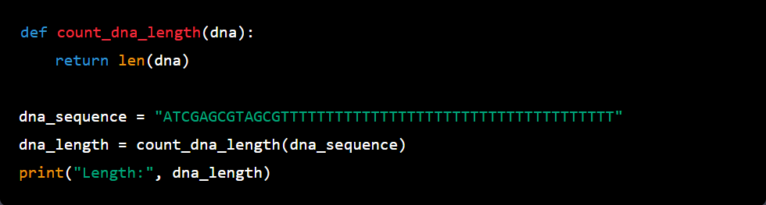
Counting the length of a DNA sequence :
Input example
Output:
The purpose of counting the length of a DNA sequence is to determine the size of the sequence. The length of a DNA sequence can provide insight into the size of a gene or the amount of DNA in a genome. It can also be used to determine the relationship between different sequences and to identify potential mutations or other changes in the DNA.
This information is often used in many areas of bioinformatics, including gene identification, genome assembly, and evolutionary studies.

Slide 5
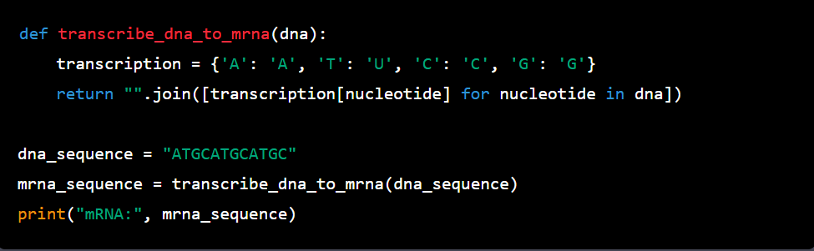
DNA into RNA “Transcription”:
Input example
Output:
Transferring DNA to mRNA is a critical step in the process of gene expression, allowing cells to access and use their genetic information to produce the proteins they need for survival and function.

Slide 6
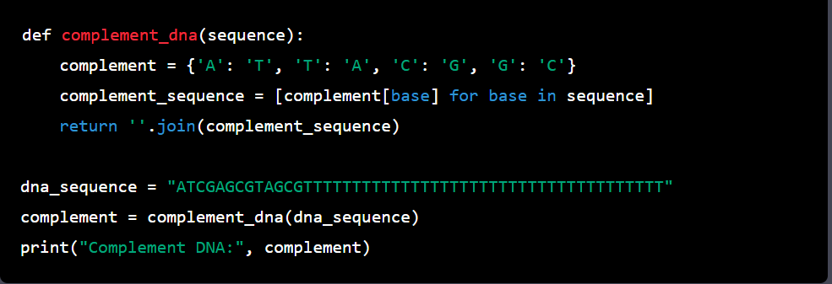
Complementing a Strand of DNA:
Input example
Output:
The purpose of DNA complementarity is to ensure the accurate replication of DNA and the transmission of genetic information from one generation to the next. This pairing allows the DNA molecule to form a double helix, which provides stability and allows for the easy replication of the DNA molecule.

Slide 7
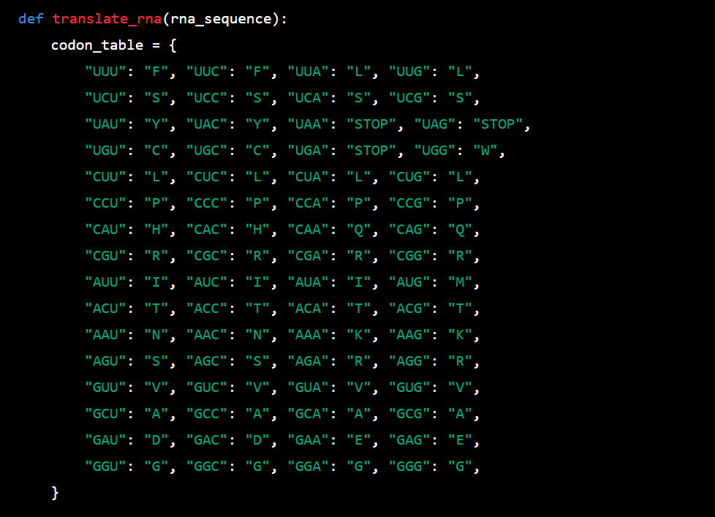
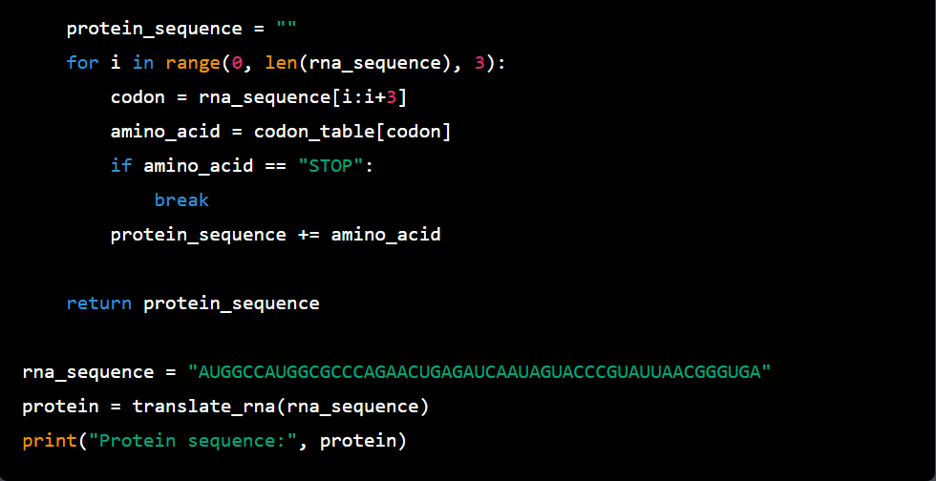
RNA into Protein “Translation”: Output:
The purpose of translating RNA into protein is to convert the genetic information stored in RNA into functional molecules called proteins. Proteins play critical roles in a wide range of biological processes, including metabolism, growth, development, and response to stimuli.
Input example

Slide 8
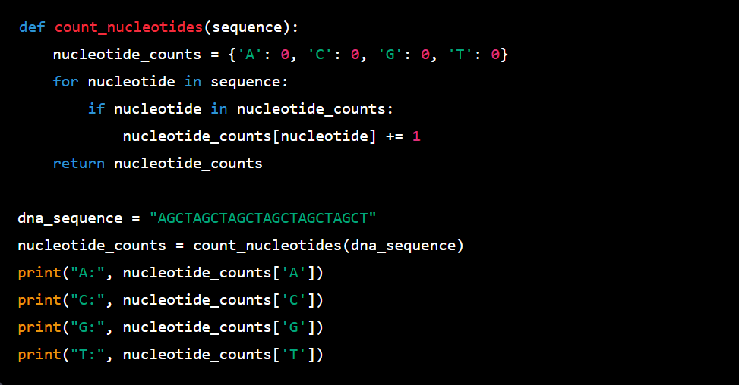
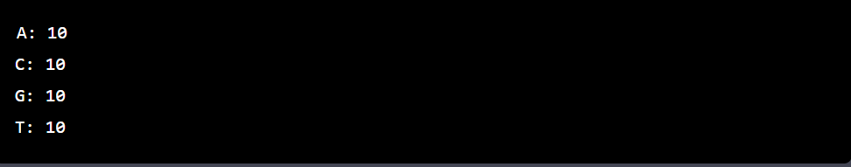
Counting the DNA nucleotides:
Counting DNA nucleotides is an important step in understanding the composition and structure of DNA molecules. The process of counting the occurrences of each of the four nucleotides in a DNA sequence provides information about the distribution of the nucleotides, which can be useful in a variety of applications, including:
Gene expression analysis: By comparing the nucleotide composition of different DNA sequences, scientists can determine which genes are being expressed and in what quantities, which can provide important information about the function of a particular cell or tissue.
Evolutionary analysis: By comparing the nucleotide composition of different species, scientists can determine how closely related two species are, and how they have evolved over time.
Input example
Output:

Slide 9
References:
CHAFFEY N. (2003). Alberts, B., Johnson, A., Lewis, J., Raff, M., Roberts, K. and Walter, P. Molecular biology of the cell. 4th edn. Annals of Botany, 91(3), 401.
https://rosalind.info/problems/locations/

