Slide 1

Android tutorial part1

Slide 2
Why Android?
The world’s most popular mobile OS.
used in tablets, watches, TVs and cars.
Android features
Messaging, Web browser, Multi-touch, Multitasking, Screen capture, Multiple language support.
Connectivity→ GSM/EDGE, Bluetooth, LTE, CDMA, Tethering….
Media support, External storage..
Android devices can include video cameras, touchscreens, GPS, accelerometers, gyroscopes, barometers, magnetometers, dedicated gaming controls, proximity and pressure sensors….

Slide 3
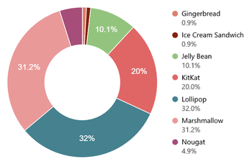
Versions of Android OS
Version | Codename | API level | Distribution
2.3.3 - 2.3.7 | Gingerbread | 9-10 | 0.9%
3.0 - 3.2.6 | Honeycomb | 11-13 | --
4.0.3 - 4.0.4 | Ice Cream Sandwich | 14-15 | 0.9%
4.1.x | Jelly Bean | 16 | 3.5%
4.2.x |  | 17 | 5.1%
4.3 |  | 18 | 1.5%
4.4 | KitKat | 19 | 20.0%
5.0 | Lollipop | 21 | 9.0%
5.1 |  | 22 | 23.0%
6.0 | Marshmallow | 23 | 31.2%
7.0 | Nougat | 24 | 4.5%
7.1 |  | 25 | 0.4%

Slide 4

Environment Setup
Java JDK5 or JDK6.
Android Studio and Android SDK

Slide 5
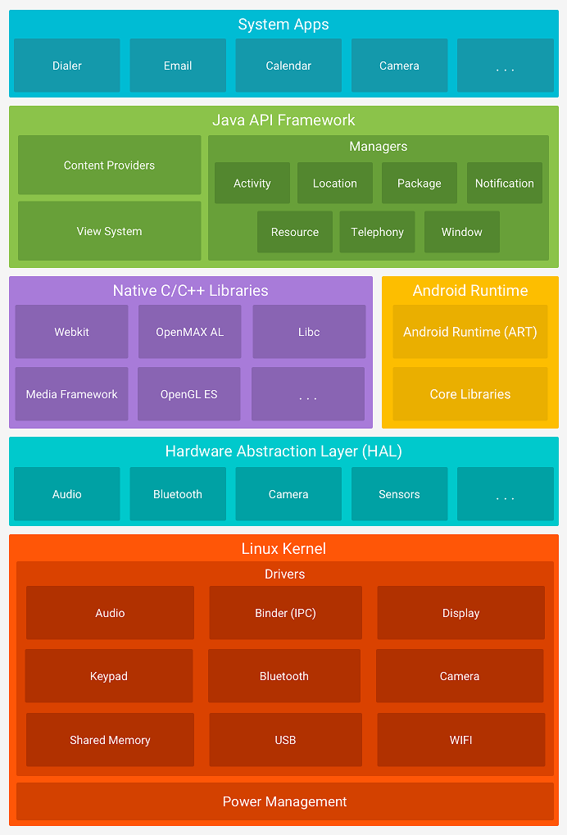
Android operating system architecture
Notes:
Linux kernel
At the bottom of the layers is Linux - Linux 2.6 with approximately 115 patches. This provides basic system functionality like process management, memory management, device management like camera, keypad, display etc. Also, the kernel handles all the things that Linux is really good at, such as networking and a vast array of device drivers, which take the pain out of interfacing to peripheral hardware.
Hardware Abstraction Layer (HAL)
The hardware abstraction layer (HAL) provides standard interfaces that expose device hardware capabilities to the higher-level Java API framework. The HAL consists of multiple library modules, each of which implements an interface for a specific type of hardware component, such as the camera orbluetooth module. When a framework API makes a call to access device hardware, the Android system loads the library module for that hardware component.
Libraries
On top of Linux kernel there is a set of libraries including open-source Web browser engine WebKit, well known library libc, SQLite database which is a useful repository for storage and sharing of application data, libraries to play and record audio and video, SSL libraries responsible for Internet security etc.
Android Runtime
This section provides a key component called Dalvik Virtual Machine which is a kind of Java Virtual Machine specially designed and
optimized for Android. The Dalvik VM makes use of Linux core features like memory management and multi-threading, which is intrinsic in the Java language. The Dalvik VM enables every Android application to run in its own process, with its own instance of the Dalvik virtual machine.
The Android runtime also provides a set of core libraries which enable Android application developers to write Android applications using standard Java programming language.
Native C/C++ Libraries
Many core Android system components and services, such as ART and HAL, are built from native code that require native libraries written in C and C++. The Android platform provides Java framework APIs to expose the functionality of some of these native libraries to apps. For example, you can accessOpenGL ES through the Android framework’s Java OpenGL API to add support for drawing and manipulating 2D and 3D graphics in your app. If you are developing an app that requires C or C++ code, you can use the Android NDK to access some of these native platform libraries directly from your native code.
Java API Framework
The entire feature-set of the Android OS is available to you through APIs written in the Java language. These APIs form the building blocks you need to create Android apps by simplifying the reuse of core, modular system components and services, which include the following:
A rich and extensible View System you can use to build an app’s UI, including lists, grids, text boxes, buttons, and even an embeddable web browser
A Resource Manager, providing access to non-code resources such as localized strings, graphics, and layout files
A Notification Manager that enables all apps to display custom alerts in the status bar
An Activity Manager that manages the lifecycle of apps and provides a common navigation back stack
Content Providers that enable apps to access data from other apps, such as the Contacts app, or to share their own data Developers have full access to the same framework APIs that Android system apps use.
System Applications
Android comes with a set of core apps for email, SMS messaging, calendars, internet browsing, contacts, and more. Apps included with the platform have no special status among the apps the user chooses to install. So a third-party app can become the user's default web browser, SMS messenger, or even the default keyboard (some exceptions apply, such as the system's Settings app).
The system apps function both as apps for users and to provide key capabilities that developers can access from their own app. For example, if your app would like to deliver an SMS message, you don't need to build that functionality yourself—you can instead invoke whichever SMS app is already installed to deliver a message to the recipient you specify.

Slide 6
Application components
Components | Description
Activities | They dictate the UI and handle the user interaction to the smartphone screen
Services | They handle background processing associated with an application.
Broadcast Receivers | They handle communication between Android OS and applications.
Content Providers | Enable Applications to share data.
Notes:
Activities
An activity represents a single screen with a user interface. For example, an email application might have one activity that shows a list of new emails, another activity to compose an email, and one for reading emails. If an application has more than one activity, then one of them should be marked as the activity that is presented when the application is launched.
Services
A service is a component that runs in the background to perform long-running operations. For example, a service might play music in the background while the user is in a different application, or it might fetch data over the network without blocking user interaction with an activity.
Broadcast Receivers
Broadcast Receivers simply respond to broadcast messages from other applications or from the system. For example, applications can also initiate broadcasts to let other applications know that some data has been downloaded to the device and is available for them to use, so this is broadcast receiver who will intercept this communication and will initiate appropriate action.
A broadcast receiver is implemented as a subclass of BroadcastReceiver class and each message is broadcasted as an Intent object.
Content Providers
A content provider component supplies data from one application to others on request. Such requests are handled by the methods of the ContentResolver class. The data may be stored in the file system, the database or somewhere else entirely. A content provider is implemented as a subclass of ContentProvider class and must implement a standard set of APIs that enable other applications to perform transactions

Slide 7
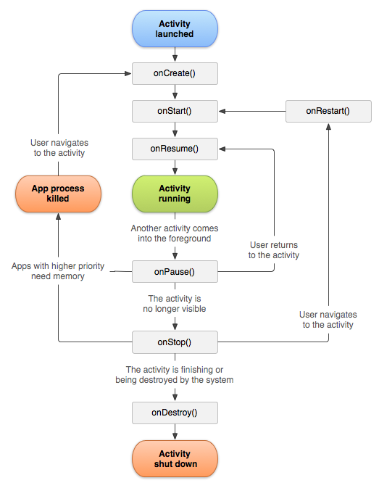
Activity Life-cycle

Slide 8
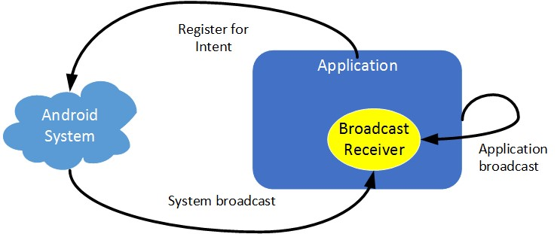
Broadcast Reciver

Slide 9
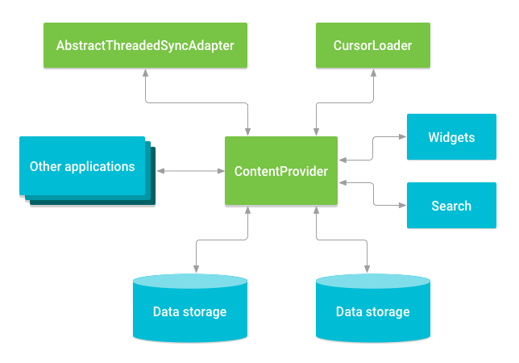
Content Providers

Slide 10
“HELLO WORLD” Example

Slide 11
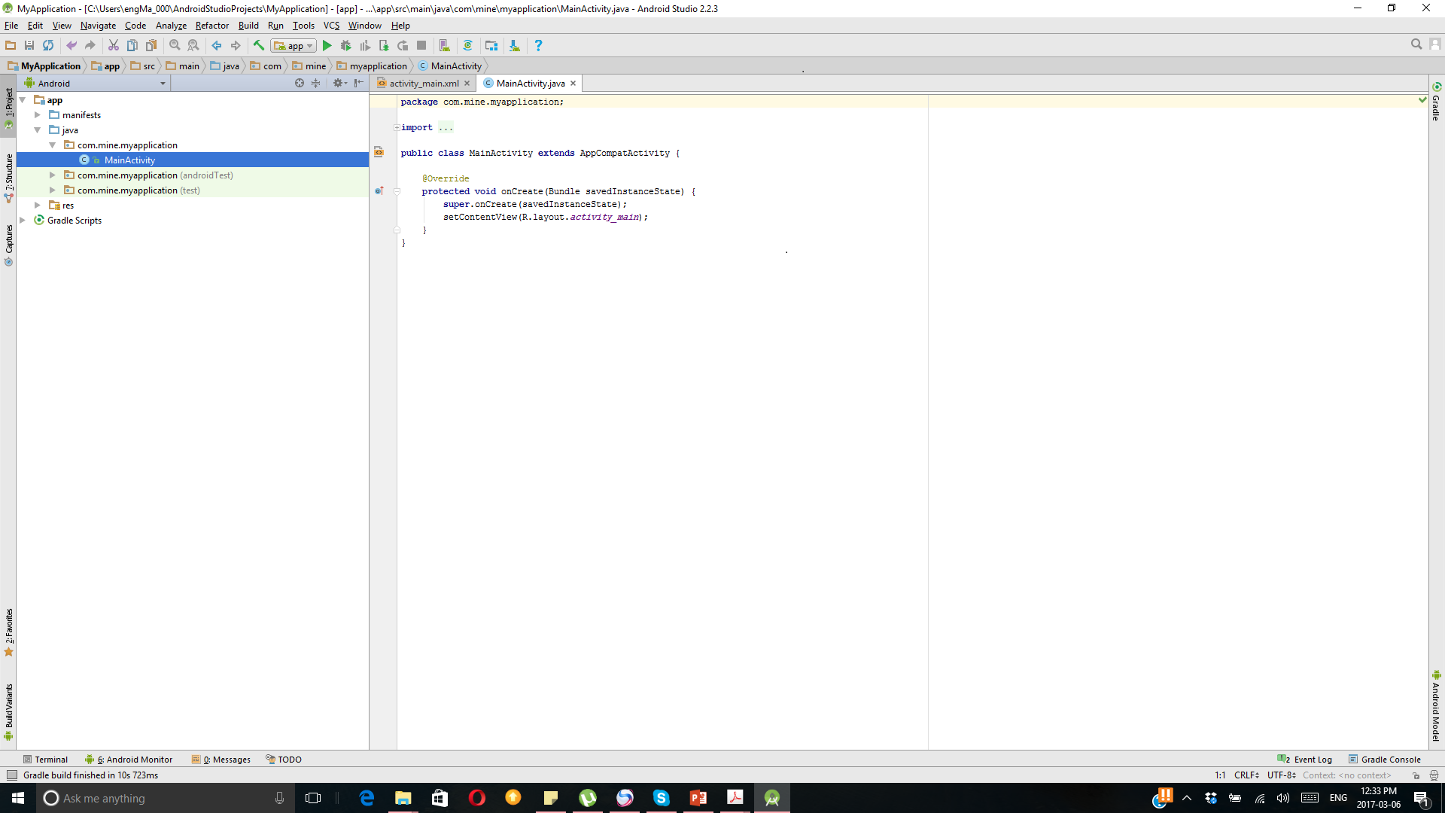
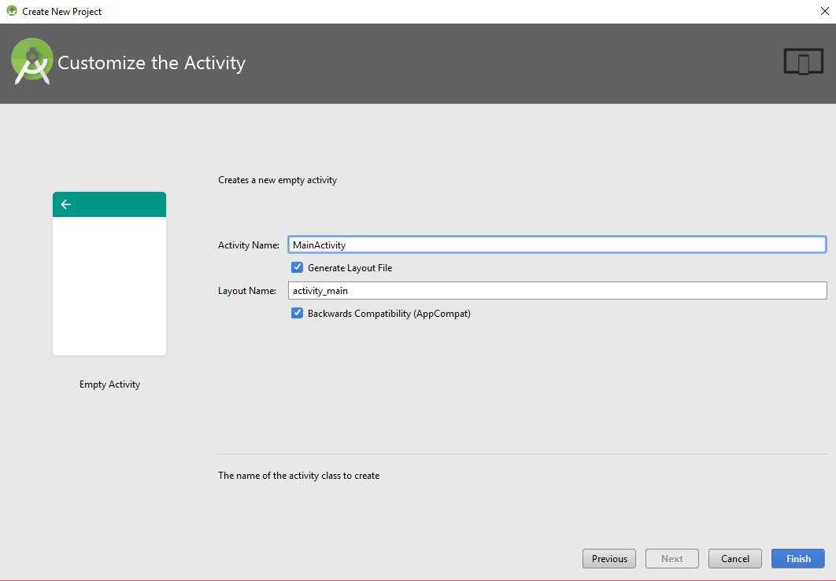
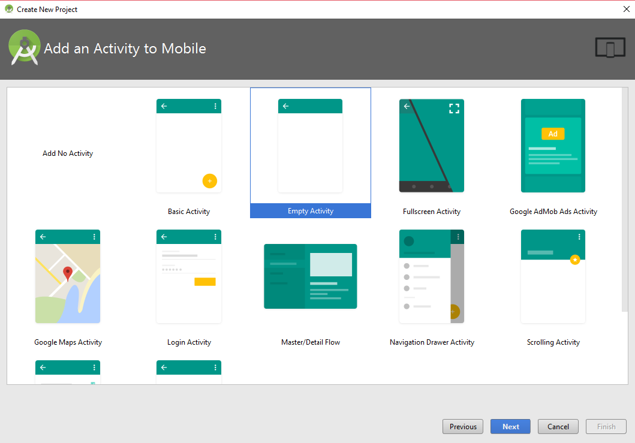
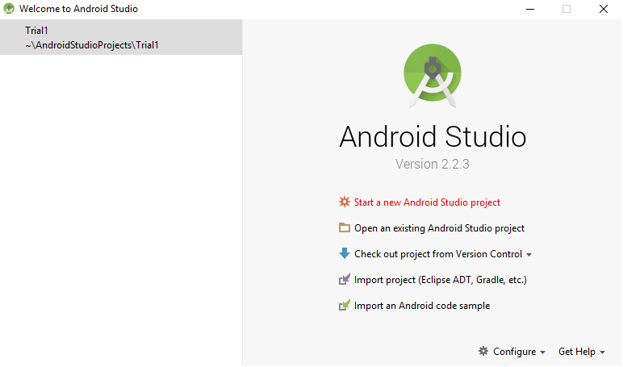
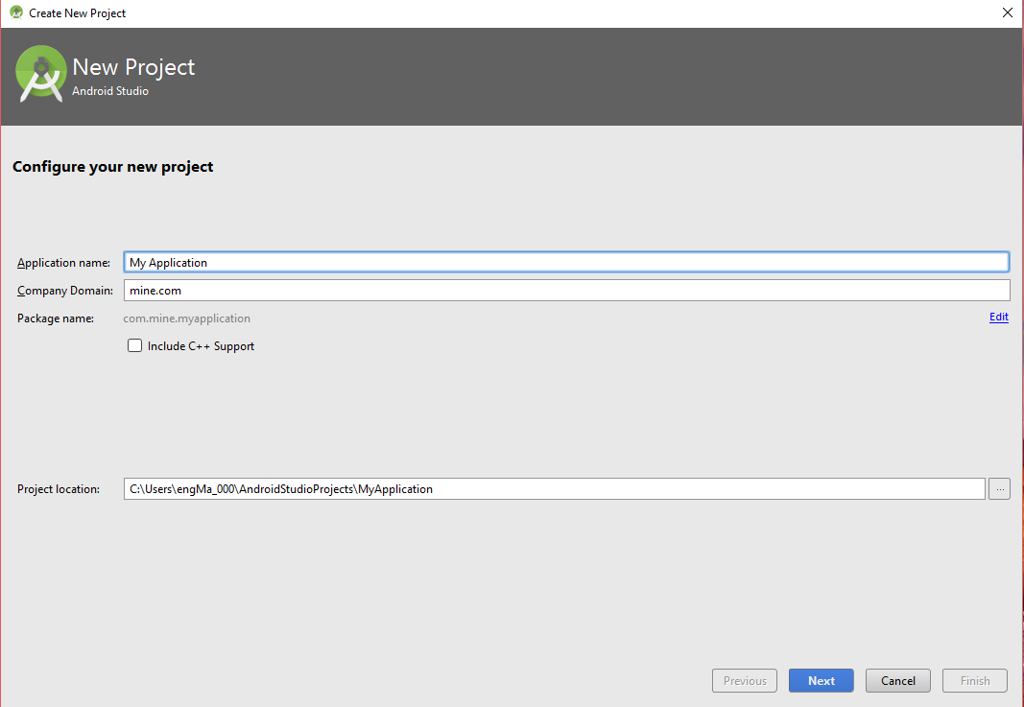
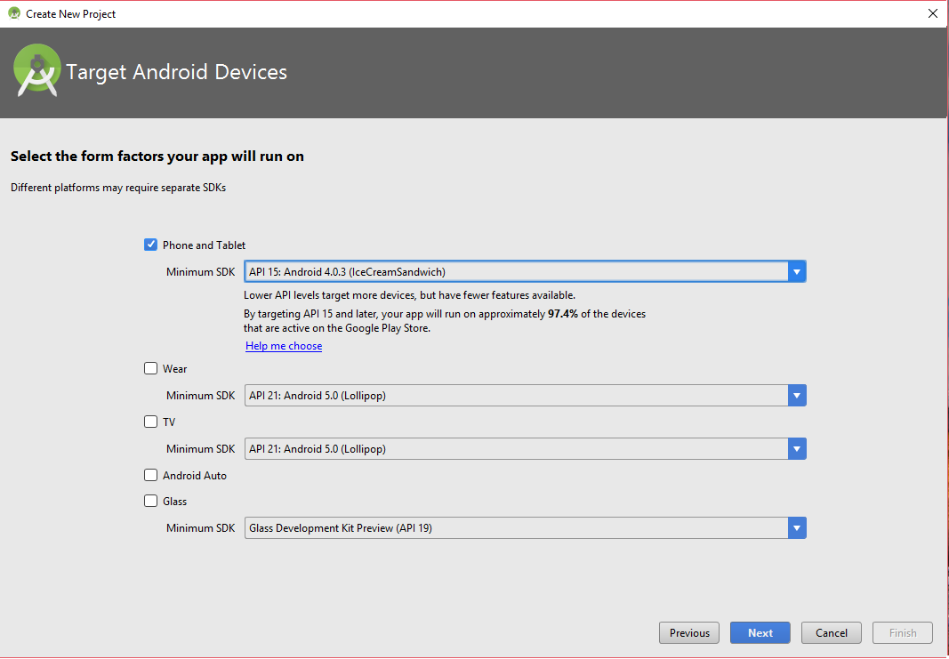
“HELLO WORLD” Example

Slide 12
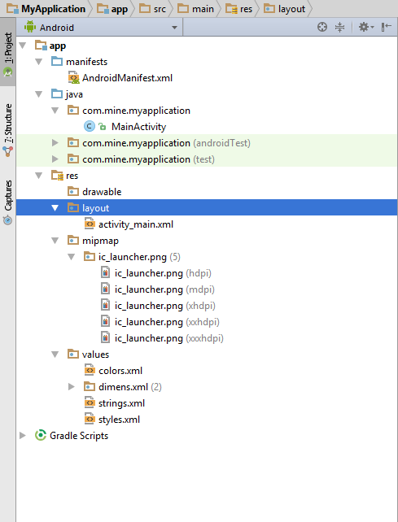
Anatomy of Android Application
1
2
3
Notes:
Folder, File & Description
Java folder
This contains the .java source files for your project. By default, it includes anMainActivity.java source file having an activity class that runs when your app is launched using the app icon.
Manifests→AndroidManifest.xml
This is the manifest file which describes the fundamental characteristics of the app and defines each of its components.
Res
Contain all the resources that will be used in your program

Slide 13
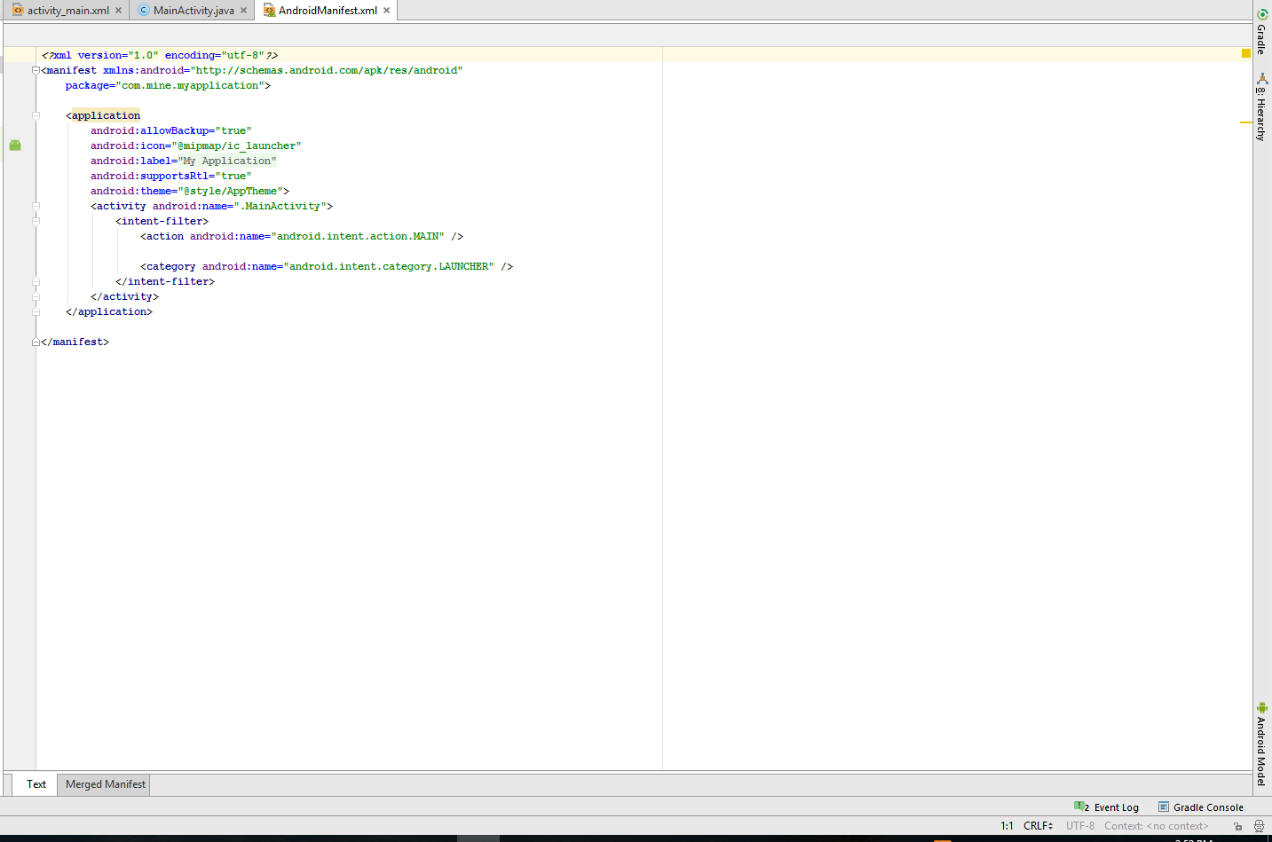
Anatomy of Android Application 1.The Manifest File
Notes:
Whatever component you develop as a part of your application, you must declare all its components in a manifest file called AndroidManifest.xml which resides at the root of the application project directory. This file works as an interface between Android OS and your application, so if you do not declare your component in this file, then it will not be considered by the OS.
Following is the list of tags which you will use in your manifest file to specify
different Android application components:
• <activity>elements for activities
• <service> elements for services
• <receiver> elements for broadcast receivers
• <provider> elements for content providers

Slide 14
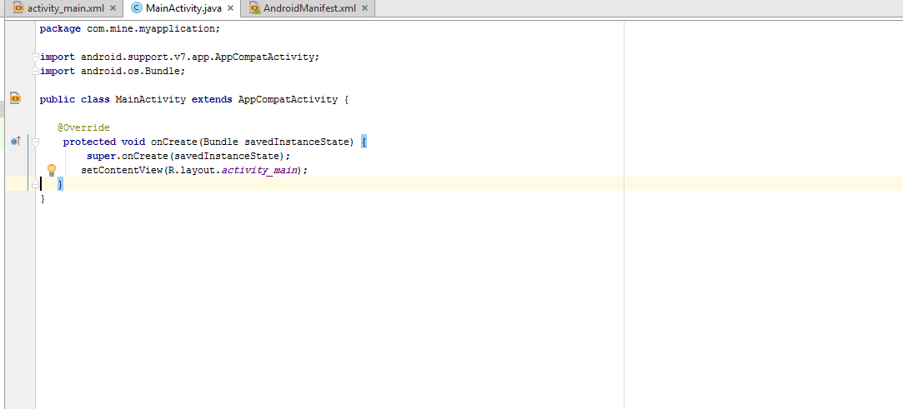
Anatomy of Android Application 2.The Main Activity File

Slide 15
Anatomy of Android Application 3.The Resource Files
Drawable
layout
Mipmap
Values
1
2
3
Notes:
Res/Drawable
This is a directory for drawable objects that are designed for different density screens.
res/layout
This is a directory for files that define your app's user interface. Its XML files
res/Mipmap
This is a directory for images that are designed for different density screens.
res/values
This is a directory for other various XML files that contain a collection of resources, such as strings and colors definitions.

Slide 16
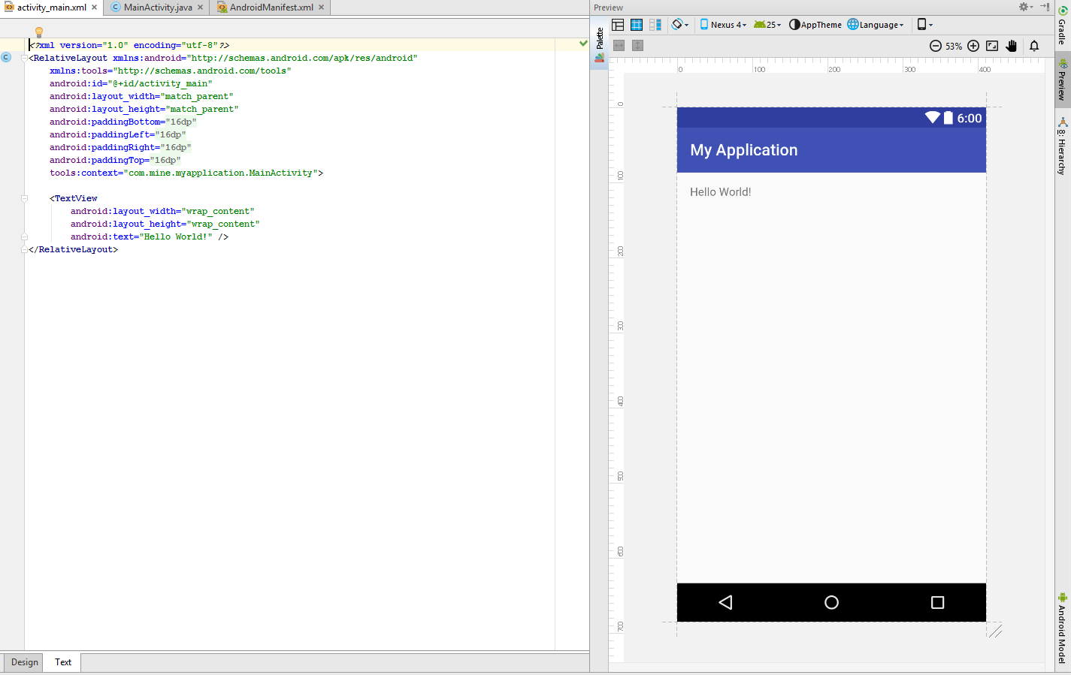
Anatomy of Android Application The Resource Files: Layout File

Slide 17
Anatomy of Android Application The Resource Files: The Strings File

Slide 18
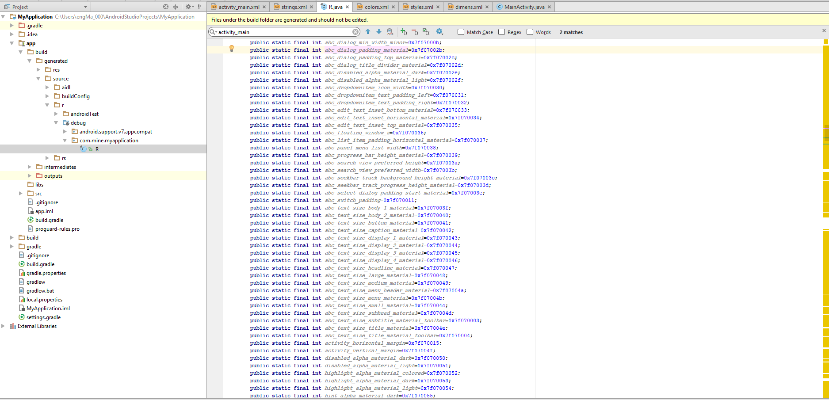
Anatomy of Android Application The R File
Notes:
R.Java
It is, a compiler-generated file that references all the resources found in your project. It is the glue between the activity Java files likeMainActivity.java and the resources like strings.xml. It is an automatically generated file and you should not modify the content of the R.java file.

Slide 19
Running the Application
You can run your application using
Available Virtual Devices (AVD)
Physical Android device

Slide 20
Running the Application Using AVD Manager

Slide 21
Running the Application Physical Android device
Notes:
As already mentioned, although AVDs are useful for emulating specific devices, particularly those that you do not have on hand, developing apps on a physical Android device is far more desirable. If your computer does not recognize your Android device when you connect it to your computer via a USB cable, you probably require a USB driver. If your computer initially recognizes your Android device, you should probably forgo installing a different or newer version of the USB driver, as this could cause the USB connection to fail. You can use the table at developer.android.com/tools/extras/oem-usb.html#Drivers to find the appropriate USB driver, or use your favorite search engine to find the USB driver for your model.
Download the driver and install it on your computer. On your Android device, tap Settings and then Developer Options. Make sure the USB Debugging check box is selected. Some devices, such as Samsung devices, require a secret code to enable USB debugging, so you may want to use your favorite search engine to research how to enable USB debugging on your device. YouTube is also a good source of how-to videos on enabling USB debugging on your specific device if this process is not patently obvious. Most Android devices ship with a cable that has a USB male plug on one end and a micro-USB male plug on the other. Connect your Android device to your computer by using this cable. Click the Android Device Monitor button encircled. If the driver was installed properly, you should see the device listed there and connected,
Keep in mind that the connection between your computer and your Android device is established by using a server called the Android Debug Bridge (ADB). If you don’t see the device, click the Terminal button at the lower-left corner of the IDE and issue the following command: adb start-server
If after restarting the ADB server you still don’t see the device, it’s possible, though unlikely, that the USB driver requires a system reboot to take effect.

Slide 22
Building User Interface View
java.lang.Object
↳ android.view.View
This class represents the basic building block for user interface components. A View occupies a rectangular area on the screen and is responsible for drawing and event handling.

Slide 23
Building User Interface View “Button”
Define a Button in the layout file and assign it a unique ID.
From the onCreate method of an Activity, find the Button
<Button android:id="@+id/my_button" android:layout_width="wrap_content" android:layout_height="wrap_content" android:text="@string/my_button_text“
android:clik=“myFunction”/>
Button myButton = (Button) findViewById(R.id.my_button);

Slide 24
Building User Interface View groups
java.lang.Object
↳ android.view.View
↳ android.view.ViewGroup
A ViewGroup is a special view that can contain other views (called children.) .
Example :
Layouts: GridLayout, LinearLayout…
Views containers: ListView, RadioGroup…

Slide 25
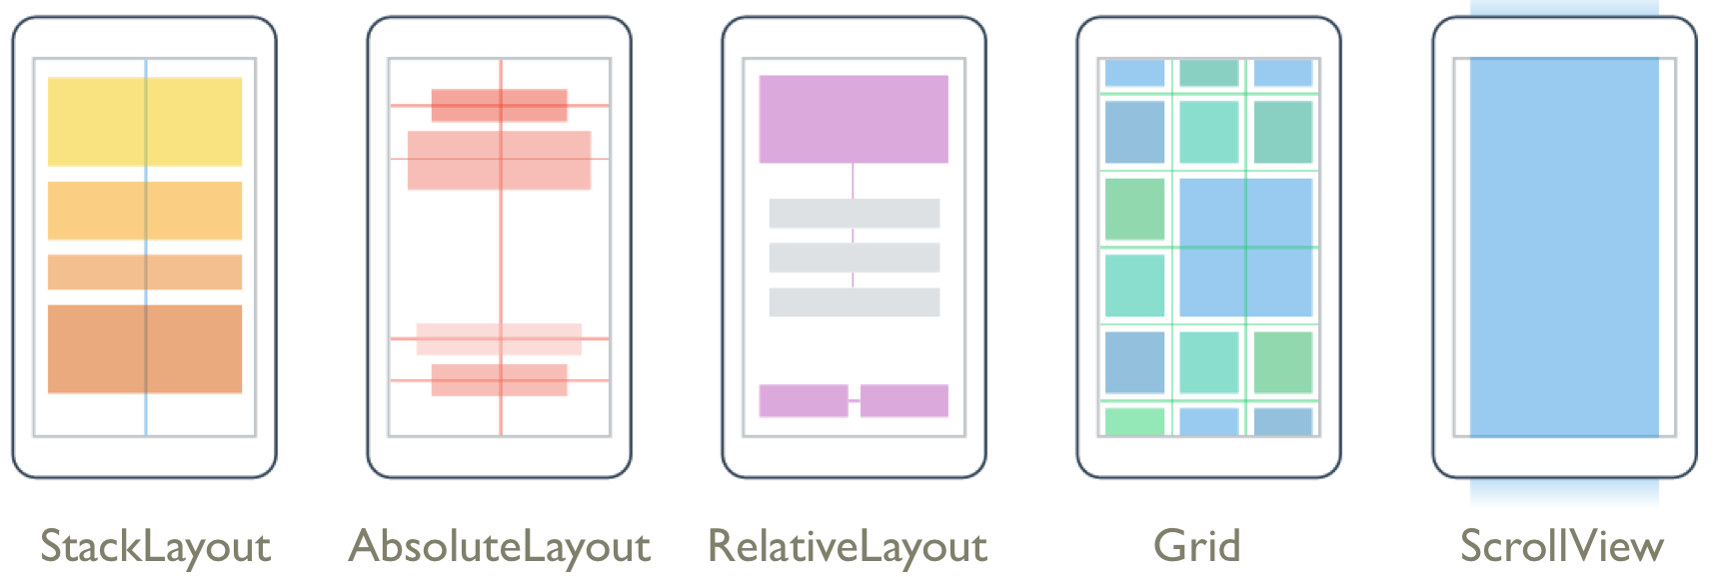
Building User Interface

Slide 26
Intents and Intent Filters
An Intent is a messaging object you can use to request an action from another app component. Although intents facilitate communication between components in several ways, there are three fundamental use cases:
Starting an activity
Starting a service
Delivering a broadcast
Notes:
Starting an activity
An Activity represents a single screen in an app. You can start a new instance of an Activity by passing an Intent to startActivity(). The Intent describes the activity to start and carries any necessary data.
If you want to receive a result from the activity when it finishes, call startActivityForResult(). Your activity receives the result as a separate Intent object in your activity's onActivityResult() callback.
Starting a service
A Service is a component that performs operations in the background without a user interface. With Android 5.0 (API level 21) and later, you can start a service with JobScheduler. For more information about JobScheduler, see its API-reference documentation.
For versions earlier than Android 5.0 (API level 21), you can start a service by using methods of the Service class. You can start a service to perform a one-time operation (such as downloading a file) by passing an Intent to startService(). The Intent describes the service to start and carries any necessary data.
If the service is designed with a client-server interface, you can bind to the service from another component by passing an Intent to bindService(). For more information, see the Services guide.
Delivering a broadcast
A broadcast is a message that any app can receive. The system delivers various broadcasts for system events, such as when the system boots up or the device starts charging. You can deliver a broadcast to other apps by passing an Intent to sendBroadcast() or sendOrderedBroadcast().

Slide 27
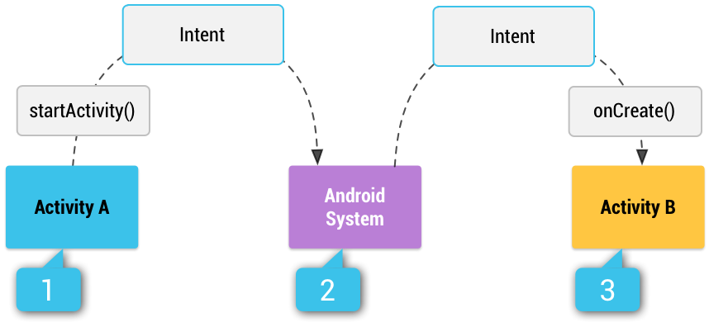
Intents and Intent Filters
Intent types
Explicit intents
use an explicit intent to start a component in your own app, because you know the class name of the activity or service you want to start
Implicit intents
Implicit intents do not name a specific component, but instead declare a general action to perform, which allows a component from another app to handle it.
Intent filter
It is an expression in an app's manifest file that specifies the type of intents that the component would like to receive.
Notes:
Intent types
There are two types of intents:
Explicit intents specify the component to start by name (the fully-qualified class name). You'll typically use an explicit intent to start a component in your own app, because you know the class name of the activity or service you want to start. For example, you can start a new activity in response to a user action or start a service to download a file in the background.
Implicit intents do not name a specific component, but instead declare a general action to perform, which allows a component from another app to handle it. For example, if you want to show the user a location on a map, you can use an implicit intent to request that another capable app show a specified location on a map.
When you create an implicit intent, the Android system finds the appropriate component to start by comparing the contents of the intent to the intent filters declared in the manifest file of other apps on the device. If the intent matches an intent filter, the system starts that component and delivers it theIntent object. If multiple intent filters are compatible, the system displays a dialog so the user can pick which app to use.
An intent filter is an expression in an app's manifest file that specifies the type of intents that the component would like to receive. For instance, by declaring an intent filter for an activity, you make it possible for other apps to directly start your activity with a certain kind of intent. Likewise, if you donot declare any intent filters for an activity, then it can be started only with an explicit intent.
Caution: To ensure that your app is secure, always use an explicit intent when starting a Service and do not declare intent filters for your services. Using an implicit intent to start a service is a security hazard because you can't be certain what service will respond to the intent, and the user can't see which service starts. Beginning with Android 5.0 (API level 21), the system throws an exception if you call bindService() with an implicit intent.
The figure shows how an implicit intent is delivered through the system to start another activity: [1] Activity A creates an Intent with an action description and passes it to startActivity(). [2] The Android System searches all apps for an intent filter that matches the intent. When a match is found, [3]the system starts the matching activity (Activity B) by invoking itsonCreate() method and passing it the Intent.

Slide 28
Intents and Intent Filters
The primary information contained in an Intent is the following:
Component name : name of the component to start.
Action ( View , Send …)
Data
ACTION_VIEW content://contacts/people/1 -- Display information about the person whose identifier is "1".
Category
additional information about the kind of component that should handle the intent.
Extras
Key-value pairs that carry additional information required.
Notes:
Component name
The name of the component to start.This is optional, but it's the critical piece of information that makes an intent explicit, meaning that the intent should be delivered only to the app component defined by the component name. Without a component name, the intent is implicit and the system decides which component should receive the intent based on the other intent information (such as the action, data, and category—described below). If you need to start a specific component in your app, you should specify the component name.
Note: When starting a Service, always specify the component name. Otherwise, you cannot be certain what service will respond to the intent, and the user cannot see which service starts.
This field of the Intent is a ComponentName object, which you can specify using a fully qualified class name of the target component, including the package name of the app, for example, com.example.ExampleActivity. You can set the component name with setComponent(), setClass(), setClassName(), or with the Intent constructor.
Action
A string that specifies the generic action to perform .In the case of a broadcast intent, this is the action that took place and is being reported. The action largely determines how the rest of the intent is structured—particularly the information that is contained in the data and extras.
You can specify your own actions for use by intents within your app (or for use by other apps to invoke components in your app), but you usually specify action constants defined by the Intent class or other framework classes. Here are some common actions for starting an activity:
ACTION_VIEW
Use this action in an intent with startActivity() when you have some information that an activity can show to the user, such as a photo to view in a gallery app, or an address to view in a map app.
ACTION_SENDAlso known as the share intent, you should use this in an intent with startActivity() when you have some data that the user can share through another app, such as an email app or social sharing app.See the Intent class reference for more constants that define generic actions. Other actions are defined elsewhere in the Android framework, such as in Settings for actions that open specific screens in the system's Settings app.
You can specify the action for an intent with setAction() or with an Intent constructor.
Data
The URI (a Uri object) that references the data to be acted on and/or the MIME type of that data. The type of data supplied is generally dictated by the intent's action. For example, if the action is ACTION_EDIT, the data should contain the URI of the document to edit.When creating an intent, it's often important to specify the type of data (its MIME type) in addition to its URI. For example, an activity that's able to display images probably won't be able to play an audio file, even though the URI formats could be similar. Specifying the MIME type of your data helps the Android system find the best component to receive your intent. However, the MIME type can sometimes be inferred from the URI—particularly when the data is a content: URI. A content: URI indicates the data is located on the device and controlled by a ContentProvider, which makes the data MIME type visible to the system.
To set only the data URI, call setData(). To set only the MIME type, call setType(). If necessary, you can set both explicitly with setDataAndType().
Caution: If you want to set both the URI and MIME type, don't call setData() and setType() because they each nullify the value of the other. Always use setDataAndType() to set both URI and MIME type.
Some examples of action/data pairs are:
ACTION_VIEW content://contacts/people/1 -- Display information about the person whose identifier is "1".
ACTION_DIAL content://contacts/people/1 -- Display the phone dialer with the person filled in.
ACTION_VIEW tel:123 -- Display the phone dialer with the given number filled in. Note how the VIEW action does what is considered the most reasonable thing for a particular URI.
ACTION_DIAL tel:123 -- Display the phone dialer with the given number filled in.
ACTION_EDIT content://contacts/people/1 -- Edit information about the person whose identifier is "1".
ACTION_VIEW content://contacts/people/ -- Display a list of people, which the user can browse through. This example is a typical top-level entry into the Contacts application, showing you the list of people. Selecting a particular person to view would result in a new intent { ACTION_VIEWcontent://contacts/people/N } being used to start an activity to display that person.
Category
A string containing additional information about the kind of component that should handle the intent. Any number of category descriptions can be placed in an intent, but most intents do not require a category. Here are some common categories:CATEGORY_BROWSABLEThe target activity allows itself to be started by a web browser to display data referenced by a link, such as an image or an e-mail message.CATEGORY_LAUNCHERThe activity is the initial activity of a task and is listed in the system's application launcher.See the Intent class description for the full list of categories.
You can specify a category with addCategory().
Extras
Key-value pairs that carry additional information required to accomplish the requested action. Just as some actions use particular kinds of data URIs, some actions also use particular extras.You can add extra data with various putExtra() methods, each accepting two parameters: the key name and the value. You can also create a Bundle object with all the extra data, then insert the Bundle in the Intent with putExtras().
For example, when creating an intent to send an email with ACTION_SEND, you can specify the to recipient with the EXTRA_EMAIL key, and specify the subject with the EXTRA_SUBJECT key.
The Intent class specifies many EXTRA_* constants for standardized data types. If you need to declare your own extra keys (for intents that your app receives), be sure to include your app's package name as a prefix, as shown in the following example:
static final String EXTRA_GIGAWATTS = "com.example.EXTRA_GIGAWATTS";

Slide 29
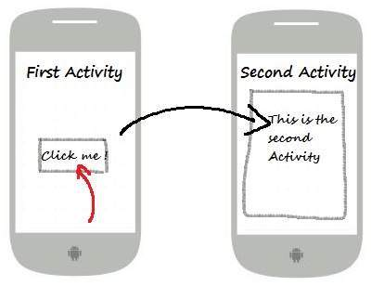
Intents and Intent Filters Examples
Explicit intent:
// Explicit Intent by specifying its class name
Intent i = new Intent(FirstActivity.this, SecondActivity.class); // Starts TargetActivity startActivity(i);
Notes:
These intents designate the target component by its name and they are typically used for application-internal messages - such as an activity starting a subordinate service or launching a sister activity.

Slide 30
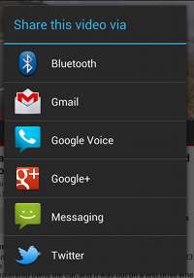
Intents and Intent Filters Examples
implicit intent:
Forcing an app chooser:
// Create the text message with a string Intent sendIntent = new Intent(); sendIntent.setAction(Intent.ACTION_SEND); sendIntent.putExtra(Intent.EXTRA_TEXT, textMessage); sendIntent.setType("text/plain"); // Verify that the intent will resolve to an activity if (sendIntent.resolveActivity(getPackageManager()) != null) { startActivity(sendIntent); }
Intent sendIntent = new Intent(Intent.ACTION_SEND); ... // Always use string resources for UI text. // This says something like "Share this photo with" String title = getResources().getString(R.string.chooser_title); // Create intent to show the chooser dialog Intent chooser = Intent.createChooser(sendIntent, title); // Verify the original intent will resolve to at least one activity if (sendIntent.resolveActivity(getPackageManager()) != null) { startActivity(chooser); }
Notes:
Example implicit intent
An implicit intent specifies an action that can invoke any app on the device able to perform the action. Using an implicit intent is useful when your app cannot perform the action, but other apps probably can and you'd like the user to pick which app to use.
For example, if you have content that you want the user to share with other people, create an intent with the ACTION_SEND action and add extras that specify the content to share. When you call startActivity() with that intent, the user can pick an app through which to share the content.
Caution: It's possible that a user won't have any apps that handle the implicit intent you send to startActivity(). Or, an app may be inaccessible because of profile restrictions or settings put into place by an administrator. If that happens, the call fails and your app crashes. To verify that an activity will receive the intent, call resolveActivity() on your Intent object. If the result is non-null, there is at least one app that can handle the intent and it's safe to call startActivity(). If the result is null, do not use the intent and, if possible, you should disable the feature that issues the intent. The following example shows how to verify that the intent resolves to an activity. This example doesn't use a URI, but the intent's data type is declared to specify the content carried by the extras.
Forcing an app chooser
When there is more than one app that responds to your implicit intent, the user can select which app to use and make that app the default choice for the action. The ability to select a default is helpful when performing an action for which the user probably wants to use the same app every time, such as when opening a web page (users often prefer just one web browser).
However, if multiple apps can respond to the intent and the user might want to use a different app each time, you should explicitly show a chooser dialog. The chooser dialog asks the user to select which app to use for the action (the user cannot select a default app for the action). For example, when your app performs "share" with the ACTION_SEND action, users may want to share using a different app depending on their current situation, so you should always use the chooser dialog, as shown in the Figure .
To show the chooser, create an Intent using createChooser() and pass it to startActivity(), as shown in the following example. This example displays a dialog with a list of apps that respond to the intent passed to the createChooser() method and uses the supplied text as the dialog title.

Slide 31
Intents and Intent Filters Receiving an implicit intent
<activity android:name="ShareActivity"> <intent-filter> <action android:name="android.intent.action.SEND"/> <category android:name="android.intent.category.DEFAULT"/> <data android:mimeType="text/plain"/> </intent-filter> </activity>
Notes:
To advertise which implicit intents your app can receive, declare one or more intent filters for each of your app components with an <intent-filter>element in your manifest file. Each intent filter specifies the type of intents it accepts based on the intent's action, data, and category. The system delivers an implicit intent to your app component only if the intent can pass through one of your intent filters.
Note: An explicit intent is always delivered to its target, regardless of any intent filters the component declares.
An app component should declare separate filters for each unique job it can do. For example, one activity in an image gallery app may have two filters: one filter to view an image, and another filter to edit an image. When the activity starts, it inspects the Intent and decides how to behave based on the information in the Intent (such as to show the editor controls or not).
Each intent filter is defined by an <intent-filter> element in the app's manifest file, nested in the corresponding app component (such as an <activity> element). Inside the <intent-filter>, you can specify the type of intents to accept using one or more of these three elements:
<action>Declares the intent action accepted, in the name attribute. The value must be the literal string value of an action, not the class constant.<data>Declares the type of data accepted, using one or more attributes that specify various aspects of the data URI (scheme, host, port, path) and MIME type.<category>Declares the intent category accepted, in the name attribute. The value must be the literal string value of an action, not the class constant.Note: To receive implicit intents, you must include the CATEGORY_DEFAULT category in the intent filter. The methods startActivity() andstartActivityForResult() treat all intents as if they declared the CATEGORY_DEFAULT category. If you do not declare this category in your intent filter, no implicit intents will resolve to your activity.
See the example

Slide 32
Fragments
A fragment has its own layout and its own behaviour with its own life cycle callbacks.
You can add or remove fragments in an activity while the activity is running.
You can combine multiple fragments in a single activity to build a multi-plane UI.
A fragment can be used in multiple activities.
Fragment life cycle is closely related to the life cycle of its host activity which means when the activity is paused, all the fragments available in the activity will also be stopped.
A fragment can implement a behaviour that has no user interface component.
Notes:
Prior to fragment introduction, we had a limitation because we can show only a single activity on the screen at one given point in time. So we were not able to divide device screen and control different parts separately. But with the introduction of fragment we got more flexibility and removed the limitation of having a single activity on the screen at a time. Now we can have a single activity but each activity can comprise of multiple fragments which will have their own layout, events and complete life cycle.

Slide 33
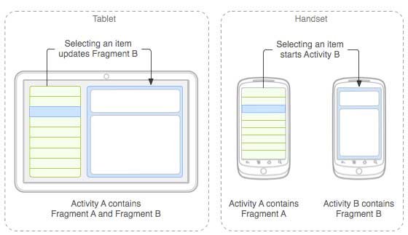
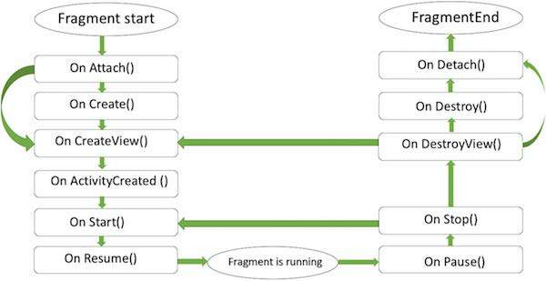
Fragments
Notes:
In the above Figure :The application can embed two fragments in Activity A, when running on a tablet-sized device. However, on a handset-sized screen, there's not enough room for both fragments, so Activity A includes only the fragment for the list of articles, and when the user selects an article, it starts Activity B, which includes the second fragment to read the article.
Here is the list of methods which you can to override in your fragment class −
onAttach()The fragment instance is associated with an activity instance.The fragment and the activity is not fully initialized. Typically you get in this method a reference to the activity which uses the fragment for further initialization work.
onCreate() The system calls this method when creating the fragment. You should initialize essential components of the fragment that you want to retain when the fragment is paused or stopped, then resumed.
onCreateView() The system calls this callback when it's time for the fragment to draw its user interface for the first time. To draw a UI for your fragment, you must return a View component from this method that is the root of your fragment's layout. You can return null if the fragment does not provide a UI.
onActivityCreated()The onActivityCreated() is called after the onCreateView() method when the host activity is created. Activity and fragment instance have been created as well as the view hierarchy of the activity. At this point, view can be accessed with the findViewById() method. example. In this method you can instantiate objects which require a Context object
onStart()The onStart() method is called once the fragment gets visible.
onResume()Fragment becomes active.
onPause() The system calls this method as the first indication that the user is leaving the fragment. This is usually where you should commit any changes that should be persisted beyond the current user session.
onStop()Fragment going to be stopped by calling onStop()
onDestroyView()Fragment view will destroy after call this method
onDestroy()onDestroy() called to do final clean up of the fragment's state but Not guaranteed to be called by the Android platform.

Slide 34
SQLite
SQLite is a open-source SQL database that stores data to a text file on a device. Android comes in with built in SQLite database implementation.
SQLite supports all the relational database features. In order to access this database, you don't need to establish any kind of connections for it like JDBC,ODBC e.t.c
The main package is android.database.sqlite that contains the classes to manage your own databases.
Database -Creation:
SQLiteDatabase mydatabase = openOrCreateDatabase("your database name",MODE_PRIVATE,null);
Notes:
There are other functions available in the database package such as:
openDatabase(String path, SQLiteDatabase.CursorFactory factory, int flags, DatabaseErrorHandler errorHandler);
openOrCreateDatabase(String path, SQLiteDatabase.CursorFactory factory);

Slide 35
SQLite Database operations
we can create table or insert data into table using execSQL method defined in SQLiteDatabase class as follows:
execSQL(String sql, Object[] bindArgs)
This method not only insert data , but also used to update or modify already existing data in database using bind arguments. Examples
Database – Fetching
We can retrieve anything from database using an object of the Cursor class. We will call a method of this class called rawQuery and it will return a resultset with the cursor pointing to the table. We can move the cursor forward and retrieve the data.
mydatabase.execSQL("CREATE TABLE IF NOT EXISTS TutorialsPoint(Username VARCHAR,Password VARCHAR);");
mydatabase.execSQL("INSERT INTO TutorialsPoint VALUES('admin','admin');");

Slide 36
SQLite Database operations
Database – Fetching
Other functions:
Cursor resultSet = mydatbase.rawQuery("Select * from TutorialsPoint",null);
resultSet.moveToFirst();
String username = resultSet.getString(0);
String password = resultSet.getString(1);
getColumnCount()
getColumnIndex(String columnName)
getColumnName(int columnIndex)
getColumnNames()
getCount()
getPosition()
isClosed()
Notes:
getColumnCount()
This method return the total number of columns of the table.
getColumnIndex(String columnName)
This method returns the index number of a column by specifying the name of the column
getColumnName(int columnIndex)
This method returns the name of the column by specifying the index of the column
getColumnNames()
This method returns the array of all the column names of the table.
getCount()
This method returns the total number of rows in the cursor
getPosition()
This method returns the current position of the cursor in the table
isClosed()
This method returns true if the cursor is closed and return false otherwise

Slide 37
Requirement Reminders- Part 1
You are supposed to develop an app to manage a list of items you want to remember.
The core functionality will allow you to create and delete reminders and flag certain reminders as important. An important item will be emphasized by an orange tab to the left of the reminder’s text.
The application will incorporate an action bar menu, context menus, a local database for persistence, and multiple selection on devices that support multiple selection.
In Part 1:
In this part you should build the complete interface of the application.
The interface consists of three layouts:
reminders_row.xml
activity_reminders.xml →see Figure 1
dialog_custom.xml
It also contains the action bar menu: menu_reminders.xml which opens a menu with two options as shown in Figure : New Reminder, and Exit. →see Figure 2
Tapping New Reminder opens a dialog box as shown in Figure 3 . In the dialog box, you can add text for your new reminder and then tap Commit to add it to the list. Tapping Exit simply quits the app.

Slide 38
Requirement Reminders- Part 1
The activity_reminders.xml consists of list view.
If we click on one item of the list view an “AlertDialog” should appear which contain another list view with two items “Edit Reminder” and” Delete Reminder” as in Figure 4. You can use the ready made layout list view provided by android “android.R.layout.simple_list_item_1”
Tapping Edit Reminder from the context menu opens the Edit Reminder pop-up dialog box shown as in Figure 5, where you can change the text of the reminder.
Think how to use dialog_custom.xml for both “New Reminder” and “Edit Reminder”.
Tapping Delete Reminder from the context menu deletes the reminder from the list.
For testing this part of the app let the adapter of the activity reminders list view take an array of strings that represent the text of the reminders.
For part 1, the actions of the buttons “commit” and “delete” is ignored.
Set the Minimum SDK to API 9. By setting your min API level to 9, you are making your app available to more than 100% of the Android market.

Slide 39
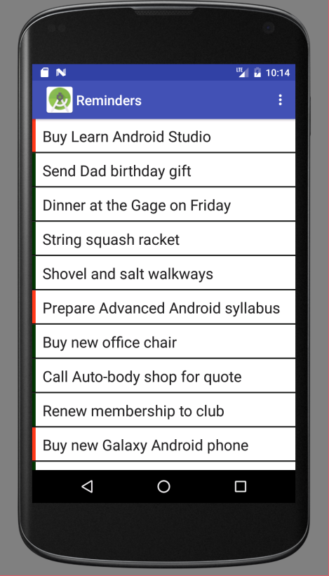
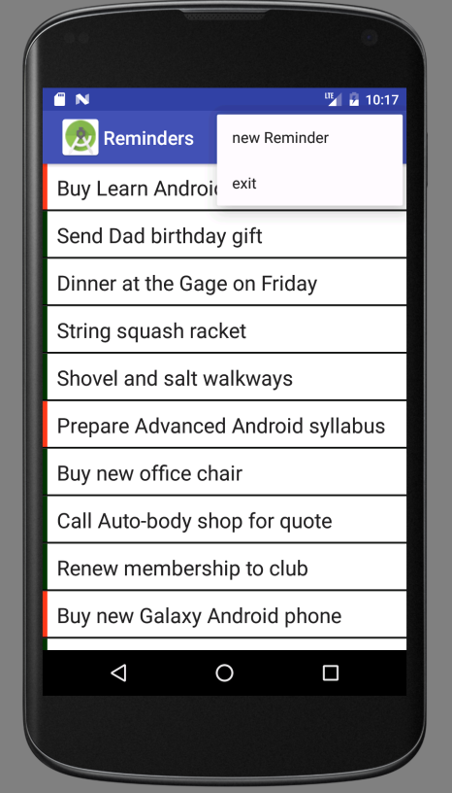
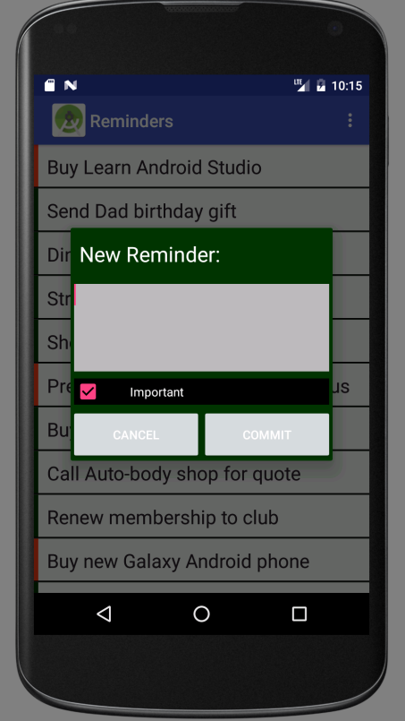
Requirement Reminders- Part 1
Figure 1 | Figure 2 | Figure 3

Slide 40
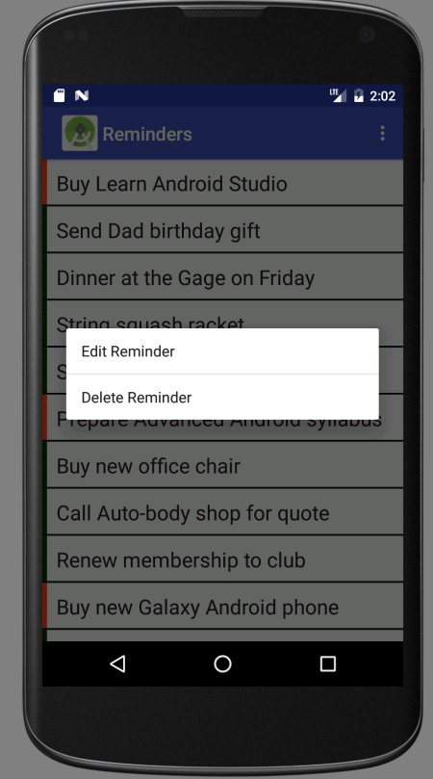
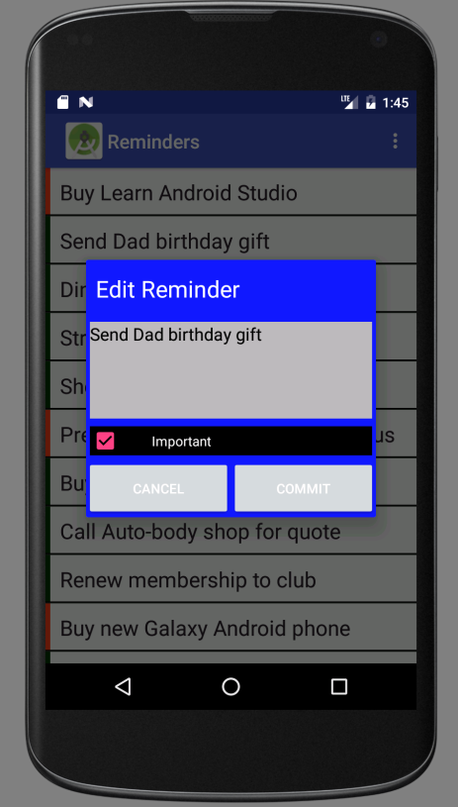
Requirement Reminders- Part 1
Figure 4 | Figure 5

Slide 41
Requirement Reminders- Part 2
You are given:
A fully implemented class “Reminder” which contain the three fields needed for any reminder
private int mId;
private String mContent;
private int mImportant;”
A partial implementation to a class called “RemindersDbAdapter”. This class is supposed to have all functions needed to create the reminder database, read from or write to the reminderdatabase. It also contain a private class DatabaseHelper which extends SQLiteOpenHelper. You will also find some strings which defines the column names and indices; two database API objects; some constants for the database name, version, and the main table name; the context object; and a SQL statement used to create the database. Check the file for more details.

Slide 42
Requirement Reminders- Part 2
You are given:
A fully implemented class “RemindersSimpleCursorAdapter” to bind database values to individual row objects by extending the special Adapter Android. See notes of this slide for more details about this class.
Notes:
During runtime, the
ListView will repeatedly invoke the bindView() method on the Adapter with individual onscreen View objects as the user loads and scrolls through the list. It is the job of the Adapter to fill these views with list items. In this code example, we’re using a subclass of Adapter called SimpleCursorAdapter. This class uses a Cursor object, which keeps track of the rows in the table.
Here you see an example of the ViewHolder pattern. This is a well-known Android pattern in which a small ViewHolder object is attached as a tag on each view. This object adds decoration for View objects in the list by using values from the data source, which in this example is the Cursor. The ViewHolder is defined as a static inner class with two instance variables, one for the index of the Important table column and one for the row_tab view you defined in the layout.
The bindView() method starts by calling the superclass method that maps values from the cursor to elements in the View. It then checks to see whether a holder has been attached to the tag and creates a new holder if necessary. The bindView() method then configures the holder’s instance variables by using both the Important column index and the row_tab you defined earlier. After the holder is either found or configured, it uses the value of the COL_ IMPORTANT constant from the current reminder to decide which color to use for the row_tab.

Slide 43
Requirement Reminders- Part 2
Follow the TODO list to complete the implementation of the class “RemindersDbAdapter”.
Create an instance of the class “RemindersDbAdapter” in your main activity “RemindersActivity.Java” to handle the main actions “add, delete and edit reminder”.
Create an instance of the class “RemindersSimpleCursorAdapter” in your main activity “RemindersActivity.Java” and set the list view adapter to this customized adapter.Also for any change in the reminders you should call the adapter member function changeCursor(…) to update the cursor of the adapter.

Slide 44
References
https://developer.android.com/index.html
https://developer.android.com/reference/classes.html
Android tutorial https://www.tutorialspoint.com/android/
Figure 4 | Figure 5

