Slide 1

Machine Learning
Support Vector Machine
Session 5

Slide 2




Session 5
Content
What is support vector machine
Cost function
SVM decision boundaries
Large margin classifier in present of outlier
Kernel
Grow Through

Slide 3
What is support vector machine
A supervised learning classification algorithm used to predict labels for categorical data.
Grow Through

Slide 4
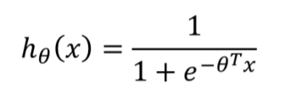
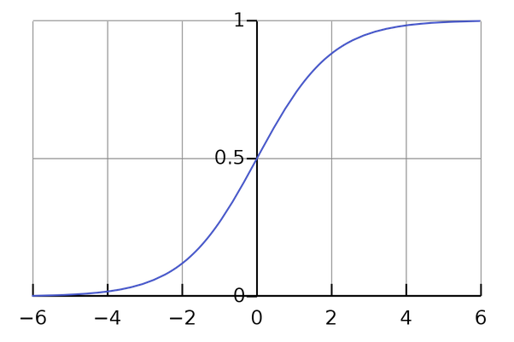
What is support vector machine
if y = 1?
if y = 0?
Grow Through

Slide 5

Cost Function
Grow Through

Slide 6
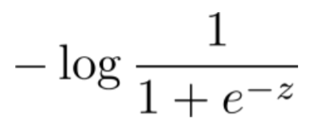
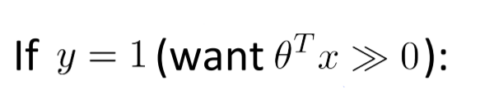
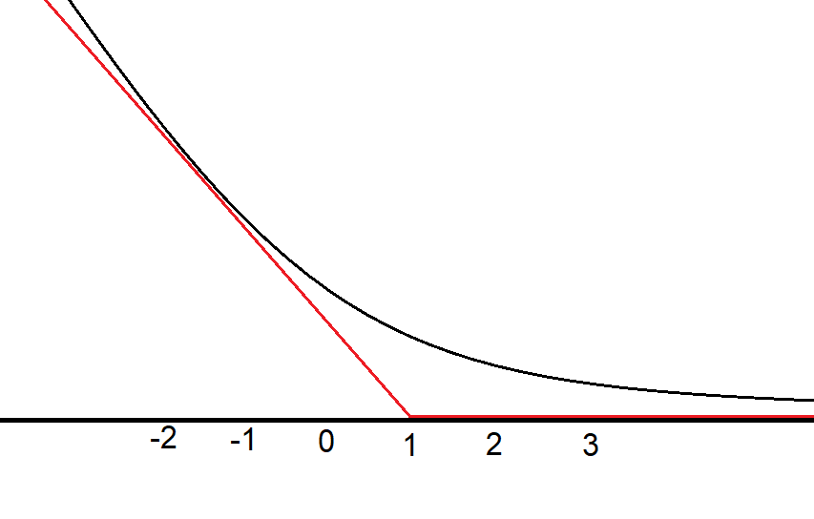
Cost Function
cost1
Grow Through

Slide 7
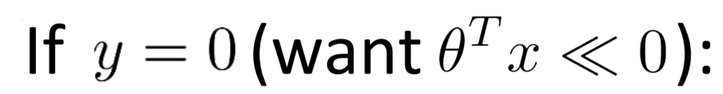
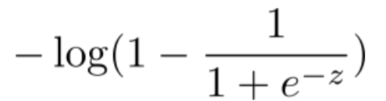
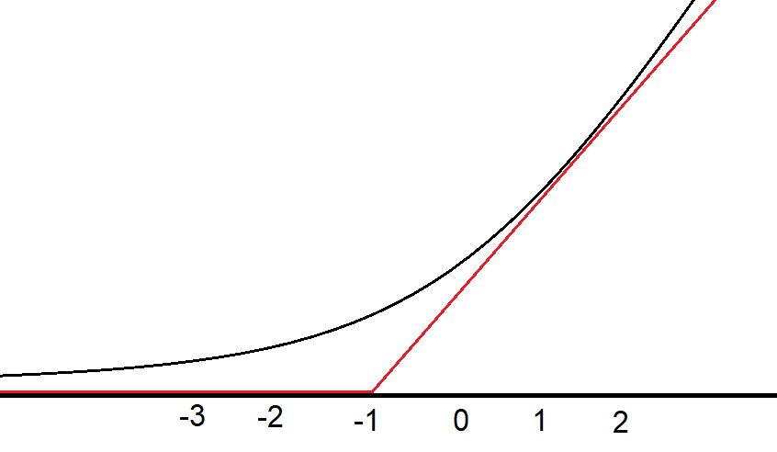
Cost Function
cost0
Grow Through

Slide 8
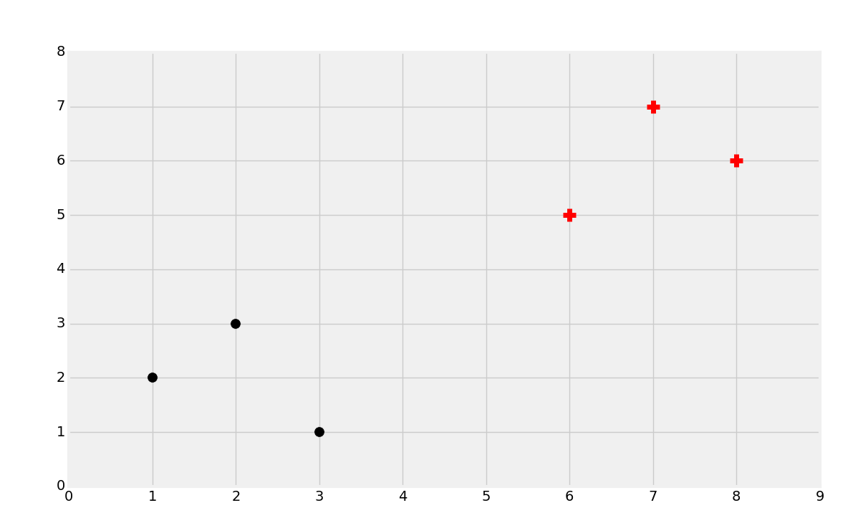
SVM Decision Boundary:
Linearly separable case
There will be two classes named as :
positive class
negative class
Grow Through

Slide 9
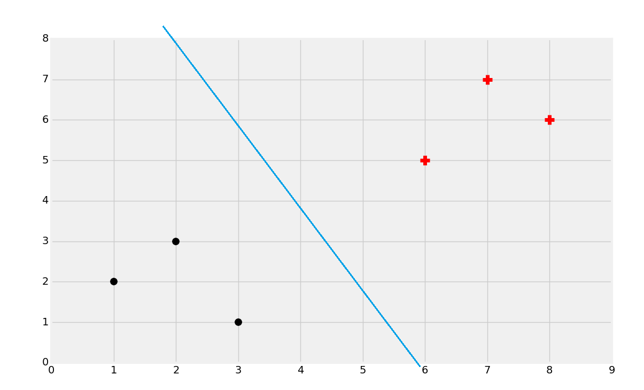
SVM Decision Boundary:
The objective of the Support Vector Machine is to find the best splitting boundary between data.
And thus, we will have two classes:
-Positive class: above hyperplane
-Negative class: below hyperplane
Grow Through

Slide 10
SVM Decision Boundary:
Support Vectors
Support vectors are the data points, which are closest to the hyperplane. These points will define the separating line better by calculating margins. These points are more relevant to the construction of the classifier.
Grow Through

Slide 11
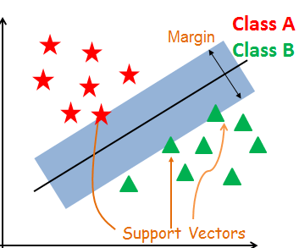
SVM Decision Boundary:
Grow Through

Slide 12
SVM Decision Boundary:
Hyperplane
A hyperplane is a decision plane which separates between a set of objects having different class memberships.
Grow Through

Slide 13
SVM Decision Boundary:
Margin
A margin is a gap between the two lines on the closest class points. This is calculated as the perpendicular distance from the line to support vectors or closest points. If the margin is larger in between the classes, then it is considered a good margin, a smaller margin is a bad margin.
Grow Through

Slide 14
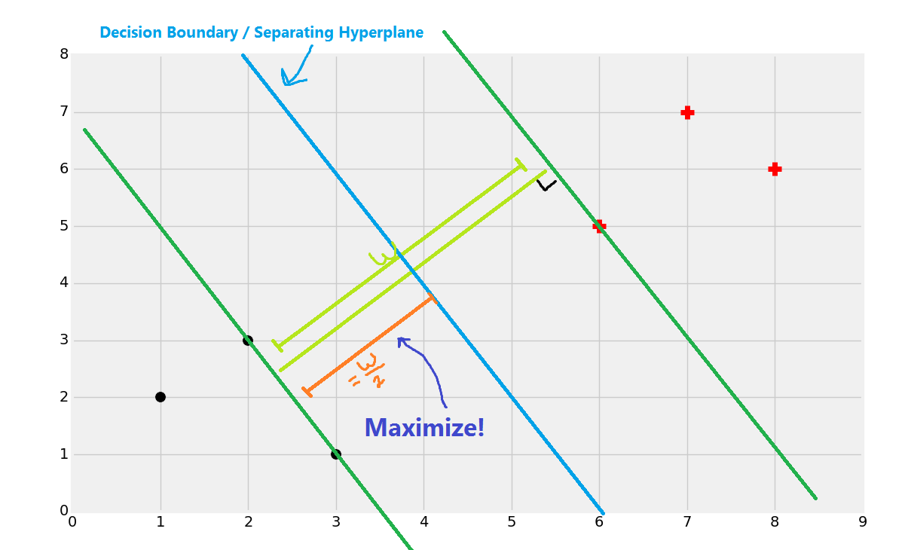
SVM Decision Boundary:
The best separating hyperplane is defined as the hyperplane that contains the "widest" margin between support vectors.
Grow Through

Slide 15
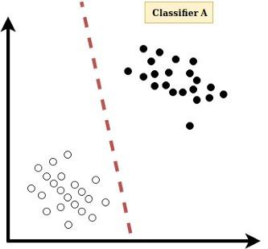
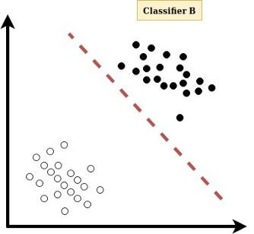
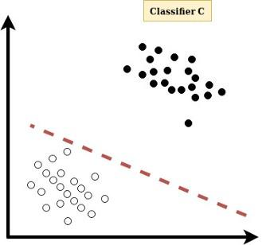

SVM Decision Boundary:
Grow Through

Slide 16
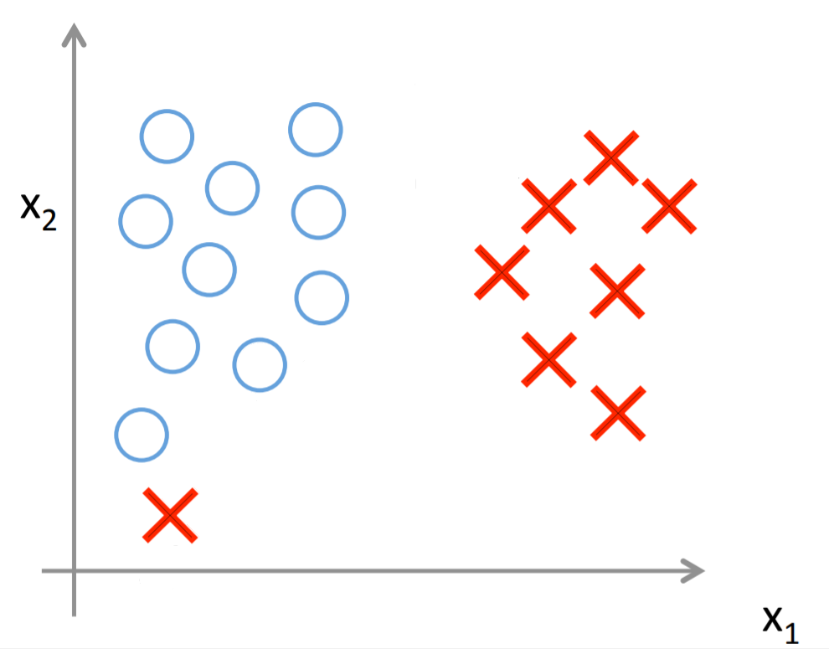
Large margin classifier in presence of outliers
Grow Through

Slide 17
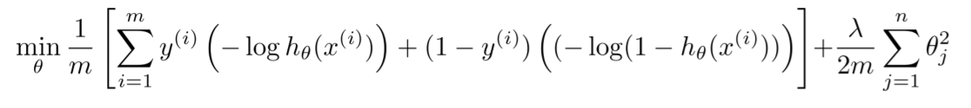
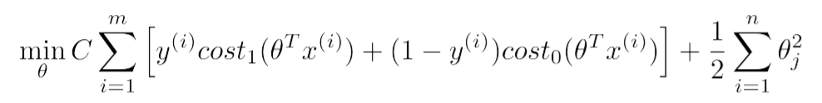
Large margin classifier in presence of outliers
Grow Through

Slide 18
Large margin classifier in presence of outliers
Grow Through

Slide 19
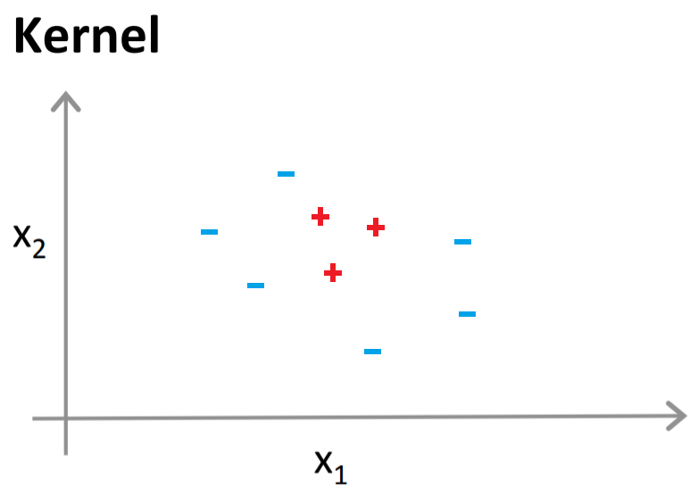
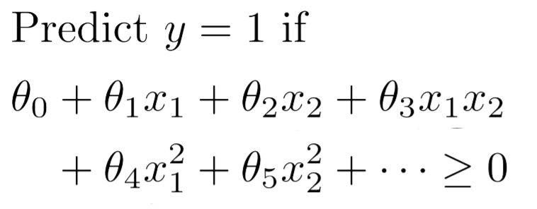
Kernels
Grow Through

Slide 20
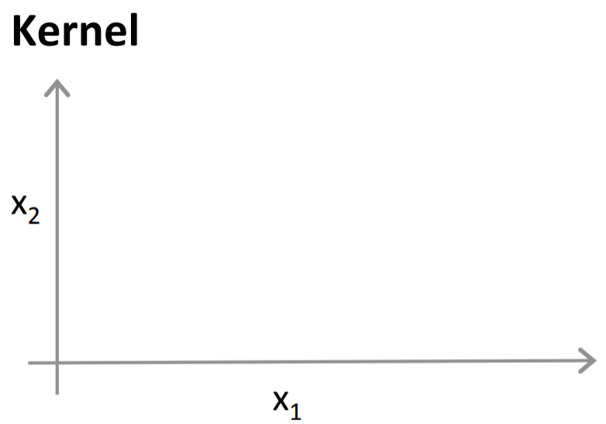
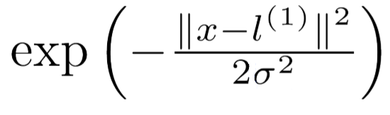
Kernels
Grow Through

Slide 21
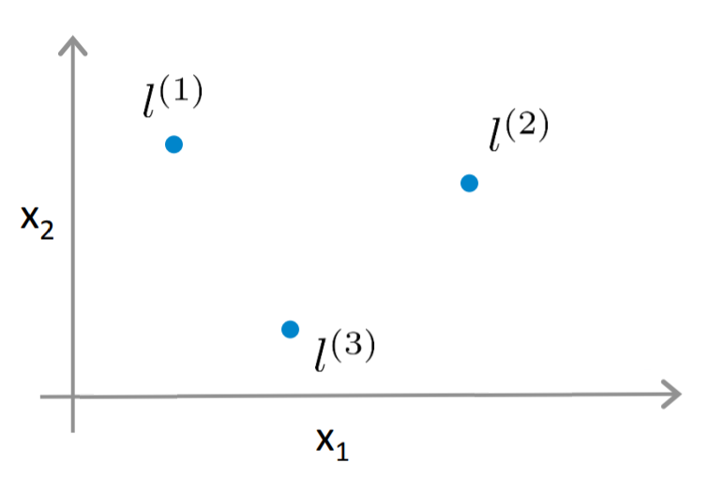
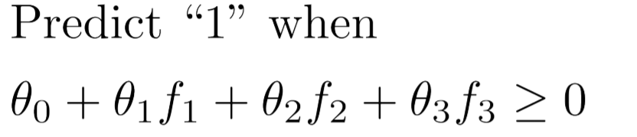
Kernels
Grow Through

Slide 22
Kernels
-0.5
1
1
0
Grow Through

Slide 23
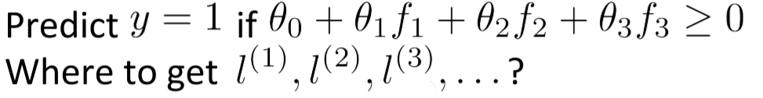
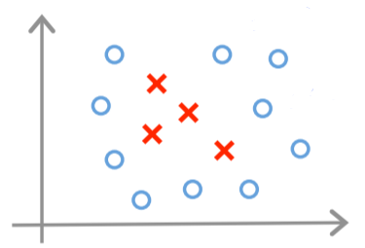
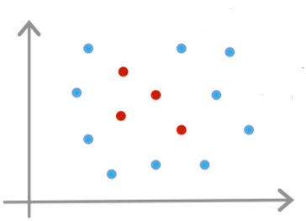
Kernels
Grow Through

Slide 24
Kernels
other types of kernel:
Polynomial kernel
String kernel
chi-square kernel
histogram
intersection kernel
Grow Through

Slide 25
Kernels
SVM parameters
use SVM software package (e.g. liblinear, libsvm,...)
need to chose:
C
kernel
more parameters:
σ, degree, gamma, …...
Grow Through

Slide 26
Goodbye
Grow Through

