Slide 1
Comprehensive Analysis of the MovieLens Dataset
BY
Norhan Mohamed Swar, 231000486
Salma Hisham Mohamed, 231000533
Shaden Abdelrahman Mohamed, 231002276

Slide 2
TABLE OF CONTENTS
01
04
02
05
03
06
MapReduce
Clustering
PageRank
Community Detection
Locality Sensitive Hashing
Recommendation Systems

Slide 3
01
MapReduce

Slide 4
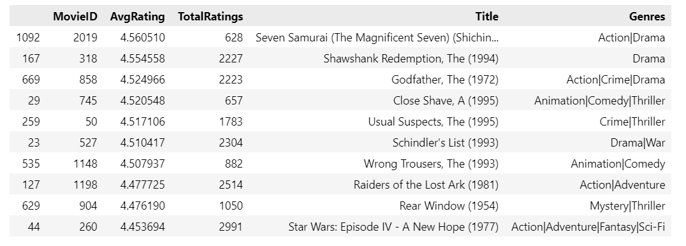
Map-Reduce for top-rated movies
Map:
Key: movie ID
Value: a dictionary containing the rating and an initial count of 1 as the value for each row.
Top 10 movies with more than 500 ratings:
Reduce:
- Aggregates the mapped data, updating the “total rating” and “user count” for each movie ID.
- Calculates the average rating.
`Seven Samurai, Shawshank Redemption, and The Godfather are the top three movies according to the highest AVG rating, which received more than 500 ratings.`

Slide 5
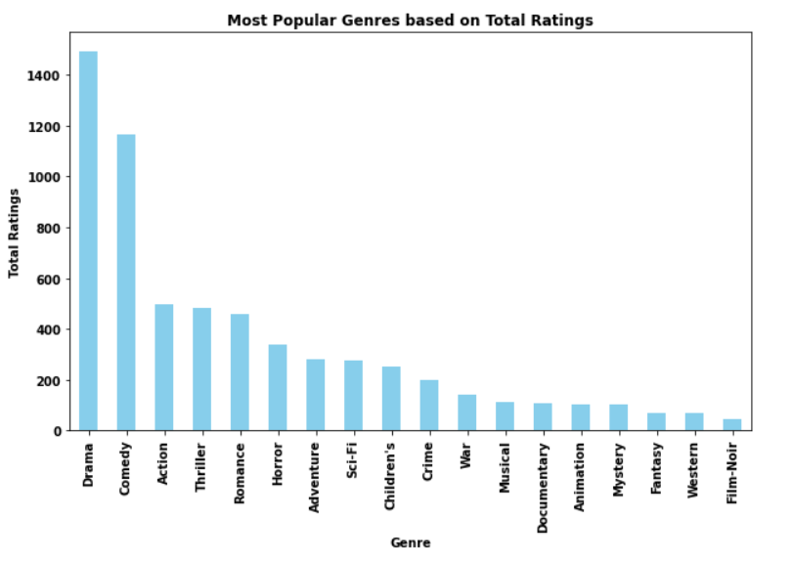
Map-Reduce for Most Popular Genres
Map:
Key: Genre
Value: set to 1 indicating its occurrence.
Reduce:
Counting the occurrences of each genre.
The result is a dictionary where keys are genres, and values represent the total count of occurrences.
Drama is the most popular genre overall based on avg ratings.

Slide 6
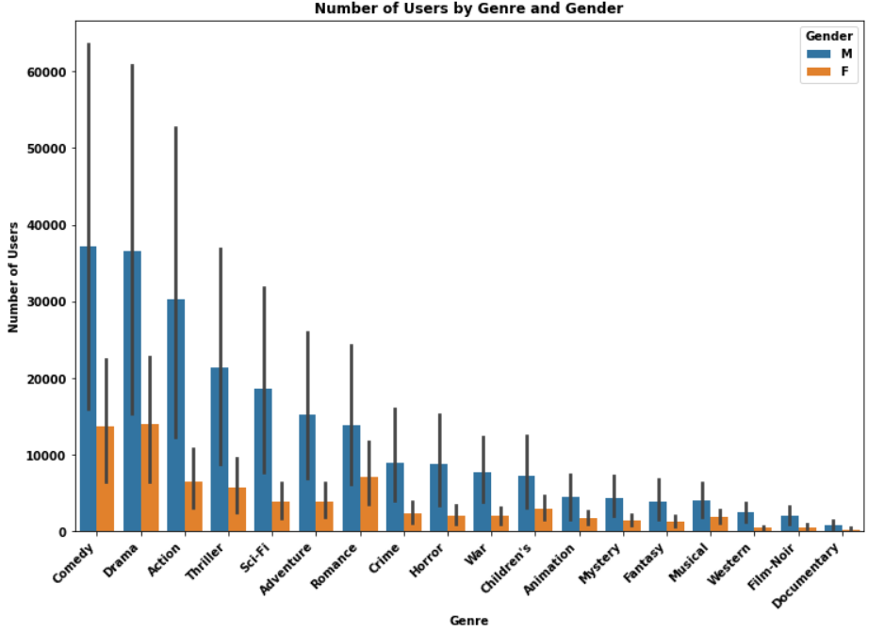
MapReduce for Gender Preferences
Map:
Key: a tuple (gender, genre)
Value: set to 1, indicating a viewer's preference for a particular genre.
Reduce:
- Aggregates the mapped data, updating the “total rating” and “user count” for each movie ID.
- Calculates the average rating.
This graph indicates that males like comedy while women tend to appreciate drama the most.

Slide 7
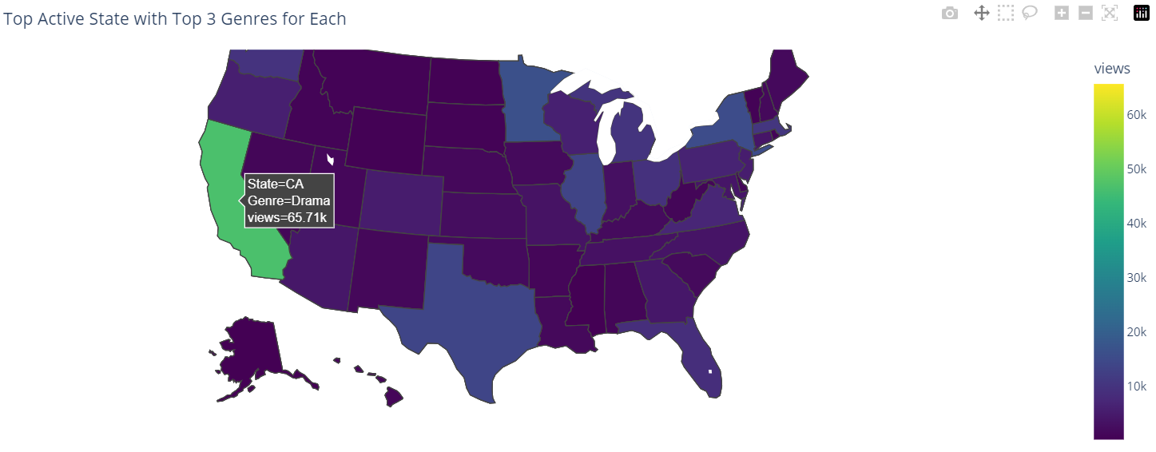
MapReduce for User Demographics Distribution
Extracted state information from the 'Zip-code_info' column
Map:
Key: a tuple (state, genre)
Value: set to 1, indicating user activity for a specific genre in a particular state.
Reduce:
Counting the occurrences of each unique combination of state and genre.
Here we can receive the amount of participants from each state with their preferred genre, as demonstrated in California, which appears to be the top among Drama.

Slide 8
02
PageRank

Slide 9
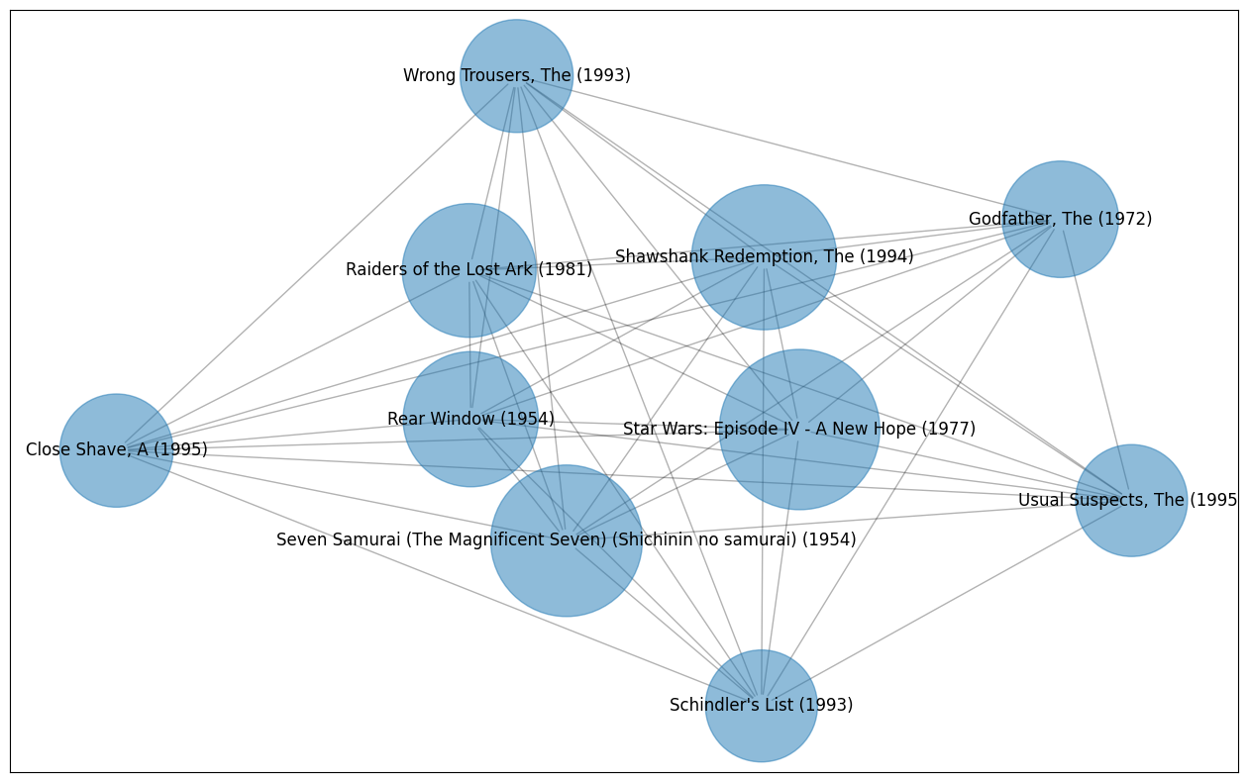
PageRank for Movie Popularity Analysis
Task:
- nodes represent movies
- edges represent user ratings.
Movies frequently rated together have stronger connections.
Implementation:
1. make 'MovieID' is used as the node identifier
2. Add edge with weight based on 'AvgRating' similarity
3. Get top 10 movie with the highest Connections aka pagerank
Star Wars: Episode IV - A New Hope (1977) and Seven Samurai (The Magnificent Seven) (Shichinin no samurai) (1954) are the top connections movies

Slide 10
03
Locality Sensitive Hashing

Slide 11
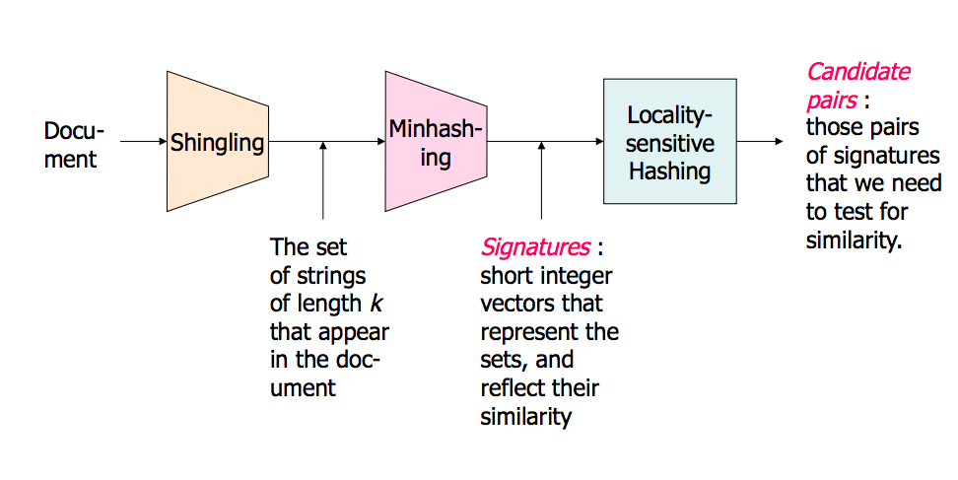

Slide 12
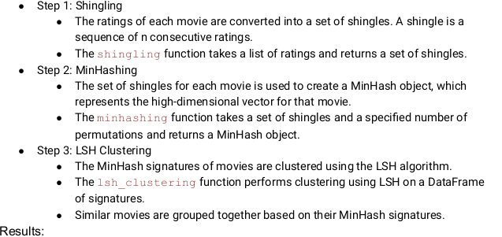
Locality Sensitive Hashing for Similar Movie Discovery

Slide 13
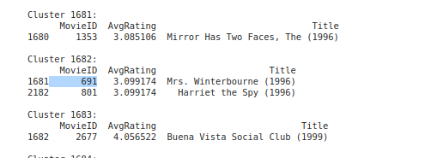
Locality Sensitive Hashing for Similar Movie Discovery
1. Shingling:
- A shingle is a sequence of n consecutive items from a list. In this case,
the items are the ratings.
- So we takes a list of ratings and returns a set of shingles
2. Minhashing:
- MinHash is a dimensionality reduction technique that projects high-dimensional data into a lower-dimensional space.
- So we take a set of shingles and a number of permutations and returns a MinHash object
3. LSH Clustering:
Loop above the signatures and Assign each signature to a cluster
Insert each signature into the LSH index
Query the LSH index to find similar signatures
2.1 If no similar signature is found, assign a new cluster ID

Slide 14
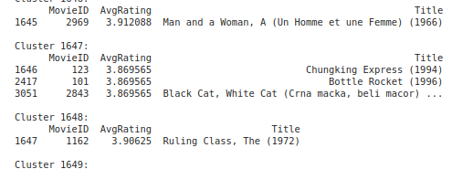
Clustering

Slide 15
04
Clustering

Slide 16
Clustering
Data Preparation:
Load the dataset containing user ratings for movies.
Normalize the ratings using a suitable method (e.g., min-max scaling) to ensure features have a consistent scale.
Extract relevant features (user IDs and movie ratings) and create a matrix representation.
K-Means Clustering:
Choose a suitable number of clusters (k) using techniques like the elbow method or silhouette analysis.
Initialize cluster centroids randomly or using strategies like K-means++.
Iterate until convergence:
Assign each user to the cluster with the closest centroid (using Euclidean distance or other appropriate metrics).
Recalculate centroids as the mean of all users within each cluster.

Slide 17
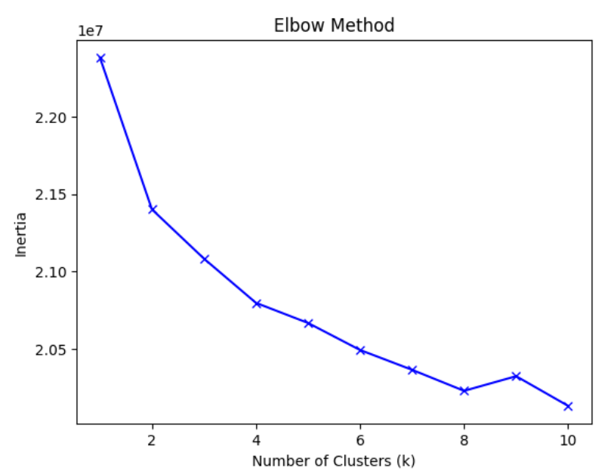
Knowing Number of clusters
Applying K-means clustering

Slide 18
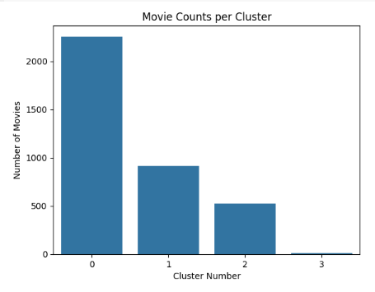

Slide 19
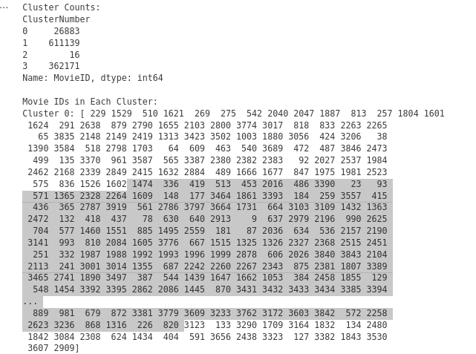

Slide 20
05
Community Detection

Slide 21
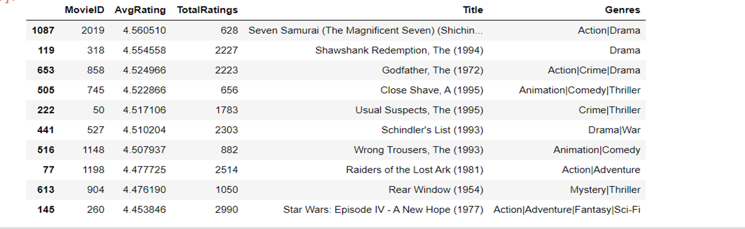
1.Getting the Top 10 Movies:

Slide 22
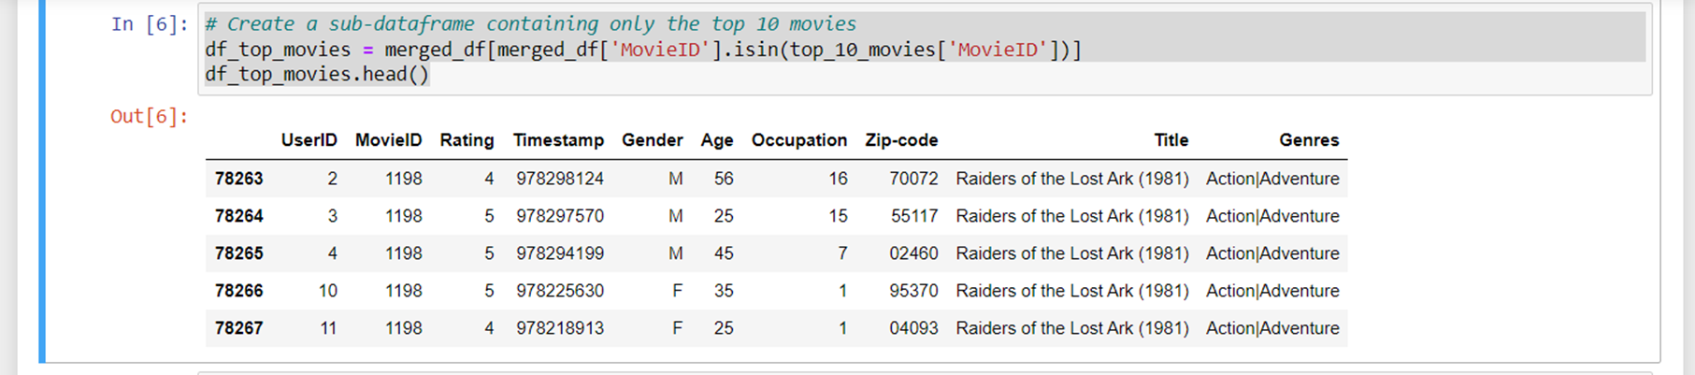
2. Creating sub_dataframe contains the top 10 movies only:

Slide 23
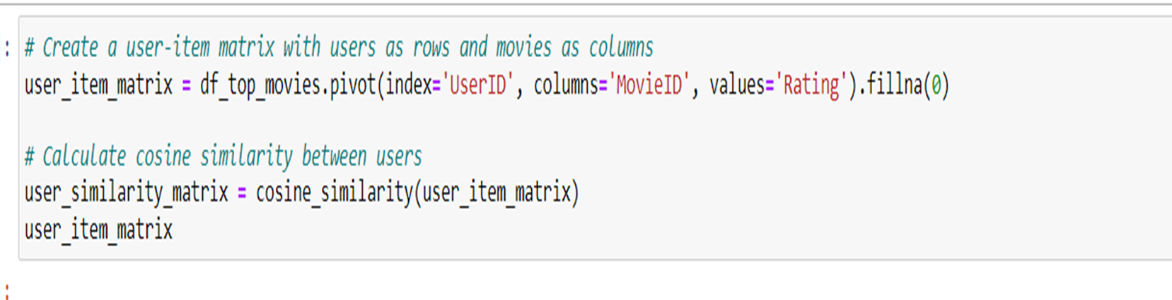
3.Cosine similarity:
Do cosine similarity between users and each others

Slide 24
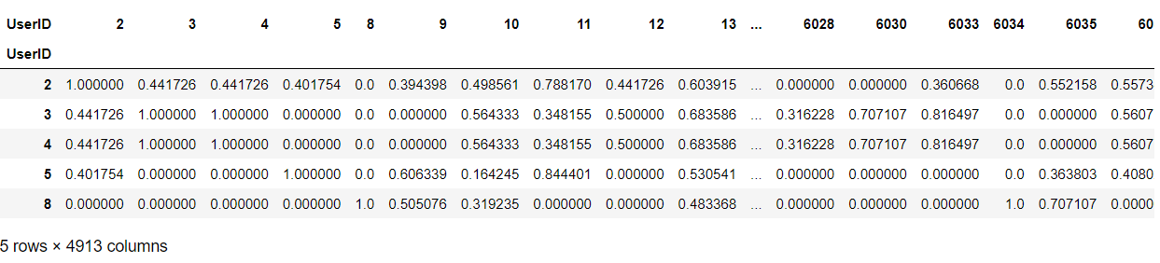
3.Cosine similarity(cont..):

Slide 25
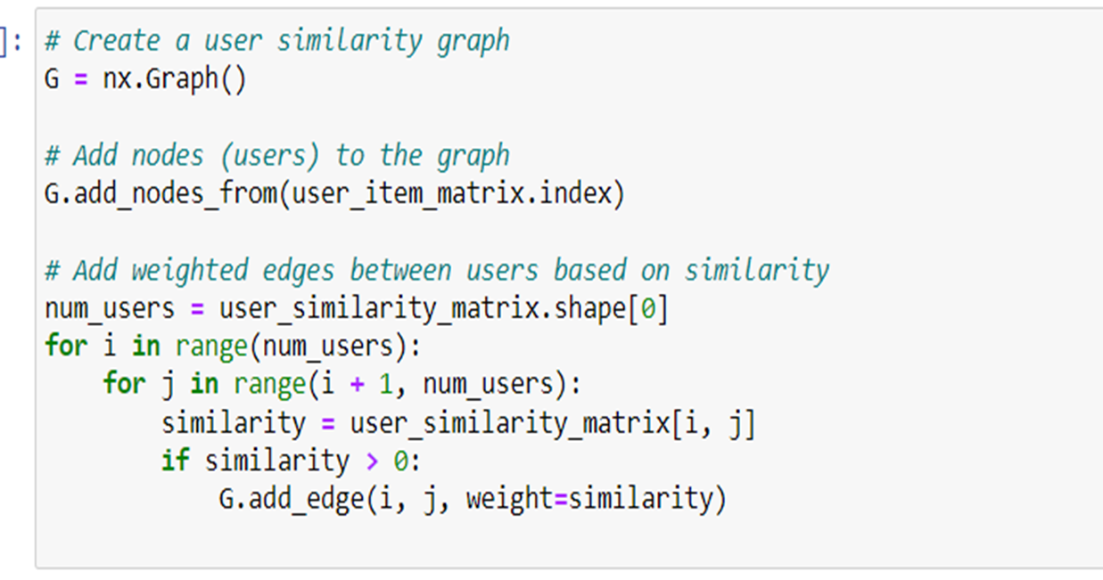
4. Create a user similarity graph:
Nodes: users
Edges: similarity between
users

Slide 26
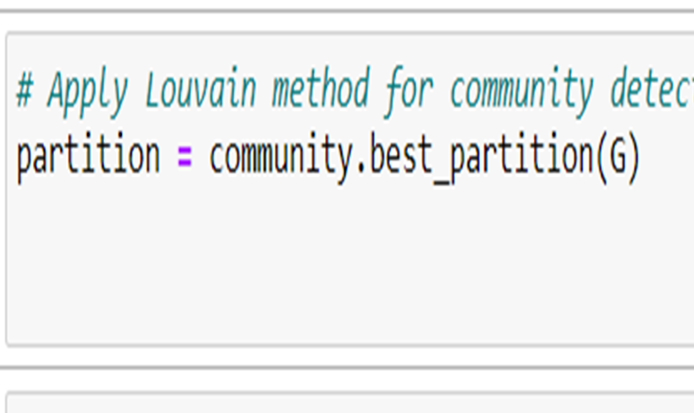
5.Apply the Louvain method for community detection:
The best_partition function from the community module applies the Louvain algorithm to the user similarity graph G. The resulting partition variable is a dictionary where each node (user) in the graph is assigned to a specific community.

Slide 27
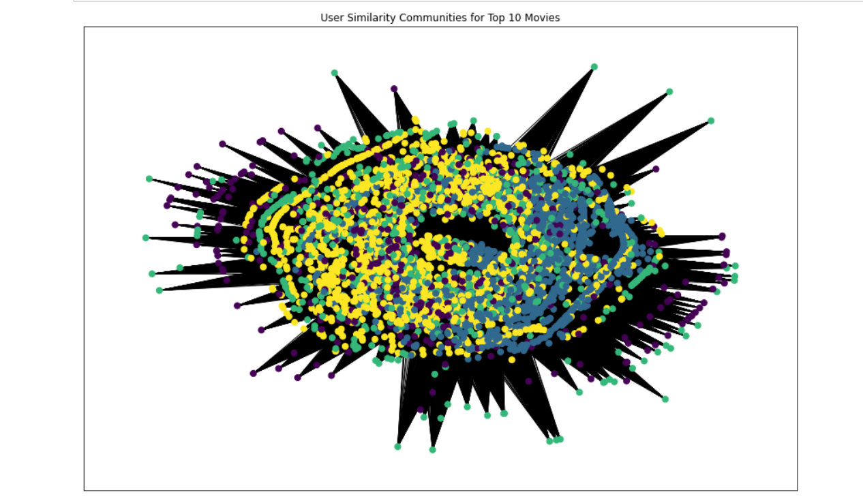
6. Visualize the communities:

Slide 28
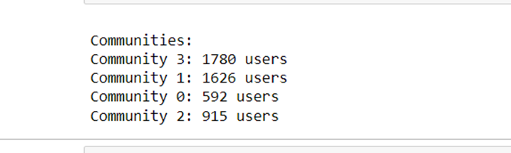
7. Analyze the communities:

Slide 29
06
Recommendation Systems

Slide 30
Item-Item Collaborative Filtering
Our problem is item-item collaborative filtering since we try finding movie's look-alike. Once we have movie's look-alike matrix, we can easily recommend alike movies to user who have rated any movie from the dataset
The similarity metric we used here is Cosine Similarity:
Implementation:
We converted the normalized pivot table of users on one axis and tv show names along the other. Into a sparse matrix since the sparsity level of the dataset was 95.5%
Build movie-movie similarity matrix
Get top N recommended movies to users based on their past ratings.

Slide 31
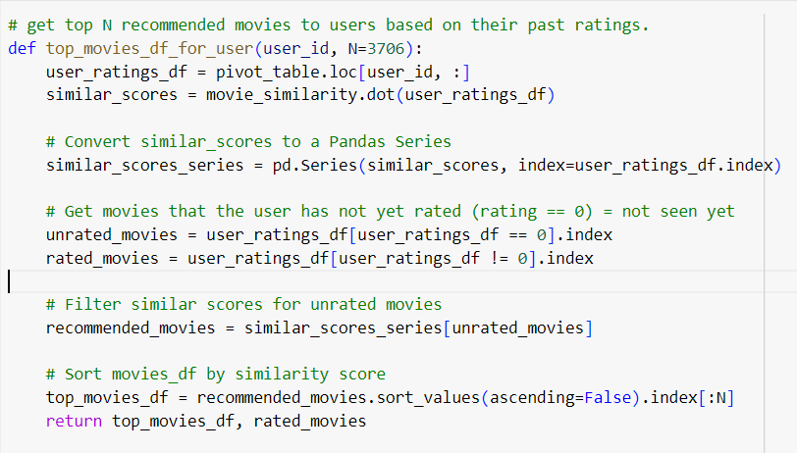
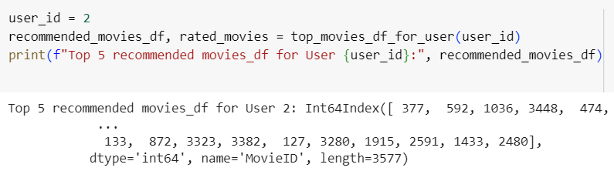
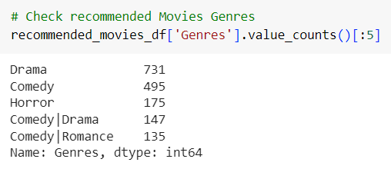
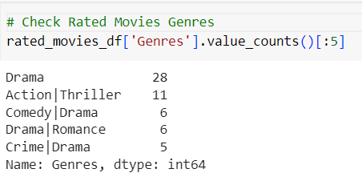

Slide 32
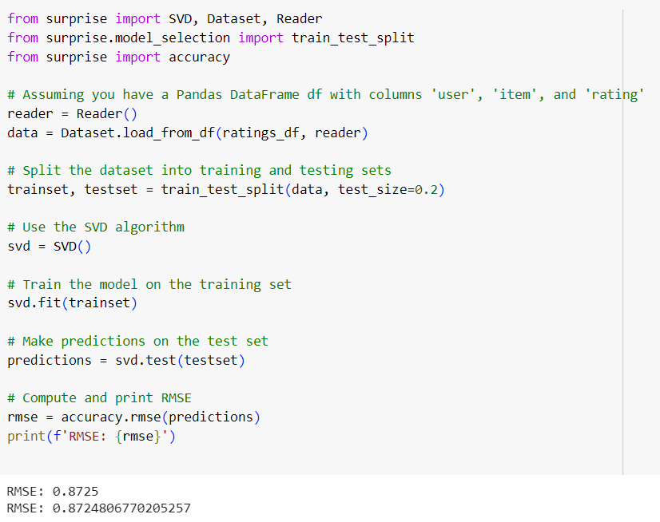
Model-Based Collaborative Filtering
To Predict user rating
Matrix Factorization (MF): MF in Model-based Collaborative Filtering learns latent user preferences and item attributes, offering scalability and handling sparsity effectively.
Low-Rank Matrix Structure: In scenarios of sparse matrices with high dimensions, MF transforms the user-item matrix into a low-rank structure, enhancing computational efficiency and enabling accurate predictions.

Slide 33
THANKS!
Do you have any questions?

