Slide 1

Amazon Books Review Sentiment Classifier
Presenter :
Salma Jedayah

Slide 2


Agenda
Problem Statement & Objectives
Dataset
Data Preprocessing
Feature Extraction with TF-IDF Vectorization
Model Performance Comparison
Why MultinomialNB?
Deployment with Streamlit
Future Improvements

Slide 3
Problem Statement & Objectives
Challenge:
Thousands of reviews make manual sentiment extraction inefficient.
Business decisions require clear signals from customer feedback
Objectives:
Develop an automated system to classify reviews as Positive or Negative.
Improve business decision-making by providing quick, reliable insights.

Slide 4

Dataset
Source : https://jmcauley.ucsd.edu/data/amazon/
Total reviews : 10000

Slide 5
Data Preprocessing
Labeling Strategy:
Score ≤ 2: Negative
Score = 3: Neutral (are excluded for clarity)
Score ≥ 4: Positive
Data Balancing:
Evenly distribute positive and negative reviews.

Slide 6
Feature Extraction with TF-IDF Vectorization
What is TF-IDF?
Converts text into numerical vectors based on word importance.
Process:
Training: Fit TF-IDF on training reviews.
Transformation: Convert both training and test data.
Advantage:
Provides a strong numerical representation for text data.

Slide 7

Model Performance Comparison
 | classifier | ACC% | F1 score | Recall | Precision
1 | SVM | 0.8244 | NEGATIVE:0.82 POSITIVE : 0.82 | NEGATIVE: 0.82 POSITIVE : 0.82 | NEGATIVE: 0.82 POSITIVE : 0.82
2 | Decision Tree | 0.6718 | NEGATIVE:0.66 POSITIVE : 0.68 | NEGATIVE: 0.64 POSITIVE : 0.70 | NEGATIVE: 0.68 POSITIVE : 0.66
3 | Multinomial Naive Bayes (MultinomialNB) | 0.8473 | NEGATIVE:0.85 POSITIVE : 0.84 | NEGATIVE:0.89 POSITIVE : 0.81 | NEGATIVE:0.82 POSITIVE : 0.88
4 | Logistic Regression | 0.8321 | NEGATIVE:0.83 POSITIVE : 0.83 | NEGATIVE: 0.82 POSITIVE : 0.84 | NEGATIVE:0.84 POSITIVE : 0.83
5 | Random Forest | 0.8206 | NEGATIVE:0.82 POSITIVE : 0.82 | NEGATIVE: 0.81 POSITIVE : 0.83 | NEGATIVE: 0.83 POSITIVE : 0.81
6 | K-Nearest Neighbors (KNN) | 0.7061 | NEGATIVE:0.70 POSITIVE : 0.72 | NEGATIVE:0.67 POSITIVE : 0.74 | NEGATIVE: 0.72 POSITIVE : 0.69
7 | SGDClassifier | 0.7977 | NEGATIVE:0.79 POSITIVE : 0.80 | NEGATIVE: 0.77 POSITIVE : 0.82 | NEGATIVE: 0.81 POSITIVE : 0.78
8 | Multi-Layer Perceptron (MLP) | 0.8359 | NEGATIVE:0.83 POSITIVE : 0.84 | NEGATIVE:0.82 POSITIVE : 0.85 | NEGATIVE: 0.85 POSITIVE : 0.82

Slide 8
Why MultinomialNB?
Best Performance:
Accuracy: 84.73% (Highest among all models)
Balanced Metrics:
High precision and recall for both classes.
Advantages of MultinomialNB:
Simple yet effective for text classification.
Handles high-dimensional sparse data (like TF-IDF vectors) well.
Conclusion:
Chosen for its overall superior performance and reliability.

Slide 9
Deployment with Streamlit
User Interface:
Manual Input: Quickly classify a single review.
Batch Processing: Upload CSV for bulk review analysis.
Visualizations:
Data tables and interactive pie charts to display sentiment proportions.
Model Integration:
Best model and TF-IDF vectorizer saved as pickle files for easy reload.

Slide 10
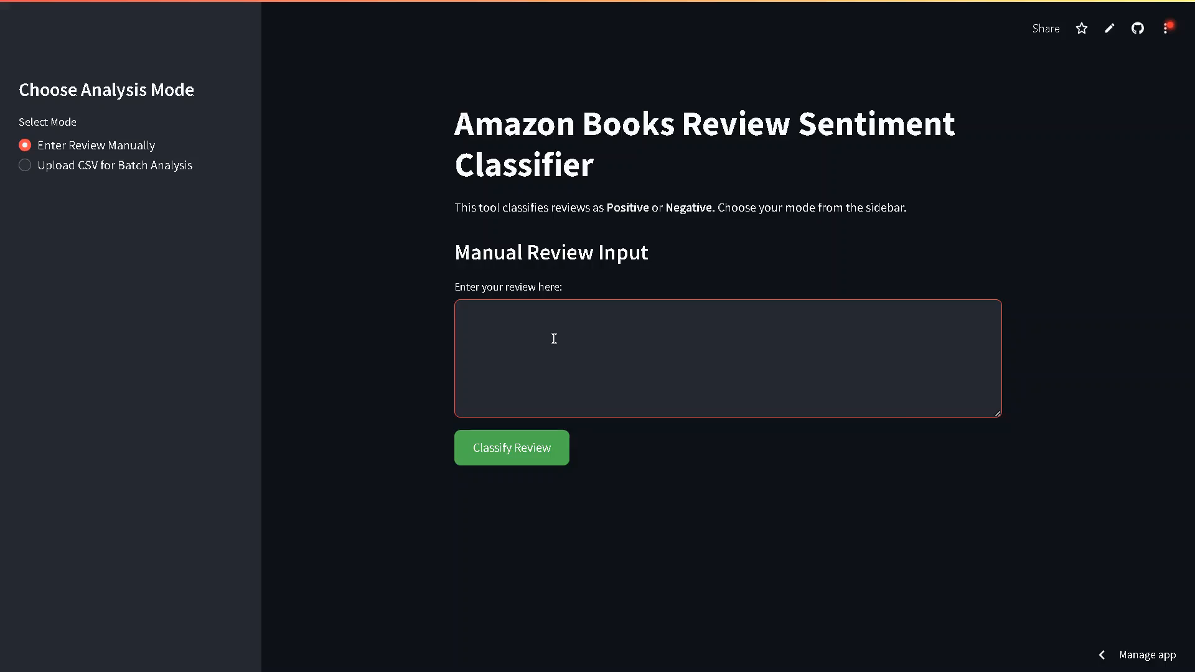
Deployment with Streamlit

Slide 11
Future Improvements
Future Improvements:
Advanced NLP:
Incorporate deep learning techniques and word embeddings for richer text representations.
Categorical Sentiment Model
Leverage review data from multiple products to build a sentiment classifier that segments reviews by product type or category. This would provide deeper insights into customer opinions across different business areas and support more targeted decision-making.

Slide 12
THANK YOU

