Slide 1

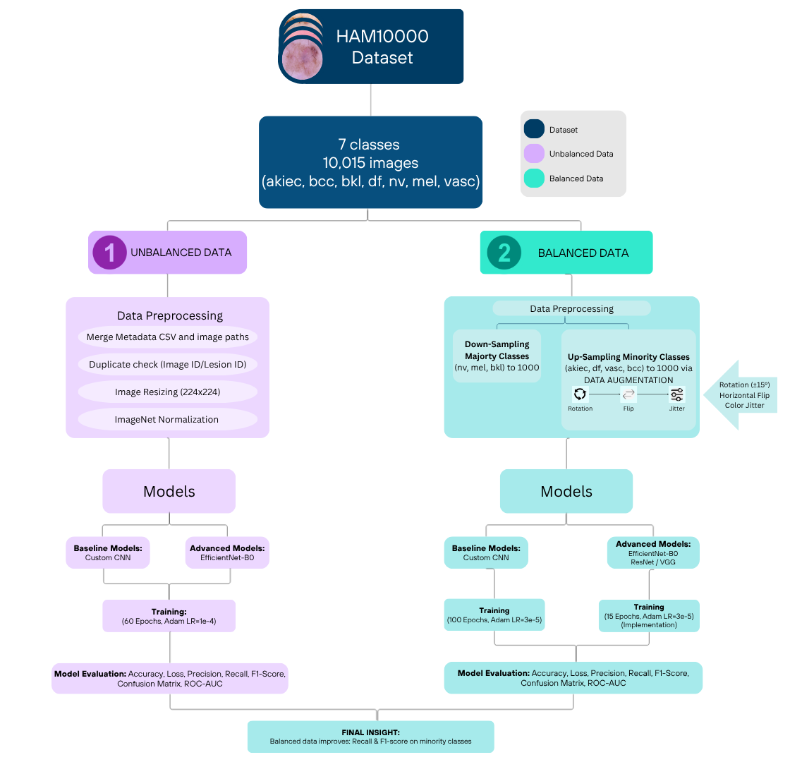
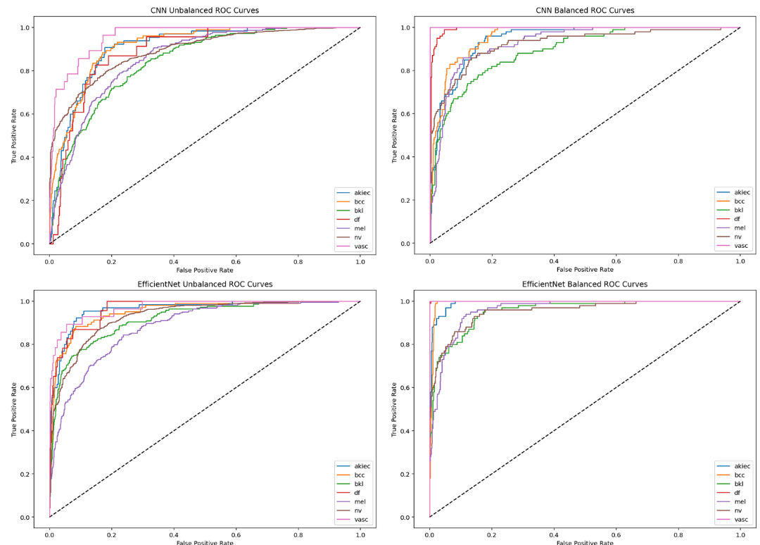
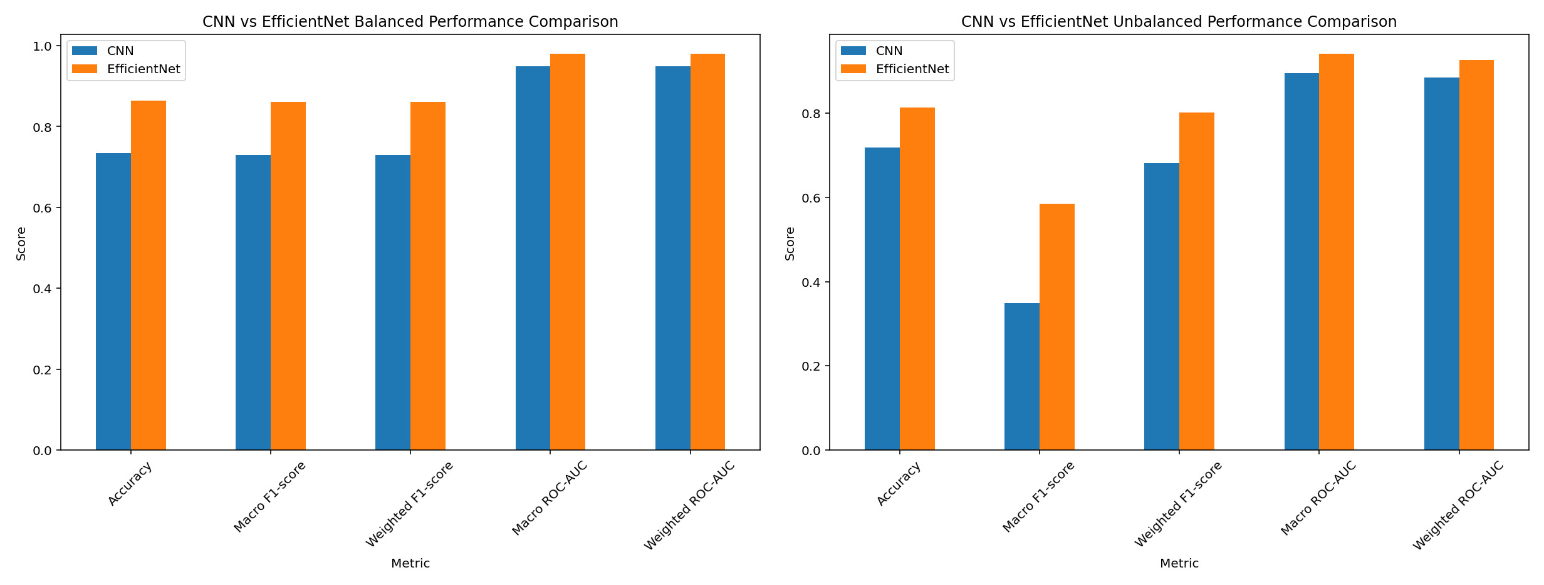
[CNN-Based Skin Lesion Classification] [Salma Khaled Abdel Samee]
[DR. Hassan Ayad] [Artificial Intelligence]
SCHOOL OF
ENGINEERING & COMPUTER SCIENCE
Introduction
Workflow
Skin cancer is one of the most prevalent cancers worldwide, where early and accurate diagnosis is critical for improving patient survival rates [1]. Recent advances in deep learning have enabled automated skin lesion classification with promising performance [3]. However, challenges such as class imbalance and limited data diversity in datasets like HAM10000 often reduce model reliability and generalization [2]. Motivated by the need to enhance diagnostic accuracy and address these limitations, this work focuses on investigating the impact of data balancing strategies and comparing custom and transfer learning models to develop more robust and clinically applicable classification systems.
Objectives
1.The use of custom CNN and transfer learning for multi-class skin lesion classification by implementing these deep learning models
2.Down sampling and data augmentation techniques used to rate the effect of data balancing on the original imbalanced data
3.Using evaluation matrices like accuracy, precision, recall, F1-score, confusion matrix, and ROC-AUC to compare different models' performance.
Methodology
Results
Data Collection: Seven skin lesion classes including dermoscopic images with built-in class imbalance were incorporated in the HAM10000 dataset.
Data Pre-processing: Resized images to a constant input size and using ImageNet normalization. Ensure data accuracy by eliminating duplicates.
Methods Used: the following two methods were used: custom CNN (3 and 5 convolutional layers) and transfer learning using EfficientNet, ResNet, and VGG.
Steps Taken: Training the models on the original dataset at first, after that using augmentation via rotation, flipping and color jitter to up sample minority classes, down sampling majority classes for dataset balancing.
Tools Employed: Python, PyTorch, NumPy, Pandas, and Matplotlib were used for implementation and visualization.
Analysis Methods: evaluating the performance by accuracy, loss, precision, recall, F1-scorre, confusion matrix, and ROC-AUC.
References
[1] A. Al Mahmud et al., “SkinNet-14: A deep learning framework for accurate skin cancer classification,” Neural Computing and Applications, 2024. https://doi.org/10.1007/s00521-024-10225-y
[2] Z. Y. Abdalla, N. H. Harun, and M. S. Ahmed, “A CNN approach for skin lesion classification using imbalanced dataset with image augmentation,” Journal of Computer Science, 2024. https://doi.org/10.3844/jcssp.2024.1430.1437
[3] S. M. Thwin and H.-S. Park, “Skin lesion classification using a deep ensemble model,” Applied Sciences, 2024.
https://doi.org/10.3390/app14135599

