Slide 1


0
10
9
8
7
6
5
4
3
2
1

Slide 2

Robotics Corner

Slide 3
Robotics Corner
Lambda Expression

Slide 4
01
Pointer to function
02
Lambda basics
AGENDA
03
Lambda Function
04
Capture by reference & value
05
Lambda function type
Robotics Corner

Slide 5
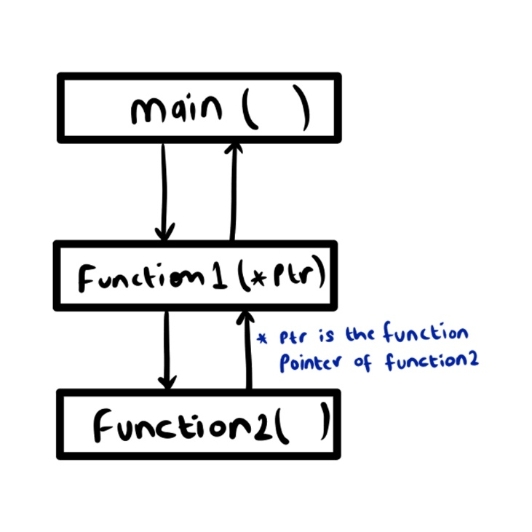
Pointer to function
01
Pointer to function
we can have pointers to functions. Following is a simple example that shows declaration and function call using function pointer.

Slide 6
Pointer to function
01
#include <stdio.h>
// A normal function with an int parameter
// and void return type
void fun(int a)
{
printf("Value of a is %d\n", a);
}
int main()
{
// fun_ptr is a pointer to function fun()
void (*fun_ptr)(int) = &fun;
/* The above line is equivalent of following two
void (*fun_ptr)(int);
fun_ptr = &fun;
*/
// Invoking fun() using fun_ptr
(*fun_ptr)(10);
return 0
}
Pointer to function

Slide 7
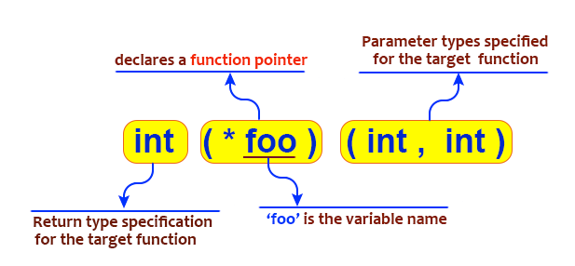
01
Pointer to function

Slide 8
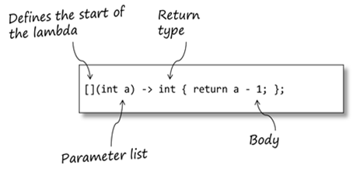
Lambda Expression
02
Lambda basics
A lambda is an ad-hoc, locally-scoped function (well, more strictly, a functor). Basically, lambdas are syntactic sugar, designed to reduce a lot of the work required in creating ad-hoc functor classes

Slide 9
Lambda basics
02
Lambda basics
The brackets ([]) mark the declaration of the lambda; it can have parameters, and it should be followed by its body (the same as any other function).
When the lambda is executed. the parameters are passed using the standard ABI mechanisms. One difference between lambdas and functions: lambda parameters can’t have defaults.
The body of the lambda is just a normal function body, and can be arbitrarily complex (although, as we’ll see, it’s generally good practice to keep lambda bodies relatively simple)

Slide 10
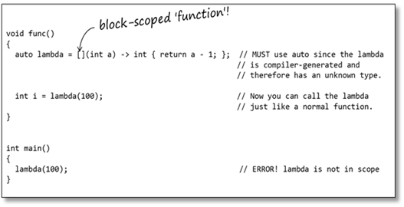
Block scoped function
02
Lambda basics

Slide 11
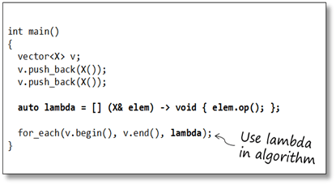
Use lambda with Algorithm
03
Lambda function

Slide 12
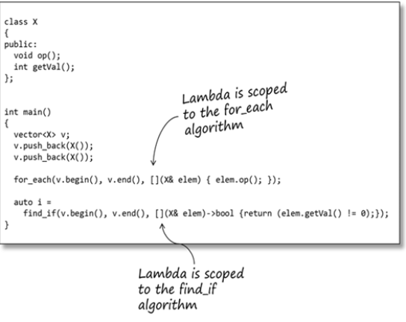
Lambda scoped to the for_each algorithm
03
Lambda function

Slide 13
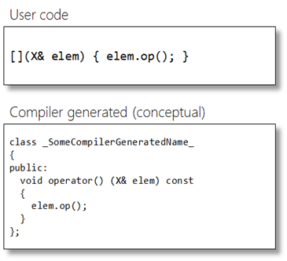
Lambda expression
03
Lambda function

Slide 14
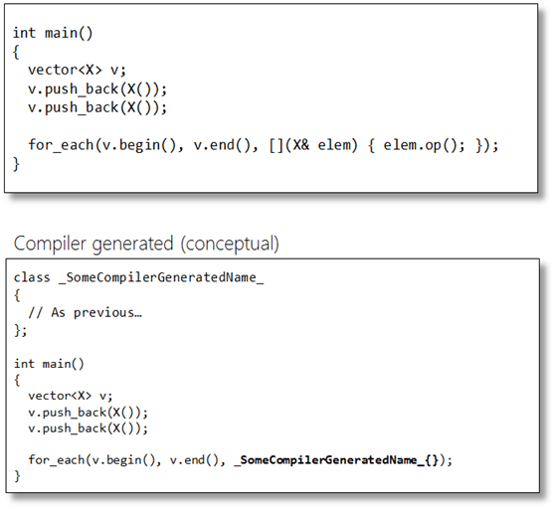
03
Lambda function

Slide 15
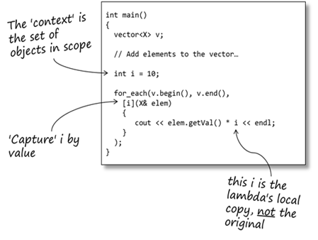
04
Capture by reference & value

Slide 16
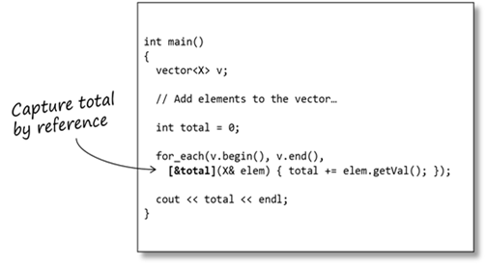
04
Capture by reference & value

Slide 17
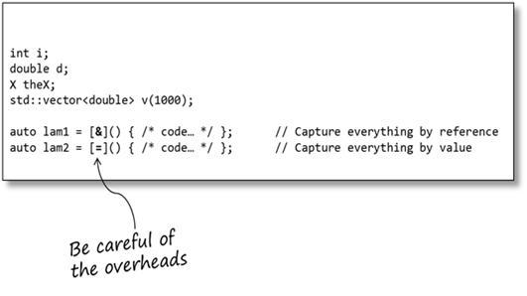
04
Capture by reference & value

Slide 18
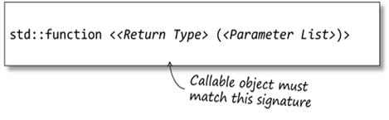
Std::function
04
Capture by reference & value
std::function is a template class that can hold any callable object that matches its signature. std::function provides a consistent mechanism for storing, passing and accessing these objects.

Slide 19
Std::function
05
Lambda function type
std::function can be thought of as a generic pointer-to-function that can point at any callable object, provided the callable object matches the signature of the std::function. And, unlike C’s pointer-to-function, the C++ compiler provides strong type-checking on the parameters of the callable object (including the return type).

Slide 20
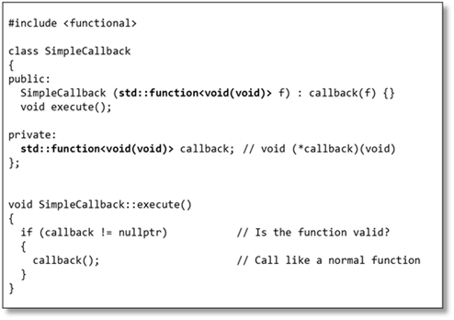
05
Lambda function type

Slide 21
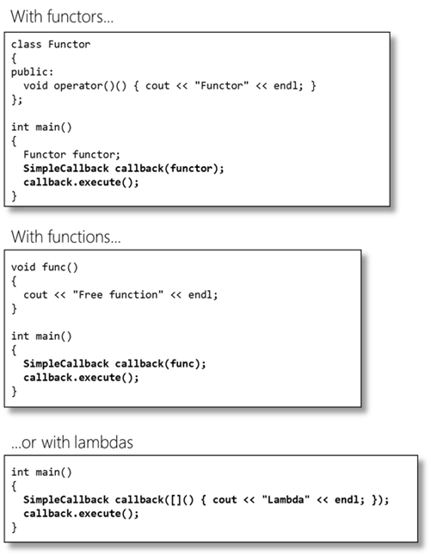
05
Lambda function type

Slide 22
Callback with std::function and Lambdas
05
Lambda function type

Slide 23


Slide 24


01211626904
www.roboticscorner.tech
Robotics Corner
Robotics Corner
Robotics Corner
Robotics Corner

