Slide 1


0
10
9
8
7
6
5
4
3
2
1

Slide 2

Robotics Corner

Slide 3
Robotics Corner
Introduction to Programming
In this course, you will learn programming from beginner to advanced.

Slide 4
01
Introduction
02
C++ History
AGEND
03
C++ Programming language
04
Variables and Data Types
05
Operators
Robotics Corner

Slide 5
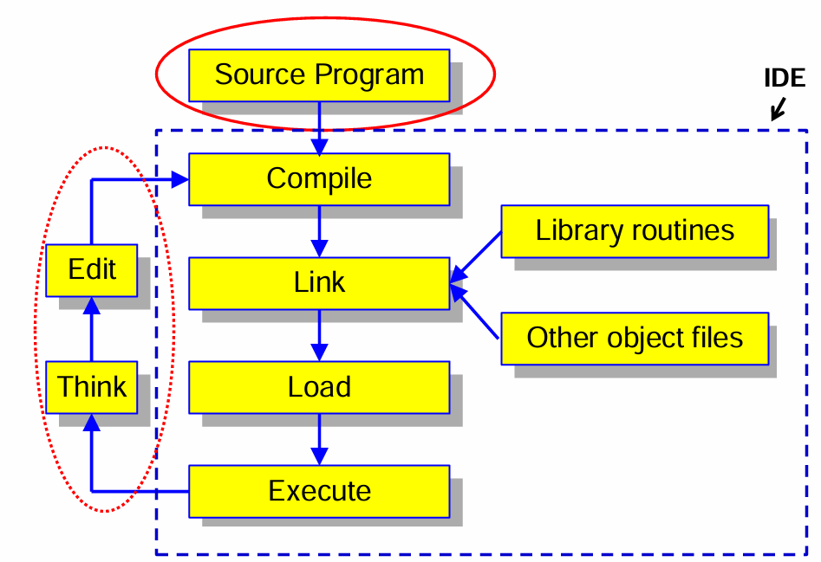
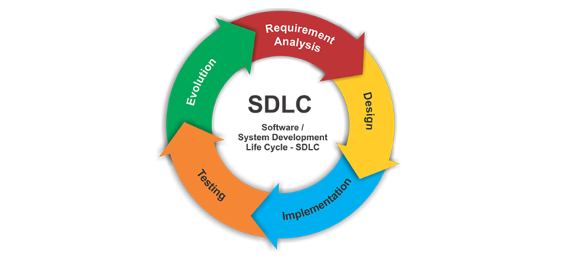


01
Introduction
Software Development Cycle
01285960031
01285960031
www.roboticscorner.tech

Slide 6
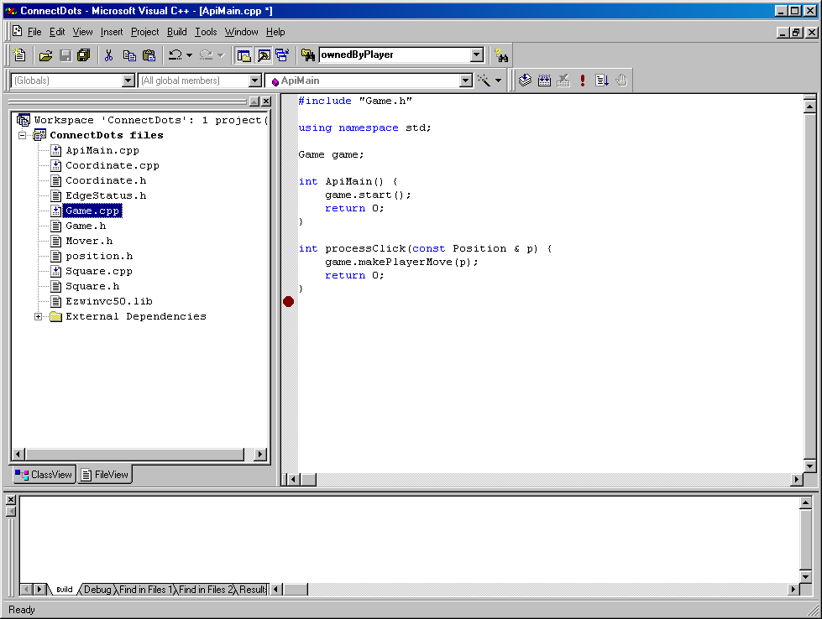
01
Introduction
IDEs
Integrated Development Environments or IDEs
  Supports the entire software development cycle
    E.g. MS Visual C++, Borland, Code Warrior
Provides all the capabilities for developing software
  Editor
  Compiler
  Linker
  Loader
  Debugger
  Viewer
01285960031
01285960031
www.roboticscorner.tech

Slide 7
What are the Key Ingredients of a Program?
01
Introduction
Common elements in programming languages:
  Keywords (aka reserved words)
    Defined in C++. Have a special meaning
  Programmer-defined entities
    Names made up by programmer
    Used to represent variables, functions, etc.
  Operators
    Defined in C++
    For performing arithmetic, comparison, etc. operations
  Constructs
Defined in C++
Sequence, selection, repetition, functions, classes, etc.
Every programming language has a syntax (or grammar) that a programmer must observe
The syntax controls the use of the elements of the program
01285960031
01285960031
www.roboticscorner.tech

Slide 8
01
Introduction
Object Oriented Programming
C++ is derived from C programming language – an extension that added object-oriented (OO) features.
- Lots of C++ syntax similar to that found in C, but there are differences and new features.
Popular because of the reuse of objects
  Classes – template or blueprint for an object
  Objects
  Methods
Objects are organized in a hierarchy
  Super Classes
  Sub Classes
01285960031
01285960031
www.roboticscorner.tech

Slide 9
02
C++ History
The Evolution of C++
C (1972)
ANSI Standard C (1989)
Bjarne Stroustrup adds features of the language Simula (an
object-oriented language designed for carrying out simulations) to
C resulting in …
C++ (1983)
ANSI Standard C++ (1998)
ANSI Standard C++ [revised] (2003)
ANSI Standard C++ (2011)
The present C++
  A general-purpose language that is in widespread use for systems and embedded
  The most commonly used language for developing system software such as databases and operating systems
… the future: another Standard (2014 and 2017?)
01285960031
01285960031
www.roboticscorner.tech

Slide 10
02
C++ History
C++ - an Object-Oriented Programming Language
Other examples: C# and Java
The modern approach to developing programs
- Objects in a real-world problem are modeled as software objects
Warning: OO features were added to C++ as an “afterthought”
- It is not a “true” OO language such as C# or Java
01285960031
01285960031
www.roboticscorner.tech

Slide 11
Program Organization
03
C++ Programming language
Program statement
  Definition, e.g. function prototype
  Declaration, e.g. variables and constants
  Action
Executable unit - Action
  Set of program statements – may be named
  Different languages refer to named executable units by different names
    Subroutine: Fortran and Basic
    Procedure: Pascal
    Function: C++
    Method: C++, C#, Java
01285960031
01285960031
www.roboticscorner.tech

Slide 12
03
C++ Programming language
The simplest C++ program consists of a single function named main.
The syntax of such programs is shown below: #include <iostream>
using namespace std;
int main()
{
declaration(s) statement(s) return 0;
}
The portions of the program shown in blue should always be present. The declarations specify the data that is used by the program. These declarations can declare either constants or variables, for example.
The statements specify the algorithm for the solution to your problem.
01285960031
01285960031
www.roboticscorner.tech

Slide 13
03
C++ Programming language
Example – Algorithm for Converting Miles to Kilometers
Problem Input
miles
Problem Output kms
distance in miles
distance in kilometers
Algorithm will use Conversion Formula 1 mile = 1.609 kilometers
Formulate the algorithm that solves the problem.
Algorithm
  Get the distance in miles.
  Convert the distance to kilometers by multiplying by 1.609
  Display the distance in kilometers.
Now convert the algorithm to program code!
01285960031
01285960031
www.roboticscorner.tech

Slide 14
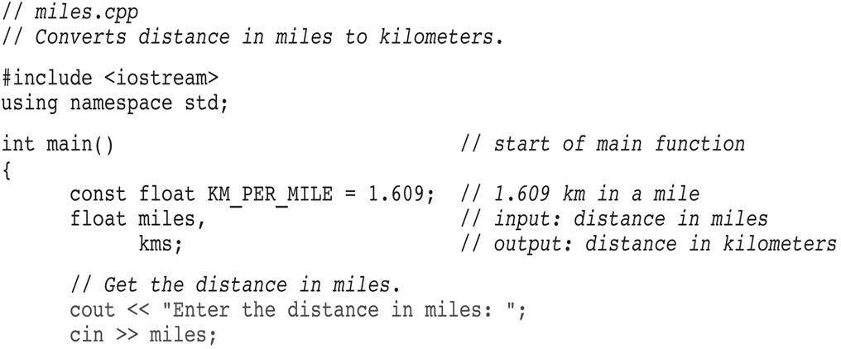
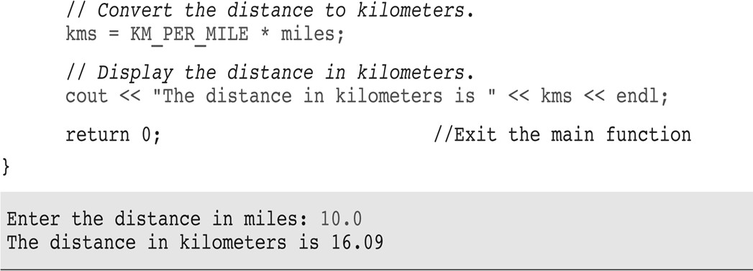
03
C++ Programming language
01285960031
01285960031
www.roboticscorner.tech

Slide 15
Statements
03
C++ Programming language
Statements are the executable “units” of a program.
Statements are the translation of an algorithm into program code. Statements may be
Simple – typically one line of program code
Structured – a grouping of several statements
E.g. control structures; functions; etc.
Statements must be terminated with a; symbol.
01285960031
01285960031
www.roboticscorner.tech

Slide 16
Program statements may be executed by one of three control structures:
03
C++ Programming language
Sequence – execute statements one after the other
Selection – select which statement(s) to execute
Repetition – repeatedly execute statement(s)
#include <iostream> using namespace std;
int main()
{
declaration(s) statement(s) return 0;
}
01285960031
01285960031
www.roboticscorner.tech

Slide 17
The #include Directive
03
C++ Programming language
Preprocessor directive
Inserts the contents of another file into the program
iostream is C++ library of input/output functions
This includes cout and cin
Do not use ; at end of #include statement
#include <iostream> using namespace std;
int main()
{
declaration(s) statement(s) return 0;
}
01285960031
01285960031
www.roboticscorner.tech

Slide 18
The namespace Directive
03
C++ Programming language
This directive allows the cout and cin statements to be used in a program without using the prefix std::
#include <iostream>
With this directive, may write
using namespace std;
cin or cout
int main()
{
declaration(s) statement(s) return 0;
}
Otherwise, we would have to write
std::cout or std::cin
Must use ; at end of namespace directive
01285960031
01285960031
www.roboticscorner.tech

Slide 19
03
C++ Programming language
Declarations - Constants and Variables
Constants are data that having unchanging values.
Variables, as their name implies, are data whose values can change during the course of execution of your program.
For both constants and variables, the name, the data type, and value must be specified.
Any variable in your program must be defined before it can be used
Data type specifies whether data is integral, real, character or logical.
01285960031
01285960031
www.roboticscorner.tech

Slide 20
Constants
03
C++ Programming language
Syntax
const type name = expression;
The statement must include the reserved word const, which designates the declaration as a constant declaration.
The type specification is optional and will be assumed to be integer.
Examples
const float TAXRATE = 0.0675;
const int NUMSTATES = 50;
Convention is to use uppercase letters for names of constants.
01285960031
01285960031
www.roboticscorner.tech

Slide 21
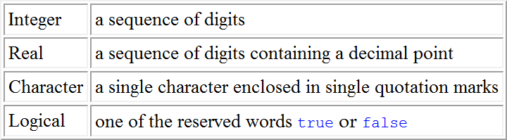
The data type of a constant may be one the types given below
03
C++ Programming language
01285960031
01285960031
www.roboticscorner.tech

Slide 22
A Simple, Yet Complete, C++ Program
03
C++ Programming language
Program producing output only
// Hello world program
Comment
#include <iostream> using namespace std;
Preprocessor directives
int main()
{
cout << "Hello world!" << endl; return 0;
}
Function named main() indicates start of the program
Ends execution
of main() which ends the program
01285960031
01285960031
www.roboticscorner.tech

Slide 23
03
C++ Programming language
Let us look at the function main()
int main()
{
cout << "Hello world!" << endl; return 0;
}
This example introduces the notion of a text string
"Hello world!"
01285960031
01285960031
www.roboticscorner.tech

Slide 24
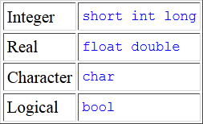
The basic data types supported by C++ are shown in the table below
03
C++ Programming language
The three integer types allow for whole numbers of three different sizes.
The two real types permit numbers with decimal parts with two different amounts of precision.
Finally, there is one type for character data that consists of a single character, and one type for logical values that are either true or false.
01285960031
01285960031
www.roboticscorner.tech

Slide 25
The cout Output Statement
03
C++ Programming language
Used to display information on computer screen
It is declared in the header file iostream
Syntax
cout << expression;
Uses << operator to send information to computer screen cout << "Hello, there!";
Can be used to send more than one item cout << "Hello, " << "there!";
01285960031
01285960031
www.roboticscorner.tech

Slide 26
03
C++ Programming language
To get multiple lines of output on screen Either
  Use the endl function
cout << "Hello, there!" << endl;
Or
  Use \n in the output string
cout << "Hello, there!\n";
Example
#include <iostream> using namespace std;
int main()
{
cout << "
* " << endl; " << endl;
cout << " ***
cout << " ***** " << endl;
cout << " cout << " cout << "
}
" << endl;
" << endl;
" << endl;
01285960031
01285960031
www.roboticscorner.tech

Slide 27
03
C++ Programming language
Example
#include <iostream> using namespace std; int main() {
double radius; double area;
// Step 1: Set value for radius radius = 20;
// Step 2: Compute area
area = radius * radius * 3.14159;
// Step 3: Display the area cout << "The area is "; cout << area << endl;
}
01285960031
01285960031
www.roboticscorner.tech

Slide 28
The cin Statement
03
C++ Programming language
Used to read input from keyboard
It is declared in the header file iostream
Syntax
cin >> variable
Uses >> operator to receive data from the keyboard and assign the value to a variable
Often used with cout to display a user prompt first
May use cin to store data in one or more variables
01285960031
01285960031
www.roboticscorner.tech

Slide 29
03
C++ Programming language
Can be used to input more than one value
cin >> height >> width;
Multiple values from keyboard must be separated by spaces
Order is important: first value entered goes to first variable, etc.
01285960031
01285960031
www.roboticscorner.tech

Slide 30
03
C++ Programming language
Example Program – Use of cout to prompt user to enter some data
#include <iostream> #include <string> using namespace std; int main()
{
string name;
cout << "What is your name? "; cin >> name;
cout << "Hello there, " << name; return 0;
}
01285960031
01285960031
www.roboticscorner.tech

Slide 31
Names
03
C++ Programming language
Used to denote language- and programmer-defined elements within the program
A valid name is a sequence of
  Letters (upper and lowercase)
  Digits
    A name cannot start with a digit
  Underscores
    A name should not normally start with an underscore
Names are case sensitive
  MyObject is a different name than MYOBJECT
There are two kinds of names
  Keywords
  Identifiers
01285960031
01285960031
www.roboticscorner.tech

Slide 32
Keywords
03
C++ Programming language
Keywords are words reserved as part of the language - syntax Example int, return, float, double
They cannot be used to name programmer-defined elements
They consist of lowercase letters only
They have special meaning to the compiler
01285960031
01285960031
www.roboticscorner.tech

Slide 33
Identifiers
03
C++ Programming language
Identifiers are the names given to programmer-defined entities within the program – variables, functions, etc.
Identifiers should be
  Short enough to be reasonable to type (single word is the norm)
    Standard abbreviations are fine
  Long enough to be understandable
    When using multiple word identifiers capitalize the first letter of each word – but this is just a convention
Examples
  Min
  Temperature
  CameraAngle
  CurrentNbrPoints
01285960031
01285960031
www.roboticscorner.tech

Slide 34
Example - Valid and Invalid Identifiers
03
C++ Programming language
IDENTIFIER | VALID? | REASON IF INVALID
totalSales | Yes
total_Sales | Yes
total.Sales | No | Cannot contain .
4thQtrSales | No | Cannot begin with digit
totalSale$ | No | Cannot contain $
01285960031
01285960031
www.roboticscorner.tech

Slide 35
Integer Data Types
03
C++ Programming language
Designed to hold whole numbers
Can be signed or unsigned
– 12 -6 +3
Available in different sizes (in memory): short, int, and long
Size of short ≤ size of int ≤ size of long
01285960031
01285960031
www.roboticscorner.tech

Slide 36
Floating-Point Data Types
04
Variables and Data Types
Designed to hold real numbers 12.45 -3.8
Stored in a form similar to scientific notation
All numbers are signed
Available in different sizes (space in memory: float, double, and long double
Size of float ≤ size of double ≤ size of long double
01285960031
01285960031
www.roboticscorner.tech

Slide 37
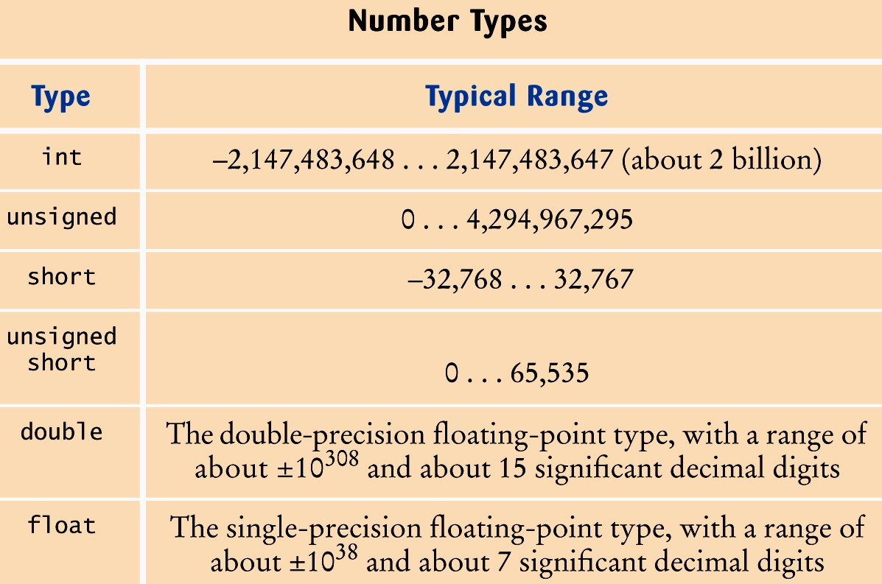
Numeric Types in C++
04
Variables and Data Types
01285960031
01285960031
www.roboticscorner.tech

Slide 38
04
Variables and Data Types
Defining Variables
Variables of the same type can be defined
  On separate lines: int length;
int width;
unsigned int area;
  On the same line:
int length, width; unsigned int area;
Variables of different types must be in different definitions
01285960031
01285960031
www.roboticscorner.tech

Slide 39
Declaring Variables
04
Variables and Data Types
int x;
// Declare x to be an
// integer variable;
double radius; // Declare radius to
// be a double variable;
char a;
// Declare a to be a
// character variable;
01285960031
01285960031
www.roboticscorner.tech

Slide 40
04
Variables and Data Types
Variable Assignments and Initialization
Assignment
Uses the = operator
Has a single variable on the left side and a value (constant, variable, or expression) on the right side
Copies (i.e. assigns) the value on the right to the variable on the left. (An expression is first evaluated)
Syntax
variable = expression ; item = 12; // constant
Celsius = (Fahrenheit - 32) * 5 / 9; // expression
y = m * x + b; // expression
01285960031
01285960031
www.roboticscorner.tech

Slide 41
Assignment Statement
04
Variables and Data Types
NewStudents OldStuden
Tota
int NewStudents = 6; int OldStudents = 21; int TotalStudents;
6
TotalStudents = NewStudents + OldStudents;
01285960031
01285960031
www.roboticscorner.tech

Slide 42
Variable Assignments and Initialization
04
Variables and Data Types
Initialization
Initialize a variable: assign it a value when it is defined: int length = 12;
Or initialize it later via assignment
Can initialize some or all variables: int length = 12, width = 5, area;
A variable cannot be used before it is defined
01285960031
01285960031
www.roboticscorner.tech

Slide 43
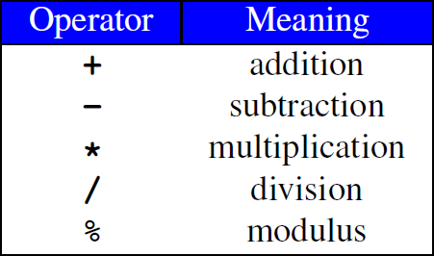
Arithmetic Operators
04
Variables and Data Types
Used for performing numeric calculations
Basic Arithmetic Operators
01285960031
01285960031
www.roboticscorner.tech

Slide 44
04
Variables and Data Types
SYMBOL | OPERATION | EXAMPLE | VALUE OF ans
+ | addition | ans = 7 + 3; | 10
- | subtraction | ans = 7 - 3; | 4
* | multiplication | ans = 7 * 3; | 21
/ | division | ans = 7 / 3; | 2
% | modulus | ans = 7 % 3; | 1
01285960031
01285960031
www.roboticscorner.tech

Slide 45
/ Operator
04
Variables and Data Types
/ (division) operator performs integer division if both operands are integers
cout << 13 / 5;
cout << 91 / 7;
// displays 2
// displays 13
If either operand is floating point, the result is floating point
cout << 13 / 5.0; // displays 2.6
cout << 91.0 / 7; // displays 13.0
01285960031
01285960031
www.roboticscorner.tech

Slide 46
% Operator
04
Variables and Data Types
% (modulus) operator computes the remainder resulting from integer division
cout << 13 % 5;
// displays 3
% requires integers for both operands
cout << 13 % 5.0; // error
01285960031
01285960031
www.roboticscorner.tech

Slide 47
Remainder Operator
04
Variables and Data Types
Remainder is very useful in programming.
For example, an even number % 2 is always 0 and an odd number % 2 is always 1.
So you can use this property to determine whether a number is even or odd.
Suppose today is Saturday and you and your friends are going to meet in 10 days. What day is in 10 days? You can find that day is Tuesday using the following expression:
Saturday is the 6th day in a week
A week has 7 days
(6 + 10) % 7 is 2
The 2nd day in a week is Tuesday
After 10 days
01285960031
01285960031
www.roboticscorner.tech

Slide 48
Expressions
04
Variables and Data Types
Can create complex expressions using multiple mathematical (and other) operators
An expression can be a constant, a variable, or a combination of constants and variables
Can be used in assignment, with cout, and with other statements:
area = 2 * PI * radius;
cout << "border length of rectangle is: " << 2*(l+w);
01285960031
01285960031
www.roboticscorner.tech

Slide 49
Expressions
04
Variables and Data Types
Expressions are a grouping of variables, constants and operators.
C++ has a defined order of precedence for the order in which operators are used in an expression
- It is not just a left-to-right evaluation
Brackets (aka parentheses) can be used to change the defined order in which operators are used.
Example
#include <iostream> using namespace std; int main()
{
cout << (1 + 2 + 3) / 3 << endl; // not the same as 1+2+3/3 return 0;
}
01285960031
01285960031
www.roboticscorner.tech

Slide 50
Expressions
04
Variables and Data Types
Multiplication requires an operator:
Area=lw is written as Area = l * w;
There is no exponentiation operator:
Area=s² is written as Area = pow(s, 2);
Parentheses may be needed to specify the order of operations Example
_{m =} y2 − y1
is written as m = (y2-y1) /(x2-x1);
x2 − x1
01285960031
01285960031
www.roboticscorner.tech

Slide 51
Note the use of brackets to group variables into expressions and inform the compiler the order of evaluation.
04
Variables and Data Types
Example
m = (y2-y1) /(x2-x1);
01285960031
01285960031
www.roboticscorner.tech

Slide 52
Compound Assignment
04
Variables and Data Types
C++ has a set of operators for applying an operation to an object and then storing the result back into the object
Examples int i = 3;
i += 4;
// i is now 7
Equivalent to i = i + 4
float a = 3.2; a *= 2.0;
// a is now 6.4
Equivalent to a = a * 2.0
01285960031
01285960031
www.roboticscorner.tech

Slide 53
Shorthand Assignment Operators
04
Variables and Data Types
Operator | Example | Equivalent
+= | i += 8 | i = i + 8
-= | f -= 8.0 | f = f - 8.0
*= | i *= 8 | i = i * 8
/= | i /= 8 | i = i / 8
%= | i %= 8 | i = i % 8
01285960031
01285960031
www.roboticscorner.tech

Slide 54
Assignment Conversions
04
Variables and Data Types
Floating-point expression assigned to an integer object is truncated
Integer expression assigned to a floating-point object is converted to a floating-point value
Consider
float y = 2.7; int i = 15; int j = 10;
i = y;
// i is now 2
y = j;
// y is now 10.0
01285960031
01285960031
www.roboticscorner.tech

Slide 55
Operators and Precedence
05
Operators
Consider m*x + b - Which of the following is it equivalent to?
(m * x) + b
m * (x + b)
Equivalent
Not equivalent but valid!
Operator precedence tells how to evaluate expressions
Standard precedence order
()
Evaluate first. If nested innermost done first
Evaluate second. If there are several, then evaluate from left-to-right
Evaluate third. If there are several, then evaluate from left-to-right
* / %
■ + -
01285960031
01285960031
www.roboticscorner.tech

Slide 56
Operator Precedence
05
Operators
Example
20 - 4 / 5 * 2 + 3 * 5 % 4
(4 / 5)
((4 / 5) * 2)
((4 / 5) * 2)
((4 / 5) * 2)
(3 * 5)
((3 * 5) % 4)
(20 -((4 / 5) * 2)) ((3 * 5) % 4)
(20 -((4 / 5) * 2)) + ((3 * 5) % 4)
01285960031
01285960031
www.roboticscorner.tech

Slide 57
Increment and Decrement Operators
05
Operators
C++ has special operators for incrementing or decrementing a
variable’s value by one – “strange”effects!
Examples
int k = 4;
++k;
k++;
// k is 5
// k is 6
Nothing strange so far!
BUT
int i = k++;
// i is 6, and k is 7
int j = ++k;
// j is 8, and k is 8
01285960031
01285960031
www.roboticscorner.tech

Slide 58
05
Operators
Increment and Decrement Operators
The “strange”effects appear when the operators are used in an
assignment statement
Operator a=++var | Name pre-increment | Description The value in var is incremented by 1 and this new value of var is assigned to a.
a=var++ | post-increment | The value in var is assigned to a and then
 |  | the value in var is incremented by 1
01285960031
01285960031
www.roboticscorner.tech

Slide 59
Similar effects for the decrement operator
05
Operators
Operator | Name | Description
a=--var | pre-decrement | The value in var is decremented by 1 and this new value of var is assigned to a.
a=var-- | post-decrement | The value in var is assigned to a and then the value in var is decremented by 1
01285960031
01285960031
www.roboticscorner.tech

Slide 60
Some Standard Libraries
05
Operators
fstream
File stream processing
assert
Assertion processing iomanip
Formatted input/output (I/O) requests
ctype
Character manipulations
cmath
Trigonometric and logarithmic functions
Note
C++ has many other libraries
01285960031
01285960031
www.roboticscorner.tech

Slide 61
C++ cmath Library
05
Operators
Typical mathematical functions
e.g. sqrt, sin, cos, log
Function use in an assignment statement
Function call
y = sqrt(x);
Function name
Function argument
01285960031
01285960031
www.roboticscorner.tech

Slide 62
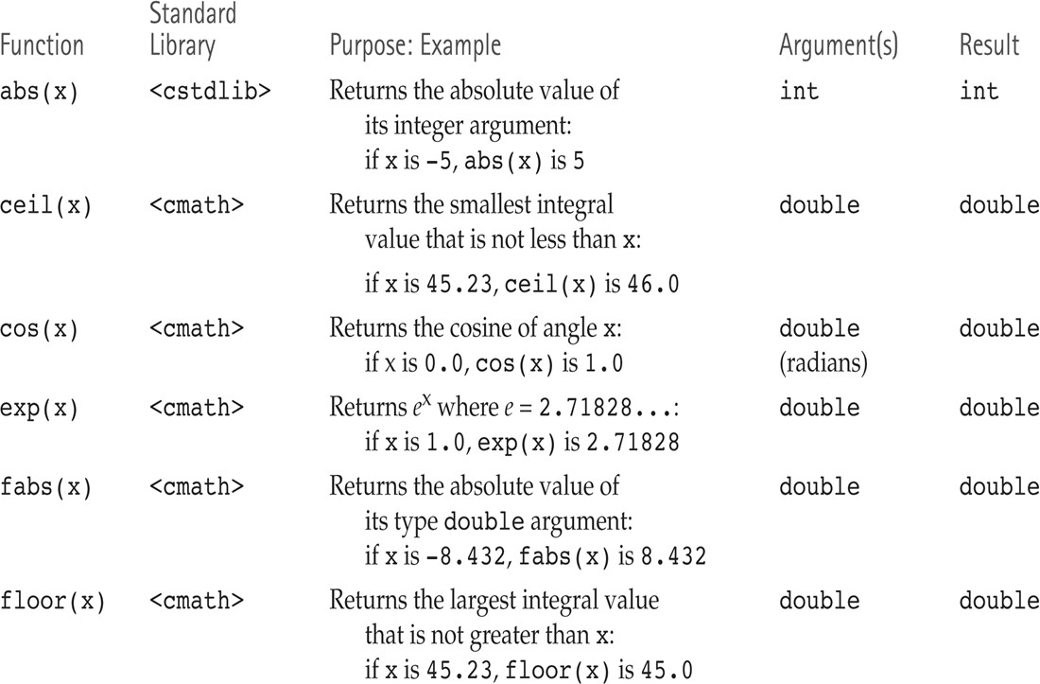
Some Mathematical Library Functions
05
Operators
01285960031
01285960031
www.roboticscorner.tech

Slide 63
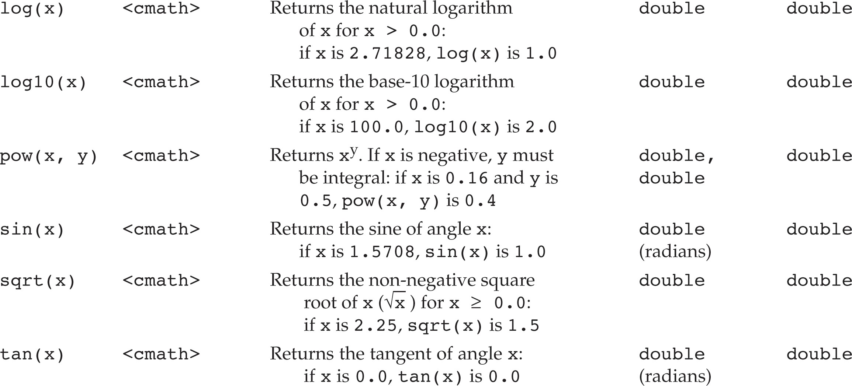
05
Operators
01285960031
01285960031
www.roboticscorner.tech

Slide 64
Example
05
Operators
#include <iostream> #include <cmath> using namespace std; int main() {
cout << "Enter Quadratic coefficients: "; double a, b, c;
cin >> a >> b >> c;
if ( (a != 0) && (b*b - 4*a*c > 0) ) {
double radical = sqrt(b*b - 4*a*c); double root1 = (-b + radical) / (2*a); double root2 = (-b - radical) / (2*a);
cout << "Roots: " << root1 << " " << root2;
}
else {
cout << "Does not have two real roots";
}
return 0;
}
01285960031
01285960031
www.roboticscorner.tech

Slide 65
05
Operators
/*
This program computes the volume (in liters) of a six-pack of soda cans and the total volume of a six-pack and a two- liter bottle.
*/
int main()
{
int cans_per_pack = 6;
const double CAN_VOLUME = 0.355; // Liters in a can double total_volume = cans_per_pack * CAN_VOLUME;
cout << "A six-pack of 12 cans contains "
<< total_volume << " liters." << endl;
const double BOTTLE_VOLUME = 2; // Two-liter bottle
total_volume = total_volume + BOTTLE_VOLUME;
cout << "A six-pack and a two-liter bottle contain "
<< total_volume << " liters." << endl;
return 0;
}
01285960031
01285960031
www.roboticscorner.tech

Slide 66
Common Error – Omitting Semicolons
06
Common Errors
Common error
Omitting a semicolon (or two)
Oh No!
1 #include <iostream> 2
3 using namespace std; 4
5 int main() 6 {
7
8
9 }
cout << "Hello, World!" << endl return 0;
01285960031
01285960031
www.roboticscorner.tech

Slide 67
06
Common Errors
Suppose you (accidentally of course) wrote:
cot << "Hello World!" << endl;
This will cause a compile-time error and the compiler will complain that it has no clue what you mean by cot.
The exact wording of the error message is dependent on the compiler, but it might be something like
“Undefined symbol cot”.
01285960031
01285960031
www.roboticscorner.tech

Slide 68
Consider this:
06
Common Errors
cout << "Hollo, World!" << endl;
Logic errors or run-time errors are errors in a program that compiles (the syntax is correct), but executes without performing the intended action.
not really an error?
01285960031
01285960031
www.roboticscorner.tech

Slide 69
Common Error – Using Undefined Variables
06
Common Errors
You must define a variable before you use it for the first time. For example, the following sequence of statements would not be legal:
double can_volume = 12 * liter_factor; double liter_factor = 0.0296;
?
Statements are compiled in top to bottom order.
When the compiler reaches the first statement, it does not know that liter_factor will be defined in the next line, and it reports an error.
01285960031
01285960031
www.roboticscorner.tech

Slide 70
Common Error – Using Uninitialized Variables
06
Common Errors
Initializing a variable is not required, but there is always a value in every variable, even uninitialized ones.
Some value will be there, the flotsam left over from some previous calculation or simply the random value there
when the transistors in RAM were first turned on.
int bottles; // Forgot to initialize
int bottle_volume = bottles * 2;// Result is unpredictable
What value would be output from the following statement?
cout << bottle_volume << endl; // Unpredictable
01285960031
01285960031
www.roboticscorner.tech

Slide 71



06
Common Errors
Common Error – Unintended Integer Division
It is unfortunate that C++ uses the same symbol: /
for both integer and floating-point division. These are really quite different operations.
It is a common error to use integer division by accident.
Consider this segment that computes the average of three integers:
cout << "Please enter your last three test scores: ";
int s1;
int s2;
int s3;
cin >> s1 >> s2 >> s3;
double average = (s1 + s2 + s3) / 3;
cout << "Your average score is " << average << endl;
01285960031
01285960031
www.roboticscorner.tech

Slide 72
06
Common Errors
What could be wrong with that?
Of course, the average of s1, s2, and s3 is
(s1+ s2+ s3) / 3
Here, however, the / does not mean division in the mathematical sense.
It denotes integer division because
both (s1 + s2 + s3)and 3 are integers.
01285960031
01285960031
www.roboticscorner.tech

Slide 73
06
Common Errors
For example, if the scores add up to 14, the average is computed to be 4.
WHAT?
Yes, the result of the integer division of 14 by 3 is 4
How many times does 3 evenly divide into 14? Right!
That integer 4 is then moved into the floating-point variable average.
So 4.0 is stored.
That’s not what we want!
01285960031
01285960031
www.roboticscorner.tech

Slide 74
The remedy is to make the numerator or denominator into a floating-point number:
06
Common Errors
double total = s1 + s2 + s3; double average = total / 3;
or
double average = (s1 + s2 + s3) / 3.0;
01285960031
01285960031
www.roboticscorner.tech

Slide 75
06
Common Errors
Common Error – Unbalanced Parentheses
Consider the expression
(-(b * b - 4 * a * c) / (2 * a)
?
What is wrong with it?
The parentheses are unbalanced.
This is very common with complicated expressions.
01285960031
01285960031
www.roboticscorner.tech

Slide 76
06
Common Errors
Common Error – Roundoff Errors
This program produces the wrong output:
#include <iostream> using namespace std; int main()
{
double price = 4.35;
int cents = 100 * price;
// Should be 100 * 4.35 = 435 cout << cents << endl;
// Prints 434!
Return 0;
}
Why?
01285960031
01285960031
www.roboticscorner.tech

Slide 77
Common Error – Roundoff Errors
06
Common Errors
In the computer, numbers are represented in the binary number system, not in decimal.
In the binary system, there is no exact representation for 4.35, just as there is no exact representation for ⅓ in the decimal system.
The representation used by the computer is just a little less than 4.35, so 100 times that value is just a little less than 435.
The remedy is to add 0.5 in order to round to the nearest integer:
int cents = 100 * price + 0.5;
01285960031
01285960031
www.roboticscorner.tech

Slide 78


Slide 79

01211626904
www.roboticscorner.tech
Robotics Corner
Robotics Corner
Robotics Corner
Robotics Corner
01285960031
01285960031
www.roboticscorner.tech

