Slide 1

Namespaces
Mohamed Saied

Slide 2
Namespace
// A program to demonstrate need of namespace
int main()
{
int value;
value = 0;
double value; // Error here value = 0.0;
}

Slide 3
Namespace 2
// Here we can see that more than one variables
// are being used without reporting any error.
// That is because they are declared in the
// different namespaces and scopes.
#include <iostream> using namespace std;
// Variable created inside namespace namespace first
{
int val = 500;
}
// Global variable
int val = 100;
int main()
{
// Local variable
int val = 200;
// These variables can be accessed from
// outside the namespace using the scope
// operator ::
cout << first::val << '\n';
return 0;
}

Slide 4
Namespace 3
// Creating namespaces #include <iostream> using namespace std; namespace ns1
{
int value() { return 5; }
}
namespace ns2
{
const double x = 100;
double value() { return 2*x; }
}
int main()
{
// Access value function within ns1
cout << ns1::value() << '\n';
// Access value function within ns2
cout << ns2::value() << '\n';
// Access variable x directly
cout << ns2::x << '\n';
return 0;
}

Slide 5
For loops
for (initialization; condition; update) { // body of-loop }
initialization - initializes variables and is executed only once
condition - if true, the body of for loop is executed if false, the for loop is terminated
update - updates the value of initialized variables and again checks the condition

Slide 6
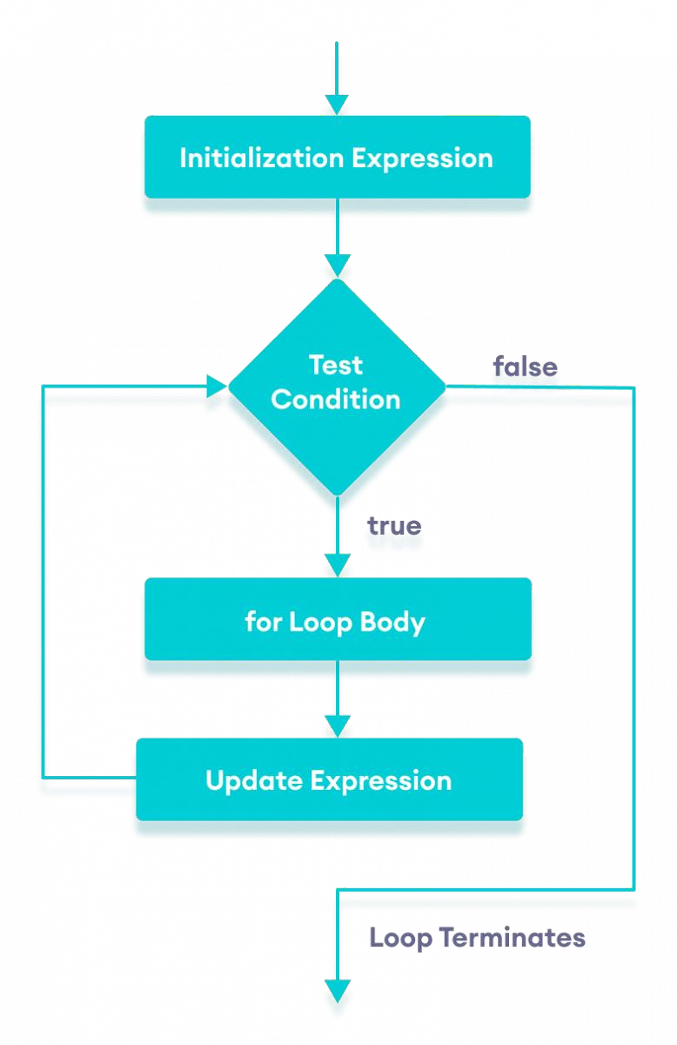

Slide 7
Range based for loops c++11
// the initializer may be a braced-init-list
for (int n : {0, 1, 2, 3, 4, 5}) std::cout << n << ' ';
std::cout << '\n';
// Iterating over array
int a[] = {0, 1, 2, 3, 4, 5};
for (int n : a)
std::cout << n << ' ';
std::cout << '\n';
// Just running a loop for every array
// element
for (int n : a)
std::cout << "In loop" << ' ';

Slide 8
Memory Management

Slide 9
Outline
The Course consists of the following topics:
  Memory Layout
  Stack
  Call Stack
  Data Segment
  Heap
  Rodata segment
9

Slide 10
Outline
The Course consists of the following topics:
  Memory Layout
  Stack
  Call Stack
  Data Segment
  Heap
  Rodata segment
10

Slide 11
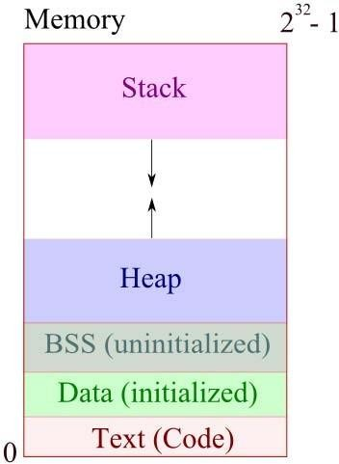
Memory Layout
Memory Layout diagram courtesy of bogotobogo.com

Slide 12
Outline
The Course consists of the following topics:
  Memory Layout
  Stack
  Call Stack
  Data Segment
  Heap
  Rodata segment
12

Slide 13
Outline
The Course consists of the following topics:
  Memory Layout
  Stack
  Call Stack
  Data Segment
  Heap
  Rodata segment
13

Slide 14
Stack
Stack contains local variables from functions and related book-keeping data. LIFO structure.
▫ Function variables are pushed onto stack when called.
▫ Functions variables are popped off stack when return.

Slide 15
Outline
The Course consists of the following topics:
  Memory Layout
  Stack
  Call Stack
  Data Segment
  Heap
  Rodata segment
15

Slide 16
Outline
The Course consists of the following topics:
  Memory Layout
  Stack
  Call Stack
  Data Segment
  Heap
  Rodata segment
16

Slide 17
Call Stack
Example: DrawSquare called from main()
void DrawSquare(int i){
int start, end, …. //other local variables
DrawLine(start, end);
}
void DrawLine(int start, int end){
//local variables
...
}

Slide 18
Call Stack
Example:
void DrawSquare(int i){
Lower address
int start, end, …. //other local variables
DrawLine(start, end);
}
void DrawLine(int start, int end){
//local variables
...
}
Top of Stack
Higher address

Slide 19
Call Stack
Example: DrawSquare is called in main void DrawSquare(int i){
int start, end, ... DrawLine(start, end);
}
void DrawLine(int start, int end){
//local variables
...
}
Lower address
Top of Stack
int i (DrawSquare arg)
Higher address

Slide 20
Call Stack
Example:
void DrawSquare(int i){
int start, end, ... DrawLine(start, end);
}
void DrawLine(int start, int end){
//local variables
...
}
Lower address
Top of Stack
main() book-keeping
int i (DrawSquare arg)
Higher address

Slide 21
Call Stack
Example:
void DrawSquare(int i)
{
int start, end, ...
DrawLine(start, end);
}
void DrawLine(int start, int end)
{
Lower address
Top of Stack
local variables (start, end)
main() book-keeping
int i (DrawSquare arg)
Higher address
DrawSquare StackFrame
//local variables
...
}

Slide 22
Call Stack
Example:
void DrawSquare(int i){
Lower address
int start, end, ... DrawLine(start, end);
Top of Stack
start, end (DrawLine args)
local variables (start, end)
main() book-keeping
int i (DrawSquare arg)
Higher address
}
void DrawLine(int start, int end)
{
//local variables
...
DrawSquare
Stack Frame
}

Slide 23
Call Stack
Lower address
Example:
void DrawSquare(int i){ int start, end, ...
DrawLine(start, end);
}
void DrawLine(int start, int end)
{
Top of Stack
DrawSquare book-keeping
start, end (DrawLine args)
local variables (start, end)
main() book-keeping
int i (DrawSquare arg)
Higher address
DrawSquare Stack Frame
//local variables
...
}

Slide 24
Call Stack
Lower address
Top of Stack
Example:
void DrawSquare(int i){
int start, end, ... DrawLine(start, end);
}
DrawLine local vars
DrawSquare book-keeping
start, end (DrawLine args)
local variables (start, end)
main() book-keeping
int i (DrawSquare arg)
Higher address
DrawLine
Stack Frame
void DrawLine(int start, int end){
//local variables
DrawSquare Stack Frame
...
}

Slide 25
Call Stack
Lower address
Top of Stack
Example: DrawLine returns void DrawSquare(int i){ int start, end, ...
DrawLine(start, end);
}
DrawLine local vars
DrawSquare book-keeping
start, end (DrawLine args)
local variables (start, end)
main() book-keeping
int i (DrawSquare arg)
Higher address
DrawLine
Stack Frame
void DrawLine(int start, int end){
//local variables
...
}
DrawSquare Stack Frame

Slide 26
Call Stack
Example: DrawLine returns void DrawSquare(int i){ int start, end, ...
DrawLine(start, end);
}
void DrawLine(int start, int end)
Lower address
Top of Stack
local variables (start, end)
main() book-keeping
int i (DrawSquare arg)
Higher address
{
//local variables
...
}
DrawSquare Stack Frame

Slide 27
Call Stack
Example: DrawSquare returns void DrawSquare(int i){
int start, end, ... DrawLine(start, end);
}
void DrawLine(int start, int end){
//local variables
Lower address
Top of Stack
local variables (start, end)
main() book-keeping
int i (DrawSquare arg)
Higher address
...
DrawSquare Stack frame
}

Slide 28
Call Stack
Example: DrawSquare returns
void DrawSquare(int i){ int start, end,
...
DrawLine(start, end);
}
void DrawLine(int start, int end){
//local variables
…
}
Lower address
Top of Stack
Higher address

Slide 29
Reference
A reference variable is an alias, that is, another name for an already existing variable. Once a reference is initialized with a variable, either the variable name or the reference name may be used to refer to the variable.

Slide 30
Reference Vs Pointers
References are often confused with pointers but three major differences between references and pointers are −
You cannot have NULL references. You must always be able to assume that a reference is connected to a legitimate piece of storage.
Once a reference is initialized to an object, it cannot be changed to refer to another object. Pointers can be pointed to another object at any time.
A reference must be initialized when it is created. Pointers can be initialized at any time.

Slide 31
Pointers
A variable that holds the address of another variable

