Slide 1


Robotics Corner

Slide 2
Robotics Corner
Introduction to Embedded Systems

Slide 3

01
Introduction
02
What is an Embedded System?
AGENDA
03
Embedded System Applications
04
Course Outline
05
Hardware Components
Robotics Corner

Slide 4
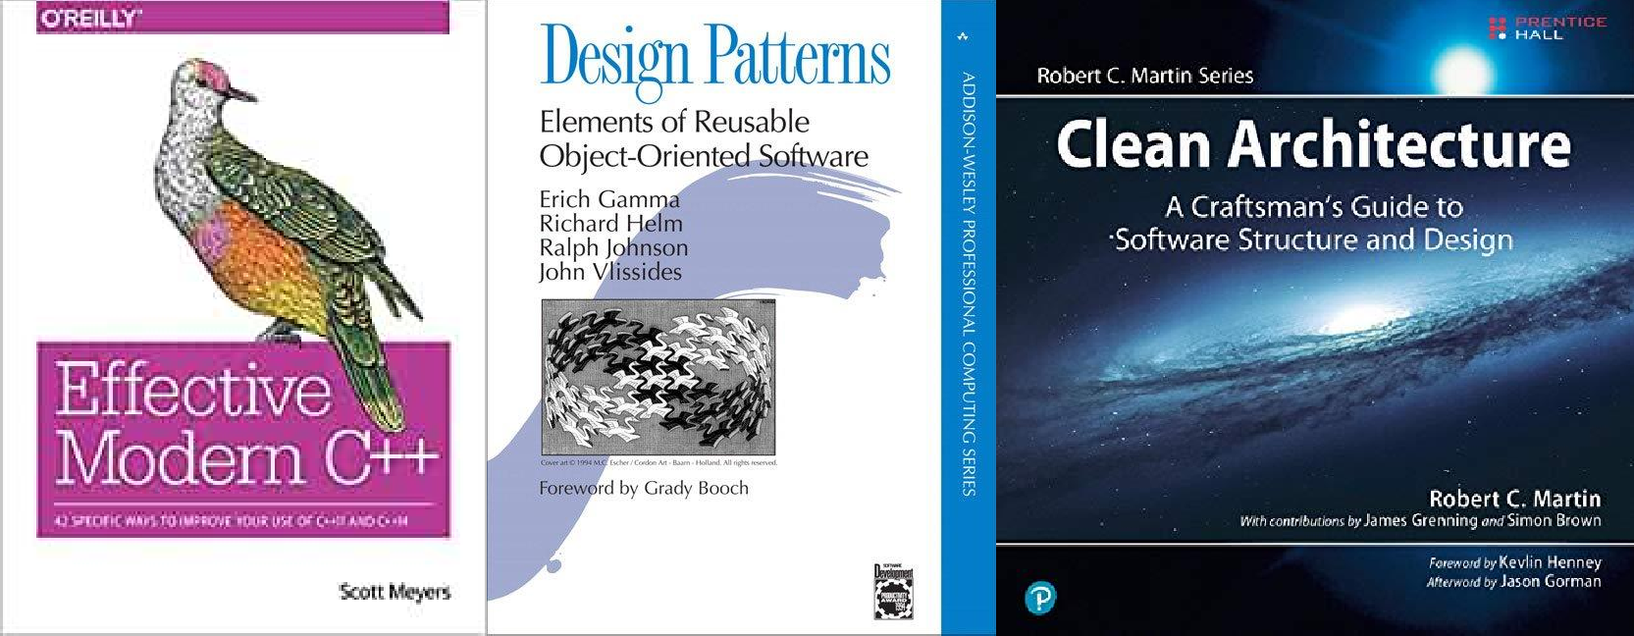
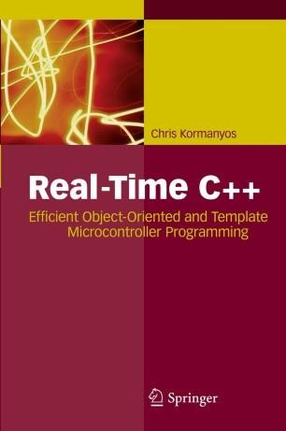
01
Introduction
Books

Slide 5
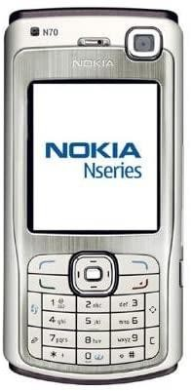
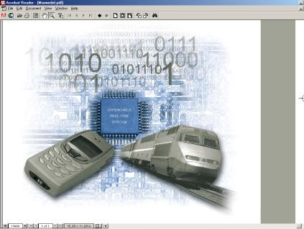


02
What is an Embedded System?
Embedded systems =
🞄 information processing systems embedded into a larger product
Two types of computing
🞄 Desktop – produced millions/year
🞄 Embedded – billions/year
Non-Embedded Systems
🞄 PCs, servers, and notebooks
The future of computing!
🞄 Automobiles, entertainment, communication, aviation, handheld devices, military and medical equipment.

Slide 6

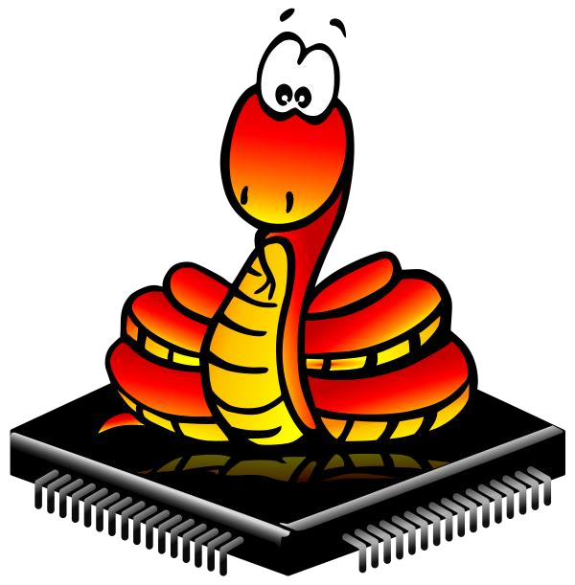

02
What is an Embedded System?
Languages of Embedded Systems

Slide 7
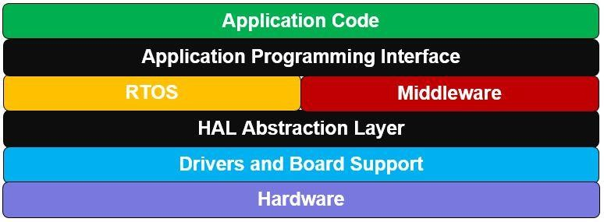
02
What is an Embedded System?
Where to find C++

Slide 8
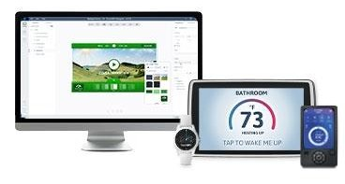
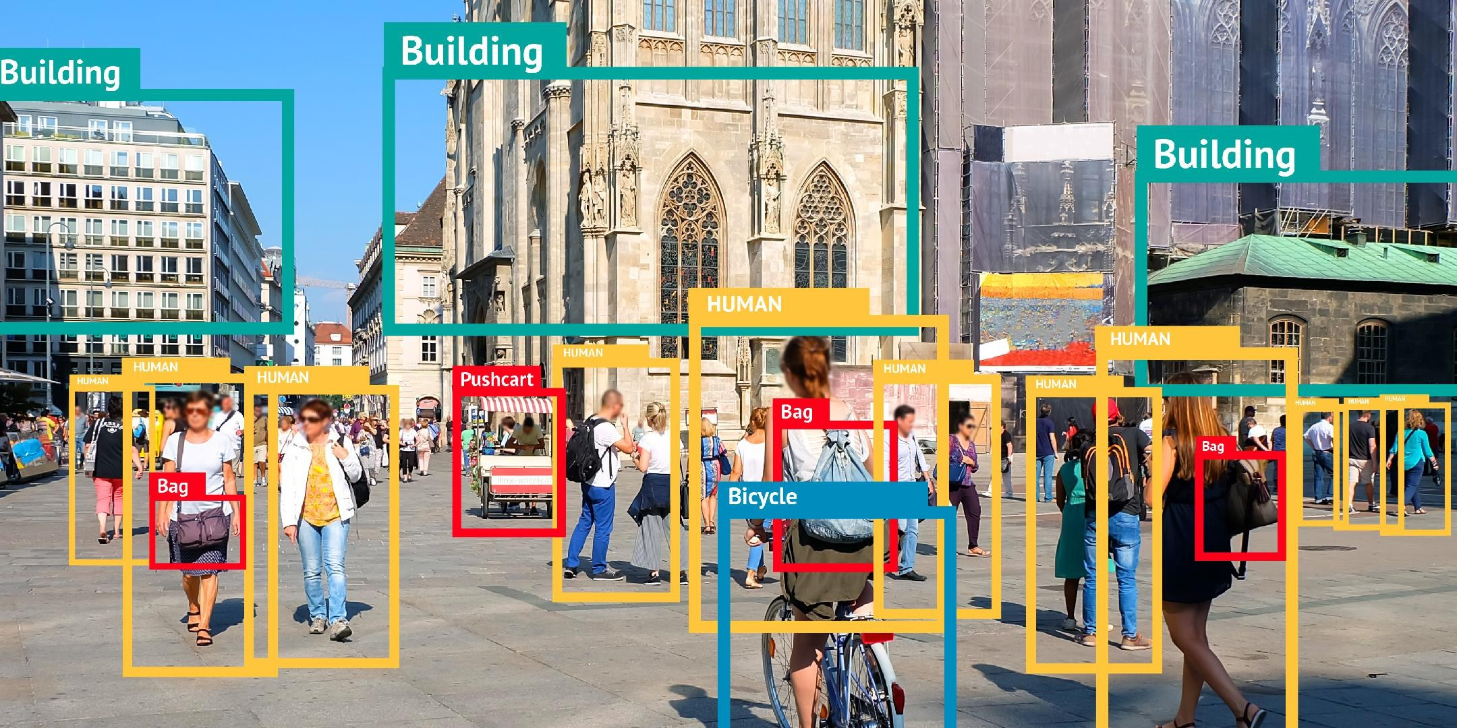
02
What is an Embedded System?
Where to find C++

Slide 9
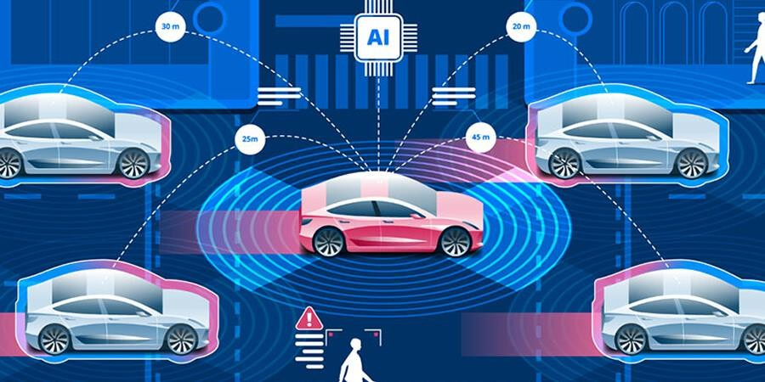

02
What is an Embedded System?
Connected Cars

Slide 10
02
What is an Embedded System?
Embedded Systems
Devices other than desktop PCs, servers, and notebooks
🞄 Electricity running through
🞄 Perform something intelligent
Hardware/software which form a component of a larger system, but are concealed from user
Computers camouflaged as non-computers
The future of computing!

Slide 11

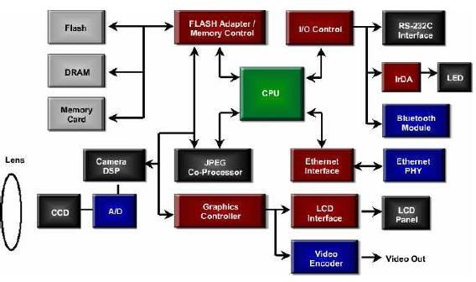
03
Embedded System Applications
An Example Embedded System
Digital Camera Block Diagram

Slide 12

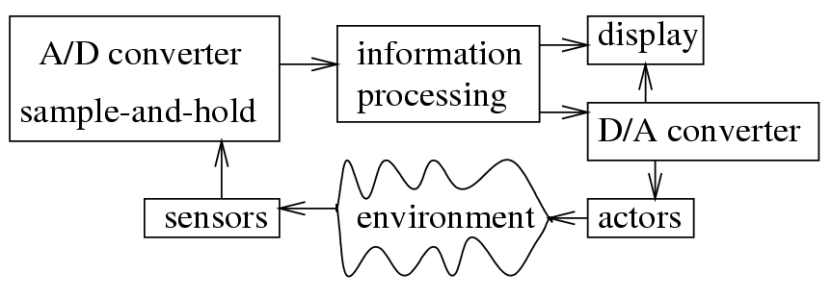


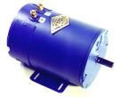
03
Embedded System Applications
ES: Simplified Block Diagram
actuators

Slide 13



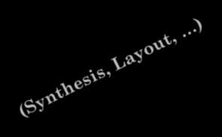



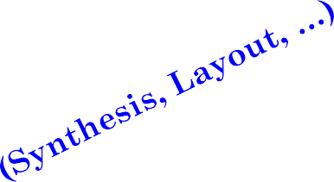








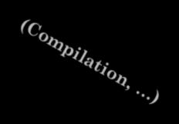



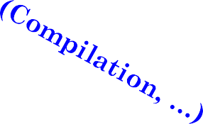

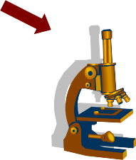

04
Course Outline
Hardware Components
Hardware
HW/SW
Partitioning
Concept
Specification
Estimation - Exploration
Software Components
Software
Winter 2010- CS 244
Validation and Evaluation (area, power, performance, …)

Slide 14


04
Course Outline
Modern Software Engineering Practices

Slide 15
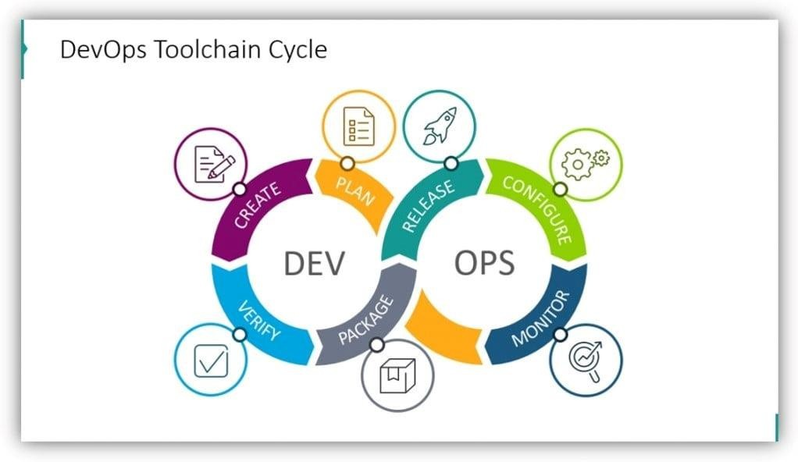
04
Course Outline
Continuous Integration CI

Slide 16
04
Course Outline
Components of Embedded Systems
Analog Components
Sensors, Actuators, Controllers, …
Digital Components
Hardware
Processor, Coprocessors
Memories
Controllers, Buses
Application Specific Integrated Circuits (ASIC)
Converters – A2D, D2A, …
Software
Software
Application Programs
Exception Handlers
14

Slide 17
Hardware Components of Embedded Systems- an example
Memory Controllers
Interface
Software
(Application Programs)
Coprocessors
Processor
ASIC
Converters
Analog
Digital
Analog

Slide 18
05
Hardware Components
Processors
What is a processor?
Artifact that computes (runs algorithms)
Controller and data-path
General-purpose (GP) processors:
Variety of computation tasks
Functional flexibility and low cost at high volumes (maybe)
Slow and power hungry
Single-purpose (SP) processors (or ASIC)
One particular computation task
Fast and power efficient
Functional inflexibility and high cost at low volumes (maybe)

Slide 19
05
Hardware Components
GP/SP Processor Architecture
Data-Path
Status
Controller
Data Input
Control
Data Output
Control

Slide 20
05
Hardware Components
General-purpose processors
Programmable device used in a variety of applications
🞄 Also known as “microprocessor”
Features
🞄 Program memory
🞄 General datapath with large register
file and general ALU
User benefits
🞄 Low time-to-market and NRE costs
🞄 High flexibility
Examples
🞄 Pentium, Athlon, PowerPC
Controller
Datapath
Control logic and State register
IR |  |  | PC
Registers
Custom ALU
Data memory
Program
memory
Assembly code
for:
total = 0
for i =1 to …
Winter 2010- CS 244

Slide 21
05
Hardware Components
Application-specific IS processors (ASIPs)
Programmable
processor optimized for a particular class of applications having common characteristics
Compromise between general-purpose and ASIC (custom hardware)
Controller
Datapath
Program memory
Optimized datapath
Special functional units
Control logic and State register
IR |  |  | PC
Registers
Custom ALU
Features
Some flexibility, good performance, size and power
Benefits
Data memory
Program
memory
Assembly code
for:
total = 0
for i =1 to …
Winter 2010- CS 244
DSPs, Video Signal Processors, Network Processors,..
Examples

Slide 22
05
Hardware Components
Application-Specific ICs (ASICs)
Digital circuit designed to execute exactly one program
coprocessor, hardware accelerator
Controller
Datapath
Control logic
State register
index
total
Features
+
Contains only the components needed to execute a
single program
No program memory
Data memory
Benefits
Fast
Low power
Small size

Slide 23
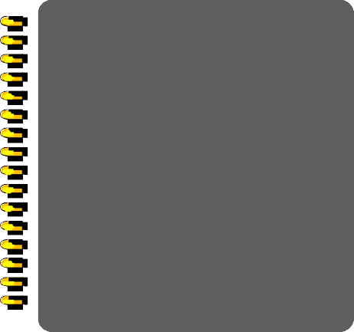
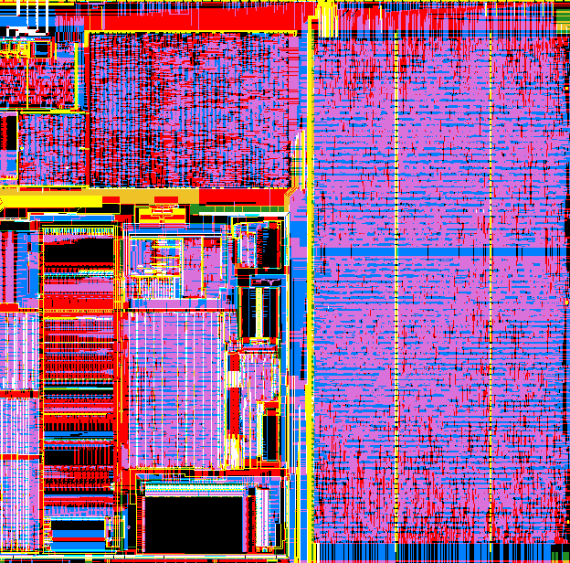



05
Hardware Components
Application Specific Circuits (ASIC)
Custom-designed circuits necessary if ultimate speed or energy efficiency is the goal and large numbers can be sold.
Approach suffers from long design times and high costs.
Winter 2010- CS 244

Slide 24
05
Hardware Components
GP vs. SP Processors
GP:
Programmable controller
🞄 Control logic is stored in memory
🞄 Fetch/decode overhead
Highly general data-path
🞄 Typical bit-width (8, 16, 32, 64)
🞄 Complete set of arithmetic/logic units
🞄 Large set of registers
High NRE/sale-volume
ASIC:
Hardwired controller
🞄 No need for program memory and cache
🞄 No fetch/decode overhead
Highly tuned data-path
🞄 Custom bit-width
🞄 Custom arithmetic/logic units
🞄 Custom set of registers
Low NRE/sale-volume

Slide 25



05
Hardware Components
Storage
Artifact that stores bits Storage fabric and access logic
Manner and speed a memory can be written ability of memory to hold stored bits after they are
written
What is a memory?
Write-ability Storage-permanence
Many different types of memories
Common to compose memories
Flash, SRAM, DRAM, etc.

Slide 26
05
Hardware Components
Write-ability
Ranges of write ability
🞄 High end
🞄 Processor writes to memory simply and quickly
🞄 E.g., RAM
🞄 Middle range
🞄 Processor writes to memory, but slower
🞄 E.g., FLASH, EEPROM
🞄 Lower range
🞄 Special equipment, “programmer”, must be used to write to memory
🞄 E.g., EPROM, OTP ROM
🞄 Low end
🞄 Bits stored only during fabrication
🞄 E.g., Mask-programmed ROM

Slide 27
05
Hardware Components
Storage-permanence
Range of storage permanence
🞄 High end
🞄 Essentially never loses bits
🞄 E.g., mask-programmed ROM
🞄 Middle range
🞄 Holds bits days/months/years after memory’s
power source turned off
🞄 E.g., NVRAM
🞄 Lower range
🞄 Holds bits as long as power supplied to memory
🞄 E.g., SRAM
🞄 Low end
🞄 Begins to lose bits almost immediately after written
🞄 E.g., DRAM

Slide 28


05
Hardware Components
Memory Types
_{Mask-programmed ROM} In-system programmable
Ideal
Storage-permanence
OTP ROM
EPROM
EEPROM
Flash
NVRAM
Nonvolatile
SRAM/DRAM
Write-ability

Slide 29
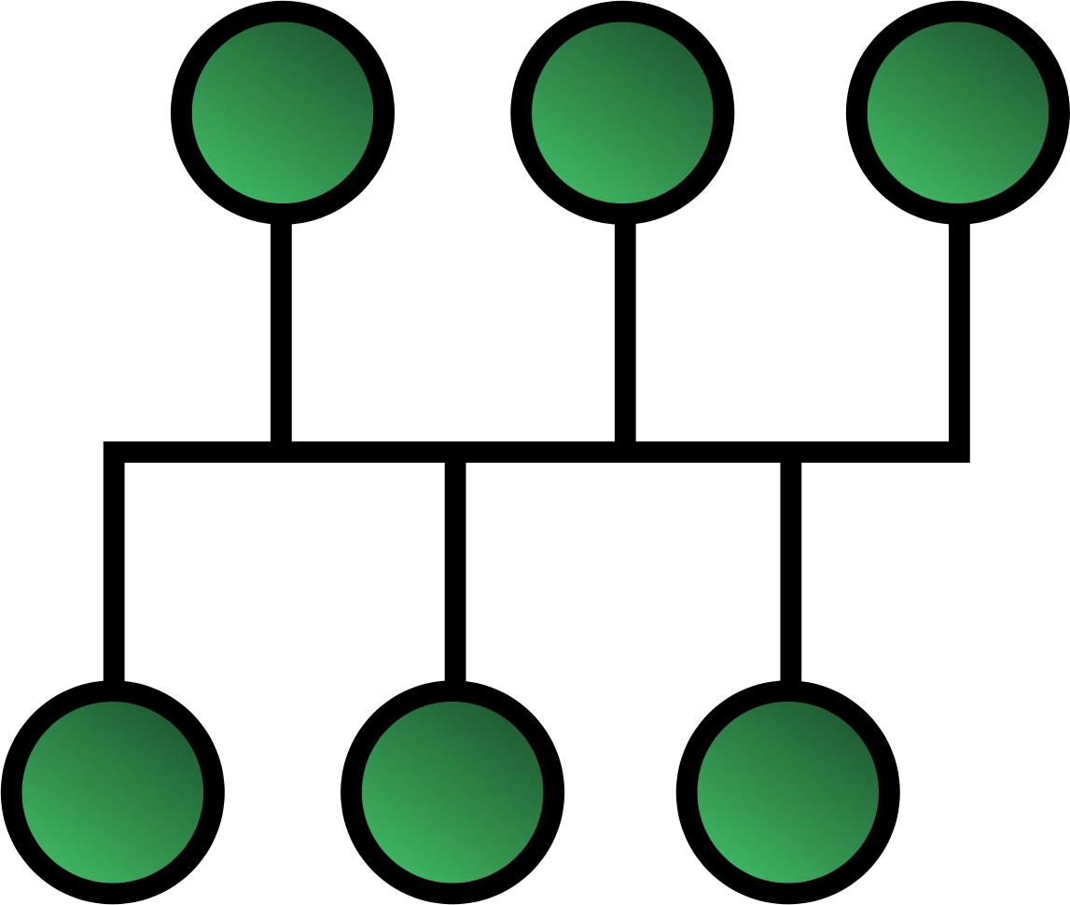
05
Hardware Components
Communication
What is a bus?
🞄 An artifact that transfers bits
🞄 Wires, air, or fiber and interface logic
Associated with a bus, we have:
🞄 Connectivity scheme
🞄 Serial Communication
🞄 Parallel Communication
🞄 Wireless Communication
🞄 Protocol
🞄 Ports
🞄 Timing Diagrams
🞄 Read and write cycles
🞄 Arbitration scheme, error detection/correction, DMA, etc.

Slide 30
05
Hardware Components
Serial Communication
A single wire used for data transfer
One or more additional wires used for control (but, some protocols may not use additional control wires)
Higher throughput for long distance communication
Often across processing node
Lower cost in terms of wires (cable)
E.g., USB, Ethernet, RS232, I²C, etc.

Slide 31
05
Hardware Components
Parallel Communication
Multiple buses used for data transfer
One or more additional wires used for control
Higher throughput for short distance communication
🞄 Data misalignment problem
🞄 Often used within a processing node
Higher cost in terms of wires (cable)
E.g., ISA, AMBA, PCI, etc.

Slide 32
05
Hardware Components
Wireless Communication
Infrared (IR)
Electronic wave frequencies just below visible light spectrum
Diode emits infrared light to generate signal
Infrared transistor detects signal, conducts when exposed to infrared light
Cheap to build
Need line of sight, limited range
Radio frequency (RF)
Electromagnetic wave frequencies in radio spectrum
Analog circuitry and antenna needed on both sides of transmission
Line of sight not needed, transmitter power determines range
Winter 2010- CS 244

Slide 33

05
Hardware Components
Peripherals
Perform specific computation task
Custom single-purpose processors
Designed by us for a unique task
Winter 2010- CS 244
Standard single-purpose processors
“Off-the-shelf”
pre-designed for a common task

Slide 34
05
Hardware Components
Timers
Timers: measure time intervals
🞄 To generate timed output events
🞄 To measure input events
🞄 Top: max count reached
Range and resolution
Basic timer
16-bit up counter
16
Cnt
Clk
Top
Reset
Winter 2010- CS 244

Slide 35
05
Hardware Components
Counters
Counter: like a timer, but counts pulses on a general input signal rather than clock
Timer/counter
Clk
2x1
mux
16-bit up
counter
Cnt
16
🞄 e.g., count cars passing over a sensor
🞄 Can often configure device as either a timer or counter
Cnt_in
Top
Reset
Mode
Winter 2010- CS 244

Slide 36
05
Hardware Components
Watchdog Timer
Must reset timer every X time unit, else timer generates a signal
Common use: detect failure, self-reset
Winter 2010- CS 244

Slide 37
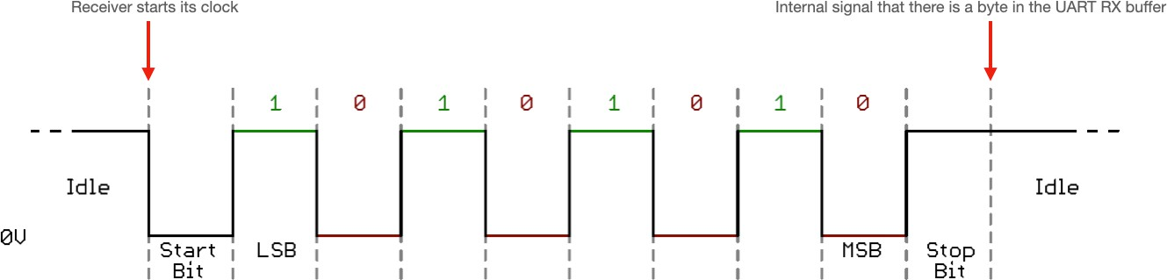
05
Hardware Components
UART
UART: Universal Asynchronous Receiver Transmitter
Takes parallel data and transmits serially
Receives serial data and converts to parallel
Parity: extra bit for simple error checking
Start bit, stop bit Baud rate
Signal changes per second
Bit rate, sometimes different
Winter 2010- CS 244

Slide 38
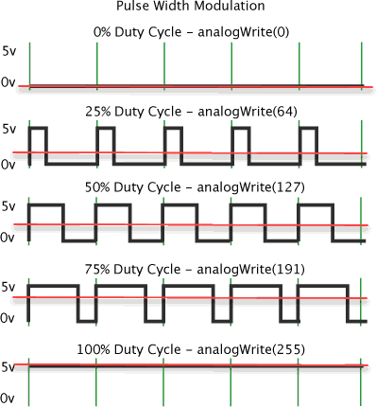
05
Hardware Components
Pulse Width Modulator (PWM)
Generates pulses with specific high/low times
Duty cycle: % time high
🞄 Square wave: 50% duty cycle
Common use: control average voltage to an electric device
🞄 Simpler than a DC-DC converter or digital-analog converter
🞄 DC motor speed, dimmer lights

Slide 39
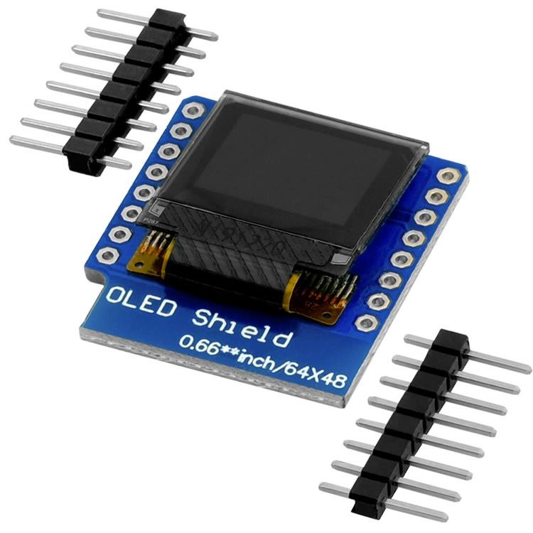
05
Hardware Components
LCD and OLED
Liquid Crystal Display
N rows by M columns
Controller build into the LCD module
Simple microprocessor interface using ports
Software controlled
Organic Light emitting Diodes
N rows by M columns
Communicates over serial
Software controlled

Slide 40
05
Hardware Components
Keypad
N1 N2 N3 N4
k_pressed
M1 M2
M3 M4
4
key_code
key_code
keypad controller
N=4, M=4

Slide 41
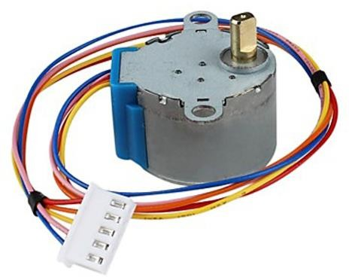
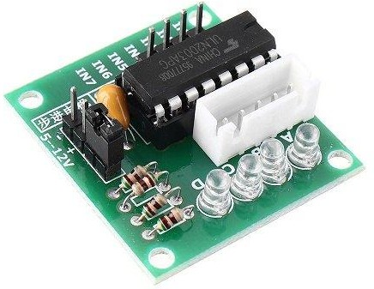
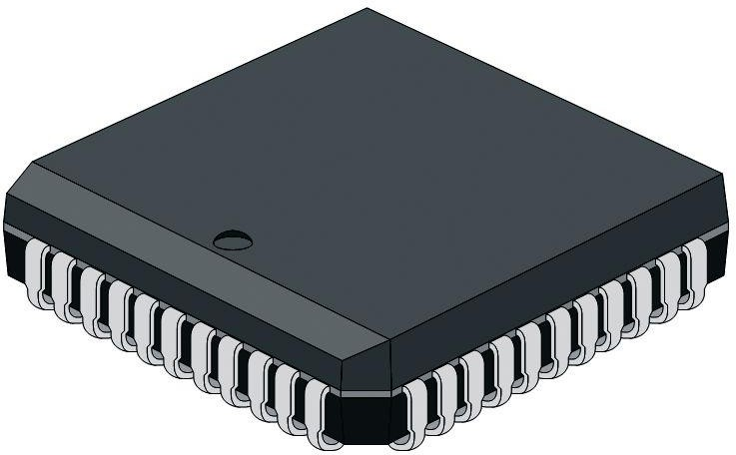
05
Hardware Components
Stepper Motor Controller
Stepper motor: rotates fixed number of degrees when given a “step” signal
🞄 In contrast, DC motor just rotates when power applied, coasts to stop
Rotation achieved by applying specific voltage sequence to coils
Controller greatly simplifies this

Slide 42
05
Hardware Components
Analog-to-Digital Converter
V_{max} = 7.5V
7.0V
6.5V
6.0V
5.5V
1111
1110
1101
1100
1011
1010
1001
1000
0111
0110
0101
0100
0011
0010
0001
0000
4
4
3
3
analog input (V)
analog output (V)
5.0V
4.5V
4.0V
3.5V
2
2
1
1
3.0V
2.5V
2.0V
1.5V
1.0V
0.5V
0V
time
time
t1
t2
t3
t4
t1
t2
t3
t4
0100 1000 0110 0101
Digital output
0100 1000 0110 0101
Digital input
proportionality
Analog to Digital (A/D)
Digital to Analog (D/A)

Slide 43
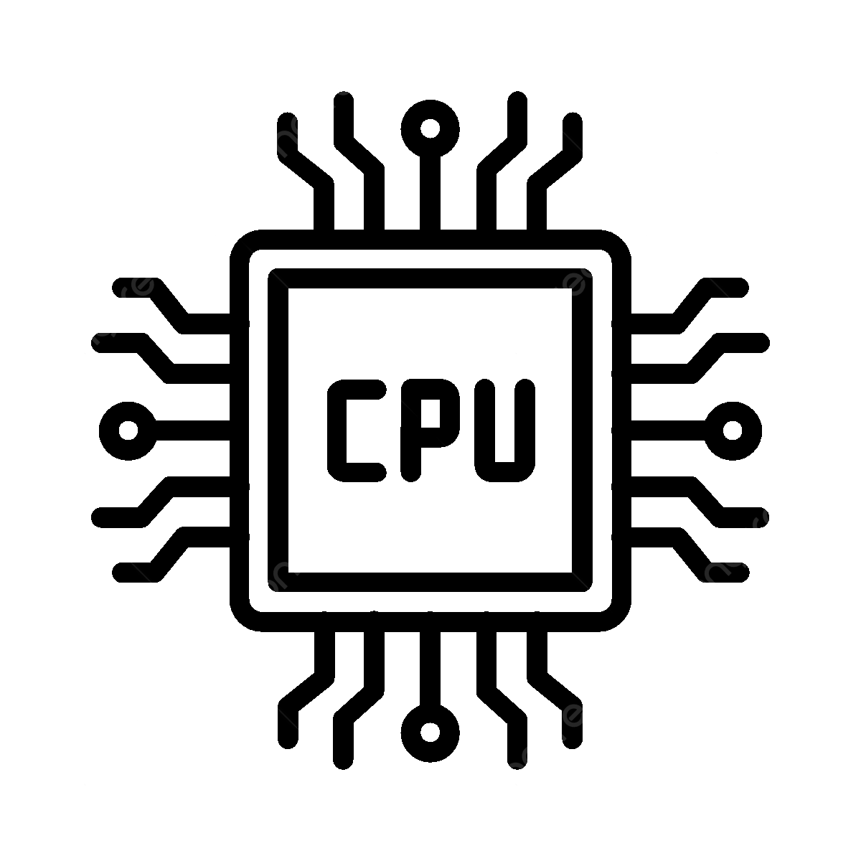


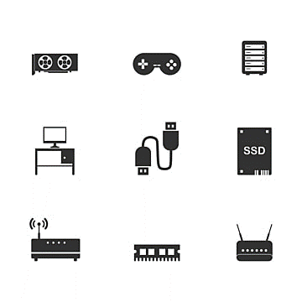
05
Hardware Components
Summary
Hardware: Information Processing
Processors
Memories
Communication
Peripherals

Slide 44


