Slide 1


0
10
9
8
7
6
5
4
3
2
1

Slide 2

Robotics Corner

Slide 3
Robotics Corner
Lesson Topic
Unique intro to the lesson and what it’s talking about.

Slide 4
01
Objectives
02
While loop
AGENDA
03
For loop
04
break & continue
05
Nested Control Structures
Robotics Corner

Slide 5


01
Objectives
In this chapter, you will:
Learn about repetition (looping) control structures
Explore how to construct and use count-controlled, sentinel-controlled, flag-controlled, and EOF-controlled repetition structures
Examine break and continue statements
Discover how to form and use nested control structures
01285960031
01285960031
www.roboticscorner.tech

Slide 6
Why Is Repetition Needed?
01
Objectives
Repetition allows you to efficiently use variables
Can input, add, and average multiple numbers using a limited number of variables
For example, to add five numbers:
  Declare a variable for each number, input the numbers and add the variables together
  Create a loop that reads a number into a variable and adds it to a variable that contains the sum of the numbers
01285960031
01285960031
www.roboticscorner.tech

Slide 7
02
While Loop
The general form of the while statement is:
while (expression) statement
while is a reserved word
Statement can be simple or compound
Expression acts as a decision-maker and is usually a logical expression
Statement is called the body of the loop
The parentheses are part of the syntax
01285960031
01285960031
www.roboticscorner.tech

Slide 8
02
While Loop
Expression provides an entry condition
Statement executes if the expression initially evaluates to true
Loop condition is then reevaluated
Statement continues to execute until the expression is no longer true
Infinite loop: continues to execute endlessly
Can be avoided by including statements in the loop body that assure exit condition will eventually be false
01285960031
01285960031
www.roboticscorner.tech

Slide 9
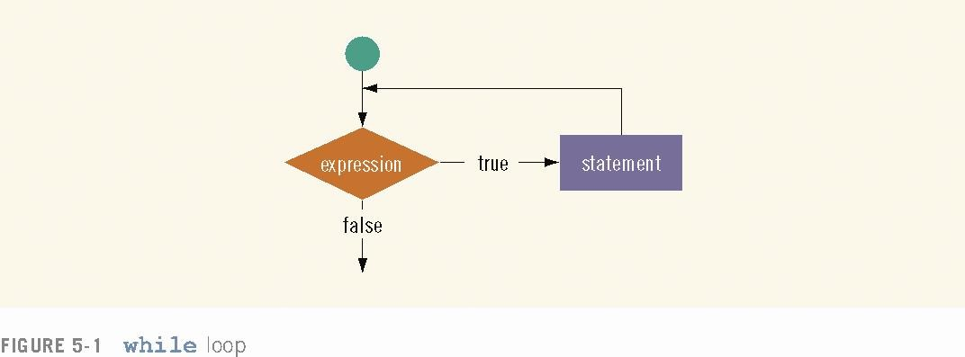
02
While Loop
01285960031
01285960031
www.roboticscorner.tech

Slide 10
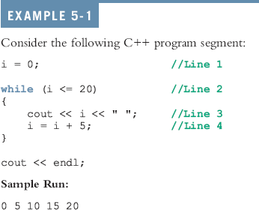
02
While Loop
01285960031
01285960031
www.roboticscorner.tech

Slide 11
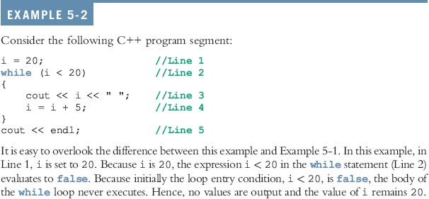
02
While Loop
01285960031
01285960031
www.roboticscorner.tech

Slide 12
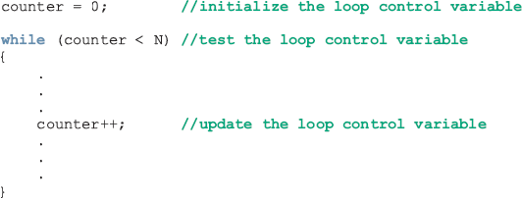
Counter-Controlled while Loops
02
While Loop
If you know exactly how many pieces of data need to be read, the while loop becomes a counter-controlled loop
01285960031
01285960031
www.roboticscorner.tech

Slide 13
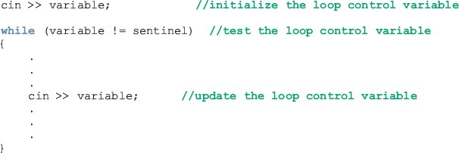
Sentinel-Controlled while Loops
02
While Loop
Sentinel variable is tested in the condition and loop ends when sentinel is encountered
01285960031
01285960031
www.roboticscorner.tech

Slide 14
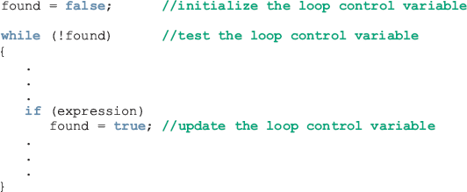
Flag-Controlled while Loops
02
While Loop
A flag-controlled while loop uses a bool variable to control the loop
The flag-controlled while loop takes the form:
01285960031
01285960031
www.roboticscorner.tech

Slide 15
The do…while Loop
02
While Loop
The general form of a do...while statement is:
do
statement
while (expression);
The statement executes first, and then the expression is evaluated
If the expression evaluates to true, the statement
executes again
As long as the expression in a do...while statement is true, the statement executes
01285960031
01285960031
www.roboticscorner.tech

Slide 16
The do…while Loop (continued)
02
While Loop
To avoid an infinite loop, the loop body must contain a statement that makes the expression false
The statement can be simple or compound
If compound, it must be in braces
do...while loop has an exit condition and always iterates at least once (unlike for and while)
01285960031
01285960031
www.roboticscorner.tech

Slide 17
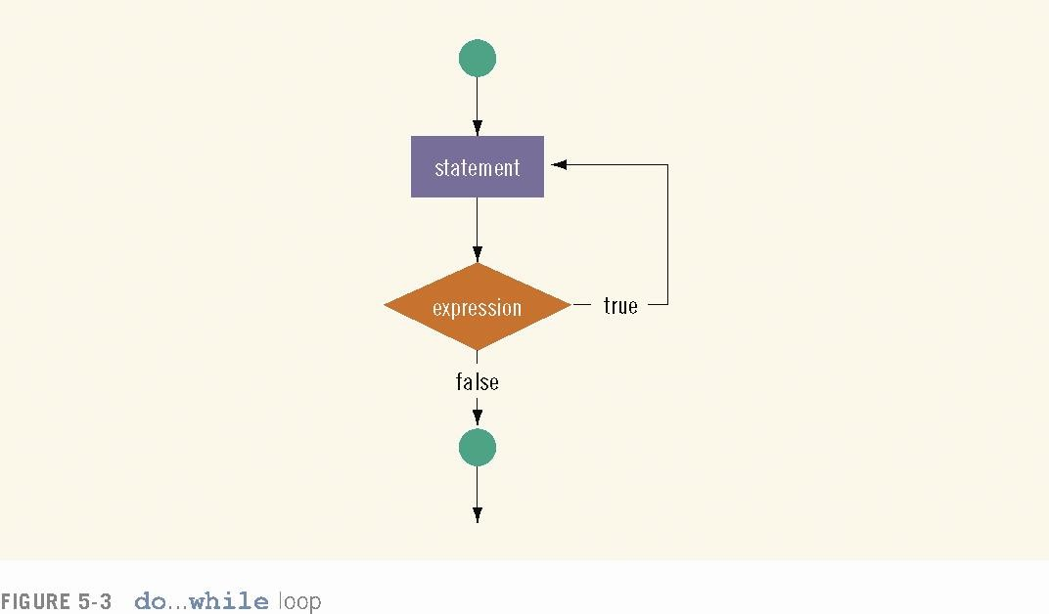
02
While Loop
01285960031
01285960031
www.roboticscorner.tech

Slide 18

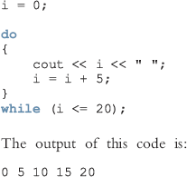
02
While Loop
01285960031
01285960031
www.roboticscorner.tech

Slide 19

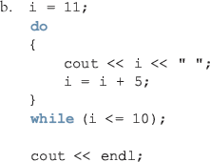
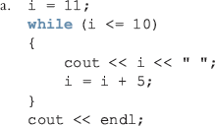
02
While Loop
01285960031
01285960031
www.roboticscorner.tech

Slide 20
03
For Loop
The general form of the for statement is:
for (initial statement; loop condition;
update statement)
statement
The initial statement, loop condition, and update statement are called for loop control statements
01285960031
01285960031
www.roboticscorner.tech

Slide 21
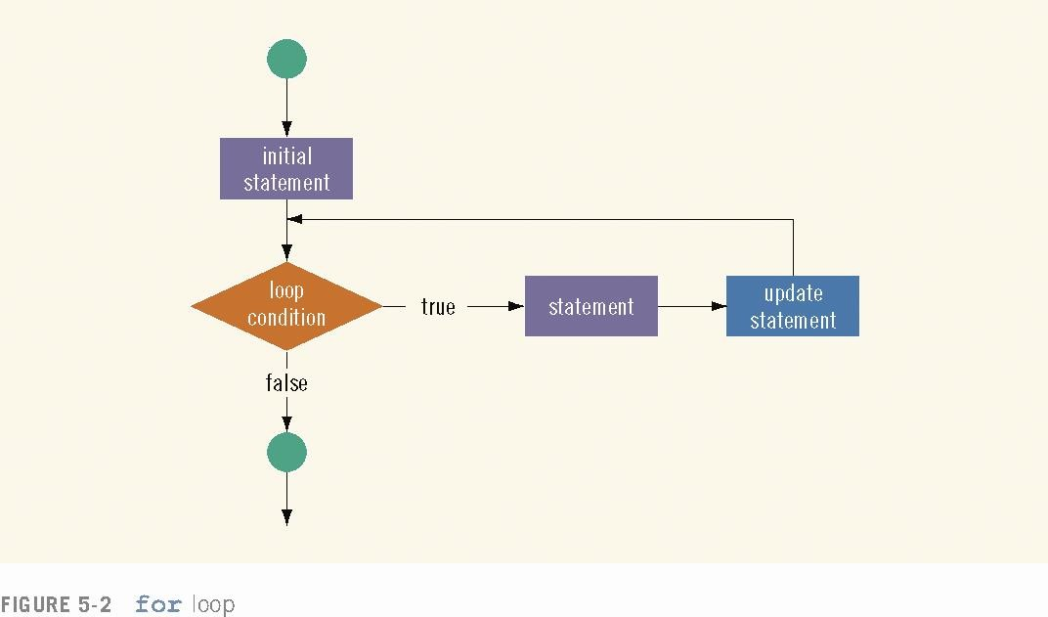
03
for Loop
01285960031
01285960031
www.roboticscorner.tech

Slide 22
03
for Loop
The for loop executes as follows:
The initial statement executes.
The loop condition is evaluated. If the loop condition evaluates to true
  Execute the for loop statement.
  Execute the update statement (the third expression in the parentheses).
Repeat Step 2 until the loop condition evaluates to false.
The initial statement usually initializes a variable (called the for
loop control, or for indexed, variable).
In C++, for is a reserved word.
01285960031
01285960031
www.roboticscorner.tech

Slide 23
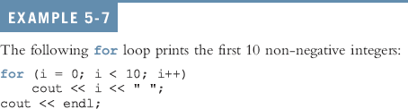

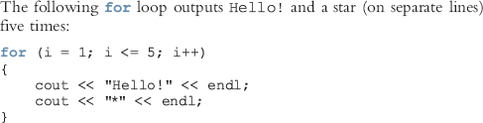
03
for Loop
01285960031
01285960031
www.roboticscorner.tech

Slide 24
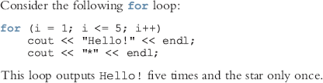
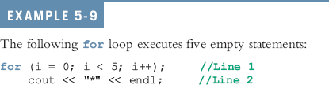
03
For Loop
01285960031
01285960031
www.roboticscorner.tech

Slide 25
The for Loop (comments)
03
For Loop
The following are some comments on for loops:
If the loop condition is initially false, the loop body does not execute.
The update expression, when executed, changes the value of the loop control variable (initialized by the initial expression), which eventually sets the value of the loop condition to false. The for loop body executes indefinitely if the loop condition is always true.
C++ allows you to use fractional values for loop control variables of the double type (or any real data type). Because different computers can give these loop control variables different results, you should avoid using such variables.
01285960031
01285960031
www.roboticscorner.tech

Slide 26
The for Loop (comments)
03
For Loop
A semicolon at the end of the for statement (just before the loop’s body) is a semantic error. In this case, the action of the for loop is empty.
In the for statement, if the loop condition is omitted, it is assumed to be true.
In a for statement, you can omit all three statements—initial statement, loop condition, and update statement. The following is a legal for loop:
for (;;)
cout << "Hello" << endl;
01285960031
01285960031
www.roboticscorner.tech

Slide 27

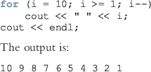


03
For Loop
01285960031
01285960031
www.roboticscorner.tech

Slide 28
04
break & continue
break and continue alter the flow of control
When the break statement executes in a repetition structure, it immediately exits
The break statement, in a switch structure, provides an immediate exit
The break statement can be used in while, for, and do...while loops
01285960031
01285960031
www.roboticscorner.tech

Slide 29
04
break & continue
The break statement is used for two purposes:
  To exit early from a loop
  To skip the remainder of the switch structure
After the break statement executes, the program continues with the first statement after the structure
The use of a break statement in a loop can eliminate the use of certain (flag) variables
01285960031
01285960031
www.roboticscorner.tech

Slide 30
04
break & continue
continue is used in while, for, and
do…while structures
When executed in a loop
– It skips the remaining statements and proceeds with the next iteration of the loop
In a while and do…while structure
  Expression (loop-continue test) is evaluated immediately after the continue statement
In a for structure, the update statement is executed after the continue statement
  Then the loop condition executes
01285960031
01285960031
www.roboticscorner.tech

Slide 31
05
Nested Control Structures
Suppose we want to create the following pattern
*
**
***
****
*****
In the first line, we want to print one star, in the second line two stars and so on
01285960031
01285960031
www.roboticscorner.tech

Slide 32
05
Nested Control Structures
Since five lines are to be printed, we start with the following for the statement
For (I = 1; I <= 5 ; i++)
The value of I in the first iteration is 1, in the second iteration it is 2, and so on
Can use the value of I as a limit condition in another for loop nested within this loop to control the number of starts in a line
01285960031
01285960031
www.roboticscorner.tech

Slide 33
05
Nested Control Structures
The syntax is:
for (i = | 1; | i | <= | 5 ; | i++)
{ for | (j | = | 1; | j <= | i; j++)
cout |  |  | << | "*";
cout << endl;
}
01285960031
01285960031
www.roboticscorner.tech

Slide 34
05
Nested Control Structures
What pattern does the code produce if we replace the first for statement with the following?
for (i = 5; i >= 1; i--)
Answer:
*****
****
***
**
*
01285960031
01285960031
www.roboticscorner.tech

Slide 35
0
Summary
C++ has three looping (repetition) structures:
while, for, and do…while
while, for, and do are reserved words
while and for loops are called pre-test loops
do...while loop is called a post-test loop
while and for may not execute at all, but
do...while always executes at least once
01285960031
01285960031
www.roboticscorner.tech

Slide 36
0
Summary
while: expression is the decision maker, and the statement is the body of the loop
In a counter-controlled while loop,
  Initialize counter before loop
  Body must contain a statement that changes the value of the counter variable
A sentinel-controlled while loop uses a sentinel to control the while loop
01285960031
01285960031
www.roboticscorner.tech

Slide 37
0
Summary
for loop: simplifies the writing of a count-controlled while loop
Executing a break statement in the body of a loop immediately terminates the loop
Executing a continue statement in the body of a loop skips to the next iteration
After a continue statement executes in a for loop, the update statement is the next statement executed
01285960031
01285960031
www.roboticscorner.tech

Slide 38


Slide 39

01211626904
www.roboticscorner.tech
Robotics Corner
Robotics Corner
Robotics Corner
Robotics Corner
01285960031
01285960031
www.roboticscorner.tech

