Slide 1


0
10
9
8
7
6
5
4
3
2
1

Slide 2

Robotics Corner

Slide 3
Robotics Corner
Arrays in STL

Slide 4
01
Introduction
02
Arrays in C++
AGENDA
03
Common Errors
04
Practice
05
Range Based For loop in C++11

Slide 5
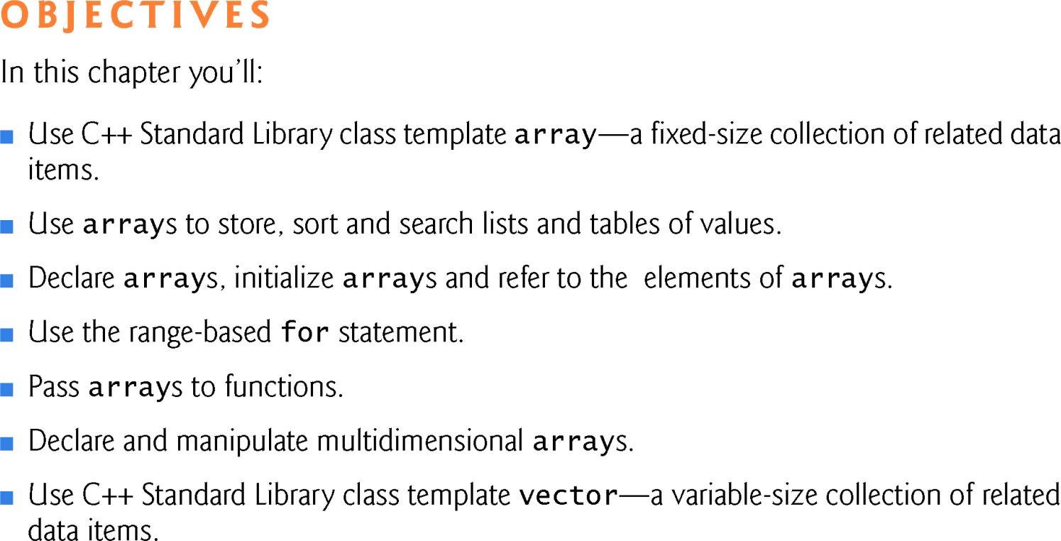
01
Introduction

Slide 6
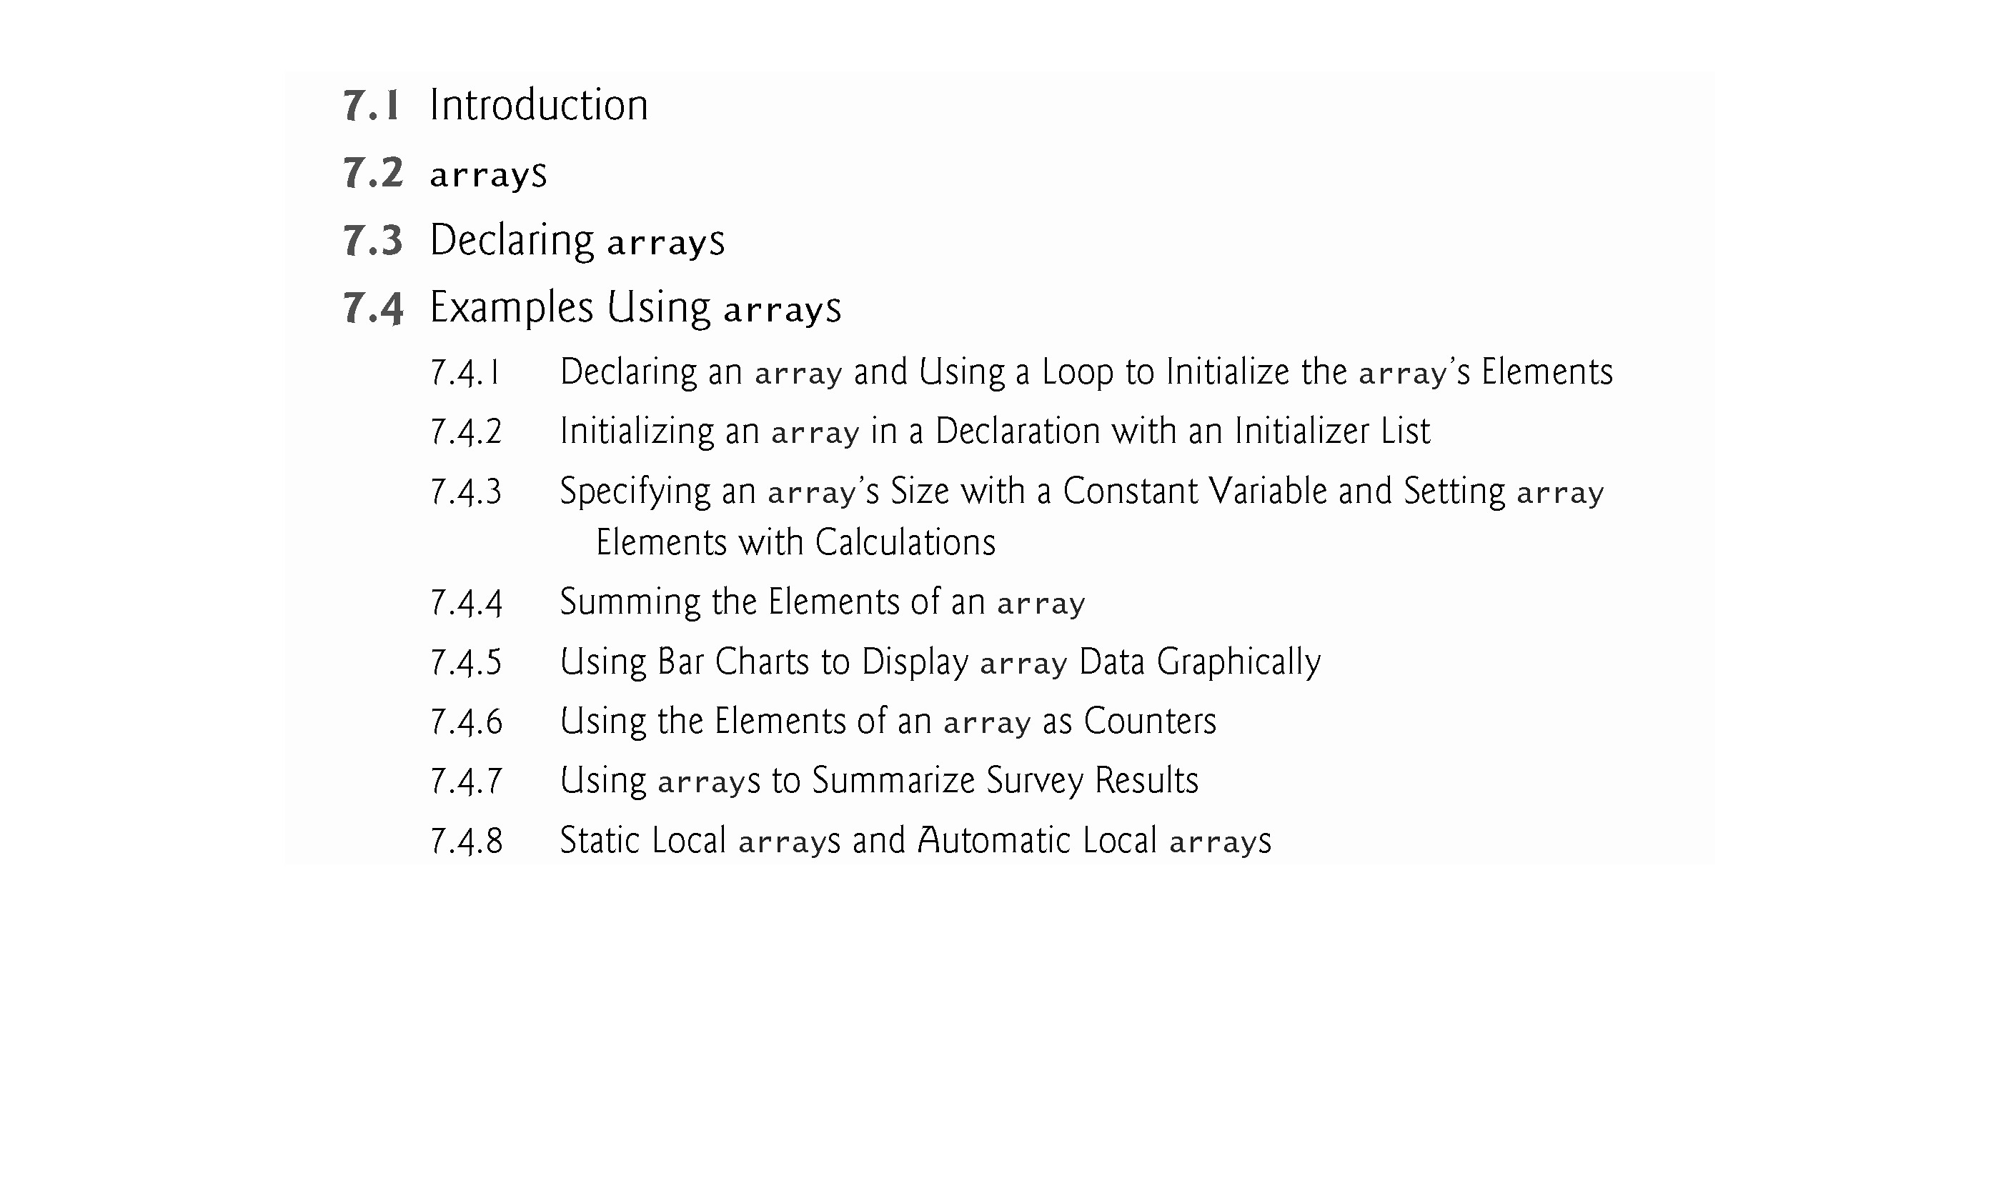
01
Introduction

Slide 7
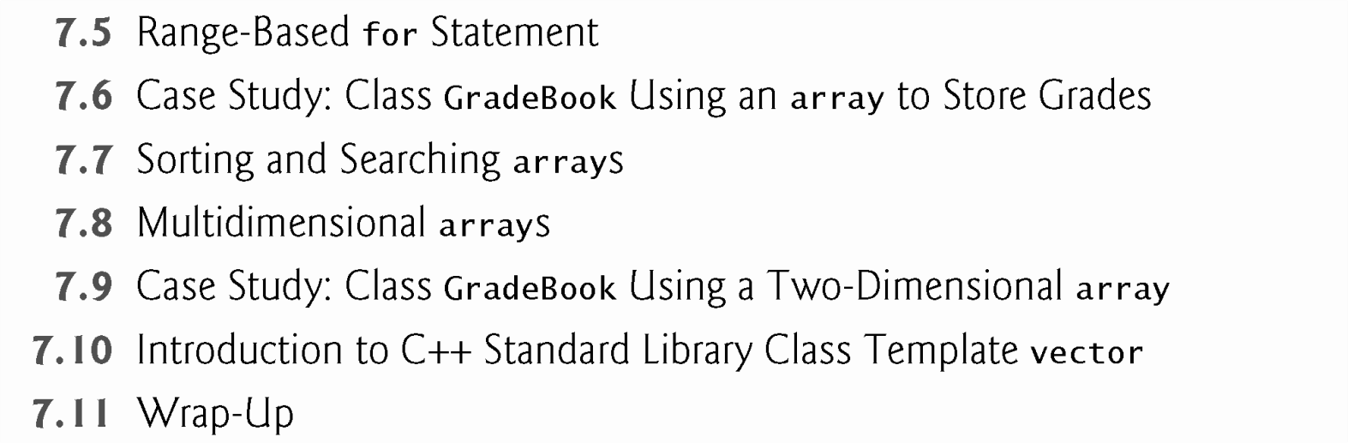
01
Introduction

Slide 8
01
Introduction
This chapter introduces the topic of data structures—collections of related data items.
We discuss arrays which are fixed-size collections consisting of data items of the same type, and vectors which are collections (also of data items of the same type) that can grow and shrink dynamically at execution time.
7.1 Introduction
Both array and vector are C++ standard library class templates.
After discussing how arrays are declared, created and initialized, we present examples that demonstrate several common array manipulations.

Slide 9
7.2 arrays
02
Arrays in C++
An array is a contiguous group of memory locations that all have the same type.
To refer to a particular location or element in the array, specify the name of the array and the position number of the particular element.
Figure 7.1 shows an integer array called c.
12 elements.
The position number is more formally called a subscript or index (this number specifies the number of elements from the beginning of the array).
The first element in every array has subscript 0 (zero) and is sometimes called the zeroth
element.
The highest subscript in array c is 11, which is 1 less than the number of elements in the array (12).
A subscript must be an integer or integer expression (using any integral type).

Slide 10
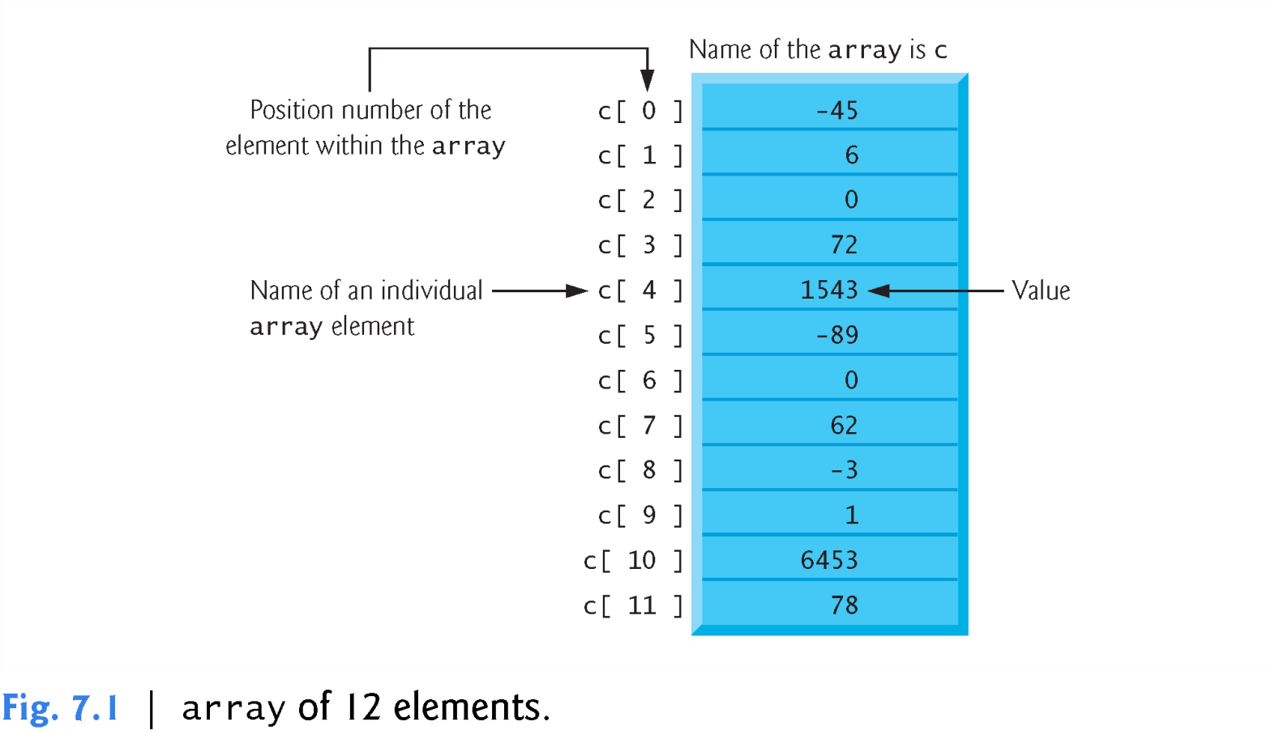
02
Arrays in C++

Slide 11
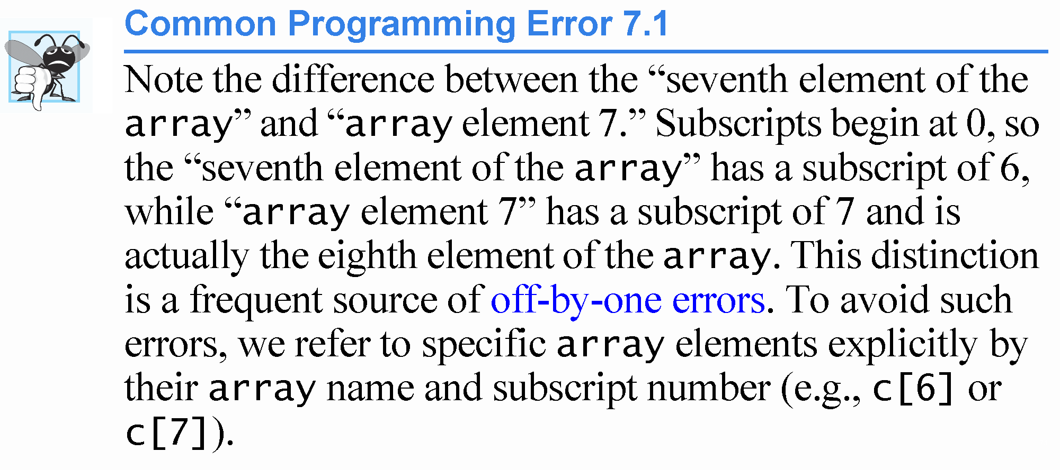
03
Common Errors

Slide 12
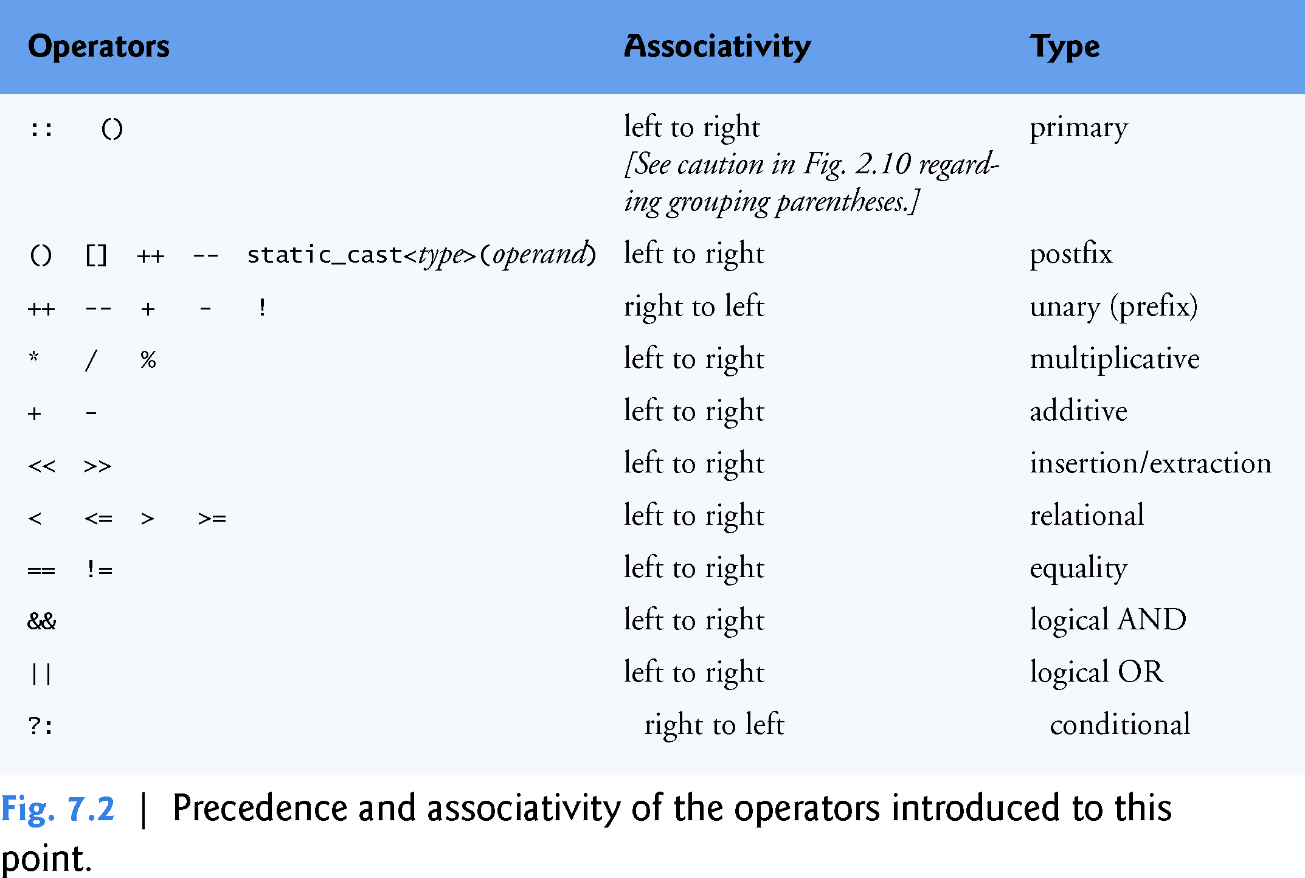
02
Arrays in C++

Slide 13
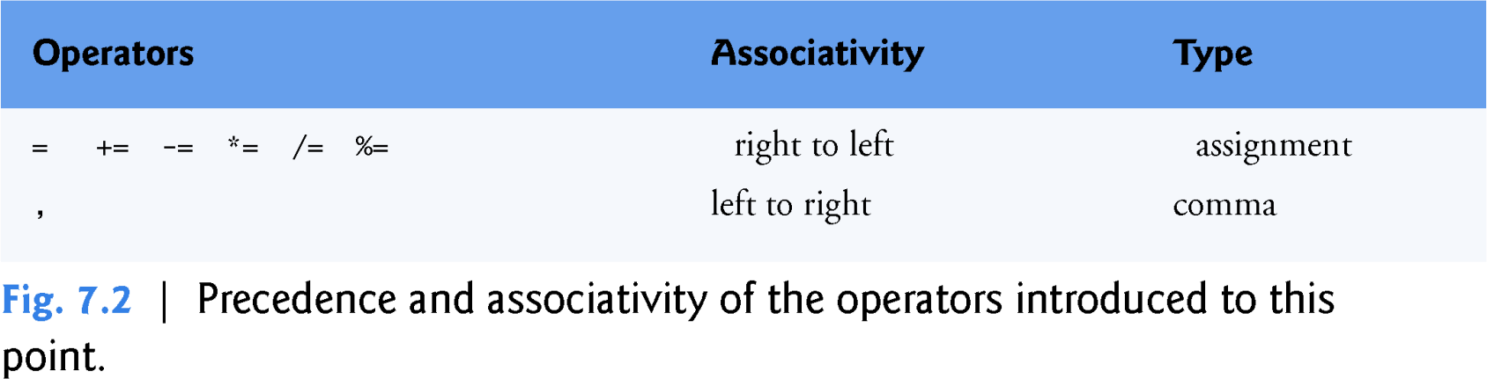
02
Arrays in C++

Slide 14
7.3 Declaring arrays
02
Arrays in C++
arrays occupy space in memory.
To specify the type of the elements and the number of elements required by an array use a declaration of the form:
  array< type, arraySize > arrayName;
The notation <type, arraySize> indicates that array is a class template.
The compiler reserves the appropriate amount of memory based on the type of the elements and the arraySize.
arrays can be declared to contain values of most data types.

Slide 15
7.4 Examples Using arrays
02
Arrays in C++
The following examples demonstrate how to declare arrays, how to initialize arrays and how to perform common array manipulations.

Slide 16
02
Arrays in C++
The program in Fig. 7.3 declares five-element integer array n (line 10).
7.4.1 Declaring an array and Using a Loop to Initialize the
size_t represents an unsigned integral type This type is recommended for any variable that represents an array’s size or an array’s subscripts..
array’s Elements
Type size_t is defined in the std namespace and is in header <cstddef>, which is included by various other headers.
If you attempt to compile a program that uses type size_t and receive errors indicating that it’s not defined, simply include <cstddef> in your program.

Slide 17
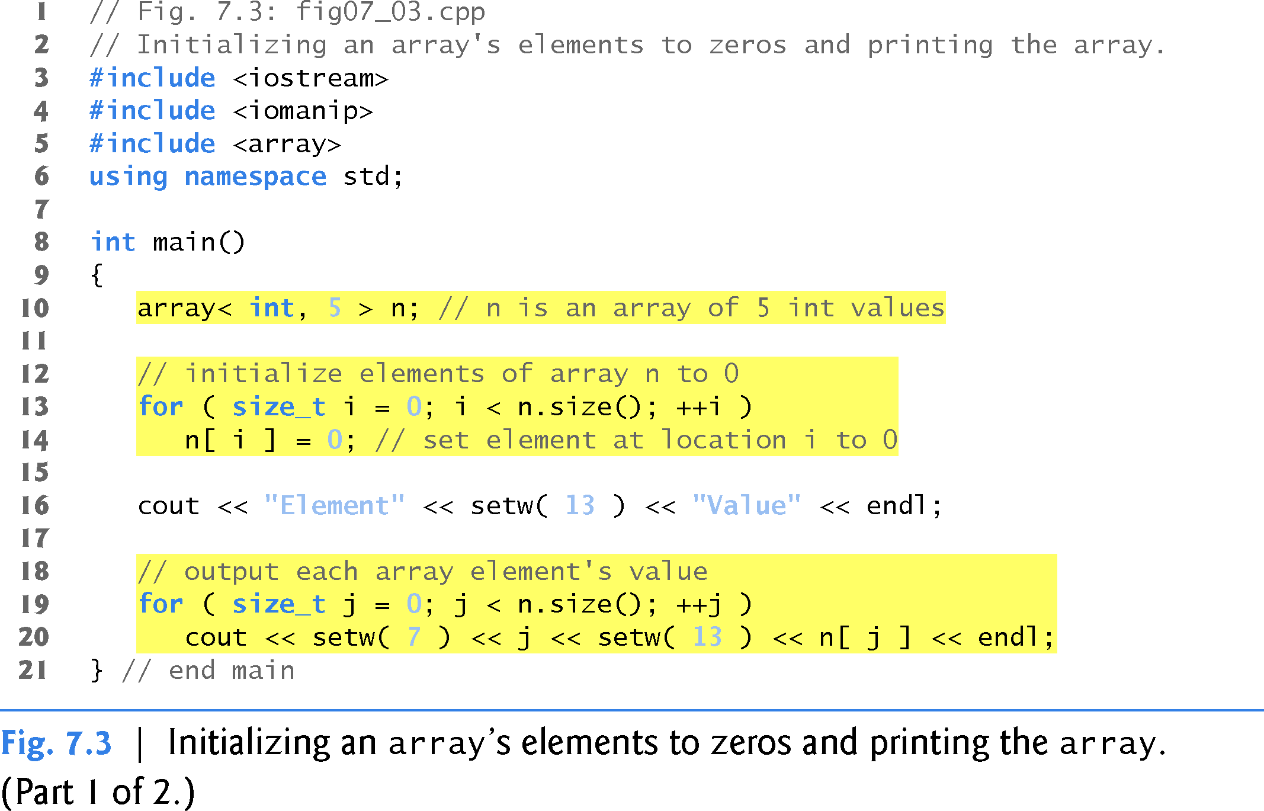
02
Arrays in C++

Slide 18
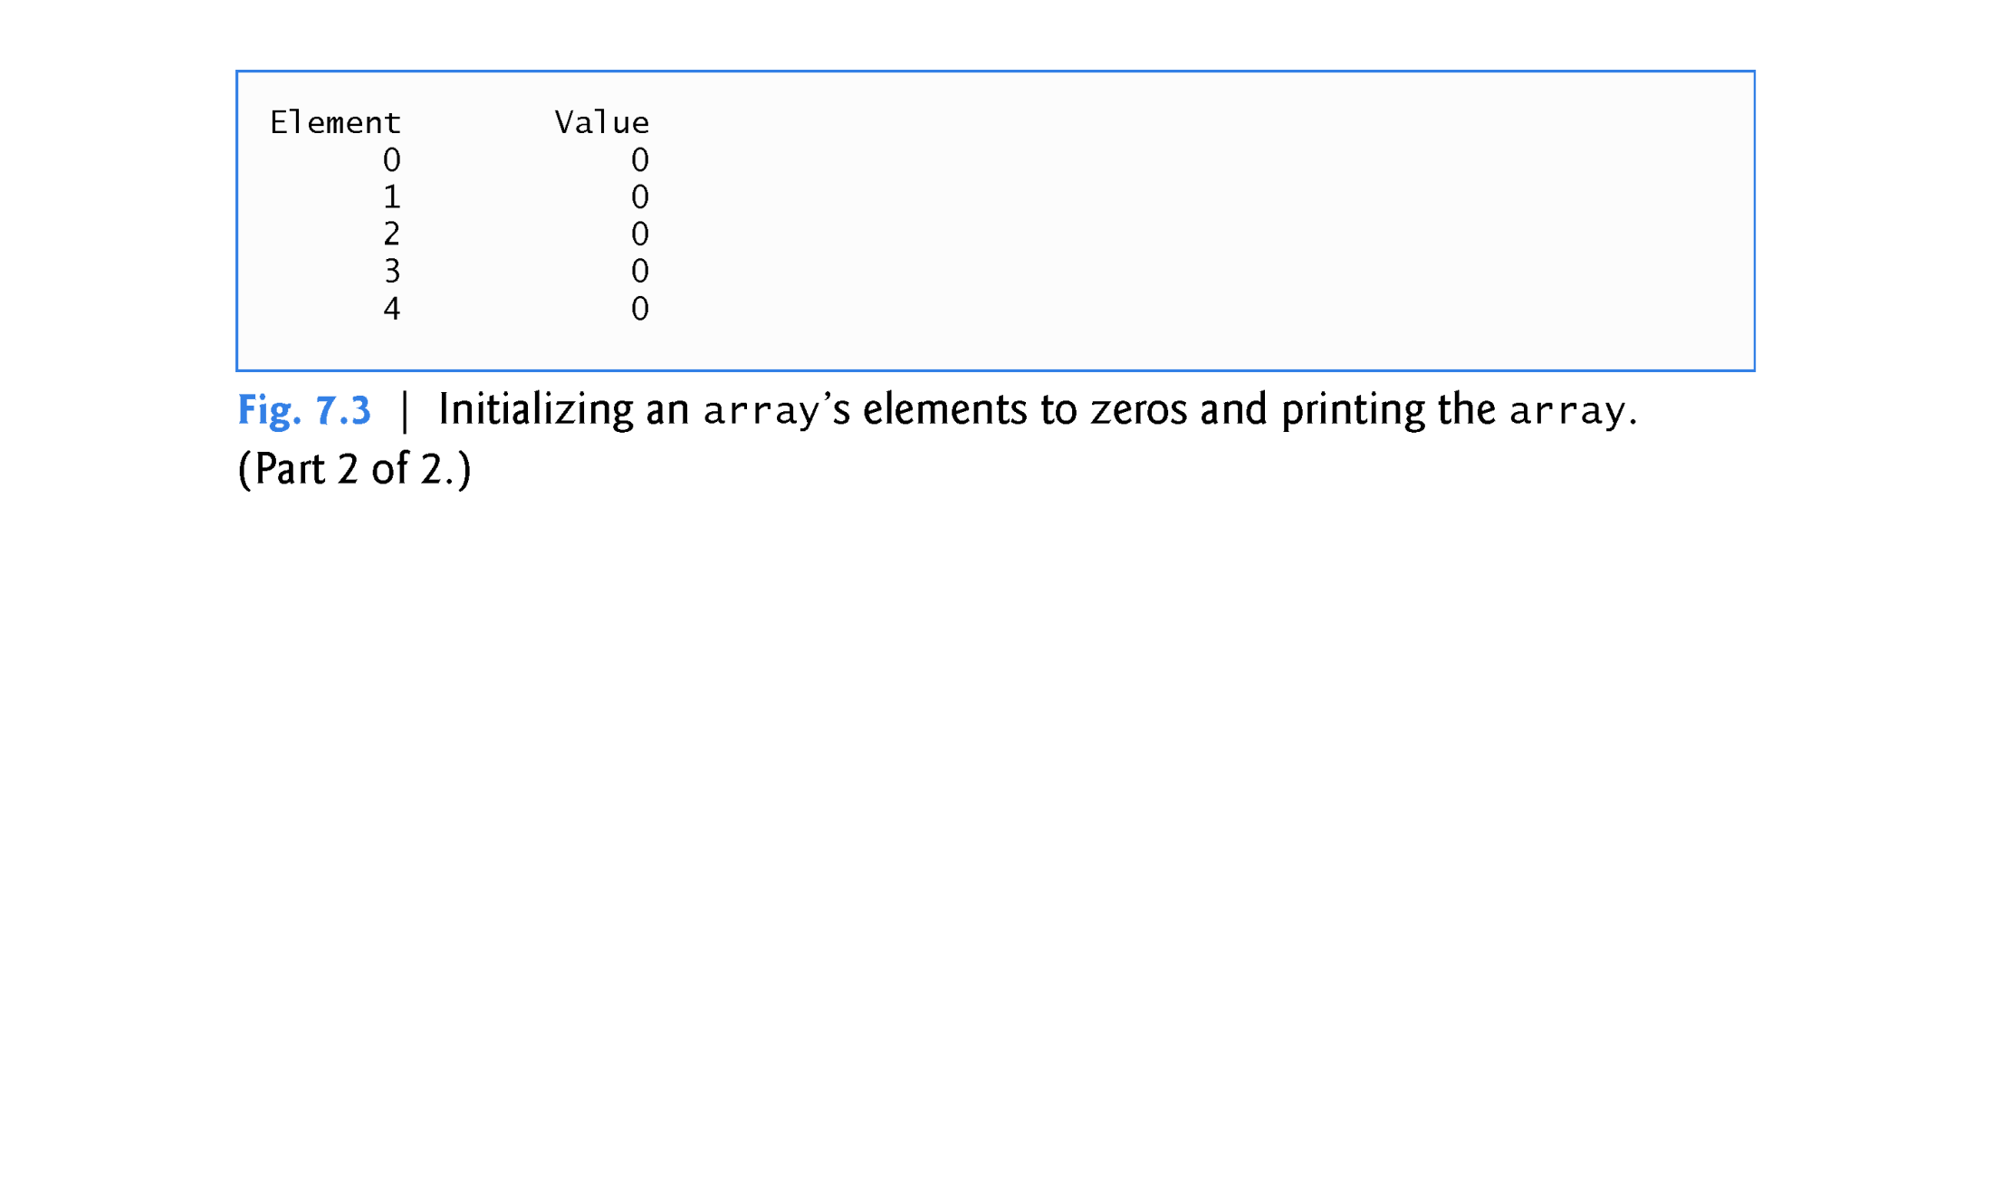
02
Arrays in C++

Slide 19
7.4.2 Initializing an Array in a Declaration with an Initializer List
02
Arrays in C++
The elements of an array also can be initialized in the array declaration by following the array name with an equals sign and a brace- delimited comma-separated list of initializers.
The program in Fig. 7.4 uses an initializer list to initialize an integer array with five values (line 11) and prints the array in tabular format (lines 13–17).
If there are fewer initializers than elements in the array, the remaining array elements are initialized to zero.

Slide 20
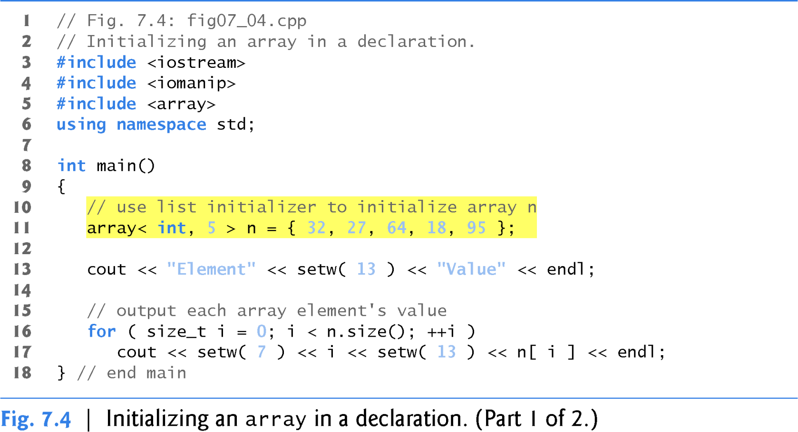
02
Arrays in C++

Slide 21
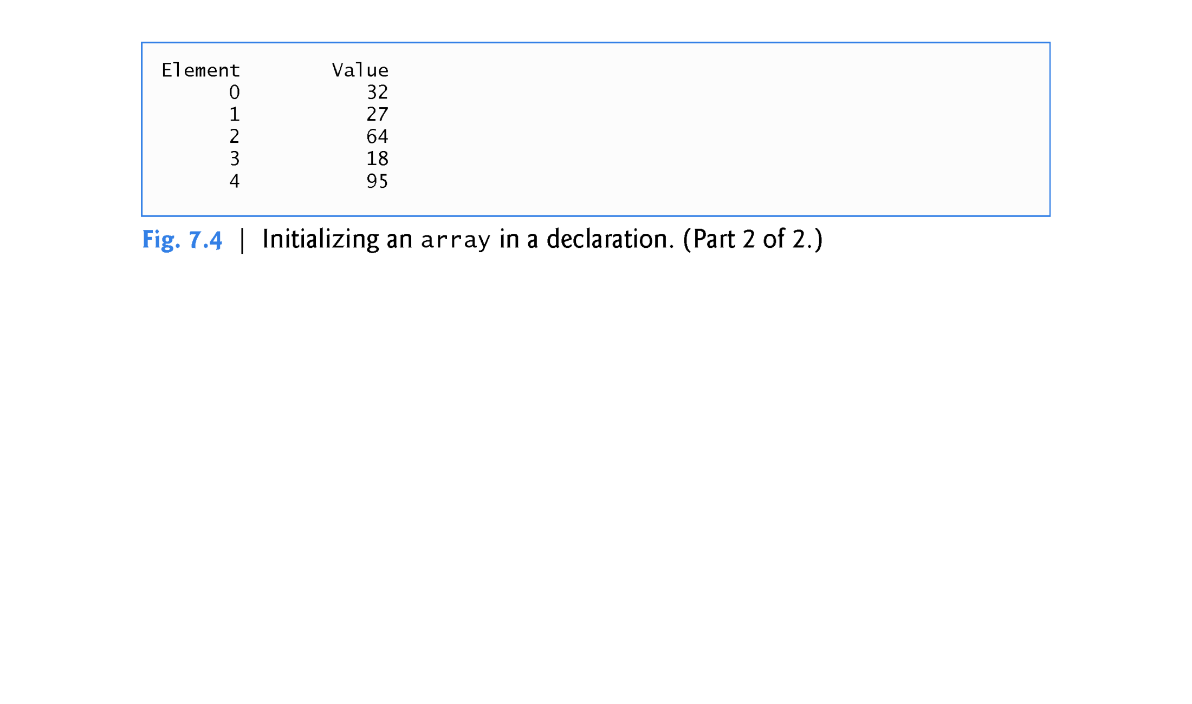
02
Arrays in C++

Slide 22
7.4.3 Specifying an array’s Size with a Constant Variable and
Setting array Elements with Calculations
02
Arrays in C++
Figure 7.5 sets the elements of a 5-element array s to the even integers 2, 4, 6, 8 and 10 (lines 15–16) and prints the array in tabular format (lines 18–22).
Line 11 uses the const qualifier to declare a constant variable
arraySize with the value 5.
A constant variable that’s used to specify array’s size must be
initialized with a constant expression when it’s declared and cannot be modified thereafter.
Constant variables are also called named constants or read-only variables.

Slide 23
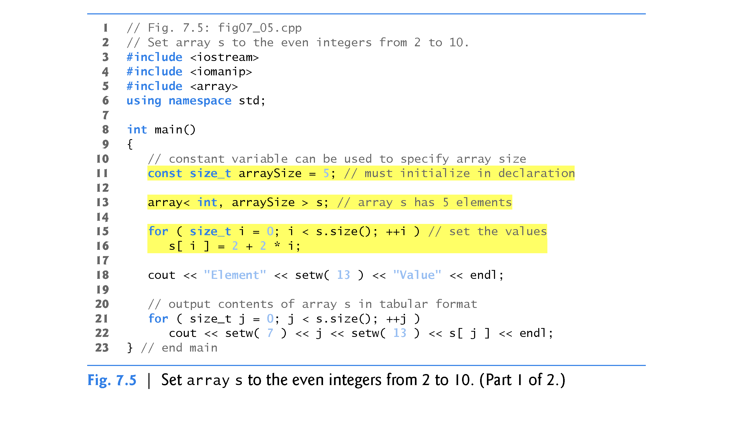
02
Arrays in C++

Slide 24
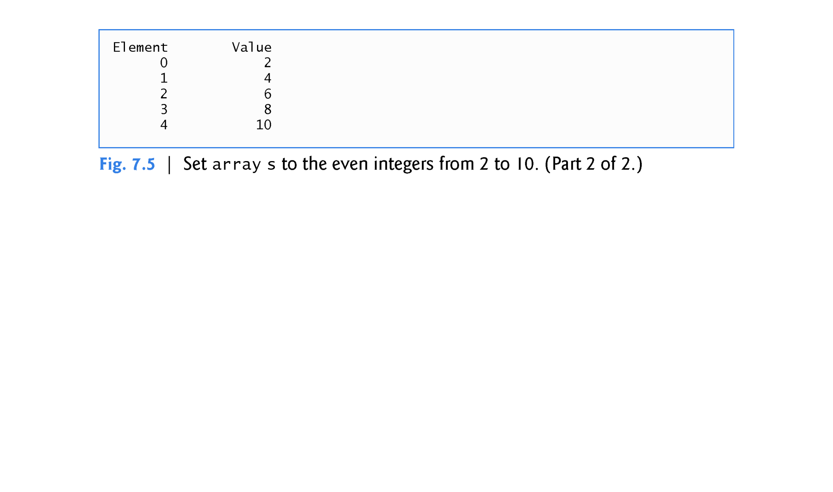
02
Arrays in C++

Slide 25
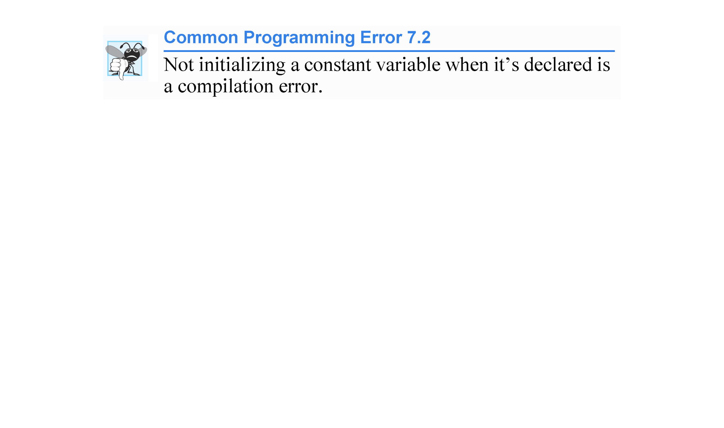
03
Common Errors

Slide 26
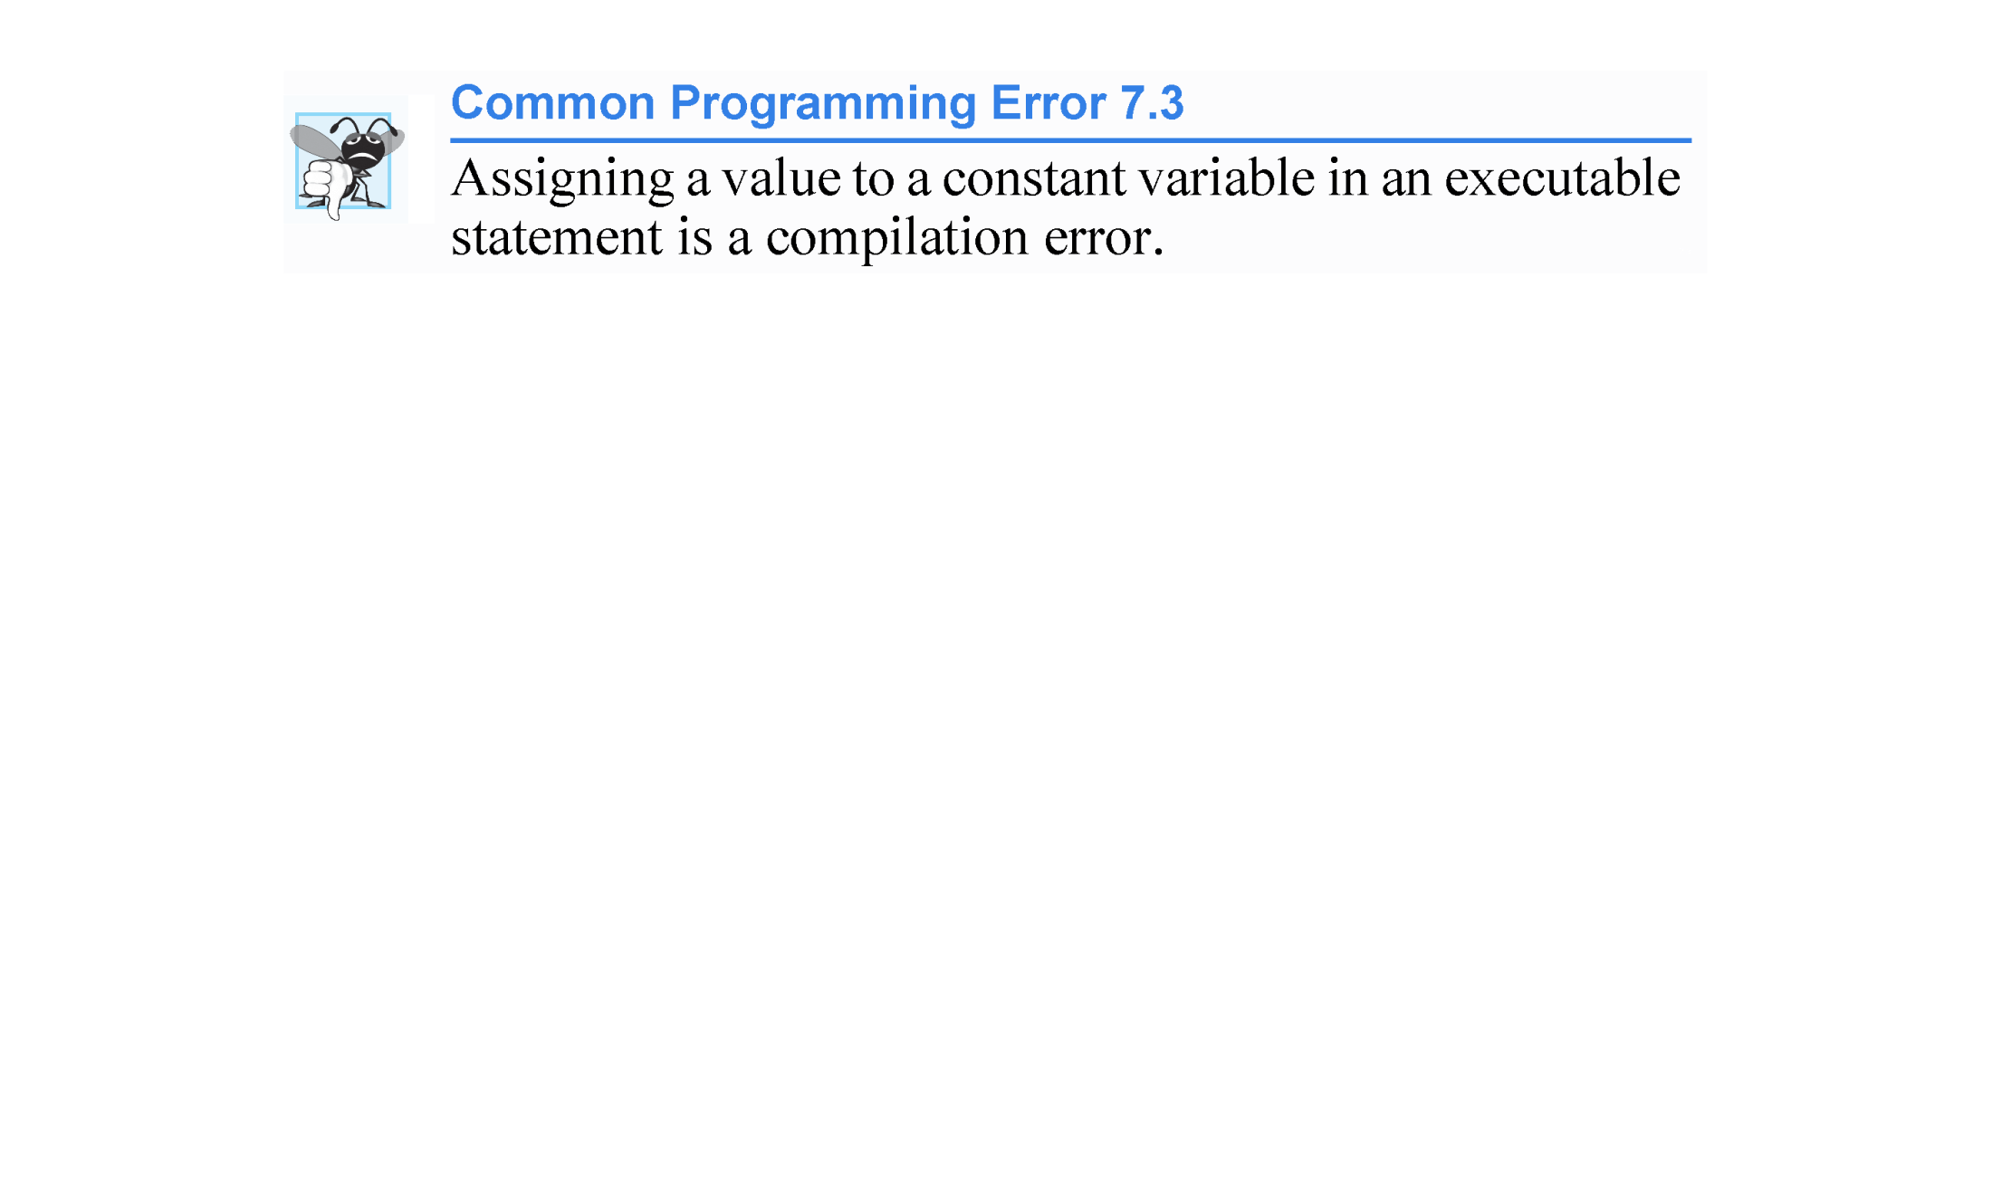
03
Common Errors

Slide 27
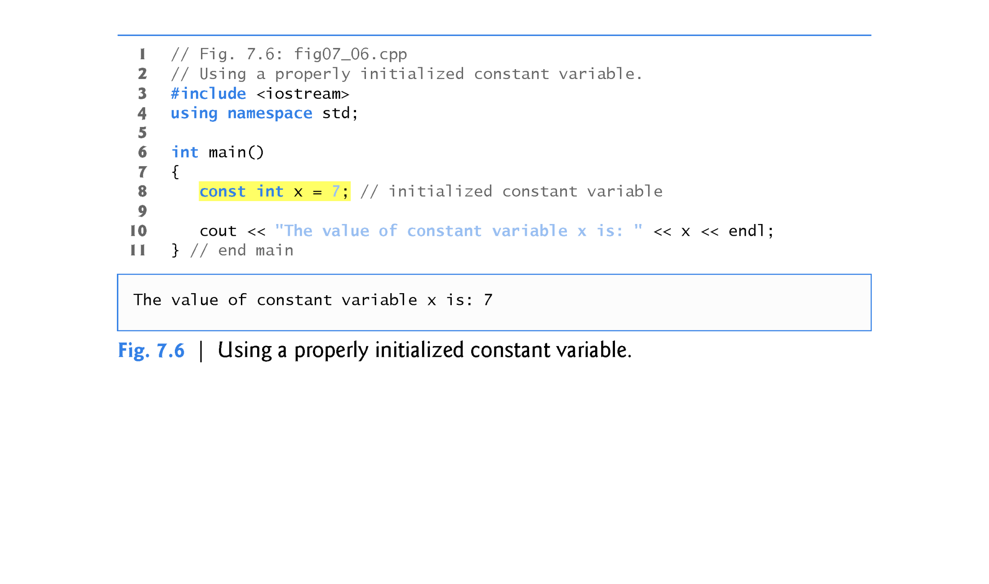
02
Arrays in C++

Slide 28
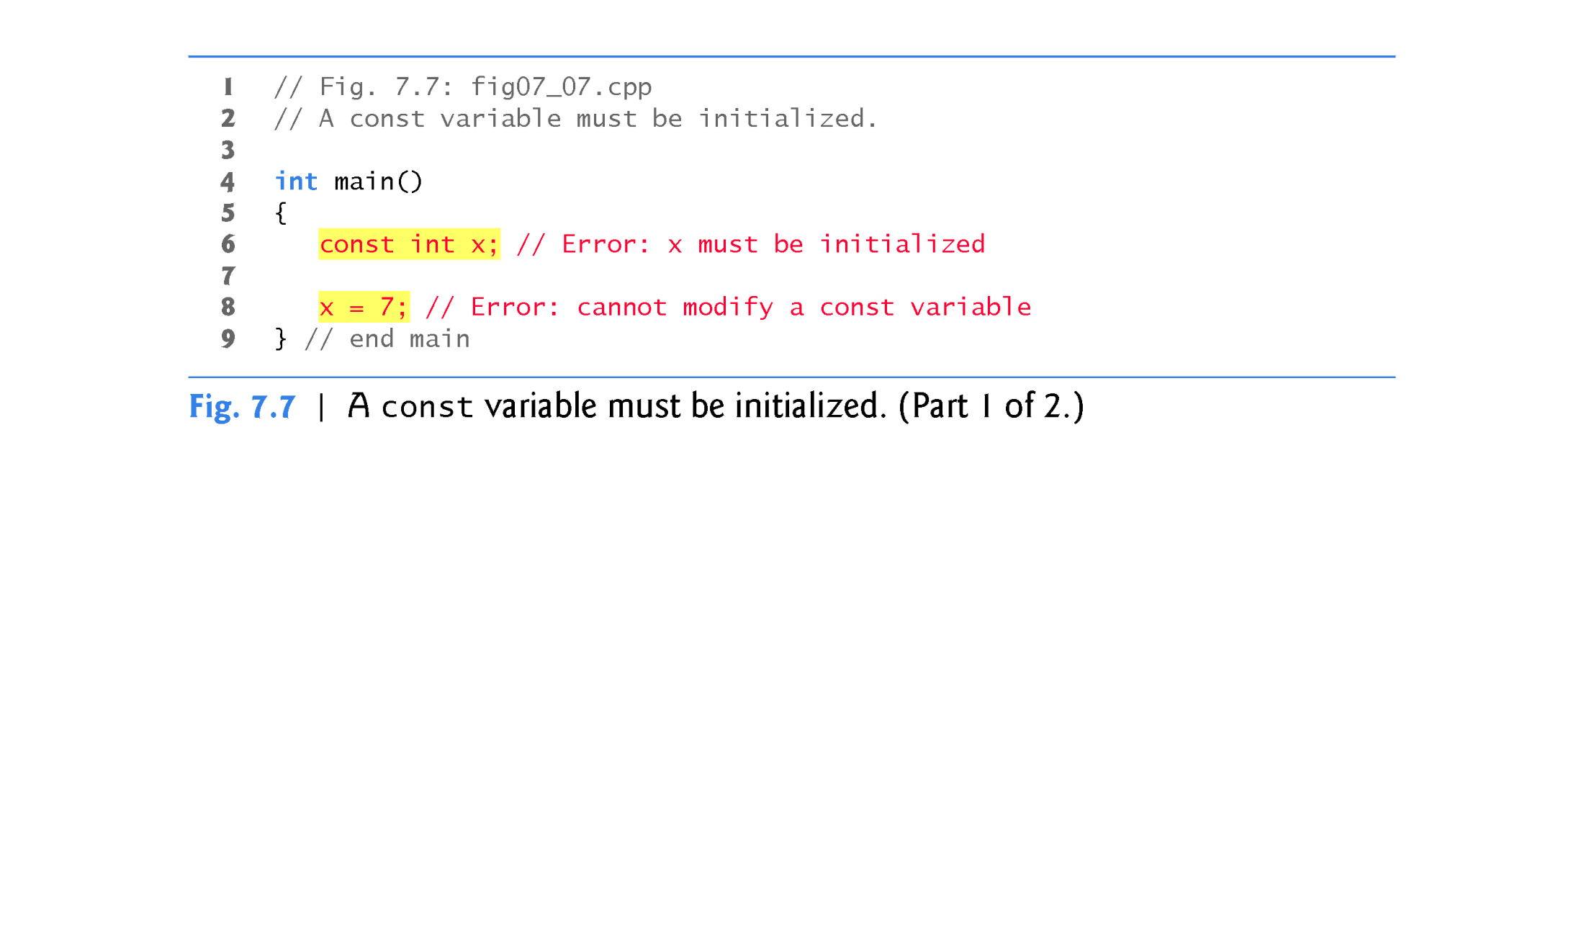
03
Common Errors

Slide 29
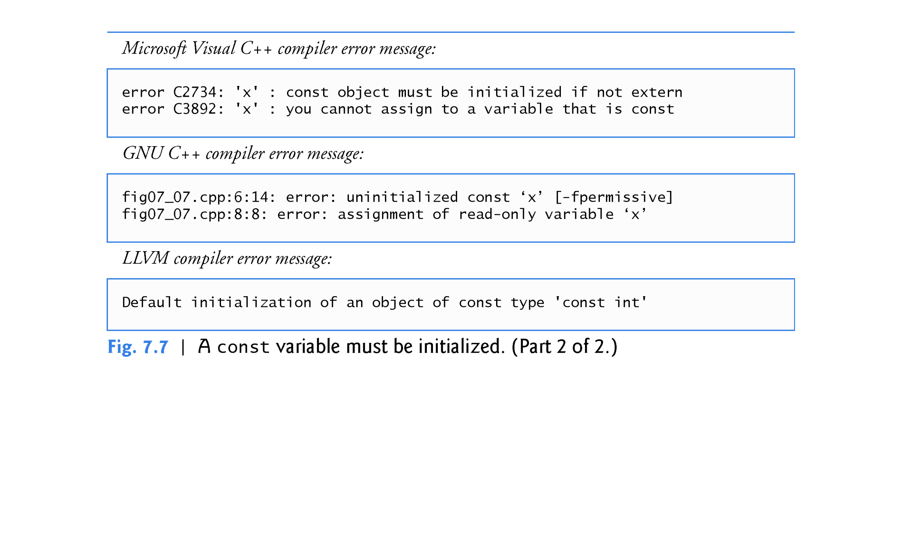
03
Common Errors

Slide 30
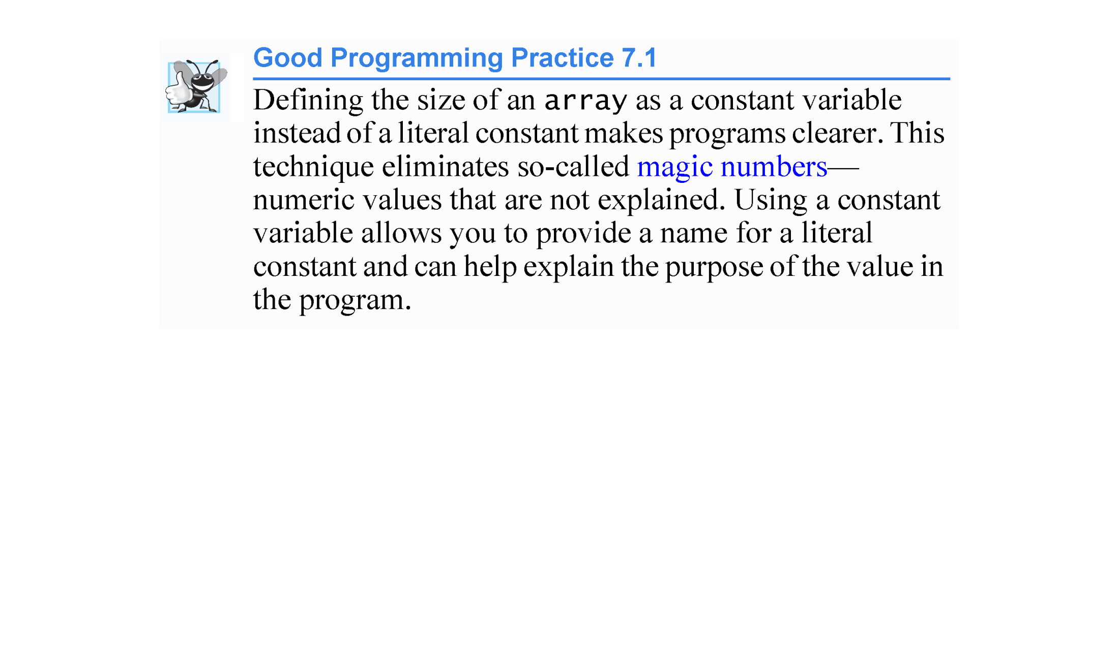
03
Common Errors

Slide 31
Often, the elements of an array represent a series of values to be used in a calculation.
04
Practice
7.4.4 Summing the Elements of an array
The program in Fig. 7.8 sums the values contained in the four-element integer array a.

Slide 32
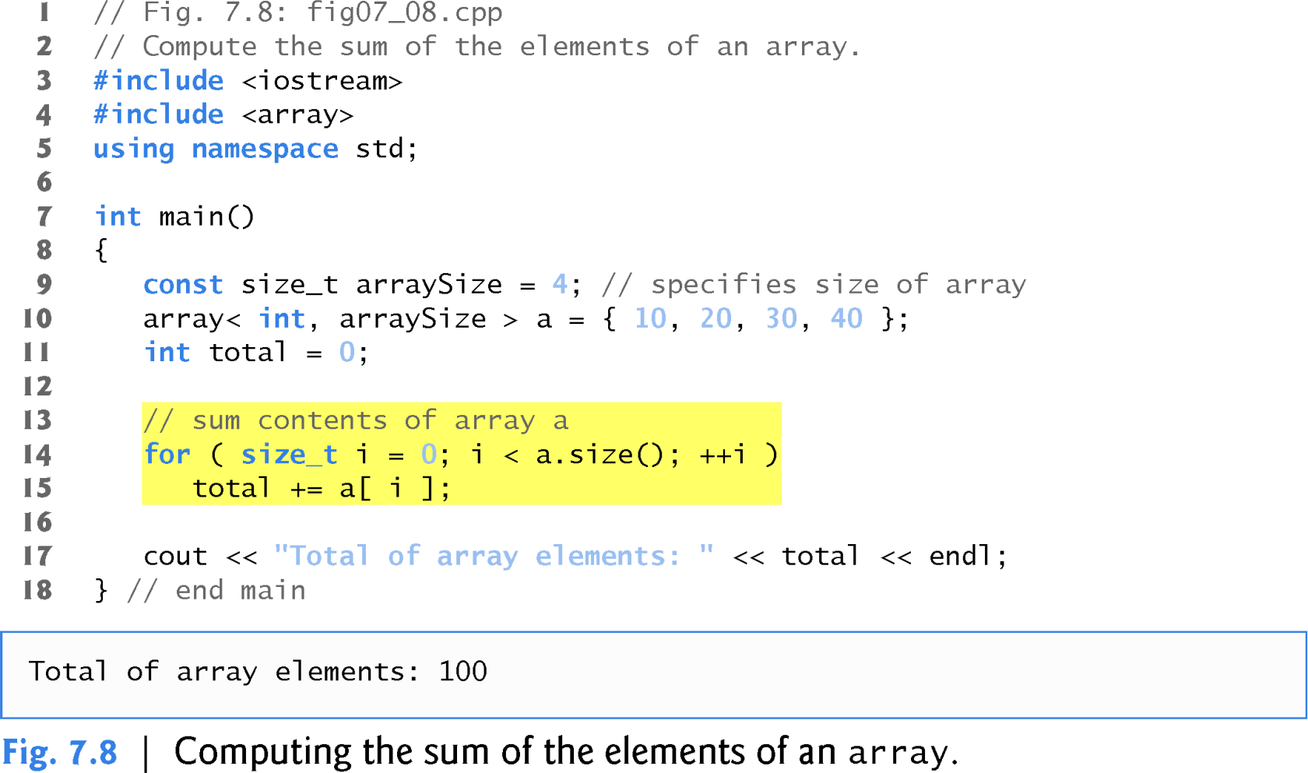
04
Practice

Slide 33
7.4.5 Using Bar Charts to Display array Data Graphically
04
Practice
Many programs present data to users in a graphical manner.
One simple way to display numeric data graphically is with a bar chart that shows each numeric value as a bar of asterisks (*).
Our next program (Fig. 7.9) stores data in an array of 11 elements, each corresponding to a grade category.

Slide 34
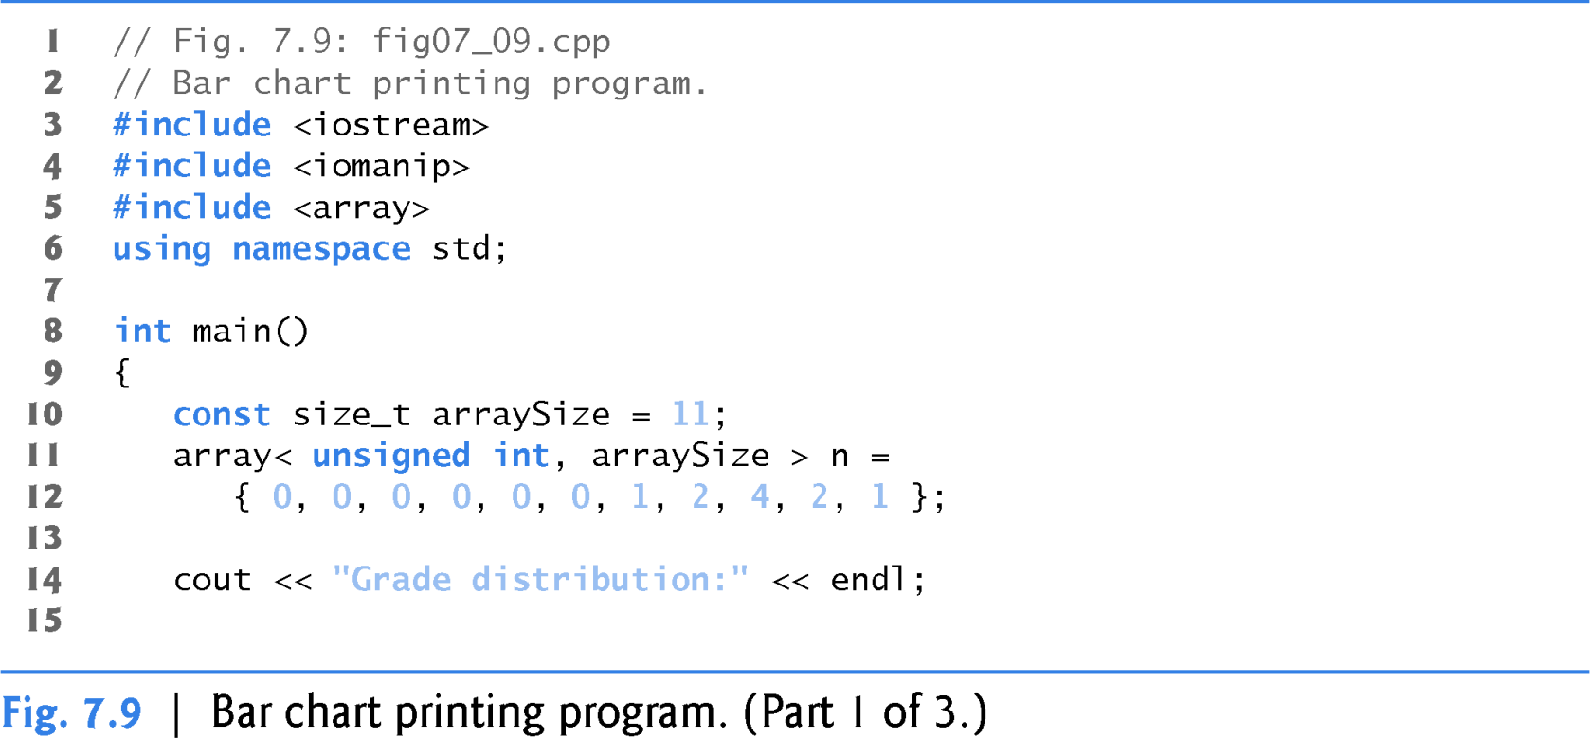
04
Practice

Slide 35
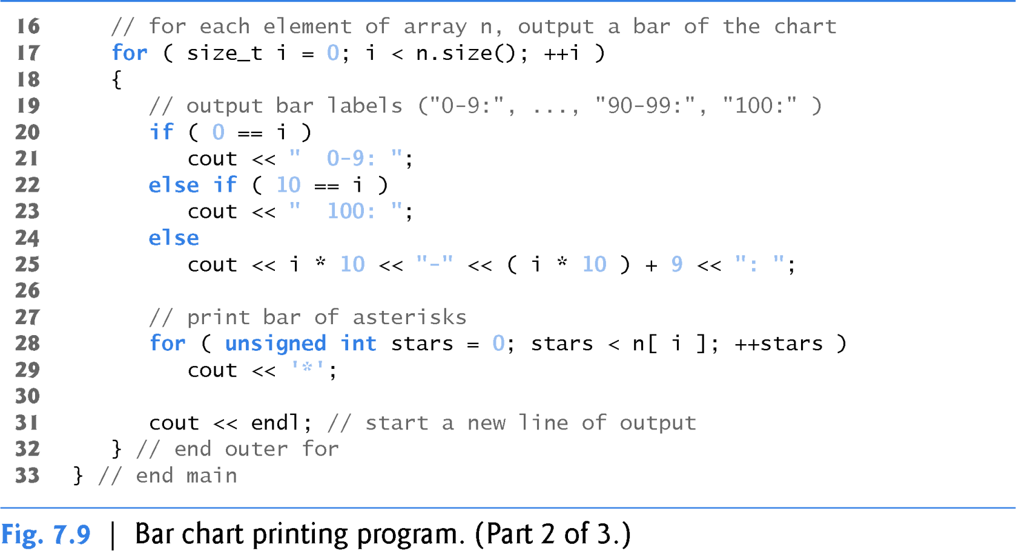
04
Practice

Slide 36
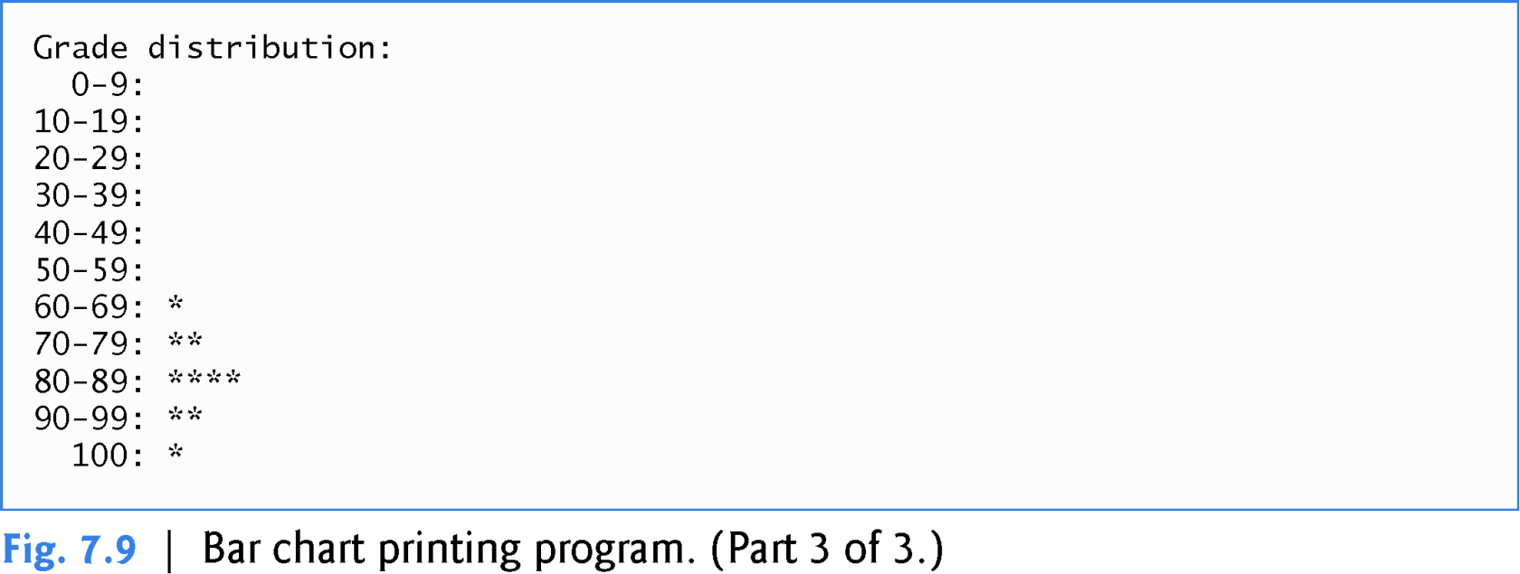
04
Practice

Slide 37
7.4.6 Using the Elements of an array as Counters
04
Practice
Sometimes, programs use counter variables to summarize data, such as the results of a survey.
In the next prog, we used separate counters in our die-rolling program to track the number of occurrences of each side of a die as the program rolled the die 6,000,000 times.
An array version of this program is shown in Fig. 7.10.
This version also uses the new C++11 random-number generation capabilities that
were introduced in Section 6.9.
The single statement in line 22 of this program replaces the switch statement in lines 23–45 of Fig. 6.9.

Slide 38
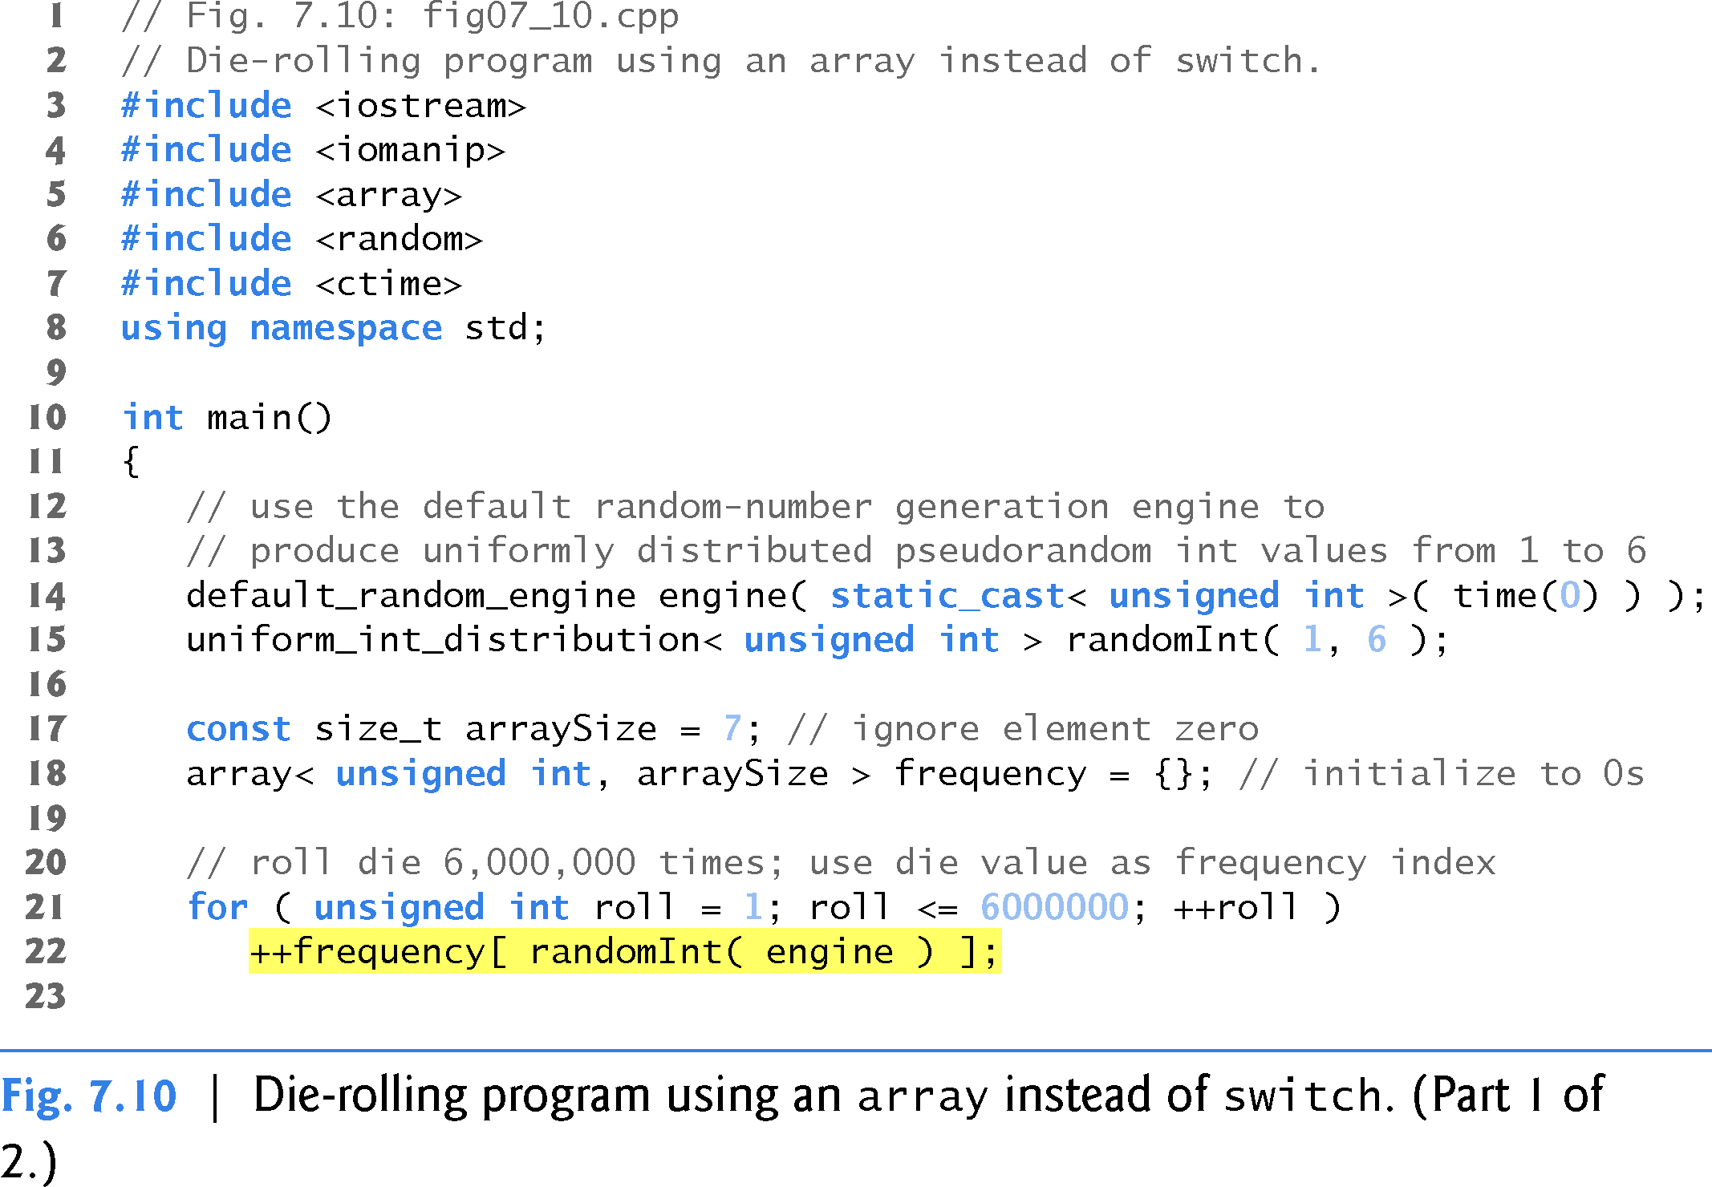
04
Practice

Slide 39
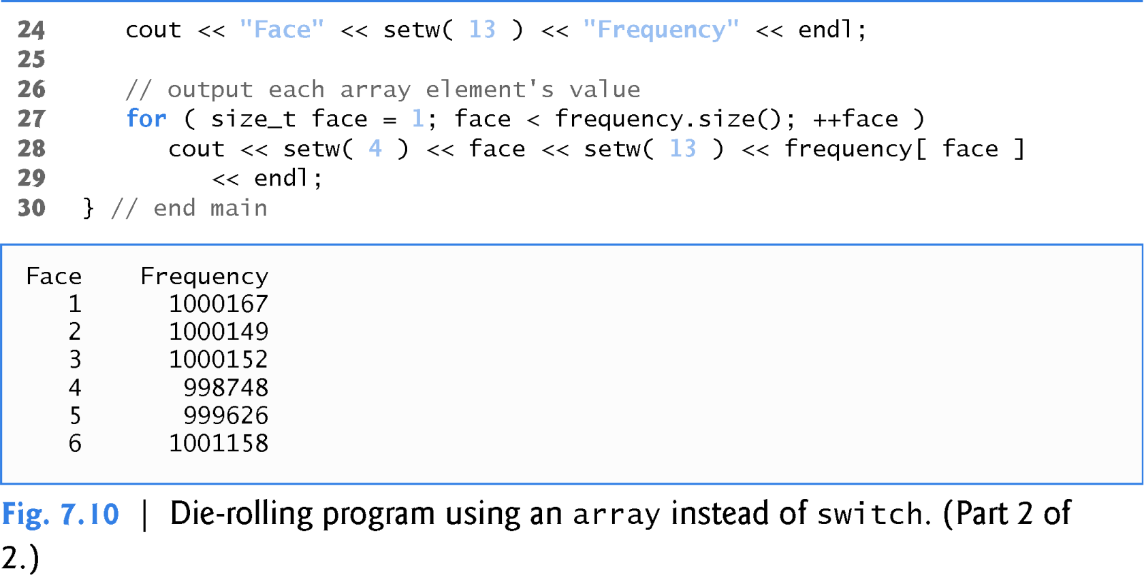
04
Practice

Slide 40
7.4.7 Using arrays to Summarize Survey Results
04
Practice
Our next example (Fig. 7.11) uses arrays to summarize the results of data collected in a survey.
Consider the following problem statement:
  Twenty students were asked to rate on a scale of 1 to 5 the quality of the food in the student cafeteria, with 1 being “awful” and 5 being “excellent.” Place the 20 responses in an integer array and determine the frequency of each rating.
C++ provides no automatic array bounds checking to prevent you from referring to an element that does not exist.
Thus, an executing program can “walk off” either end of an array without warning.
In Section 7.10, we demonstrate the class template vector’s at function, which
performs bounds checking for you.
Class template array also has an at function.

Slide 41
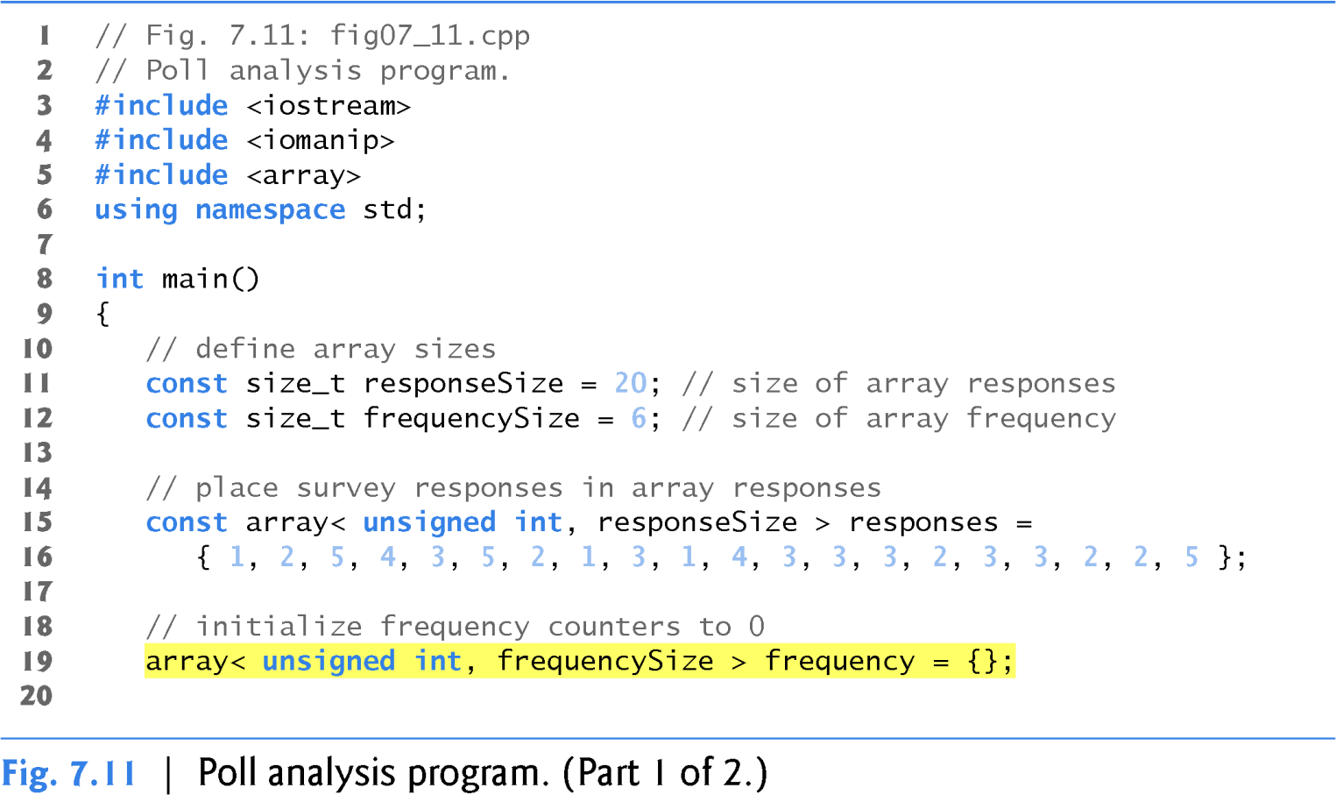
04
Practice

Slide 42
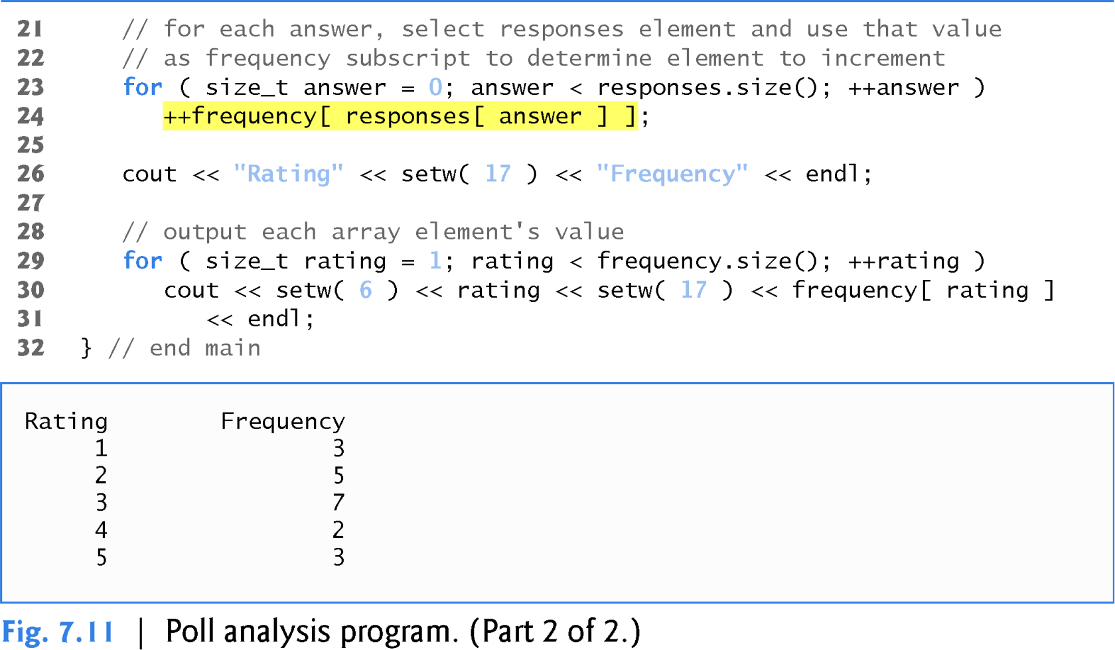
04
Practice

Slide 43
7.4.7 Using arrays to Summarize Survey Results
04
Practice
It’s important to ensure that every subscript you use to access an array element is within the array’s bounds—that is, greater than or equal to 0 and less than the number of array elements.
Allowing programs to read from or write to array elements outside the bounds of arrays are common security flaws.
Reading from out-of-bounds array elements can cause a program to crash or even appear to execute correctly while using bad data.
Writing to an out-of-bounds element (known as a buffer overflow) can corrupt a program’s data in memory, crash a program and allow attackers to exploit the system and execute their own code.

Slide 44
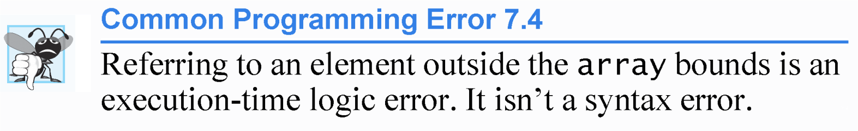
03
Common Errors

Slide 45
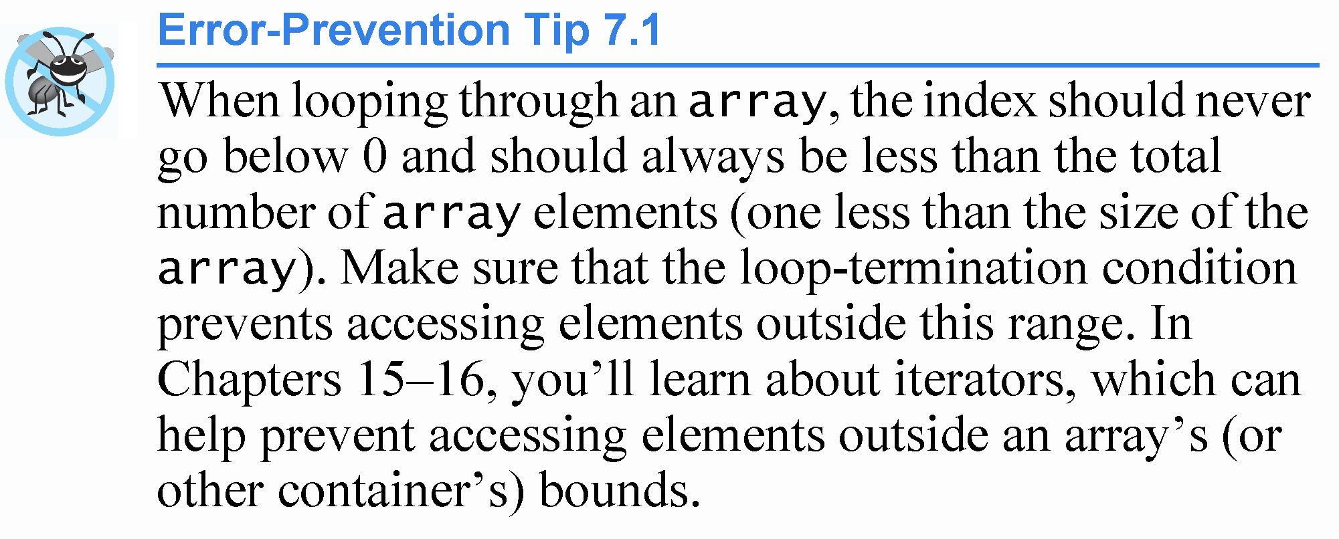
03
Common Errors

Slide 46
7.4.8 Static Local arrays and Automatic Local arrays
02
Arrays in C++
If a static array is not initialized explicitly by you, each element of that array is initialized to zero by the compiler when the array is created.
A program initializes static local arrays when their declarations are first encountered.

Slide 47
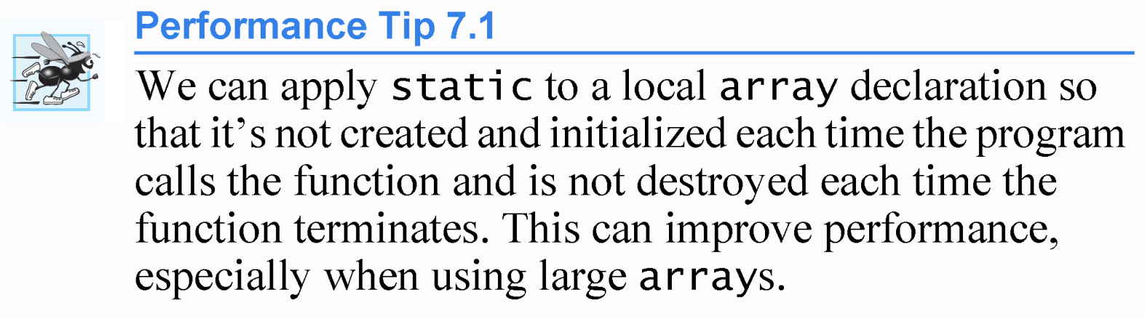
02
Arrays in C++

Slide 48
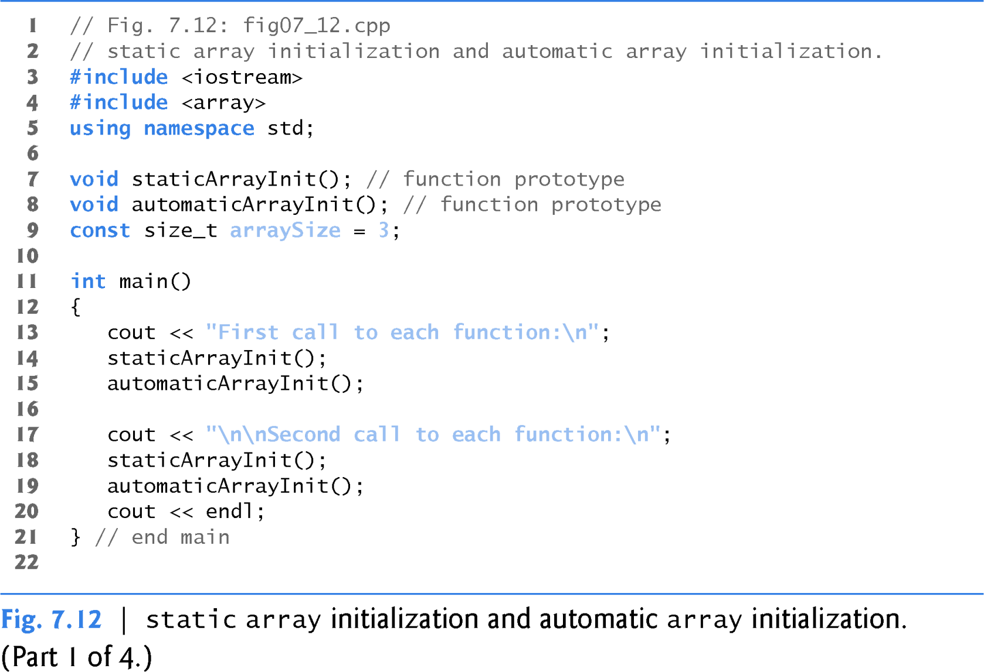
02
Arrays in C++

Slide 49
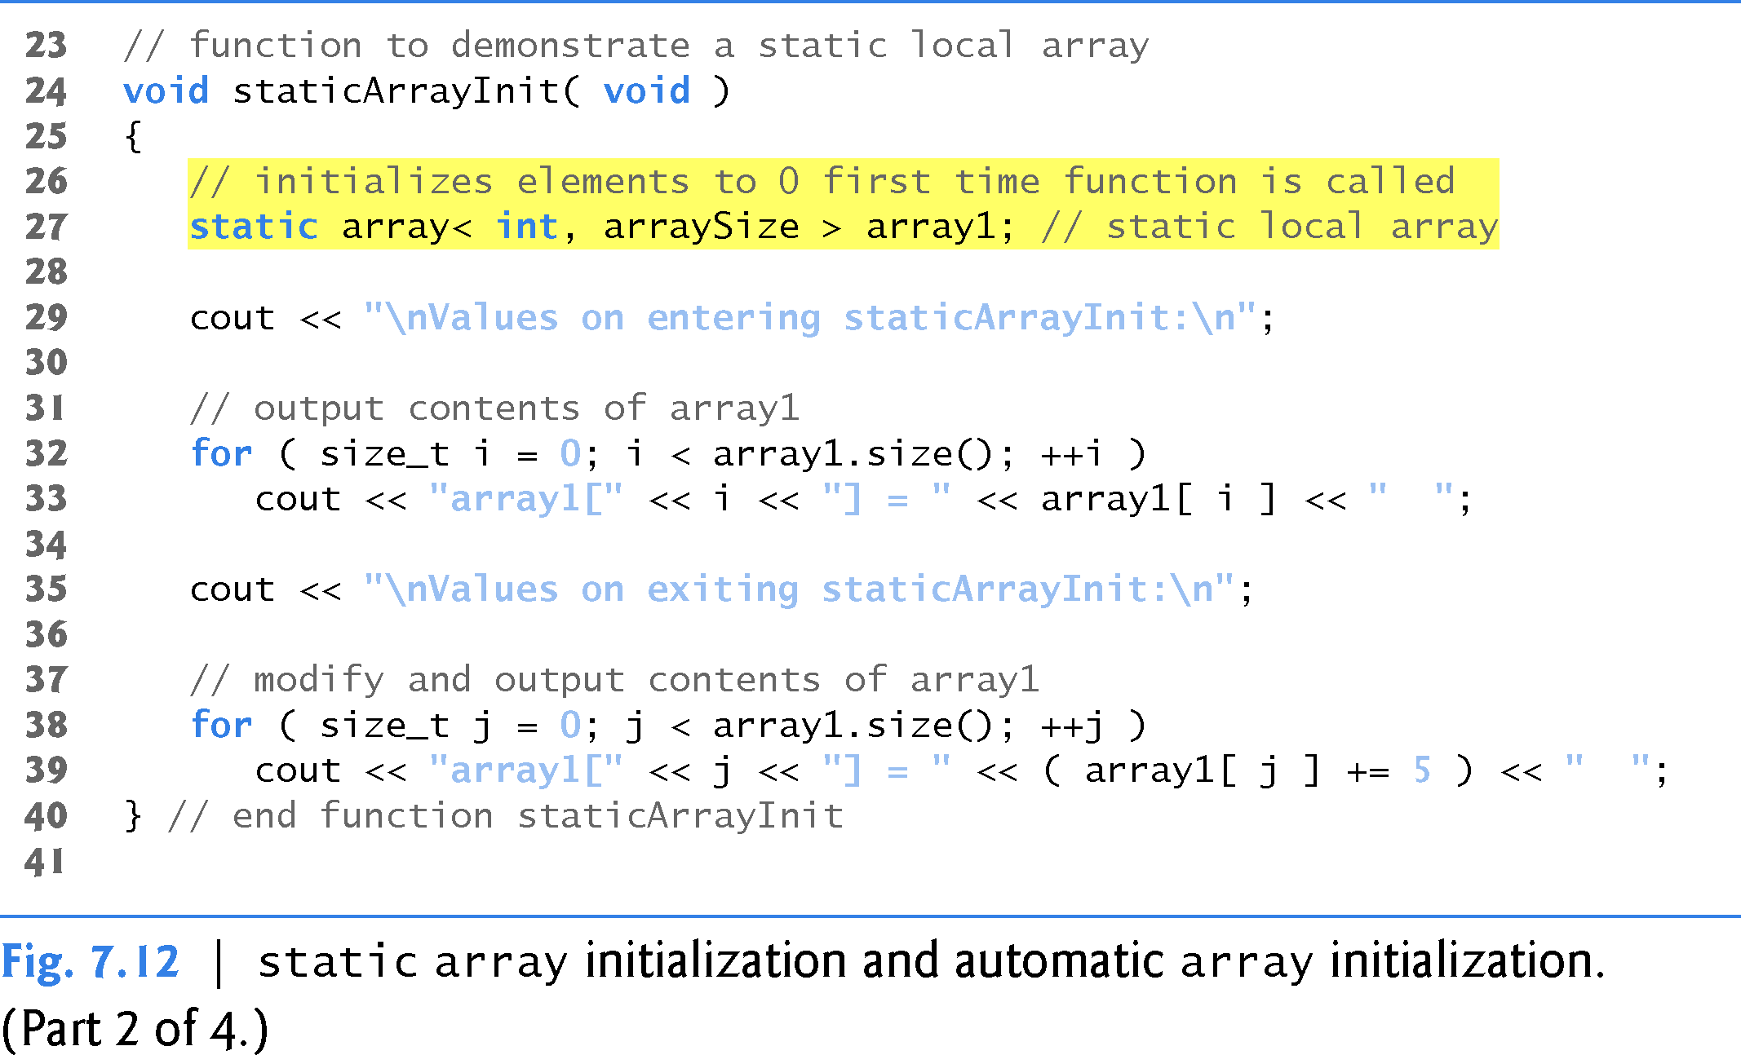
02
Arrays in C++

Slide 50
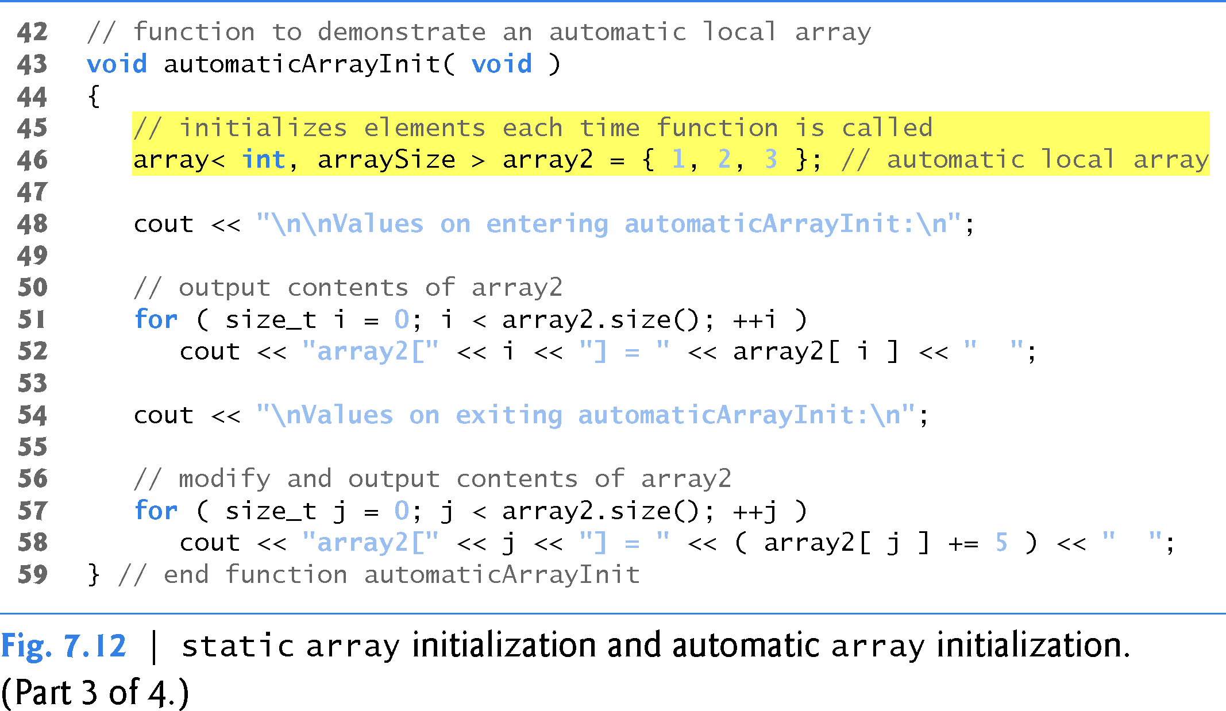
02
Arrays in C++

Slide 51
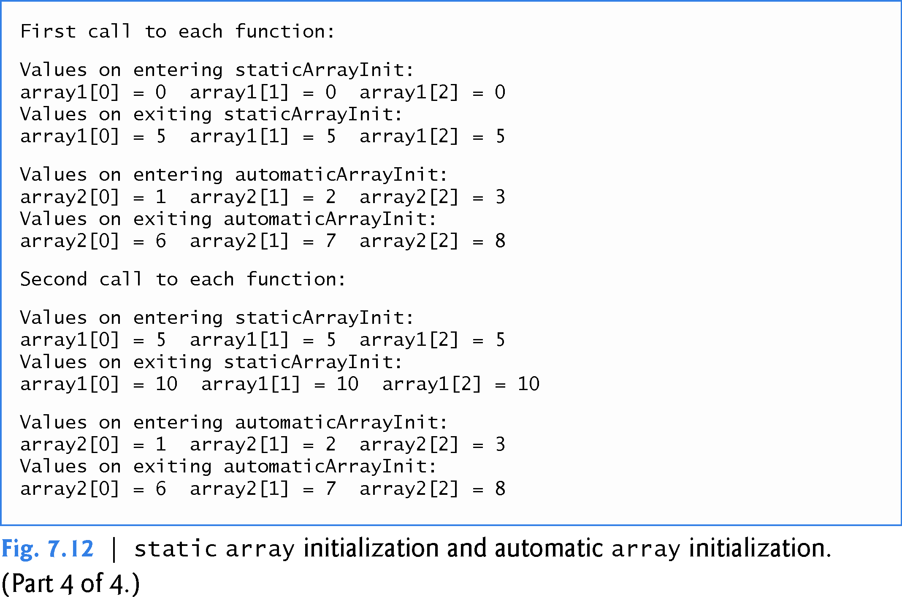
02
Arrays in C++

Slide 52
It’s common to process all the elements of an array.
05
Range Based For loop in C++11
The new C++11 range-based for statement allows you to do this without using a counter, thus avoiding the possibility of “stepping outside” the array and eliminating the need for you to implement your own bounds checking.

Slide 53
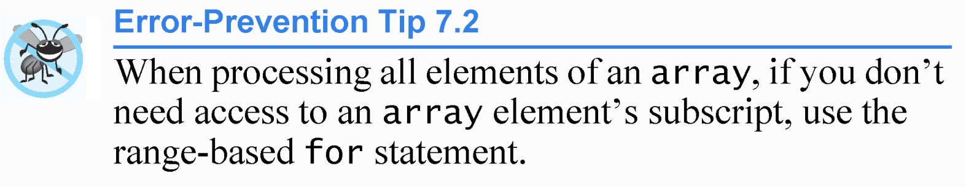
05
Range Based For loop in C++11

Slide 54
05
Range Based For loop in C++11
The syntax of a range-based for statement is:
for ( rangeVariableDeclaration : expression )
statement
where rangeVariableDeclaration has a type and an identifier (e.g.,
int item), and expression is the array through which to iterate.
The type in the rangeVariableDeclaration must be consistent with the type of the array’s elements.
The identifier represents successive array element values on successive iterations of the loop.

Slide 55
05
Range Based For loop in C++11
You can use the range-based for statement with most of the C++ Standard Library’s prebuilt data structures (commonly called containers), including classes array and vector.
Figure 7.13 uses the range-based for to display an array’s contents (lines 13–14 and 22–23) and to multiply each of the array’s element values by 2 (lines 17–18).

Slide 56
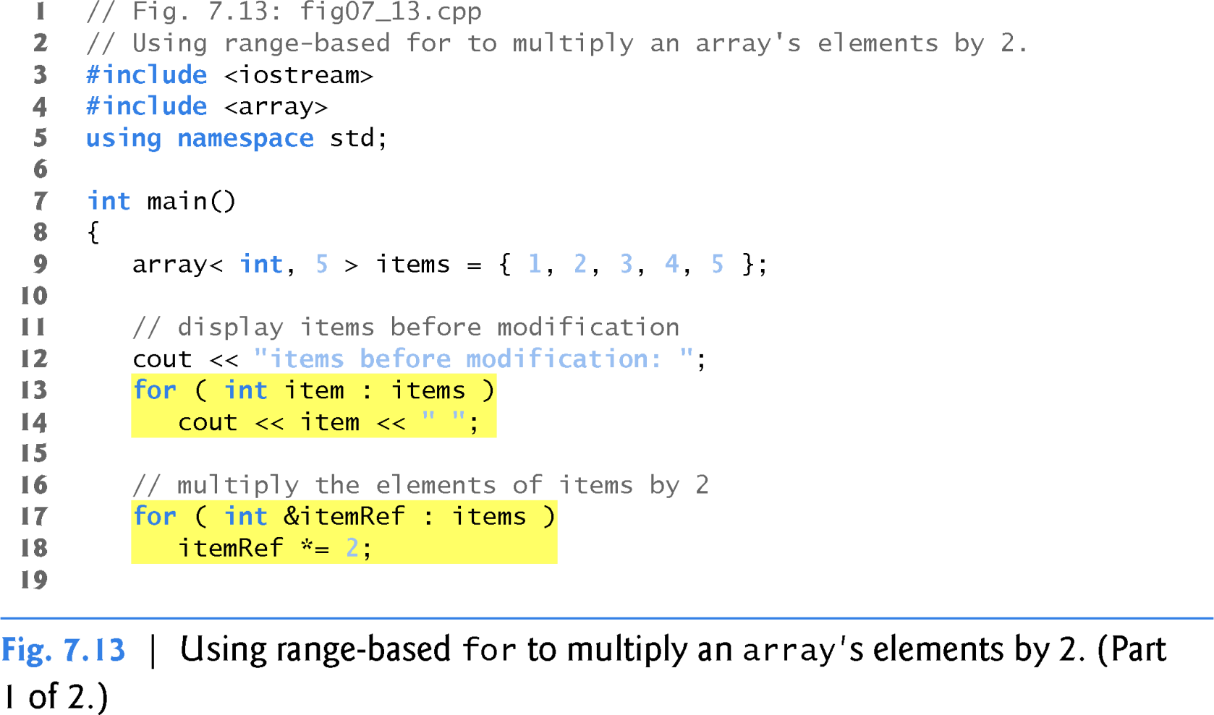
05
Range Based For loop in C++11

Slide 57
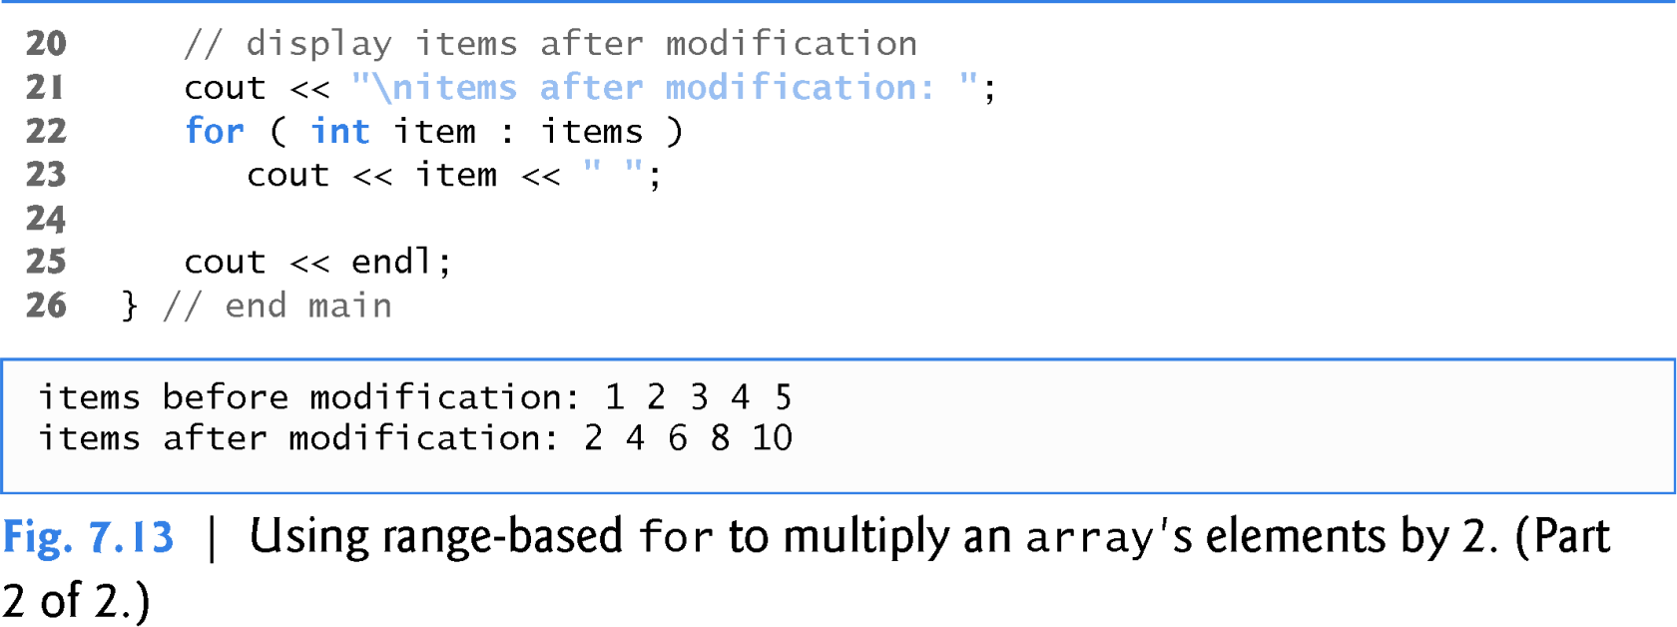
05
Range Based For loop in C++11

Slide 58
05
Range Based For loop in C++11
Using the Range-Based for to Display an array’s Contents
The range-based for statement simplifies the code for iterating through an array.
Line 13 can be read as “for each iteration, assign the next element of
items to int variable item, then execute the following statement.”
Lines 13–14 are equivalent to the following counter-controlled repetition:
for ( int counter = 0; counter < items.size(); ++counter ) cout << items[ counter ] << " ";

Slide 59
05
Range Based For loop in C++11
Using the Range-Based for to Modify an array’s Contents
Lines 17–18 use a range-based for statement to multiply each element of items by 2.
In line 17, the rangeVariableDeclaration indicates that itemRef is an int reference
(&).
We use an int reference because items contains int values and we want to modify each element’s value—because itemRef is declared as a reference, any change you make to itemRef changes the corresponding element value in the array.

Slide 60
05
Range Based For loop in C++11
Using an Element’s Subscript
The range-based for statement can be used in place of the counter- controlled for statement whenever code looping through an array does not require access to the element’s subscript.
However, if a program must use subscripts for some reason other than simply to loop through an array (e.g., to print a subscript number next to each array element value, as in the examples early in this chapter), you should use the counter-controlled for statement.

Slide 61
This section further evolves class GradeBook, introduced in Chapter 3 and expanded in Chapters 4–6.
04
Practice
7.6 Case Study: Class GradeBook Using an array to Store Grades
Previous versions of the class process grades entered by the user, but do not maintain the individual grade values in the class’s data members.
Thus, repeat calculations require the user to reenter the grades.
In this section, we store grades in an array.

Slide 62
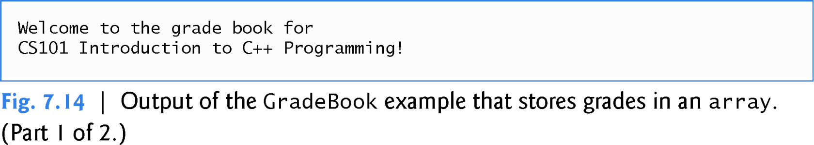

Slide 63
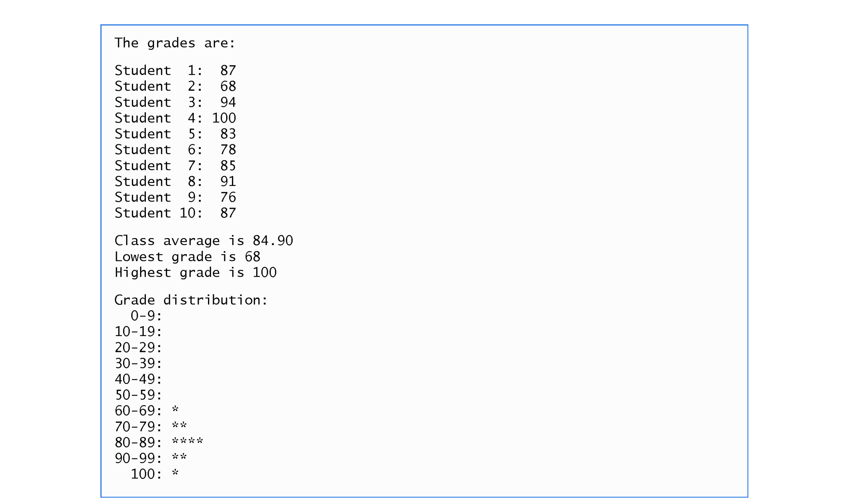

Slide 65


01211626904
www.roboticscorner.tech
Robotics Corner
Robotics Corner
Robotics Corner
Robotics Corner

