Slide 1
Author identification system
Salma Wanja Mbogori

Slide 2
OVERVIEW/PROBLEM STATEMENT
Anyone with an internet access is able to anonymously post on many platforms. Some use this as an opportunity to spread hate and threats which may escalate to violence. It is difficult to identify who wrote what.
In the history of literature, there have been multiple publications on various topics that have been written anonymously often due to their political and controversial nature or the authors wanting to keep their privacy. Often these mysterious authors tend to release more than one publication and it becomes difficult to identify their work to someone who may be interested in it.

Slide 3
OBJECTIVES
System Objectives
To use a machine learning algorithm to develop a system that is able to identify the owner of a specific written text.
Research Objectives
To understand the workings of existing algorithms in natural language processing used for author identification.
To establish a set of factors considered in the determination of the author of a text exert.
To evaluate the benefits and problems of existing author identification software.

Slide 4
ISSUES RAISED
Improvement on the literature review
Better understanding of the system
Determine which type of text

Slide 5
REQUIREMENT ANALYSIS
Online research on which aspects of text to consider to identify author of a text
Research on the most suitable classification algorithms to be used to identify texts
Feasibility study

Slide 6

SAMPLE CODE

Slide 7
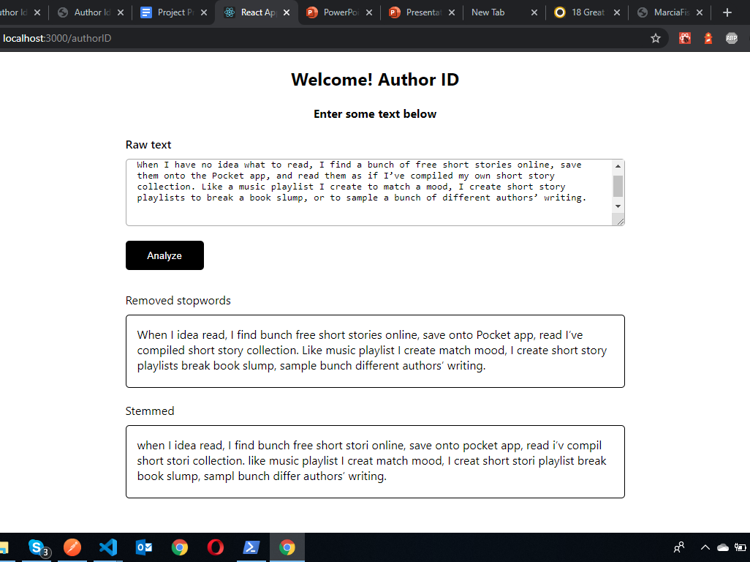
UI of Author ID sample output

Slide 8
PROPOSED SOLUTIONS

Slide 9
TEXT ANALYSIS
Involves preparing the text to be in a proper form that the machine learning algorithm can work with steps;
Tokenizing - breaking up strings into tokens
Parts of speech tagging - identified tokens are assigned grammatical category.
Parsing - this involves creating syntactic structures based on token and PoS models specified.
FEATURE EXTRACTION
In this step, the annotated text is converted into features which are simple objects that contain a name and a value which gives a machine learning algorithm a sample text that is easier to process. In this phase, certain attributes of the text are taken into consideration to create features.
During feature extraction, very many features may be created which makes is difficult to analyze each and every variable. Dimension reduction allows reduction of the number of features without losing vital information while improving the performance of the algorithm.
AUTHOR CLASSIFICATION
The dataset is split into training and validation sets. The training set will be used to train a classifier which will predict the auther of the text.

