Slide 1
Algorithms and Data Structures Lecture-1
Implementation and applications using C lang
Prepared by Mazen Osama
Copyright-IMT school

Slide 2

Who Am I ?
Mechatronics – ASU
3D Printing engineer
ITI graduate (Top of Class )
Embedded systems instructor @ IMT school
Embedded Systems Engineer @ Coretech innovations
You can find me @ linkedin and github

Slide 3
Table of contents
The What and Why ? Of DS and A
Recall..Arrays
Recall..Multi-dimensional Arrays
Applications on Arrays: Matrices
Implementation of dynamically allocated array data type.

Slide 4
The What and Why ?
Programming:
=
Problem solving + lang-syntax

Slide 5
The What and Why ?
What are Data structures ?
A collection of data that can be manipulated in a specific way

Slide 6
What are Data structures
Terminology:
Element: the simplest data unit
It consists of:
Index: the position of the element in the data structure.
Record: the actual data contained in the element.

Slide 7
What are Data structures
DS operations:
Create/destroy
Insert/deletion/append/clear of elements
Read/Write access
Traversal
Search
Sort
Print (one element or more or All of DS )

Slide 8
The What and Why ?
What are Algorithms ?
An algorithm is simply a list of defined steps that when executed , will solve a given problem.
It’s like cooking :D !!!

Slide 9
Algorithms and Data structures
Data Structures
Algorithms

Slide 10
Arrays
Linear data structure
Elements are in contiguous memory locations
Homogenous : All elements have same data type.
Random Access
Simplest data structure
Building block of other DS
Implemented by in C

Slide 11
Arrays: 1-D array
Index | 0 | 1 | 2 | 3 | 4 | 5 | .. | .. | N-1
Record

Slide 12
Array operations
 | Create | Destroy
Statically (stack) | int arr[10] ;
Dynamically (heap) | int*arr=(int*)malloc(10* sizeof(int)); | free(arr);

Slide 13
Array operations: insertion
Beginning
Middle
End

Slide 14
Array operations: insertion
Lab 1:
Implement insertion of an element @ a given index of an array. Handle the case if this element is in the beginning of the array.
The program should print the array before and after insertion.
Use an int array.

Slide 15
Array operations: insertion
Lab 2:
Implement insertion @ the end of a dynamically allocated array.
Use int array.
Assignment 1: repeat Lab 2 for strings!
Assignment 2: implement insertion of multiple elements !

Slide 16
Array operations: deletion
Lab 3:
Implement deletion of an element @ a given index of an array. Handle the case if this element is in the beginning of the array.
The program should print the array before and after deletion.
Use an int array.
Assignment 3: implement deletion of multiple elements !

Slide 17
Array operations: Indexing
Array indexing is straight forward:
Given an array int arr[]={20,25,26,18,45};
Read access: arr[2] -> 26
Write access: arr[2] = 10; //assignment

Slide 18
Array operations: Printing
Congrats !!
That has been done already :D !!

Slide 19

Array operations: Search & sort
Here we must stop to think !!

Slide 20
Array: N-D
Arrays in C can be multi-dimensional.
Ex: 2-D array:

Slide 21
Array: N-D
How does it work ?
Calculate address of i th element:
Notes:
*(arr+i)

Slide 22
Array: N-D
How does it work ?

Slide 23
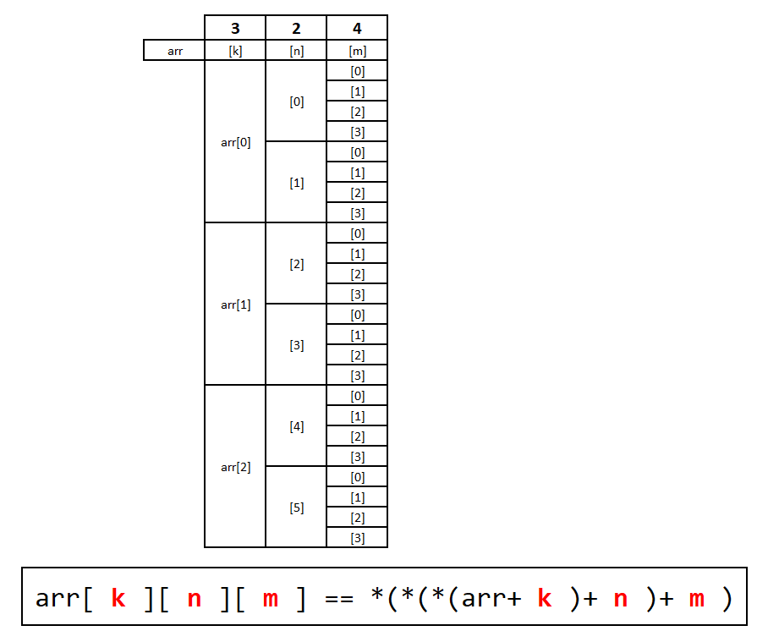
Array: 2-D
int arr[2][4] = {
{10,20,30},
{40,50,60},
.
.
};

Slide 24
Array: 3-D
int arr[3][2][4] = {
{10,20,30},
{40,50,60},
.
.
};
Assignment 4: Calculate the address of an element in an 3-D array:

Slide 25
Array: 3-D

Slide 26
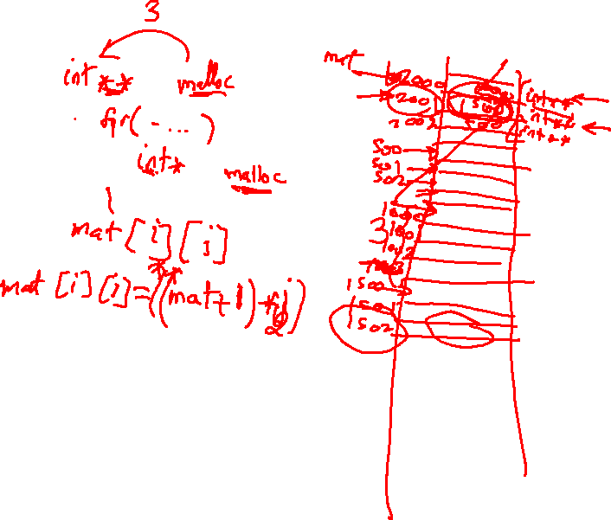

Slide 27
Array 2-D applications:
Matrix Multiplication:
Lab 4: write a c program to multiply two matrices together using the matrix multiplication rules.
use int arrays.
use square matrix (Assignment: not Square!)
Size of matrix is 3x3

Slide 28
Array 2-D applications:
Image processing :O !!!!!
Research: apply a filter on an image

Slide 29
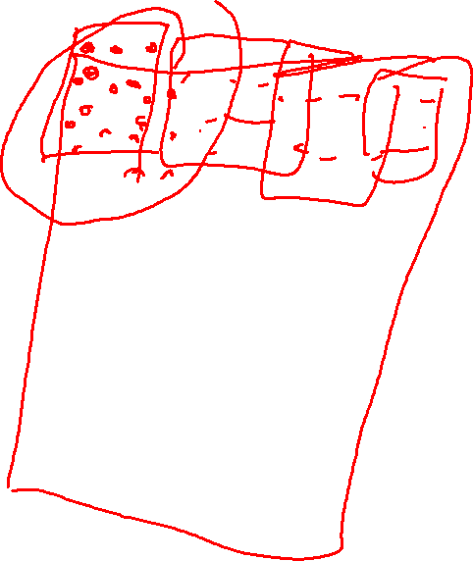
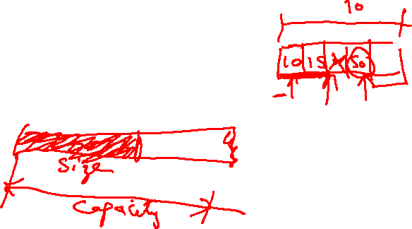

Slide 30
Array operations: Search & sort (continued)
Here we must stop to think !!

