Slide 1
Algorithms and Data Structures Lecture-2
Implementation and applications using C lang
Prepared by Mazen Osama
Copyright-IMT school

Slide 2

Who Am I ?
Mechatronics – ASU
3D Printing engineer
ITI graduate (Top of Class )
Embedded systems instructor @ IMT school
Embedded Systems Engineer @ Coretech innovations
You can find me @ linkedin and github

Slide 3
Table of contents
Algorithms: Complexity analysis
Algorithms: the array Search problem
Linear search
Binary search
Algorithms: the array Sorting problem
Bubble sort
Selection sort
Insertion sort

Slide 4
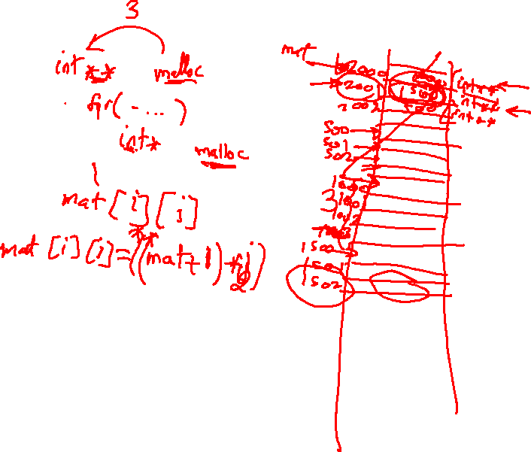

Slide 5
Array 2-D applications:
Matrix Multiplication:
Lab 4: write a c program to multiply two matrices together using the matrix multiplication rules.
use int arrays.
use square matrix (Assignment: not Square!)
Size of matrix is 3x3

Slide 6
Array 2-D applications:
Image processing :O !!!!!
Research: apply a filter on an image

Slide 7
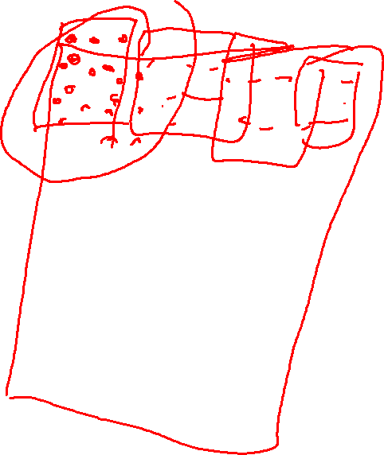
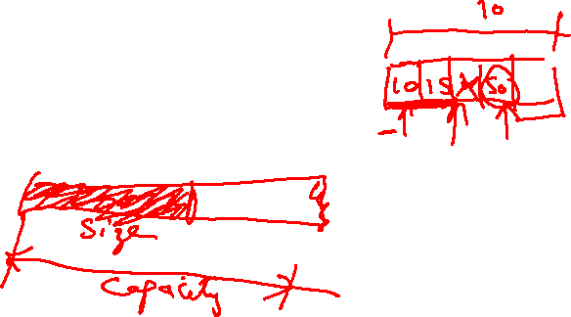

Slide 8

Array operations: Search & sort (continued)
Here we must stop to think !!

Slide 9
Algorithms: Complexity analysis
problem:
We want to analyze the speed of a given algorithm and how memory it needs to solve a given problem.
Challenges:
Different machines
Different compilers
Different programmers/implementations
Actual testing takes long time

Slide 10
Algorithms: Complexity analysis
Criteria:
Based on the size of input (N)
Worst-case scenario of the algorithm

Slide 11
Algorithms: Complexity analysis
the Big-O Notation
It’s a math. Notation used for growth functions
It has some mathematical properties.

Slide 12
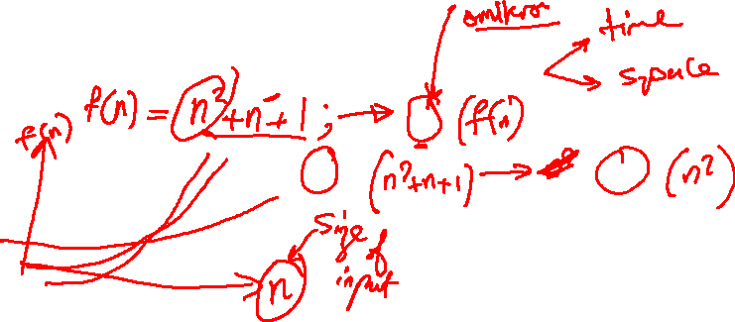
Algorithms: Complexity analysis
the Big-O Notation properties:
Notes:
Big-o mathematical properties

Slide 13
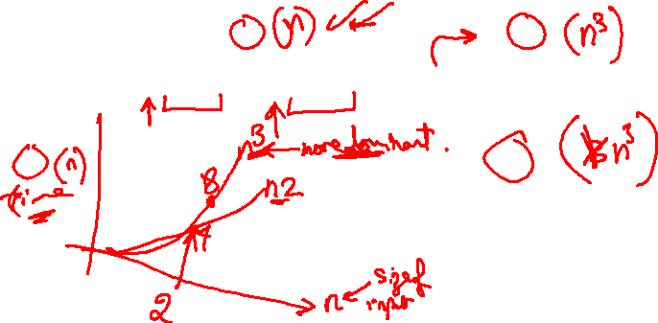
Algorithms: Complexity analysis
ex 1:
f(n) = 3n^3 + 2n^2 + 5 -> O(f(n)) ?
Notes:
Big-o mathematical properties

Slide 14
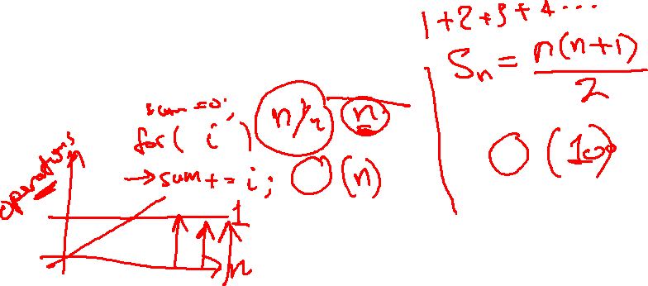
Algorithms: Complexity analysis
ex 2:
Sum the numbers from 1 -> 100
Notes:
Big-o mathematical properties

Slide 15
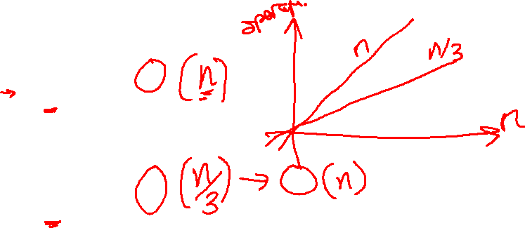
Algorithms: Complexity analysis
Ex 3:
While(i<n)
i++;
Ex 4:
While(i<n)
i+=3;
Notes:
Big-o mathematical properties

Slide 16
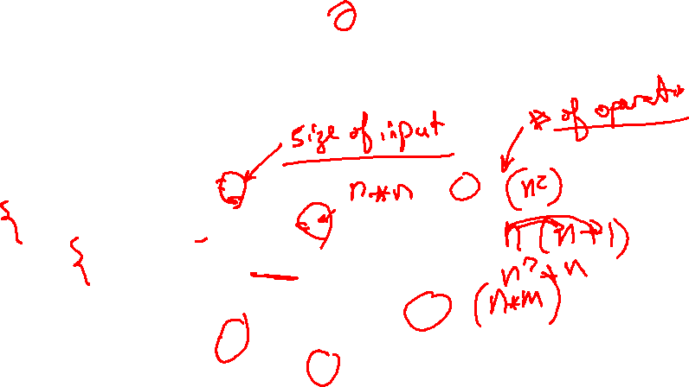
Algorithms: Complexity analysis
Ex 5:
for(int i=0; i<n; i++)
for(int j=0; j<n; j++)
/* some operation */
Ex 6:
for(int i=0; i<n; i++)
for(int j=0; j<m; j++)
/* some operation */
Notes:
Big-o mathematical properties

Slide 17
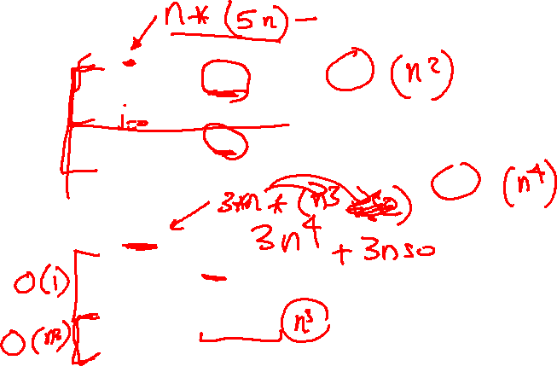
Algorithms: Complexity analysis
Ex 7:
While(i<n)
while(j<3*n)
/*work*/
while(j<2*n)
/*more work*/
Ex 8:
While(i<3*n)
while(i<50)
/*work*/
while(i<n*n*n)
/*more work*/
Notes:
Big-o mathematical properties

Slide 18
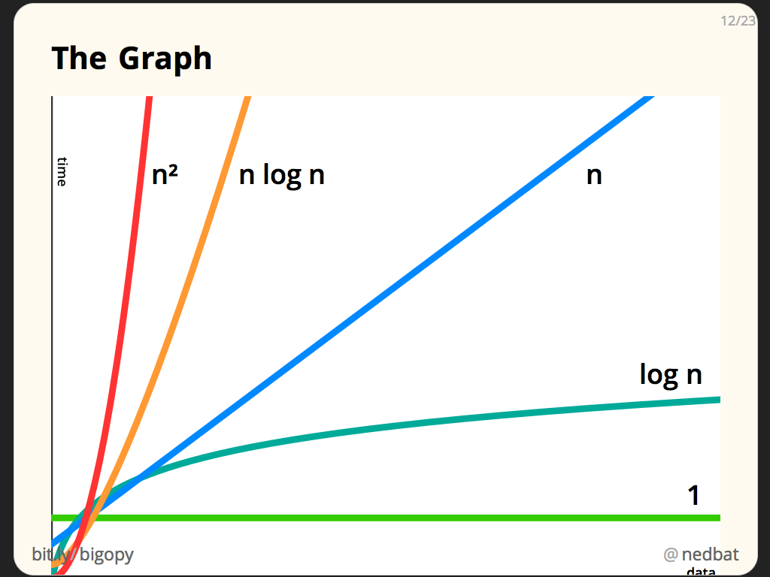
Algorithms: Complexity analysis
The big picture:

Slide 19
Algorithms: Complexity analysis
For each algorithm:
pseudocode
implementation
Complexity analysis
Corner cases
Advantages and disadvantages

Slide 20
Array operations: Search & sort (continued)
can stop thinking now ?

Slide 21
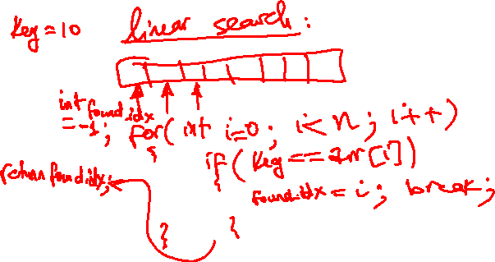
Array operations: Search
What is the best way to search for a value in a DS like an array ?

Slide 22
Array operations: Search
Lab 5:
Implement a linear search algorithm.

Slide 23
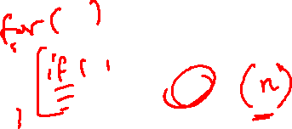
Array operations: linear Search
Complexity analysis:

Slide 24
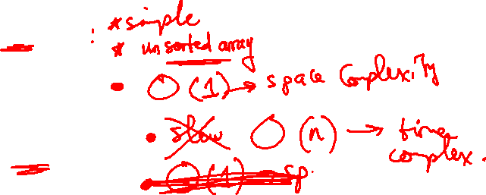
Array operations: linear Search
Advantages
DisAdvantages

Slide 25
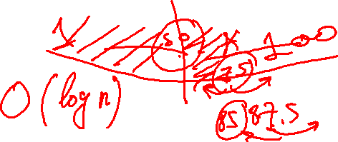
Array operations: Search
What is the best way to search for a value in a DS like an array ?

Slide 26
Array operations: Search
Lab 6:
Implement a binary search algorithm using iterative approach.
Lab 7: implement a binary search algorithm using recursion

Slide 27
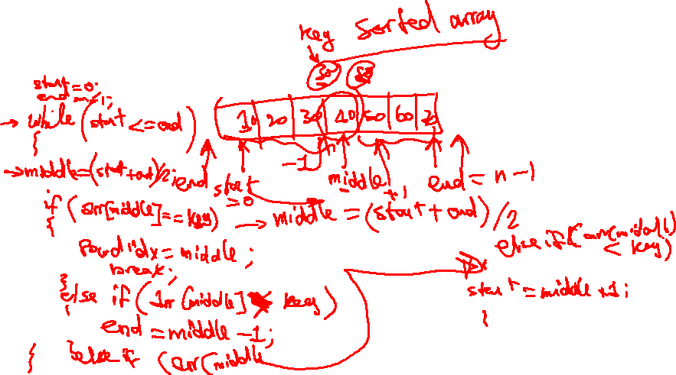
Array operations: binary Search
Complexity analysis

Slide 28
Array operations: binary Search
Advantages
diadvantages

Slide 29
Array operations: Search
Advanced applications:
String matching problem

Slide 30
Array operations: Sort
What is the best way to sort a DS like an array ?

Slide 31
Array operations: Sort
Bubble sort

Slide 32
Array operations: Sort
Complexity analysis

Slide 33
Array operations: Sort
Advantages
disadvantages

Slide 34
Array operations: Sort
Selection sort

Slide 35
Array operations: Sort
Complexity analysis

Slide 36
Array operations: Sort
Advantages
disadvantages

Slide 37
Array operations: Sort
insertion sort

Slide 38
Array operations: Sort
Complexity analysis

Slide 39
Array operations: Sort
Advantages
disadvantages

