Slide 1
GROUP MEMBERS:
Salman Shahid (L1F21bsse0136)
Mudassar Ashraf (L1f21bsse0267)

Slide 2

PROJECT NAME:
GYM MANAGEMENT SYSTEM

Slide 3
PROJECT DESCRIPTION:
As the name suggests the Gym Management System is a software that handles the entire data of the Gym. It makes the work of a Fitness Manager very easy instead of writing data in a notebook. In past, the gym managers were using notebooks to write the data along with customers’ names who purchased the gym memberships. So it was very difficult to keep track of each and every record.
If a Gym Manager wants to search for a particular gym record, then that task was very time-consuming. So, to make this task easy the programming languages were developed and the C++ language is one of them. These are some of the main objectives we are trying to achieve by developing this project:

Slide 4
CONTINUE:
We have created separate logins for the users and the gym managers i.e; admin, in which the gym manager password is protected.
In this project, the gym manager can add, update, delete gym members and can also create membership.
The user can quit the gym anytime, whenever he or she wanted.
The software gives facility for the users to edit their profiles.
Only the admin can delete and edit the membership.

Slide 5
CLASSES:
1. Gym class.
2. Admin class.
3. User class.
4. Trainer class.

Slide 6
ASSOCIATION:
Gym class associated with Admin class
Admin class associated with Trainer class.
Trainer class associated with User class.
We are using multi-level Inheritance in this project.

Slide 7
CLASS REFINING:
Gym:
Has a name
Admin:
Have an admin id
Have an admin password
Separate menu

Slide 8
CONTINUE:
Trainer:
Have trainer id
Has a trainer fee
Have a phone number
User:
Has gym fee
Has a membership
Has a name

Slide 9
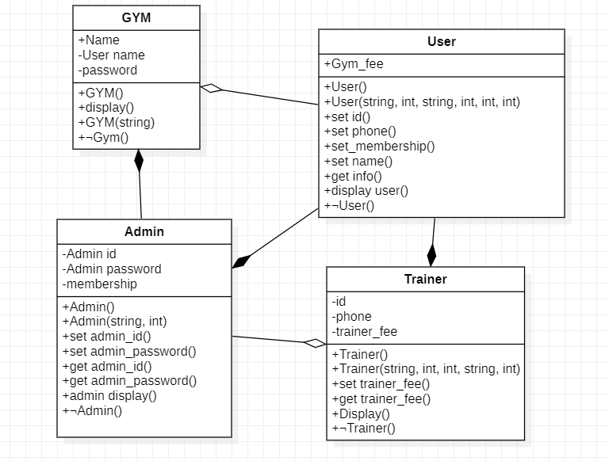
UML DIAGRAM:

Slide 10
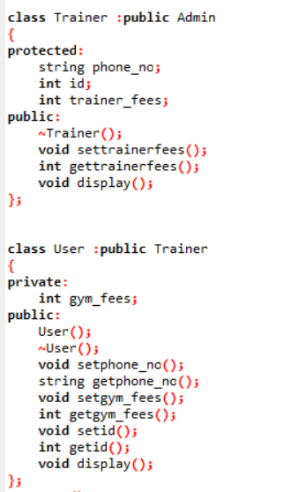
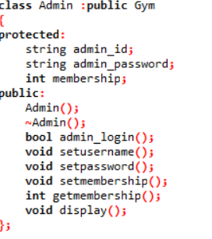
INHERITANCE:

Slide 11
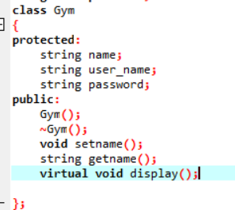
POLYMORPHISM:

Slide 12
THANK YOU

