Slide 1
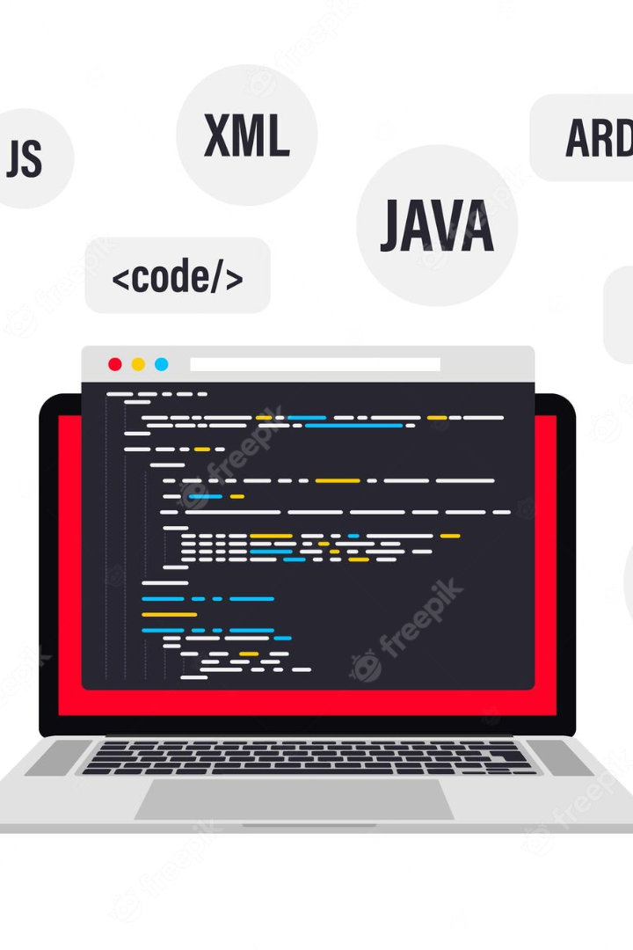

Code Quiz - A Java Desktop Quiz Application
The "Code Quiz" is the perfect tool to enhance your programming skills and assess your knowledge in an interactive and enjoyable way.

Slide 2
Meet Our Team
Salman Ahmad
Moonis Andrabi
(CSE-20-03)
(CSE-20-10)

Slide 3
How to Use Code Quiz
1
Login
2
Answer Questions
Enter your name and follow the instructions for a personalized experience.
Use your coding skills to answer multiple-choice questions and earn points.
3
Submit and Get Score
Submit your answers and receive an immediate score and feedback on your test.

Slide 4
Benefits of Using Code Quiz
Enhance Programming Skills
Test Knowledge
Self-Paced Learning
Assess your knowledge and deepen your understanding of programming concepts.
Learn at your own pace and track your progress over time.
Sharpen and test your coding skills with different programming topics and challenges.

Slide 5
Future Developments of Code Quiz
1
2
3
Additional Programming Languages
Custom Quiz Creation
Mobile Compatibility
Allow users to create their own quizzes on topics of their choice, improving their learning experience.
Make Code Quiz available for mobile devices to allow users to test their knowledge anytime and anywhere.
Expand Code Quiz's quiz offerings to include popular programming languages like Python, C++, and JavaScript.

Slide 6
Conclusion
Engaging Learning Experience
Challenging and Rewarding
Code Quiz provides an interactive and engaging learning experience for all levels of programming and computer science enthusiasts.
Test your knowledge and improve your coding skills with Code Quiz's features, personalized interface, and immediate feedback.

Slide 7
Thank You
We sincerely appreciate your time and attention.

