Slide 1
CSS FLEXBOX

Slide 2
Concepts

Slide 3
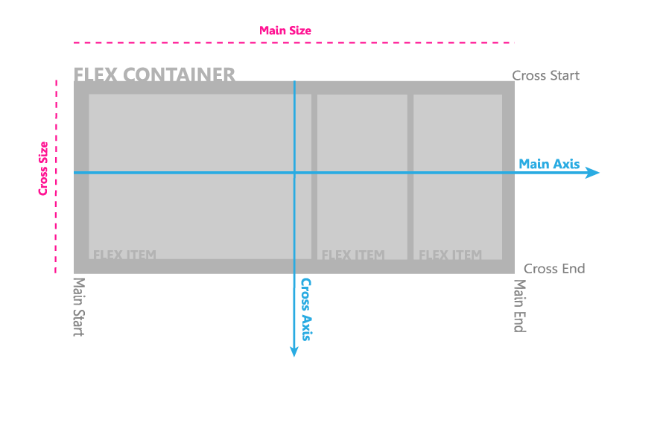

Slide 4
Properties

Slide 5
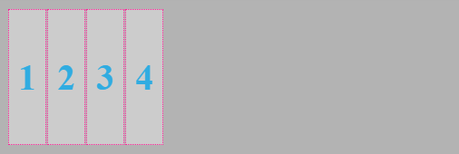
.parent {
display : flex;
}

Slide 6

.parent {
flex-direction : row-reverse;
}

Slide 7
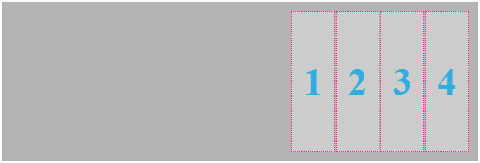
.parent {
justify-content : flex-end;
}

Slide 8

.parent {
align-items : center;
}

Slide 9
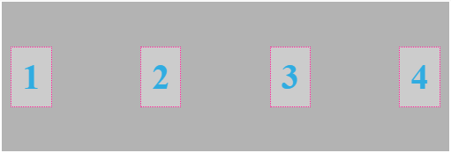
.parent {
justify-content : space-between;
}

Slide 10
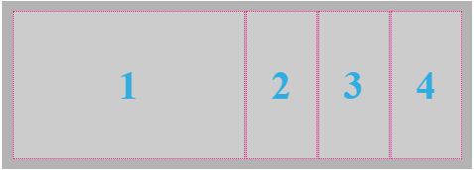
.parent {
flex-grow : 1;
flex-shrink : 1;
flex-basis : 30px;
}
.item:hover {
flex : 2 2 30px;
}

Slide 11
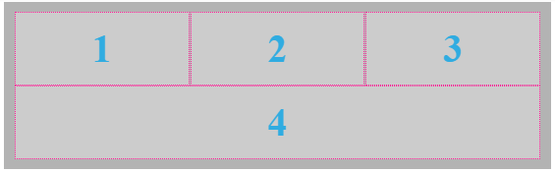
.parent {
flex-wrap : nowrap;
flex-flow : row wrap;
}
.item {
width : 150px;
flex-grow : 1;
}

Slide 12
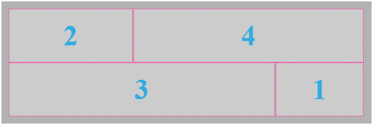
. one {
order : 3;
width : 100px;
}
. two {
order : 0;
}
. three {
order : 2;
flex-grow : 1;
}
. four {
order : 1;
flex-grow : 1;
}

