Slide 1
Credit Card Fraud Detection
Salman Irfan
2024-PhD-CS-5

Slide 2
Libraries
Data Manipulation: Pandas
Visualization: matplotlib, seaborn
Preprocessing: train_test_split, StandardScaler (for scaling Time and Amount)
Modeling: RandomForestClassifier
Evaluation: classification_report, precision_recall_curve, roc_auc_score
Class Imbalance Handling: SMOTE (addresses class imbalance by generating synthetic samples for the minority class)

Slide 3
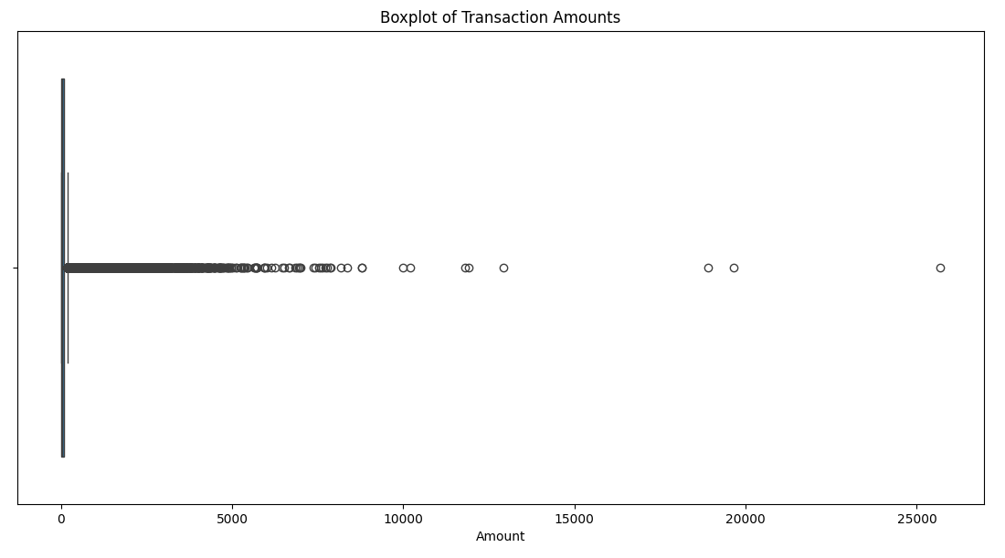
Boxplot
Interpretation of the Boxplot
Central Box:
The central rectangular box represents the Interquartile Range (IQR), which contains the middle 50% of the data (from the 25th percentile to the 75th percentile).
In this dataset:
Most of the data lies between 0 and approximately 5,000.
A small number of points (dots) extend beyond 5,000, with some outliers reaching as high as 25,000.
What the Boxplot Tells Us
High Concentration of Small Transactions:
The bulk of transactions (based on density) is clustered around amounts between 0 and 5,000. This suggests most transactions involve smaller amounts.
A small number of points (dots) extend beyond 5,000, with some outliers reaching as high as 25,000.

Slide 4
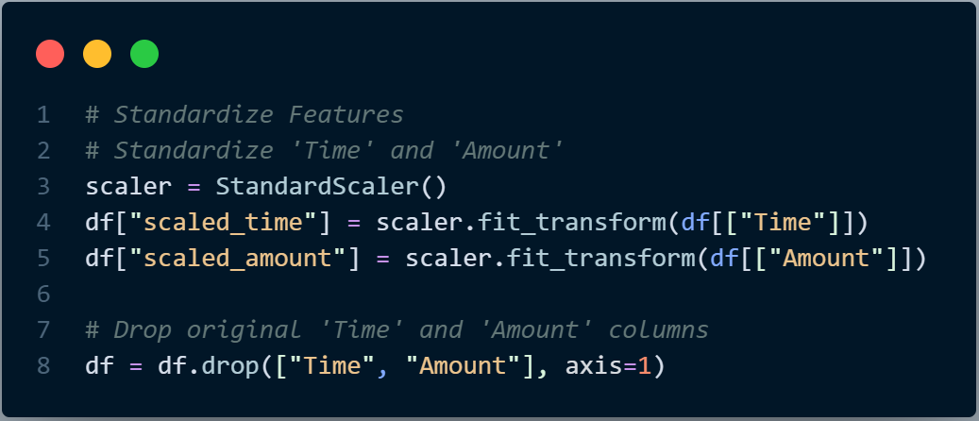
Standardize Features

Slide 5
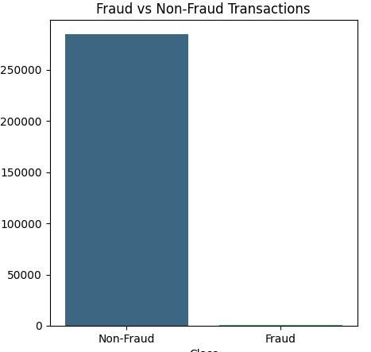
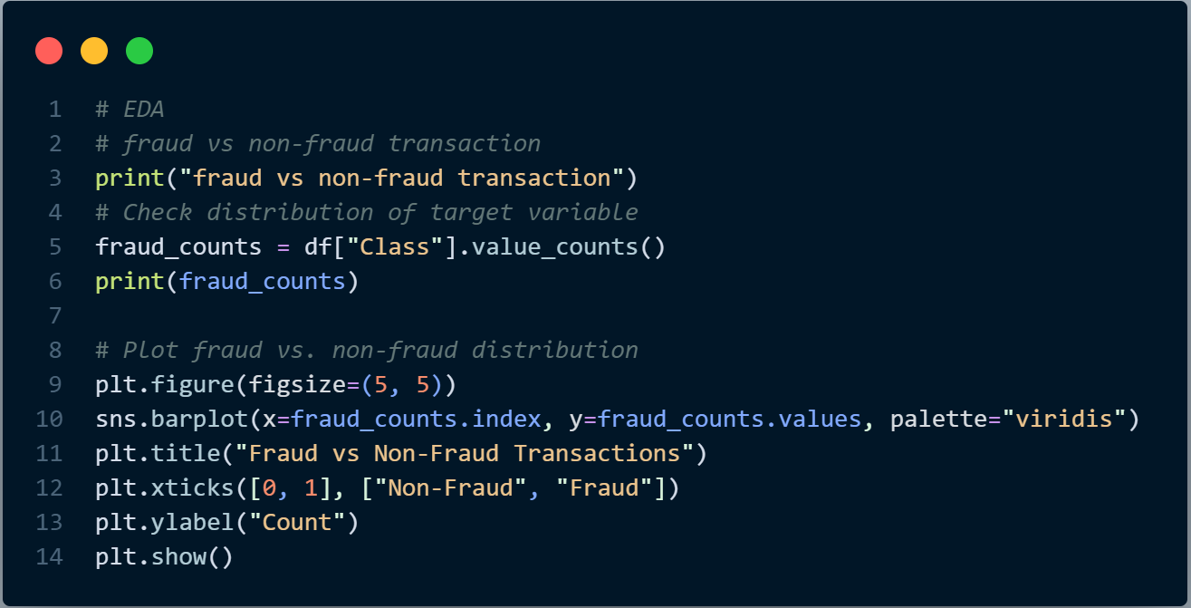

EDA
Fraud vs Non-fraud Distribution

Slide 6
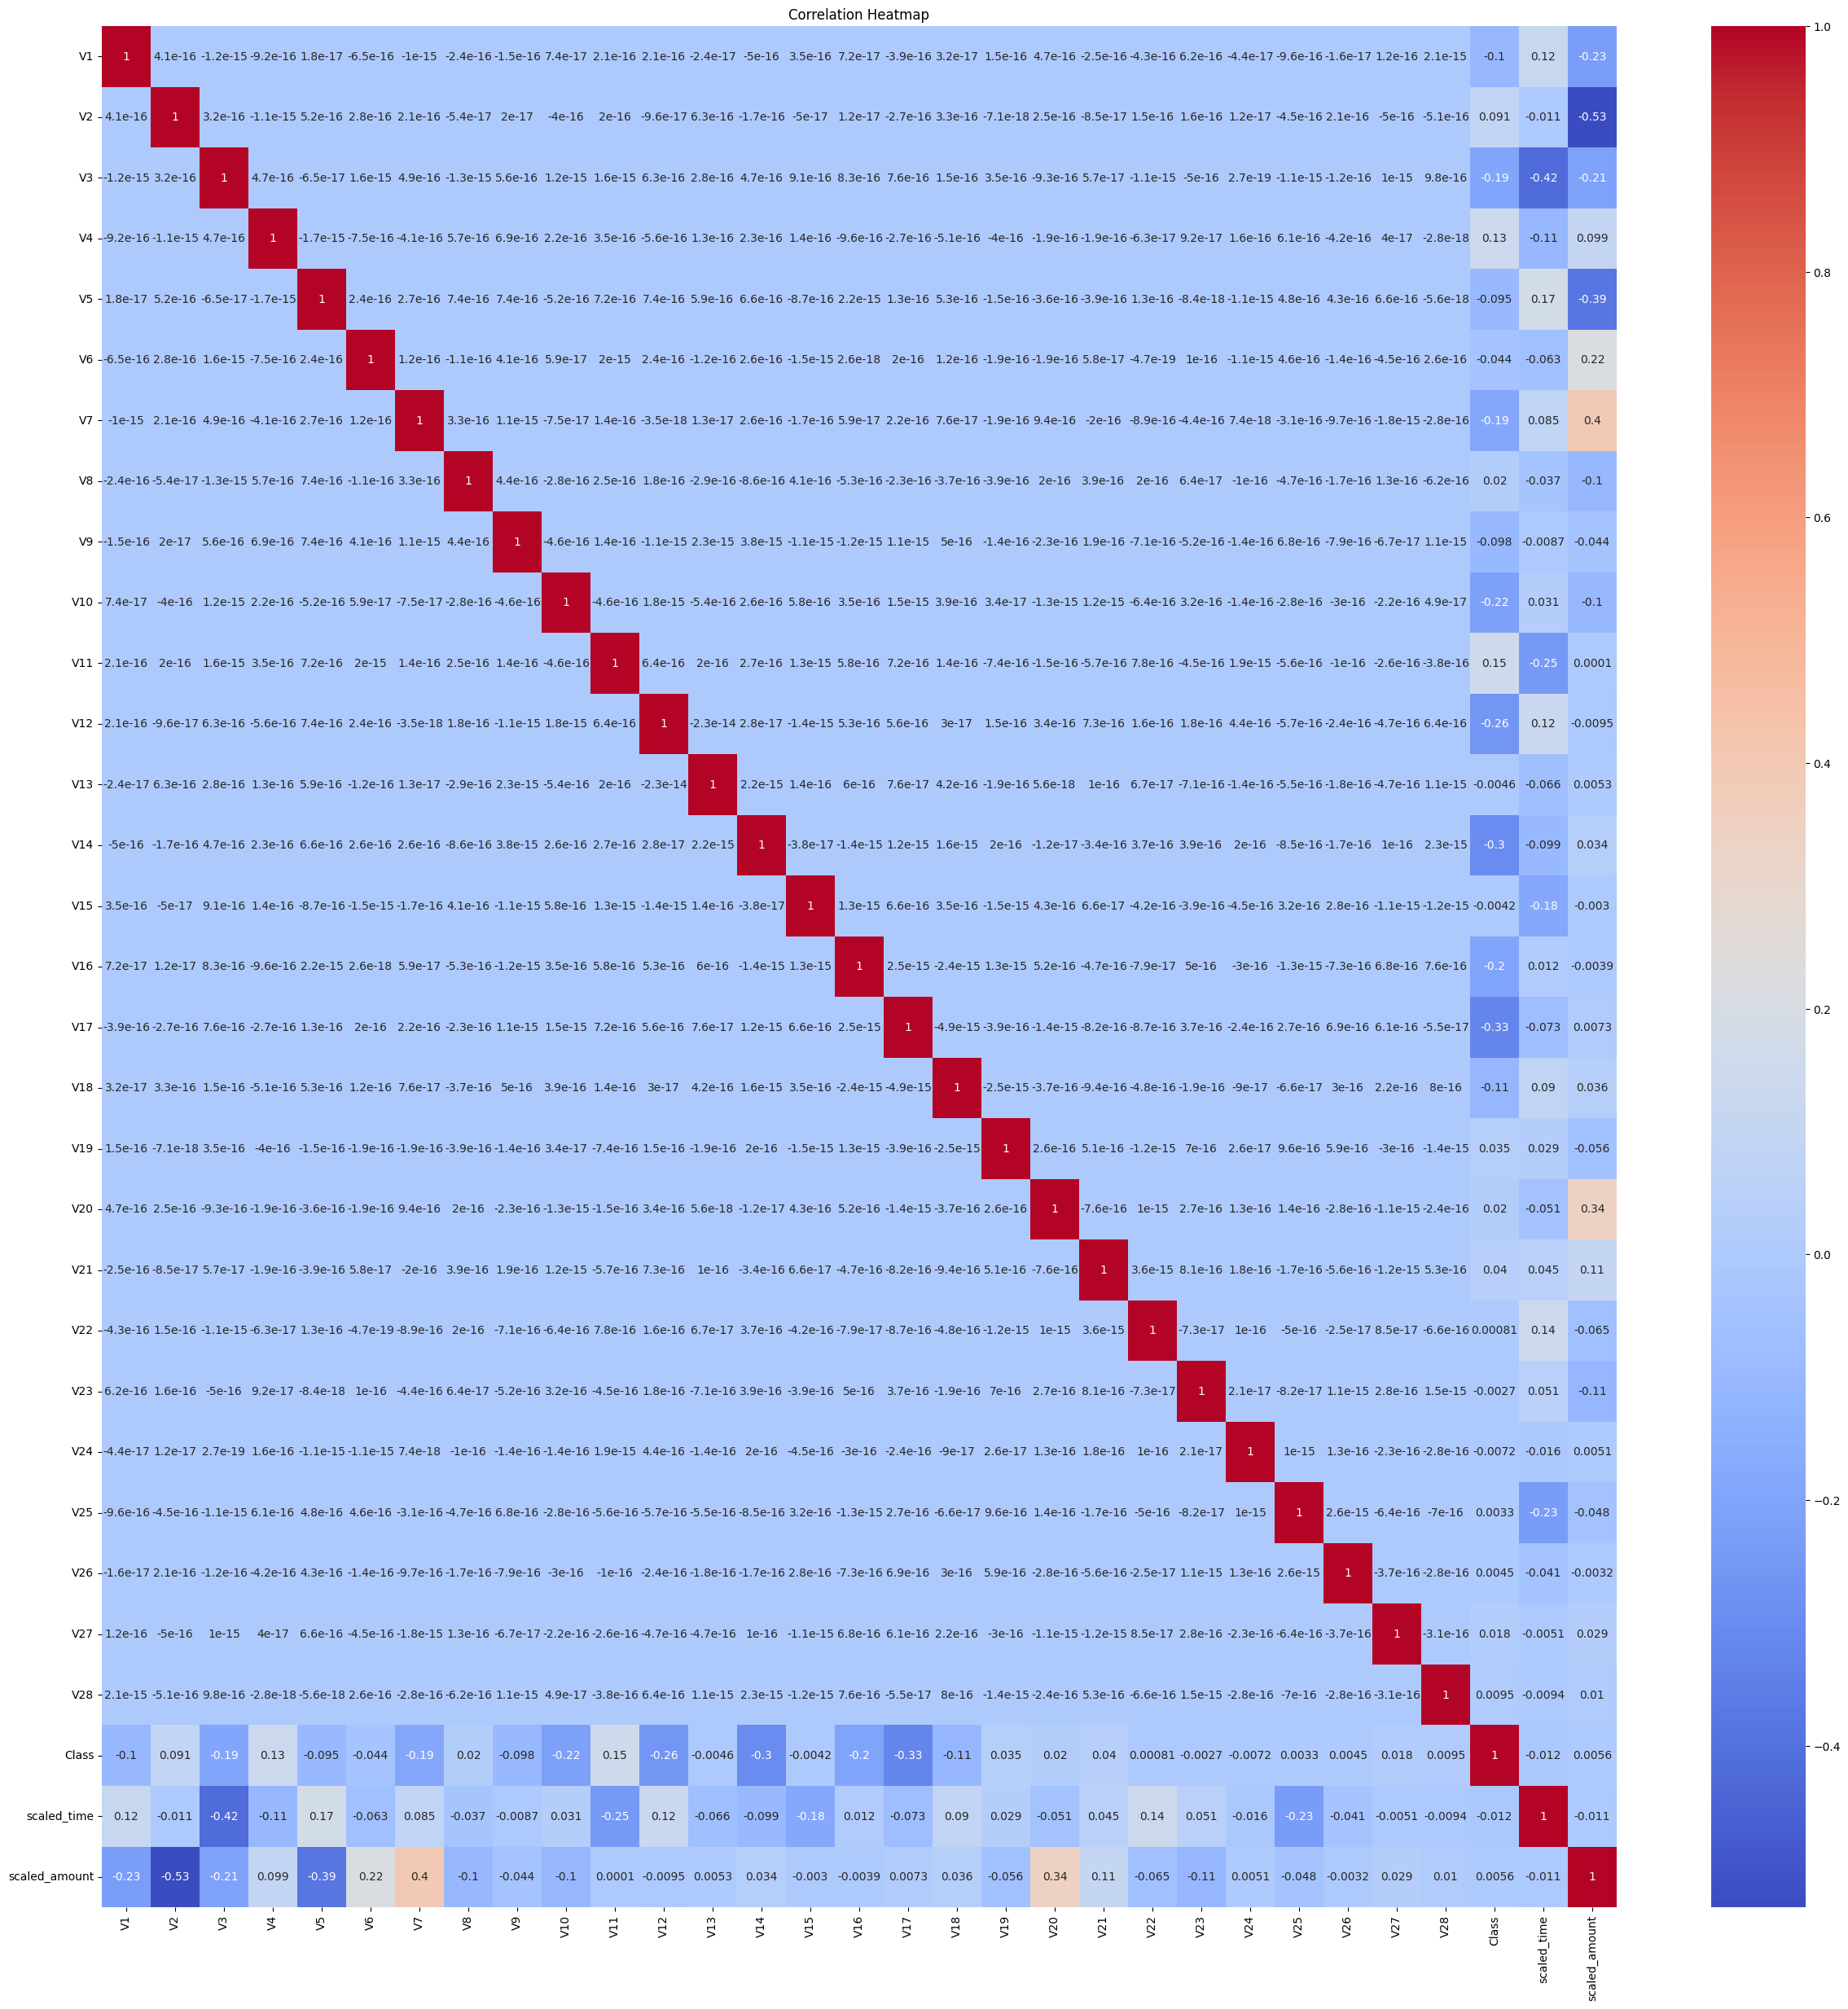
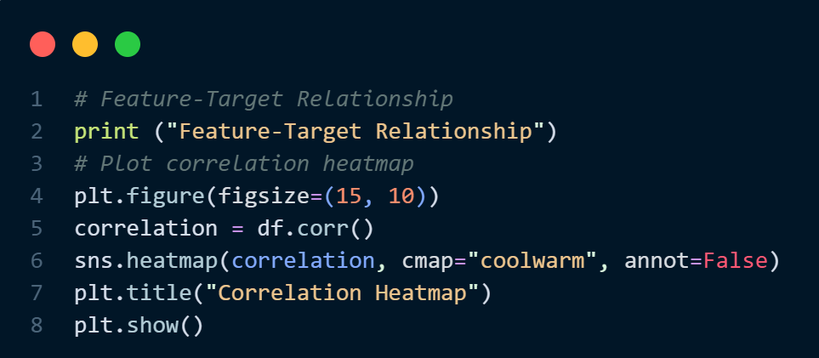
Feature-target Relationship
Correlation heatmap to explore relationships between features in a dataset.
cmap="coolwarm“
A diverging colormap with colors transitioning from cool (blue) to warm (red).
Red represents positive correlations and Blue represents negative correlations.

Slide 7
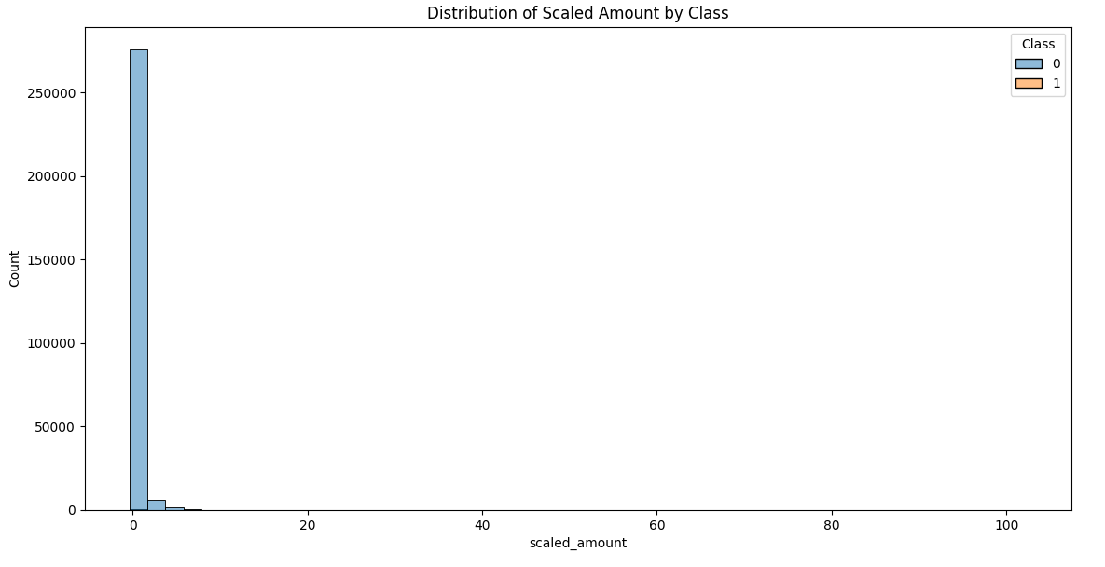
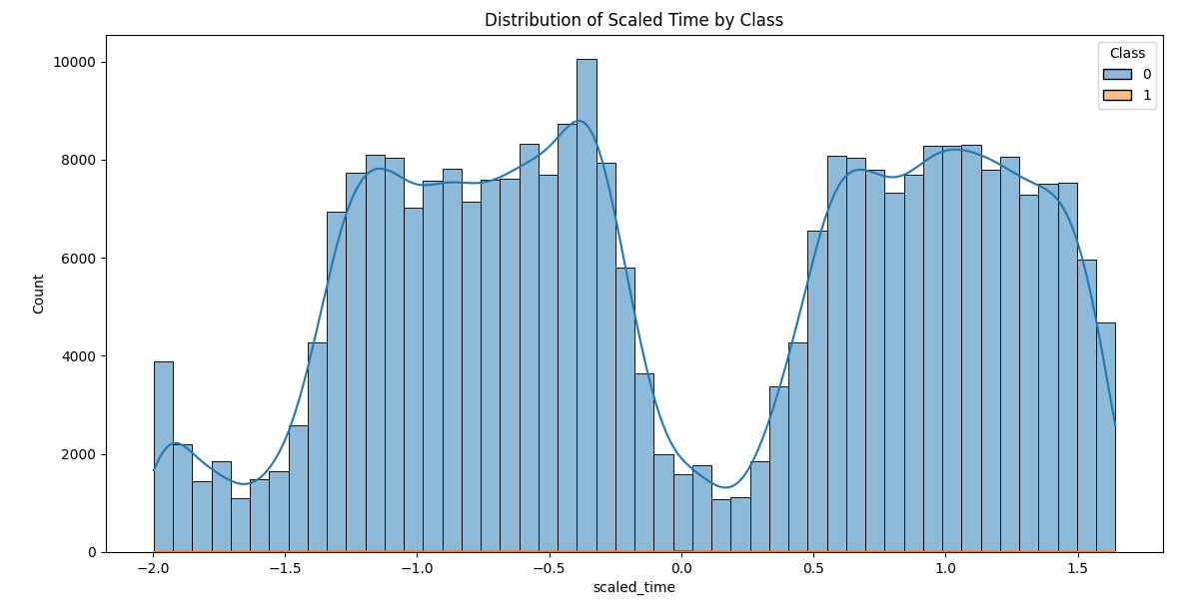
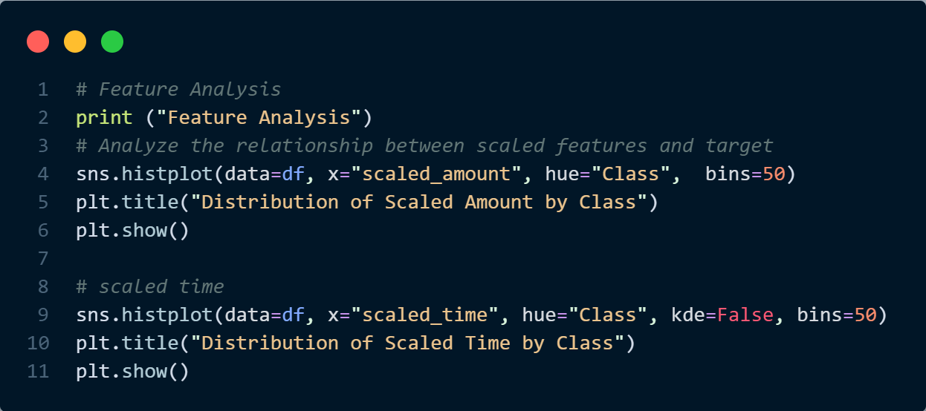
Feature Analysis
This plot is used to analyze how the features scaled_amount and scaled_time vary between fraud and non-fraud transactions, giving insights into patterns or differences between the two classes.
For Scaled Amount: Fraud cases are sparse but occur within the same range as non-fraud cases. This suggests scaled amounts alone are insufficient for distinguishing fraud.
For Scaled Time: Fraud and non-fraud cases are temporally distributed without clear separation, reinforcing the need for additional features or methods (e.g., multivariate analysis) to identify fraud effectively.

Slide 8
Predictive Analysis
The code using SMOTE (Synthetic Minority Oversampling Technique) was applied to handle the class imbalance in the dataset.
The target variable (Class) is highly imbalanced:
Non-fraudulent transactions (Class = 0) account for over 99.8%.
Fraudulent transactions (Class = 1) make up only 0. 2%.
This imbalance poses a challenge for machine learning models, which tend to be biased toward the majority class and perform poorly on the minority class (fraud).
SMOTE (Synthetic Minority Oversampling Technique) generates synthetic samples for the minority class (fraudulent transactions) by interpolating between existing samples
After applying SMOTE, the training set has a balanced number of samples for both classes, allowing the model to:
Learn patterns associated with fraud more effectively.

Slide 9
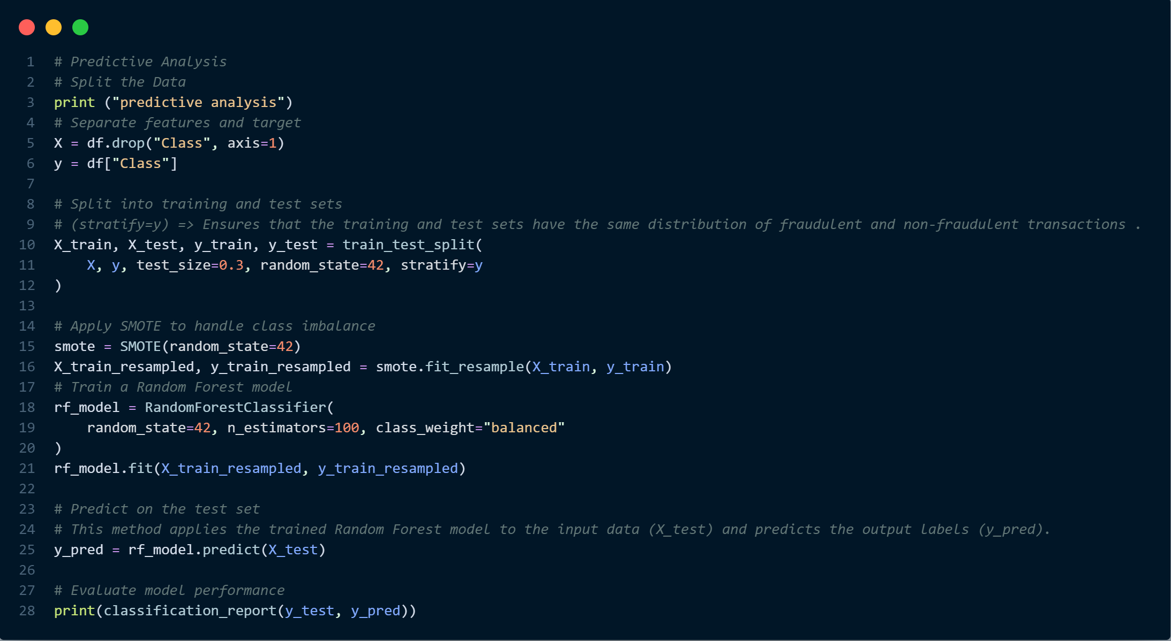
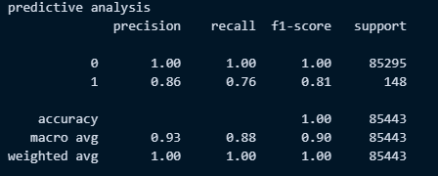
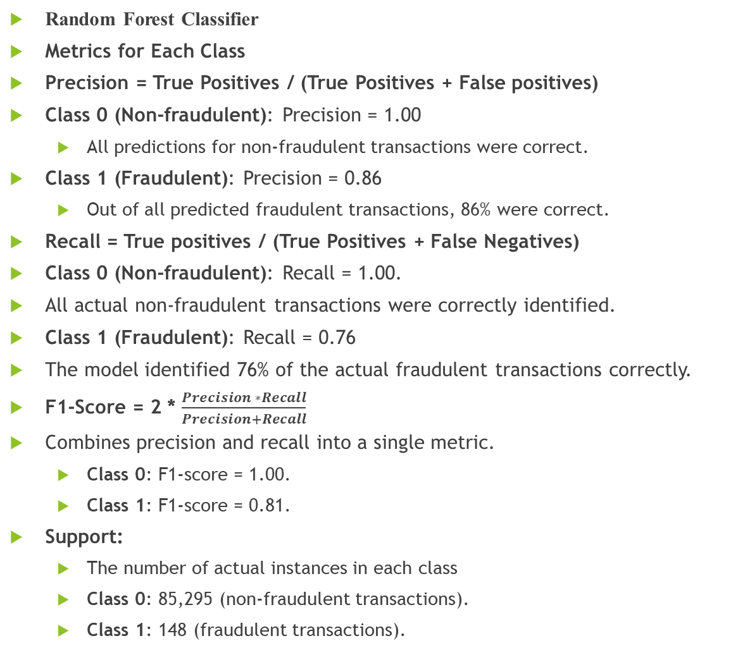
Predictive Analysis
Random Forest Classifier
Metrics for Each Class
Precision = True Positives / (True Positives + False positives)
Class 0 (Non-fraudulent): Precision = 1.00
All predictions for non-fraudulent transactions were correct.
Class 1 (Fraudulent): Precision = 0.86
Out of all predicted fraudulent transactions, 86% were correct.
Recall = True positives / (True Positives + False Negatives)
Class 0 (Non-fraudulent): Recall = 1.00.
All actual non-fraudulent transactions were correctly identified.
Class 1 (Fraudulent): Recall = 0.76
The model identified 76% of the actual fraudulent transactions correctly.
F1-Score = 2 * $\frac{Precision ∗Recall}{Precision+Recall}$
Combines precision and recall into a single metric.
Class 0: F1-score = 1.00.
Class 1: F1-score = 0.81.
Support:
The number of actual instances in each class
Class 0: 85,295 (non-fraudulent transactions).
Class 1: 148 (fraudulent transactions).

Slide 10
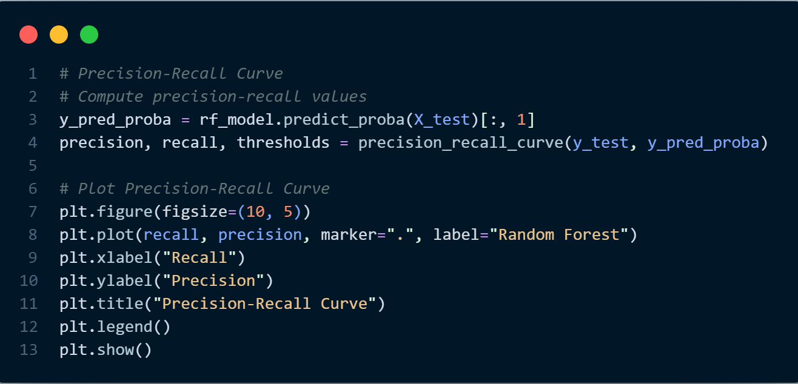
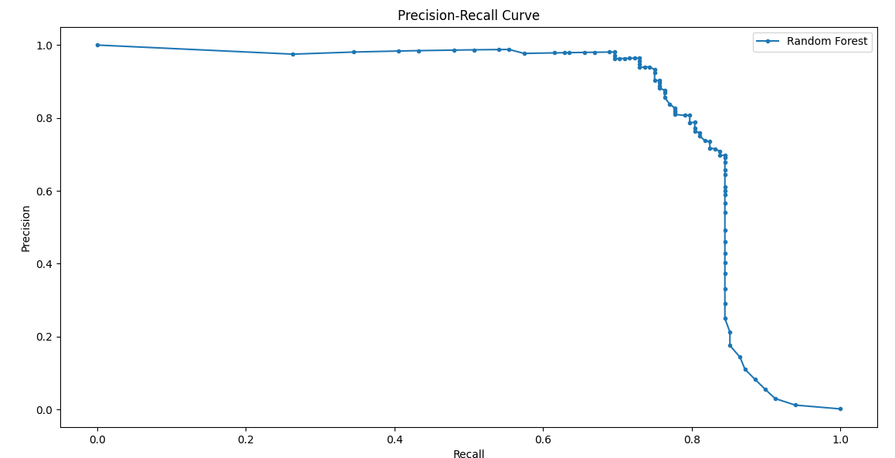
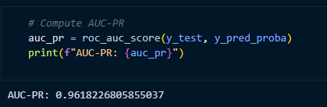
Precision-Recall Curve
Precision-Recall Curve:
Precision: The fraction of correctly predicted positive samples among all predicted positive samples.
Recall: The fraction of correctly predicted positive samples among all actual positive samples.

