Slide 1
PYTHON PROJECT
CAR RACE
FERRARI
Vs
LAMBORGHINI
vs
MERCEDES

Slide 2

import playsound → module is a cross platform module that can play audio files. This doesn't have any dependencies, simply install with pip in vs terminal
Import random → This module implements Pseudo – random number generartors for various distributions

Slide 3
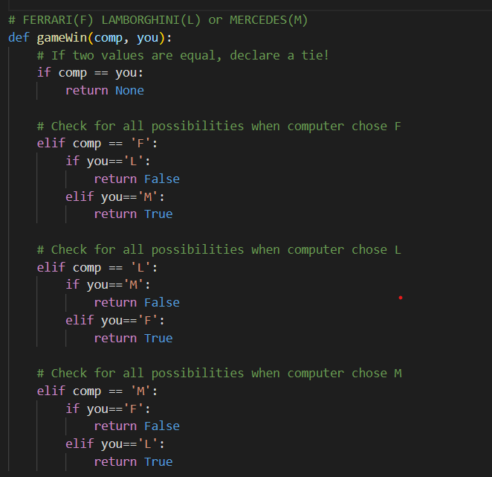

Slide 4
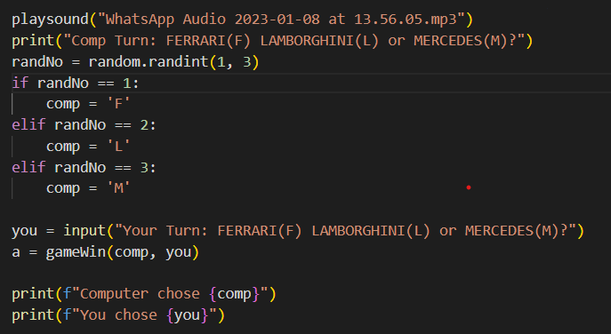
Playsound → select audio and copy the path of audio then paste in playsound
Random → Here random is computer
Input → Here user input

Slide 5
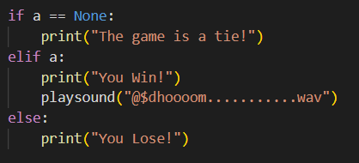
IF → FERRARI VS FERRARI __GAME IS TIE__
ELIF → FERRARI WIN __IT PLAY SONG__
ELSE → FERRARI __LOSE__

Slide 6
VOTE OF THANKS
Presented By → Salman v

