Slide 1
Pandas

Slide 2
Introduction
pandas is a Python package providing fast, flexible, and expressive data structures designed to make working with “relational” or “labeled” data both easy and intuitive.
Pandas can work with:
CSV
SQL
Json
Excel
So on
Pandas Unique Features
Easy handling of missing data
Size mutability
Automatic and explicit data alignment
Powerful, flexible group by functionality
Make it easy to convert
Intelligent label-based slicing, fancy indexing, and subsetting
Flexible reshaping and pivoting of data sets

Slide 3
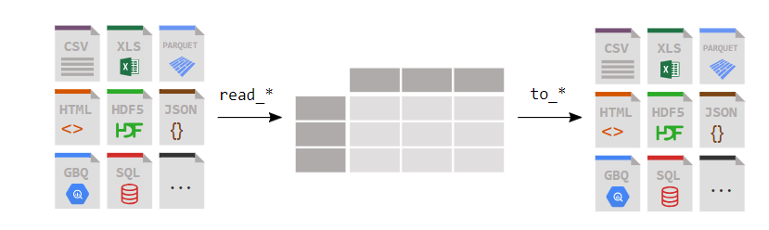
DataFrame

Slide 4
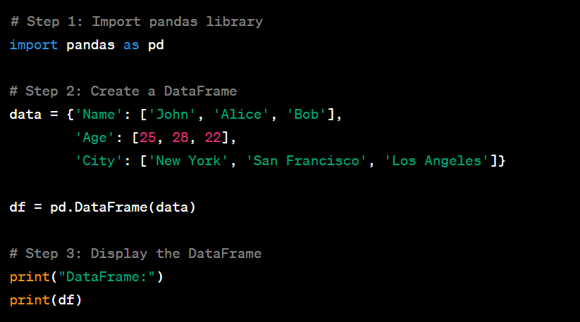
Create a DF

Slide 5
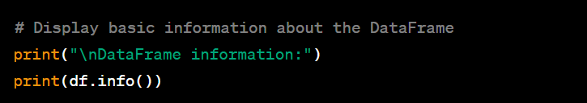
Display Info about Dataframe

Slide 6
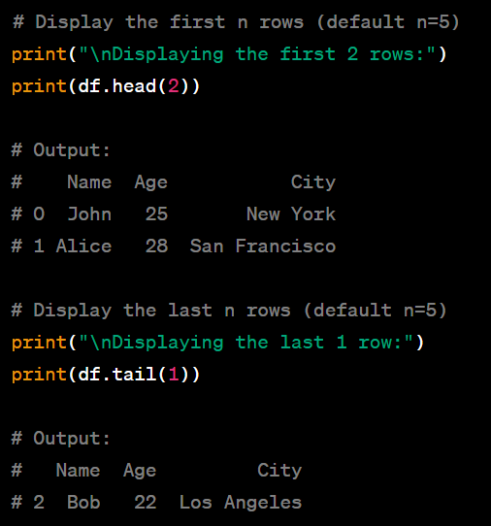
Displaying N Rows

Slide 7
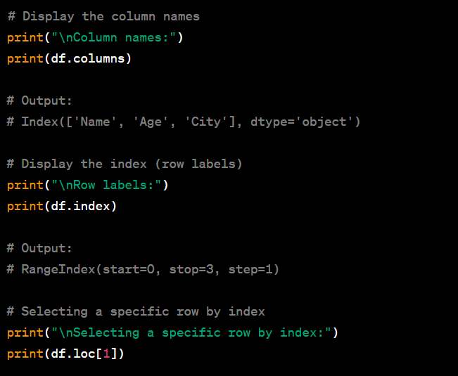
Indexing and Selection

Slide 8
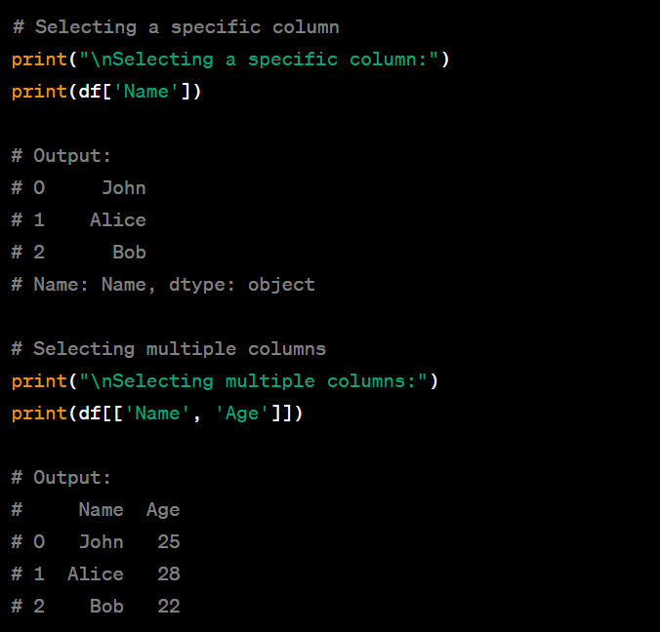
Selecting Column

Slide 9
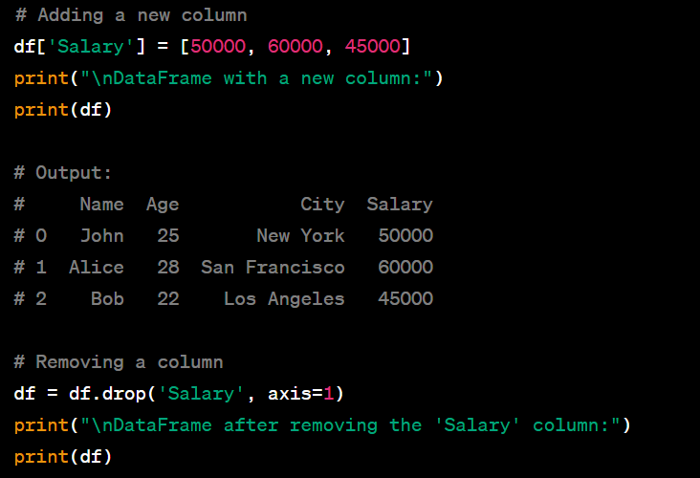
Adding and Removing a Column

Slide 10
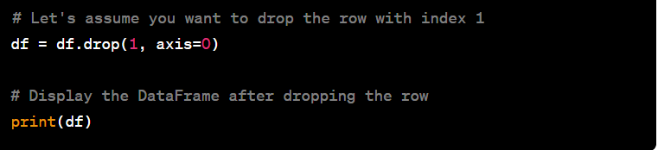
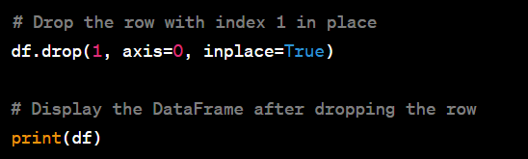
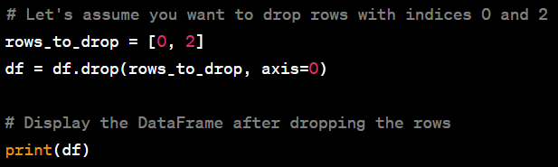
Removing rows

Slide 11
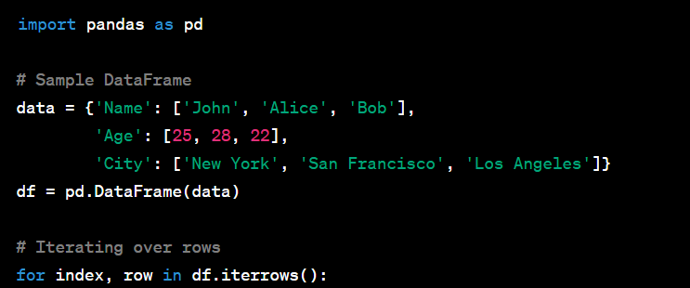
Iterate a dataframe

Slide 12
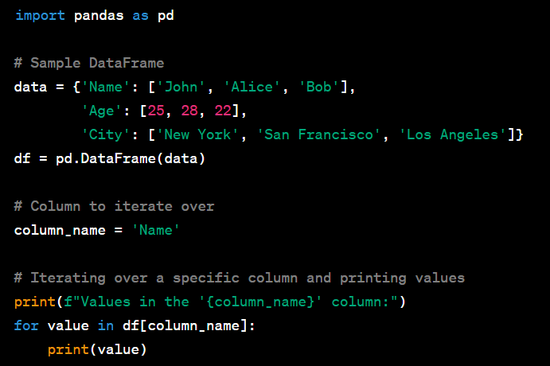
Iterate a Specific Column

Slide 13
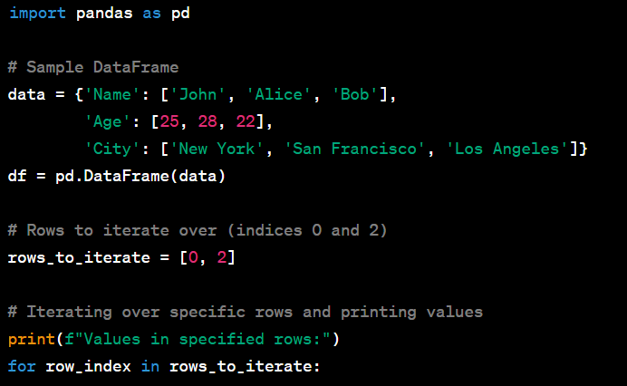
Iterate a Specific row

Slide 14
Thank You For Watching

