Slide 1
ML Based Web Development with Python & Django
Class No: 1

Slide 2
Contents
Introduction – Scope & Objective of this course (Overall Journey)
Essential Tools Setup (VSCODE, Trello, Github)
Python Fundamentals - Variable, Output, Data Types, Numbers, Operators
Solve a problem based on the topics that we covered
Q/A Session

Slide 3
Overall Journey Part 1: Python & ML
Python Fundamentals
Exam - 1
Python OOP
Exam - 2
Automation Data Collection Process
Exam - 3
Machine Learning Basic
Exam - 4
Recommendation System
MID TERM

Slide 4
Overall Journey Part 2: SDLC & Frontend & Django
Requirement Analysis & System Design
Exam - 6
SQL
Exam - 7
HTML, CSS, Bootstrap, JS
Exam - 8
Django
ML Based Web APP
Final Term

Slide 5
The Topics that will Cover within 5 months
Criteria | Topics
Python Fundamentals | Setup, Variable, output, input, data type, number, operator, string, list, loop, dictionary, tuple, function, lamda, some python tricks
Python OOP | Class, Objects, Constructor, Inheritance, method overidding, polymorphism, abstract, some popular design patterns
Automation | Web Driver API, Locators, waiting time handling, fetch data, send data, click, hover, download
Machine Learning | Fundamentals, essential mathematics, recommendation system design, implementation using essential tools
Database Design | Scenario Based Database Design, Database Normalization, Relationship, ERD
SQL | CREATE, INSERT, READ, EDIT, DELETE, JOIN, WHERE, WILDCARDS, Aggregate Function, NESTED SQL

Slide 6
The Topics that will Cover within 5 Months
Criteria | Topics
Frontend | HTML, CSS, BOOTSTRAP, JS Basic
Django | MVT, Setup & Configuration, URL, Context Preprocessor, Request Handling, Django ORM, Django-Admin, Form Handling, Authentication, Authorization, Token Handling, 3rd Party API Handling, DRF, Machine Learning Model Integration, Django Project
Student | Each student will individual project
Job/Freelancing Preparation | Job Short List, CV Prepare, Interview, Upwork Profile Setup, Proposal Template, Email Writing

Slide 7
Evaluation
Instructor, Service & Student Evaluation
Monthly Evaluation
Blind Evaluation
Student Evaluation Process
Attendance
8 Assignments
3 Projects
Bonus Marks based on KPI
Soft Skills

Slide 8
Evaluation
Instructor Evaluation Process
Topic Cover
Lecture
Student Support
Fair Judgment
Service Evaluation Process
Response Time
Feedback Handling
Student Support

Slide 9
Class 1: Topic
Criteria | Topics
Python Fundamentals | Setup, Variable, output, input, data type, number, operator, Let’s Solve a Problem

Slide 10
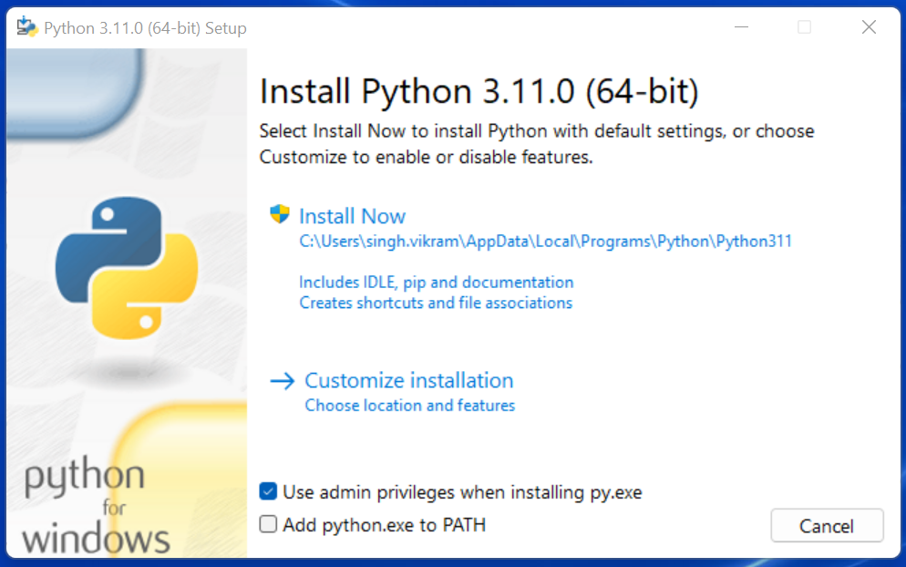
Python Download & Installation
Go to - https://www.python.org/downloads/
Click on Download & Start Installation
During Installation - please check add to path option

Slide 11
Let’s Start Coding

Slide 12
Q & A Session

Slide 13
Thank You For Watching

