Slide 1
ML Based Web Development with Python & Django
Class No: 2

Slide 2
Contents
Each aspect of String
String Methods/Manipulation
Conditional Statement
Form Validation – conditional part
Git setup & upload
Q/A Session

Slide 3
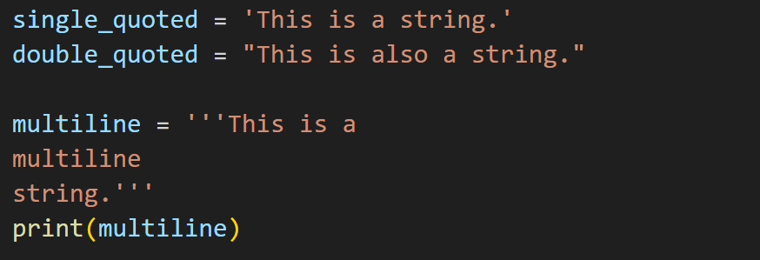
String
Single Quote, Double Quote, Multiline

Slide 4
String Manipulation
Convert to uppercase
Convert to lowercase
Capitalize the first letter
Replace a substring
Split the string into a list of words
startswith(prefix) and endswith(suffix)
find(substring) and index(substring)
count(substring)
Strip,lstrip,rstrp (Home Task)

Slide 5
Conditional Statement
IF/ELSE
IF/ELIF/ELSE
NESTED IF
Conditional - Comparison Operator & Logical Operator
Form Validation Example

Slide 6
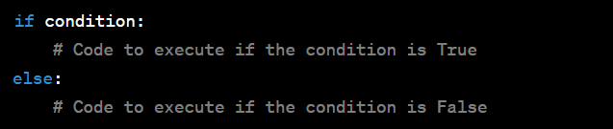
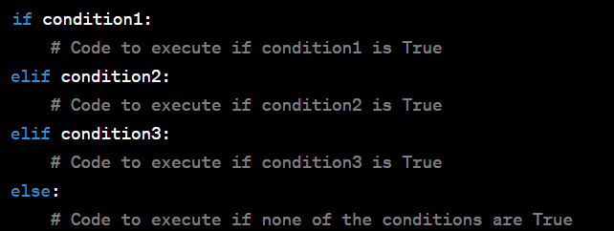
Conditional Statement
IF/ELSE
If/Elif/Else

Slide 7
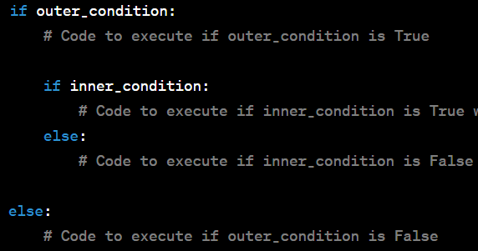
Conditional Statement
Nested If

Slide 8
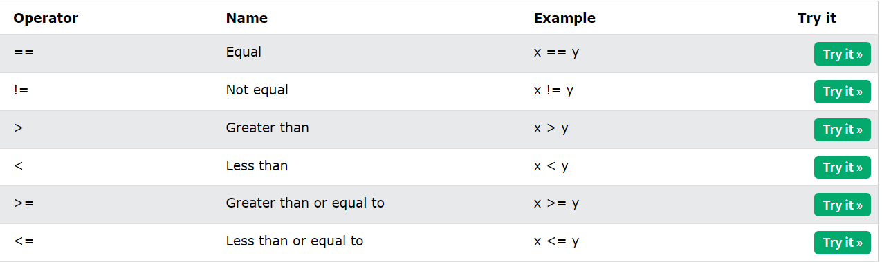
Conditional Statement
Comparison Operator : https://www.w3schools.com/python/python_operators.asp

Slide 9
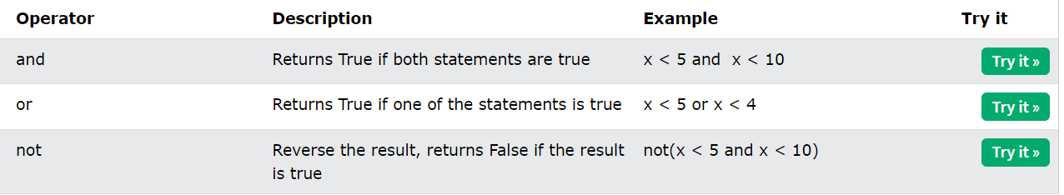
Conditional Statement
Logical Operator : https://www.w3schools.com/python/python_operators.asp

Slide 10
Form Validation - Logic
Check a variable empty or not
Check all variable are required
Check length of a variable
Check a variable is number

Slide 11
Q/A - Session

Slide 12
Thank You

