Slide 1
ML Based Web Development with Python & Django
Class No: 3

Slide 2
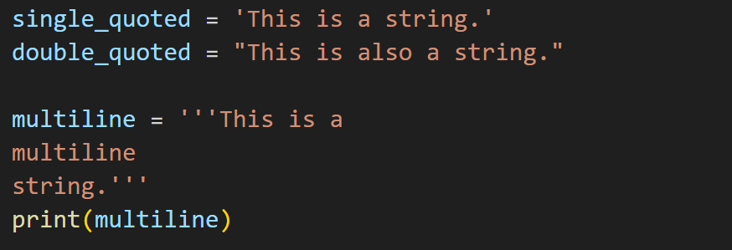
String
Single Quote, Double Quote, Multiline

Slide 3
String Manipulation
Convert to uppercase
Convert to lowercase
Capitalize the first letter
Replace a substring
Split the string into a list of words
startswith(prefix) and endswith(suffix)
find(substring) and index(substring)
count(substring)
Strip,lstrip,rstrp (Home Task)

Slide 4
Conditional Statement
IF/ELSE
IF/ELIF/ELSE
NESTED IF
Conditional - Comparison Operator & Logical Operator
Form Validation Example

Slide 5
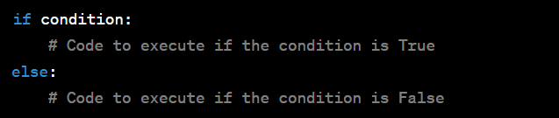
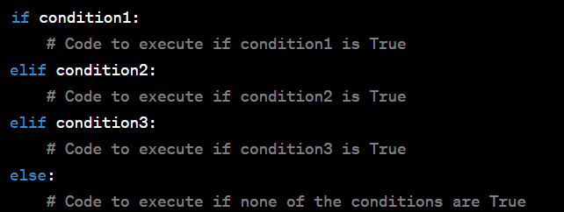
Conditional Statement
IF/ELSE
If/Elif/Else

Slide 6
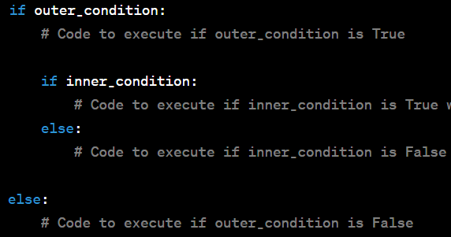
Conditional Statement
Nested If

Slide 7
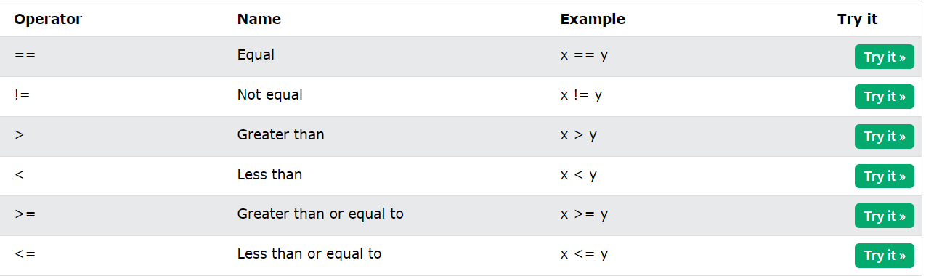
Conditional Statement
Comparison Operator : https://www.w3schools.com/python/python_operators.asp

Slide 8
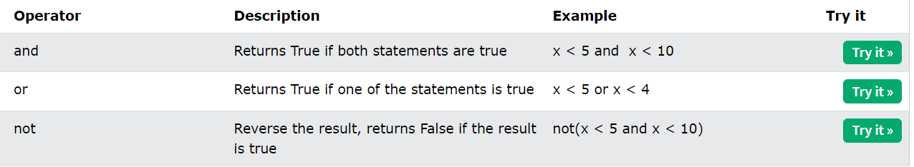
Conditional Statement
Logical Operator : https://www.w3schools.com/python/python_operators.asp

Slide 9
Form Validation - Logic
Check a variable empty or not
Check all variable are required
Check length of a variable
Check a variable is number

Slide 10
List
Can store multiple data in one variable
my_list = [1, 2, 3, 4, 5]
Accessing: first_element = my_list[0] # Access the first element (1)
second_element = my_list[1] # Access the second element (2)
last_element = my_list[-1] # Returns 5 (last element)
second_last_element = my_list[-2] # Returns 4 (second-to-last element)

Slide 11
List Sliced
original_list = [10, 20, 30, 40, 50, 60, 70, 80, 90, 100]
# Basic slicing
sliced_1 = original_list[2:5] # Returns [30, 40, 50]
sliced_2 = original_list[4:] # Returns [50, 60, 70, 80, 90, 100]
sliced_3 = original_list[:3] # Returns [10, 20, 30]
# Slicing with step
sliced_even_indices = original_list[::2] # Returns [10, 30, 50, 70, 90]
sliced_odd_indices = original_list[1::2] # Returns [20, 40, 60, 80, 100]
reverse_sliced = original_list[::-1] # Returns [100, 90, 80, 70, 60, 50, 40, 30, 20, 10]
# Slicing with negative
sliced_negative = original_list[-4:-1] # Returns [70, 80, 90]

Slide 12
List Methods
append(single item)
extend(list)
insert(index,item)
remove(item)
pop(index)
index(item)
count(item)
sort()
reverse()
copy()
List Iteration using loop

Slide 13
Assignment - 24th August
Question 1: Given the list fruits = ['apple', 'banana', 'cherry'], how can you add the item 'orange' to the end of the list?
Question 2: If you have the list numbers = [1, 2, 3, 4, 5], what method would you use to remove the item 3 from the list?
Question 3: You have the list colors = ['red', 'green', 'blue']. How can you insert the item 'yellow' at the second position in the list?
Question 4: If you have the list letters = ['a', 'b', 'c', 'a', 'd'], how many occurrences of the letter 'a' are there in the list?
Question 5: Given the list data = [10, 20, 30, 40, 50], which method can you use to remove and return the last item from the list?

Slide 14
Assignment - 24th August
Question 6: If you want to sort the list values = [4, 1, 7, 3, 9] in ascending order, which method would you use?
Question 7: You have the list cities = ['New York', 'Los Angeles', 'Chicago', 'Houston']. How can you find the index of the item 'Chicago'?
Question 8: Given the list animals = ['dog', 'cat', 'elephant', 'lion'], how can you replace 'elephant' with 'tiger'?
Question 9: If you have the list numbers = [5, 2, 8, 2, 1], what method can you use to count the number of occurrences of the value 2?
Question 10: You have the list fruits = ['apple', 'banana', 'cherry']. How can you reverse the order of the items in the list? can you use to remove and return the last item from the list?

Slide 15
Assignment - 25th August
Check a character exists in a number or not?

Slide 16
Assignment - 27th August
Question: You are tasked with developing a Python program that takes the marks obtained by a student in the SSC examination and calculates the corresponding grade, grade point, and percentage range according to the SSC grading system in Bangladesh. Design a program that accomplishes this task efficiently.
Your program should include the following:
Prompt the user to input the marks obtained by the student.
Calculate the percentage achieved by the student.
Based on the calculated percentage, determine and display the appropriate grade, grade point, and the corresponding percentage range.
Remember to handle possible invalid input, such as negative marks or marks exceeding the total marks. Provide meaningful error messages when needed.
Please provide comments in your code to explain the purpose of each step and any calculations performed. Your program should be user-friendly and ensure accurate calculation of grades based on the official SSC grading system.
Solve the problem using the concept that we covered

Slide 17
Q/A - Session

Slide 18
Thank You

