Slide 1
Numpy

Slide 2
Introduction
NumPy, which stands for Numerical Python, is a powerful open-source library in Python for numerical and mathematical operations.
It provides support for large, multi-dimensional arrays and matrices, along with a collection of mathematical functions to operate on these arrays.
Key features of NumPy include:
Multi-dimensional Arrays
Broadcasting
Mathematical Functions
Random Number Generation
Integration with Other Libraries

Slide 3
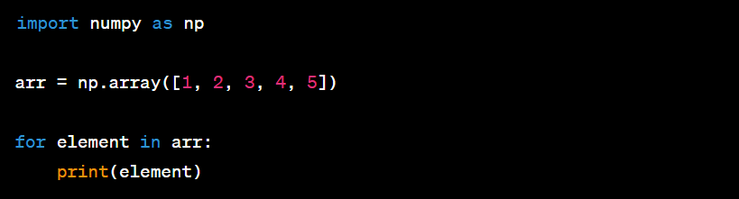
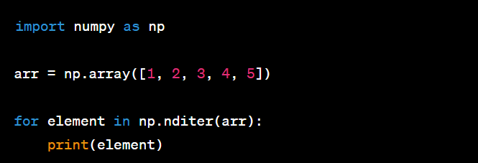
Creating Arrays and Iterate

Slide 4
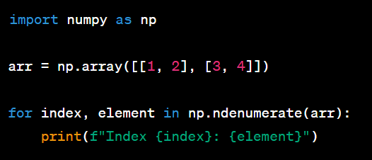
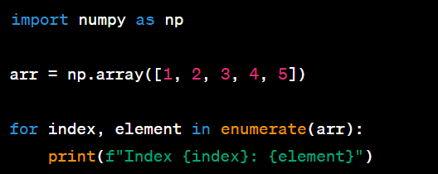
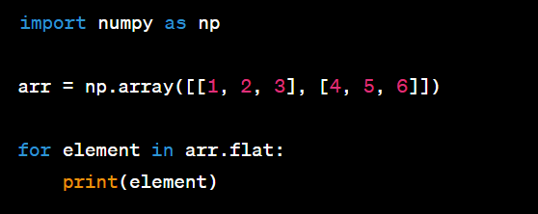
Creating Arrays and Iterate

Slide 5
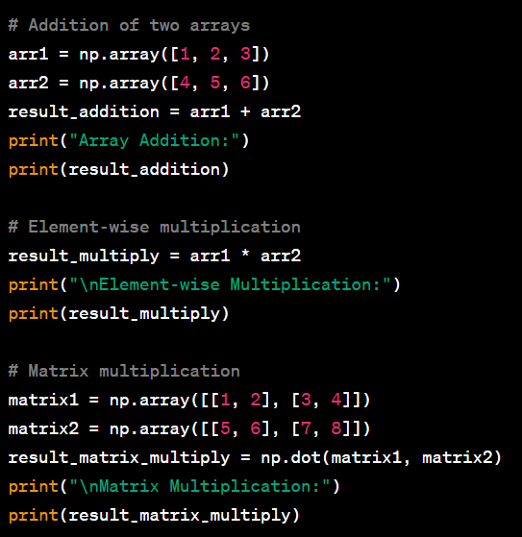
Numpy Array Operations

Slide 6
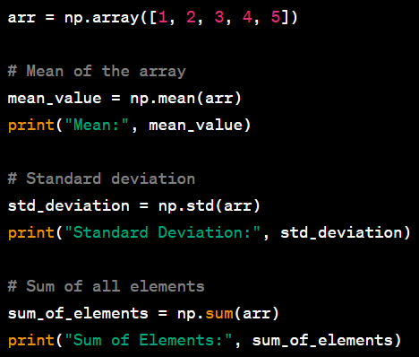
Numpy Statistics Operation

Slide 7
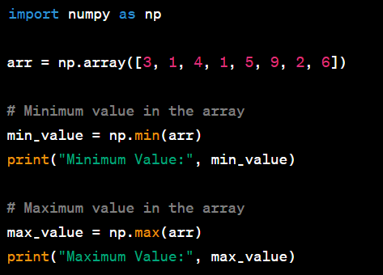
Numpy Statistics Operation

Slide 8
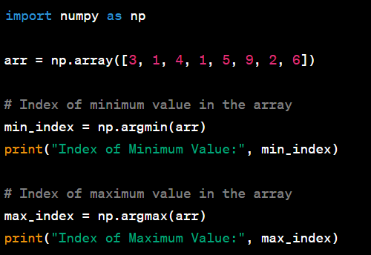
Numpy Statistics Operation

Slide 9
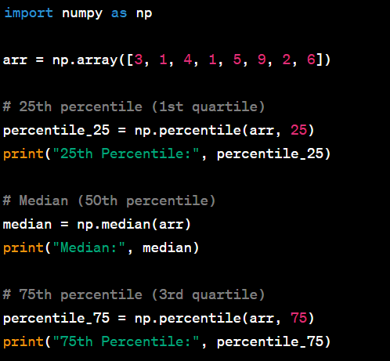
Numpy Statistics Operation

Slide 10
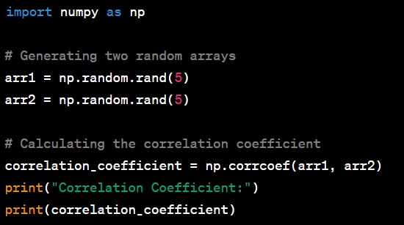
Numpy Statistics Operation

Slide 11
Numpy Statistics Operation

Slide 12
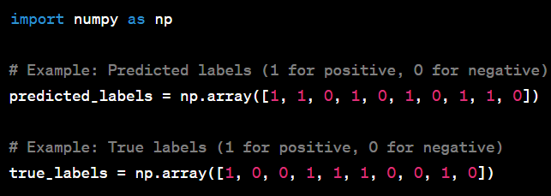
Assignment - Scenario
Imagine you are working on a natural language processing (NLP) project where you have developed a text classification model to categorize customer reviews into positive and negative sentiments. The model has been trained on a dataset, and now you want to evaluate its performance.

Slide 13
Question
What is the accuracy of the text classification model?
Calculate the precision of the model for positive sentiment.
Determine the recall of the model for negative sentiment.
Compute the F1 score of the text classification model.
Calculate the confusion matrix for the model's predictions.
What is the prevalence of positive sentiment in the true labels?
Compute the specificity of the model for positive sentiment.

Slide 14
Thank You For Watching

