Slide 1
Machine Learning for Natural Language Processing
Class No: 1

Slide 2
Contents
Introduction – Scope & Objective of this course (Overall Journey)
Essential Tools Setup (VSCODE, Trello, Github)
Python Fundamentals - Variable, Output, Data Types, Numbers, Operators
Solve a problem based on the topics that we covered
Q/A Session

Slide 3
Overall Journey Part 1: Fundamental Concepts
Python Fundamentals
Exam - 1
Python OOP
Exam - 2
Pandas
Exam - 3
Numpy
Midterm 1

Slide 4

Overall Journey Part 2: Web Scrapping
Salenium
Beautiful Soup
Scrappy
Exam - 5

Slide 5
Overall Journey Part 3: NLP Tools
NLTK
Spacy
Genism
Scikit Learn
Matplotlib
Seaborn
Exam 6

Slide 6
Overall Journey Part 3: Data Analytics
Text Preproessing
Feature Extraction
Data Filtering
Bag-of-words
N-Grams
Statistical Analysis
EDA
Exam - 7

Slide 7
Overall Journey Part 4: Machine Learning & Deep Learning Concept
Title
Naïve Bayes
Logistic Regression
Support Vector Machine
Random Forest
Gradient Boosting
Neural Network
Deep Neural Network
Fully Connected Neural Network
LSTM
Reinforcement Learning (Q-Table)
Deep Reinforcement Learning (DQN)

Slide 8
Overall Journey Part 5: Projects
Category | Title
Text Classification | Comment Classification
Recommendation System | Daraz Recommendation System
NER Project | Intelligent Resume Evaluation
Conversation AI Project | Intelligent Chatbot using pretrained model
Milestone Project | New Problem Solve

Slide 9
Evaluation
Instructor, Service & Student Evaluation
Monthly Evaluation
Blind Evaluation
Student Evaluation Process
Attendance
8 Assignments
3 Projects
Bonus Marks based on KPI
Soft Skills

Slide 10
Evaluation
Instructor Evaluation Process
Topic Cover
Lecture
Student Support
Fair Judgment
Service Evaluation Process
Response Time
Feedback Handling
Student Support

Slide 11
Class 1: Topic
Criteria | Topics
Python Fundamentals | Setup, Variable, output, input, data type, number, operator, Let’s Solve a Problem

Slide 12
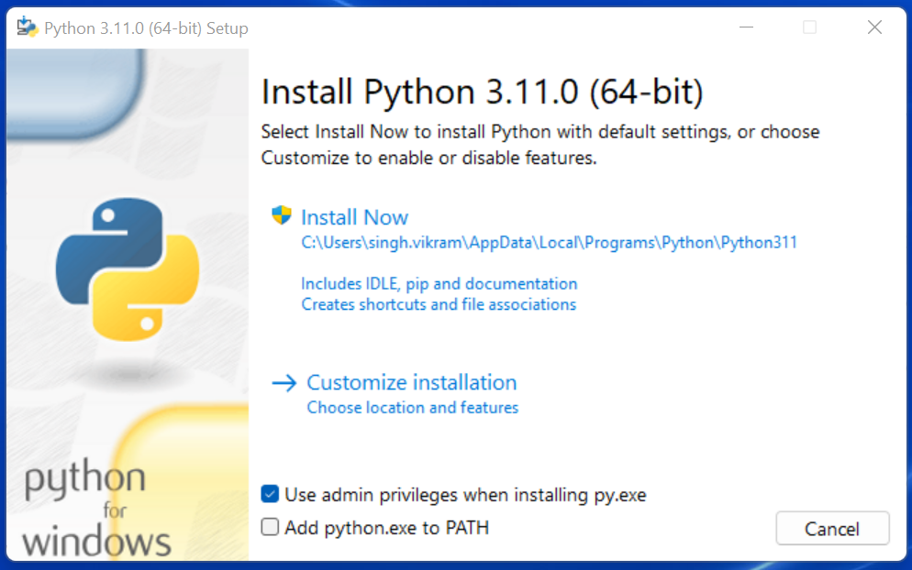
Python Download & Installation
Go to - https://www.python.org/downloads/
Click on Download & Start Installation
During Installation - please check add to path option

Slide 13
Let’s Start Coding

Slide 14
Q & A Session

Slide 15
Thank You For Watching

