Slide 1
Pandas

Slide 2
Introduction
pandas is a Python package providing fast, flexible, and expressive data structures designed to make working with “relational” or “labeled” data both easy and intuitive.
Pandas can work with:
CSV
SQL
Json
Excel
So on
Pandas Unique Features
Easy handling of missing data
Size mutability
Automatic and explicit data alignment
Powerful, flexible group by functionality
Make it easy to convert
Intelligent label-based slicing, fancy indexing, and subsetting
Flexible reshaping and pivoting of data sets

Slide 3
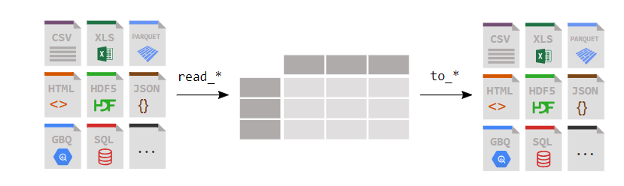
DataFrame

Slide 4
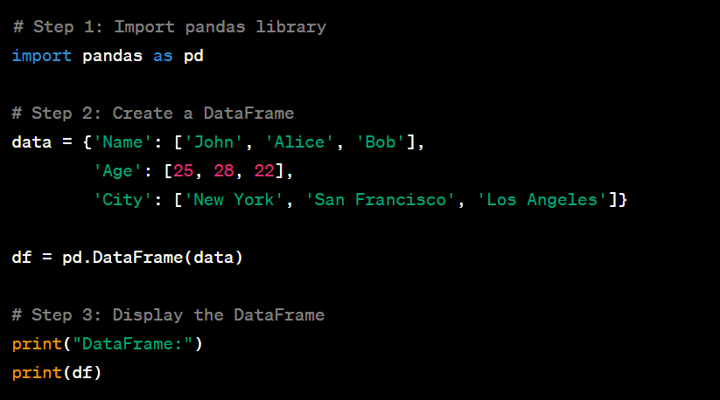
Create a DF

Slide 5
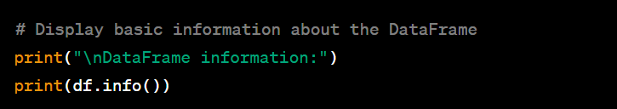
Display Info about Dataframe

Slide 6
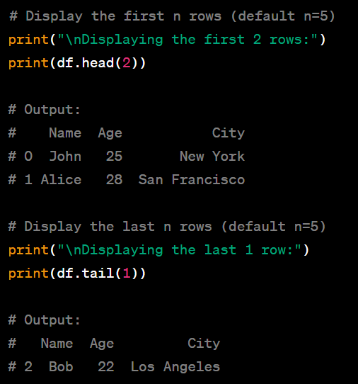
Displaying N Rows

Slide 7
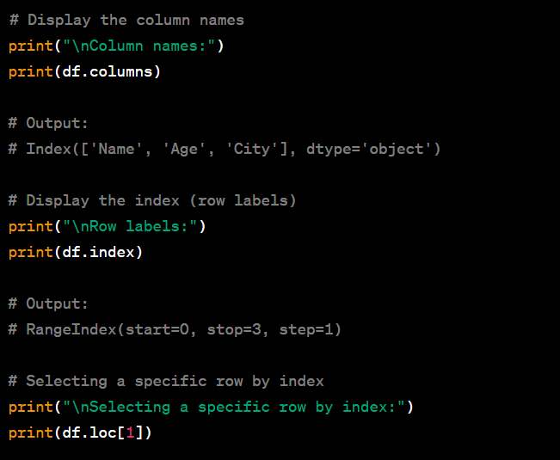
Indexing and Selection

Slide 8
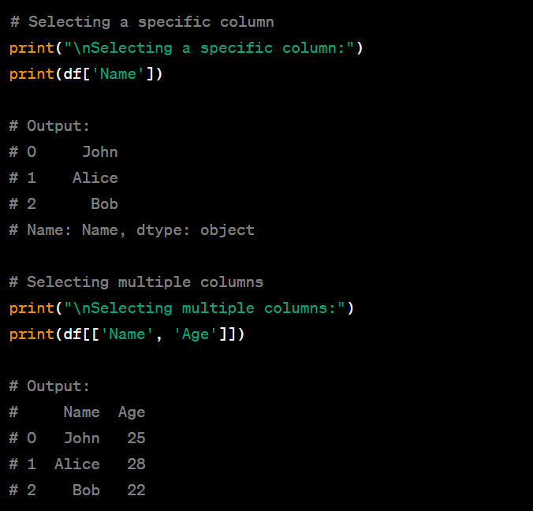
Selecting Column

Slide 9
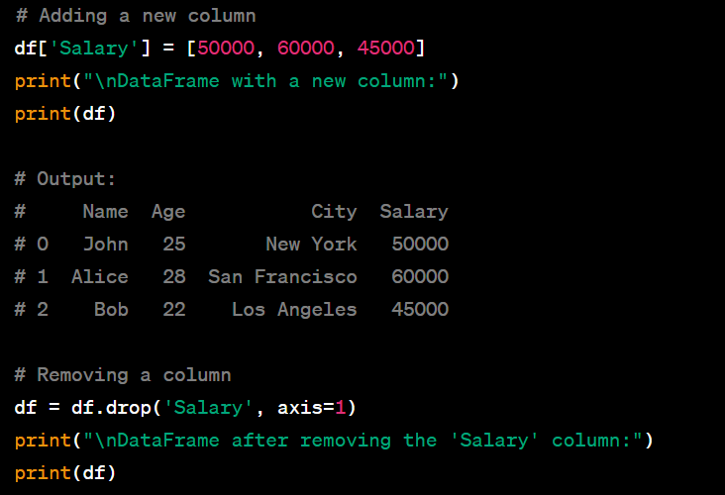
Adding and Removing a Column

Slide 10
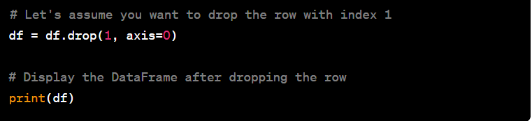
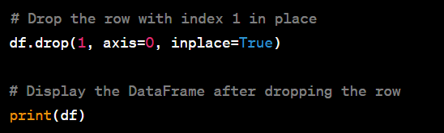
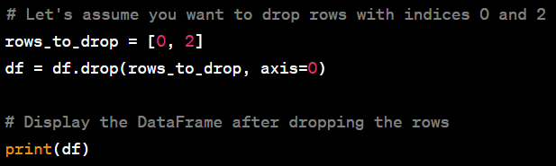
Removing rows

Slide 11
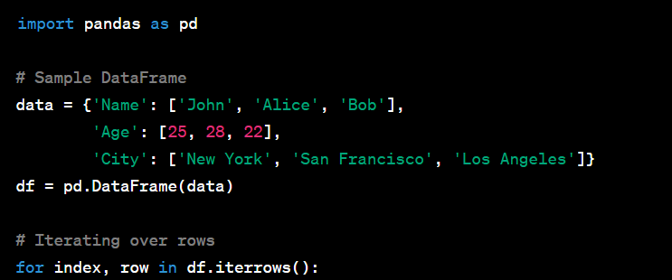
Iterate a dataframe

Slide 12
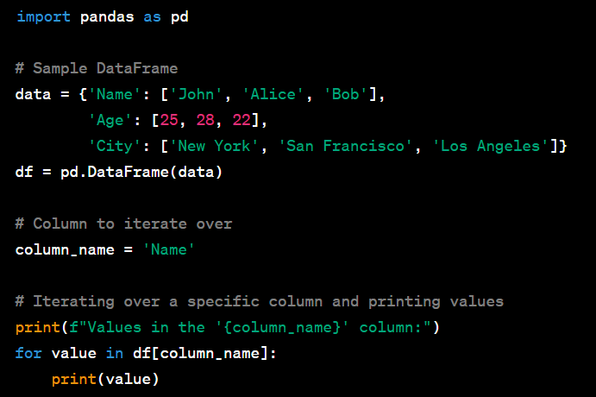
Iterate a Specific Column

Slide 13
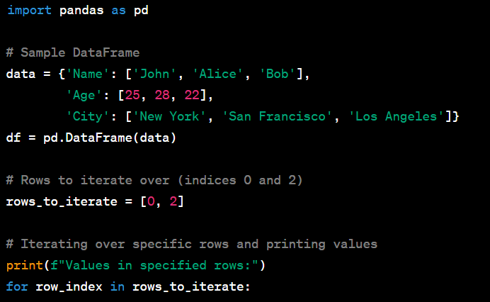
Iterate a Specific row

Slide 14
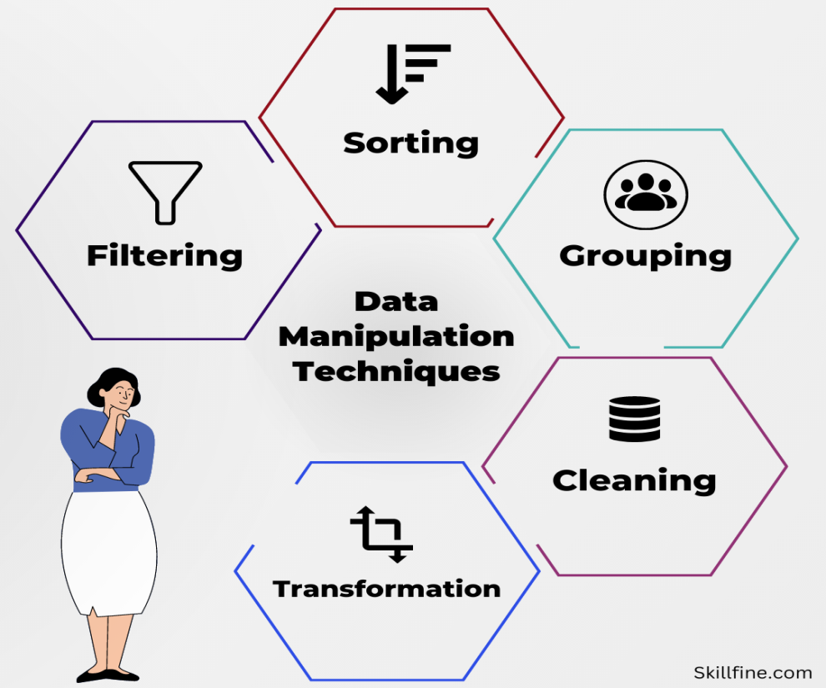
Data Manipulation
Data manipulation refers to the process of transforming and altering data to extract useful information or prepare it for analysis

Slide 15
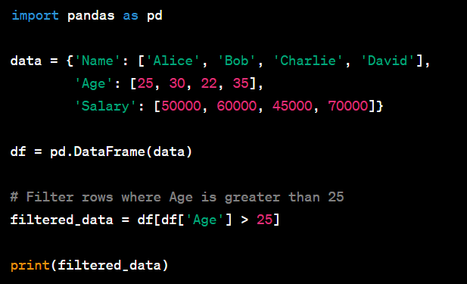
Data Manipulation
Filtering Data based on single Condition

Slide 16
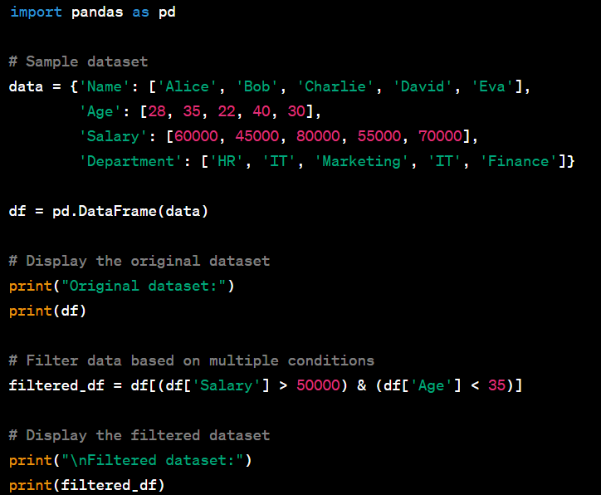
Data Manipulation
Filtering Data based on Multiple Condition

Slide 17
Data Manipulation
Filtering Data based on Multiple Condition

Slide 18
Data Manipulation
Filtering Data based on Multiple Condition

Slide 19
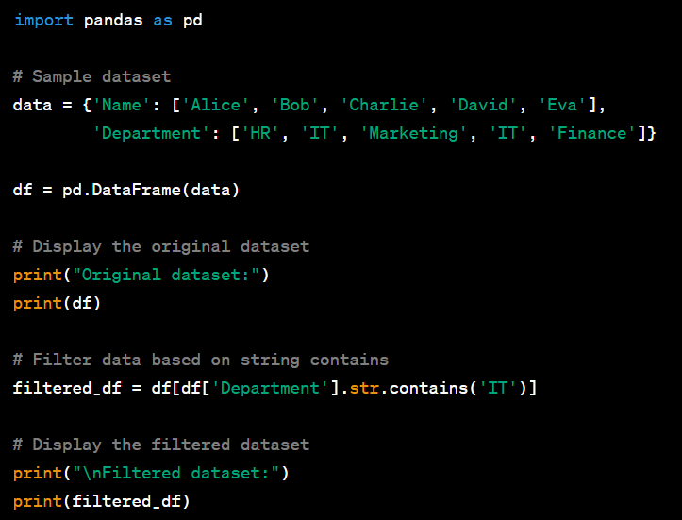
Data Manipulation
Filtering based on String Contains

Slide 20
Data Manipulation
Filtering based on String Contains

Slide 21
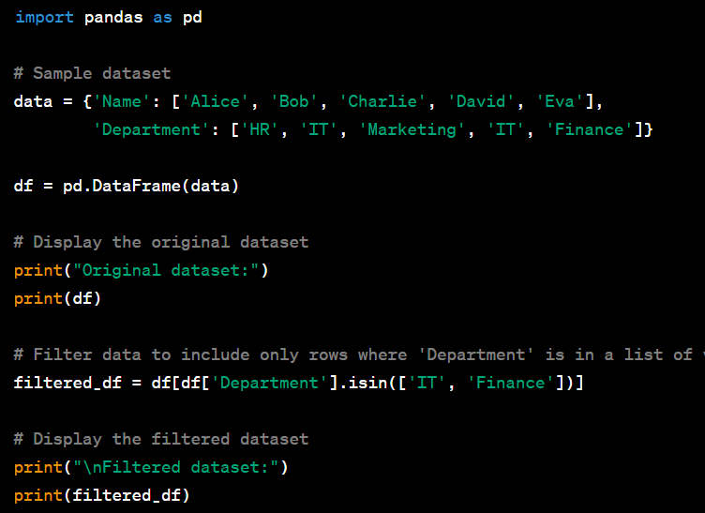
Data Manipulation
Filtering based on a List of Values

Slide 22
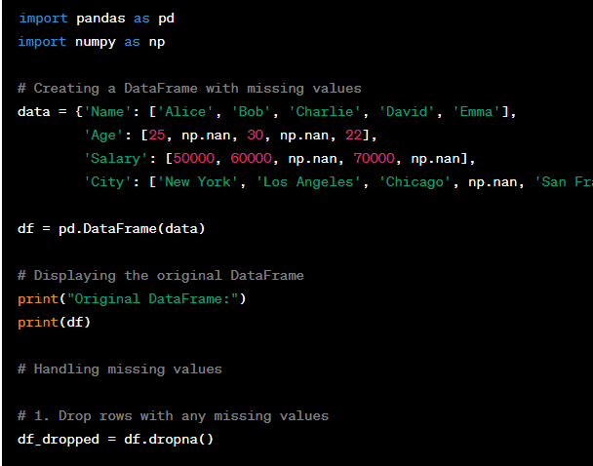
Data Manipulation
Handling Missing Data – drop rows

Slide 23


Data Manipulation
Handling Missing Data – drop rows/Replace

Slide 24
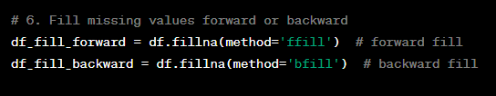
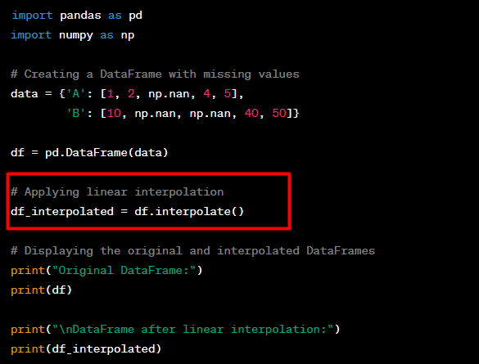
Data Manipulation
Handling Missing Data – Fill Missing Values Forward or backward
Interpolation
Polynomial (Task)
Spline (Task)
Time (Task)

Slide 25

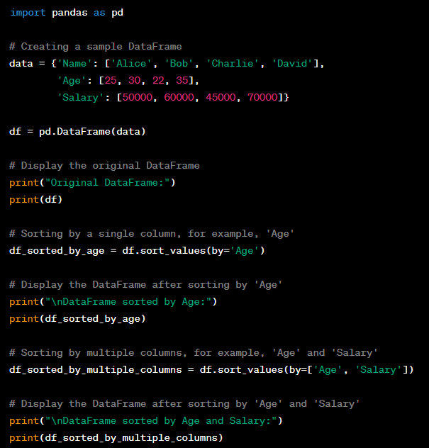
Data Manipulation
Sort

Slide 26
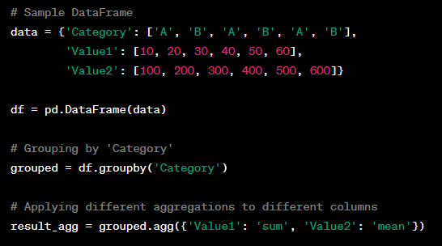
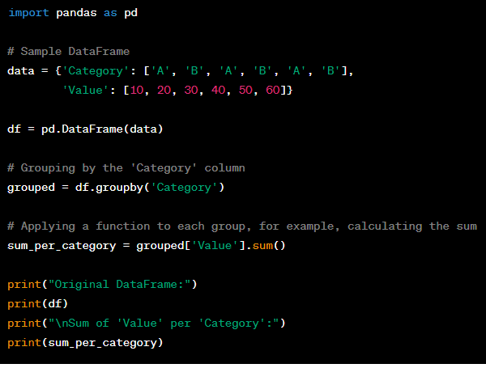


Data Manipulation
Grouping with Sum/mean

Slide 27
Data Manipulation
Task for Grouping
Grouping by Range of Values
Grouping by Date Range
Grouping by Custom Function
Grouping and Applying Multiple Functions

Slide 28
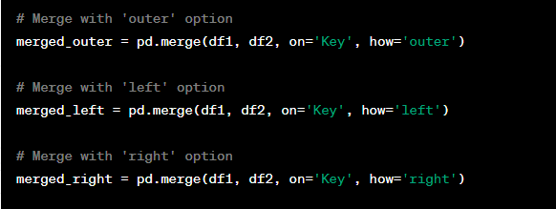
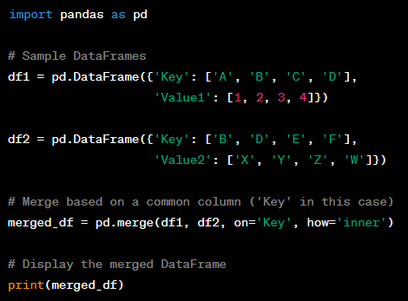
Data Manipulation
Merging

Slide 29
Thank You For Watching

