Slide 1


Git Tutorial – Part 1

Slide 2
Our Daily Task
Create Things
Save Things
Edit Things
Save the Thing again

Slide 3

Our Daily Task
Create Things
Save Things
Edit Things sadadasd
Save the Thing again

Slide 4
What is Git
Distributed Version Control System
Repositories
Record changes to our files over time
We can recall the specific version of our files at any time
Flexibility and Collaboration

Slide 5
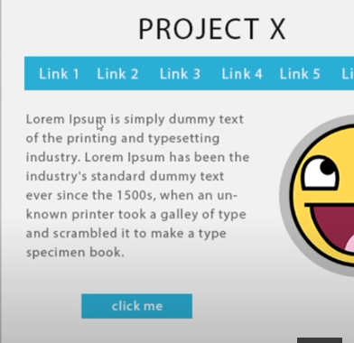
Why Git
Project X – V1

Slide 6
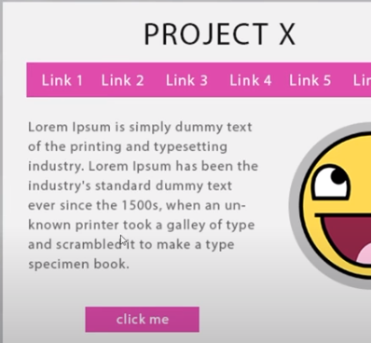
Why Git
Project X – V1
Project X – V2

Slide 7
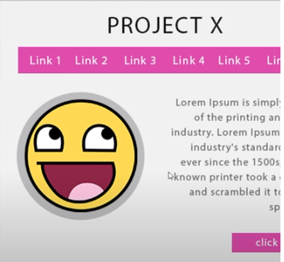
Why Git
Project X – V1
Project X – V2
Project X – V3

Slide 8
Why Git
Project X – V1
Project X – V2
Project X – V3

Slide 9
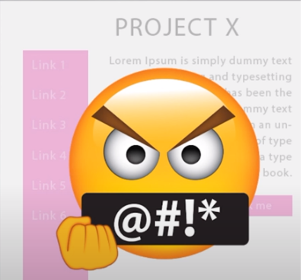
Why Git
Project X – V1
Project X – V2
Project X – V3
……………………..
……………………..
Project X- V_N

Slide 10
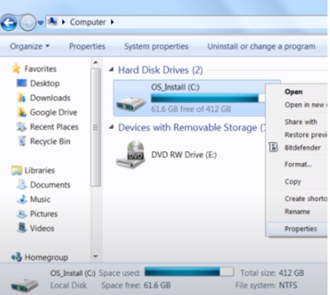
Why Git
Project X – V1
Project X – V2
Project X – V3
……………………..
……………………..
Project X- V_N

Slide 11
Benefits of git
Store Revision in a project history in one directory
Revert Back to any version at any time
History Tracking
Collaboration
Client Happiness
Interactive Backup
Efficiency

Slide 12
Git Installation
Go to this link - https://git-scm.com/downloads
Download the latest Version
Create a directory to your drive
Go to your directory
Open git bash
Check git version – Command: git --version
Set Username and email
User name: git config –global user.name “your git user name”
Email: git config –global user.email “your git email”

Slide 13
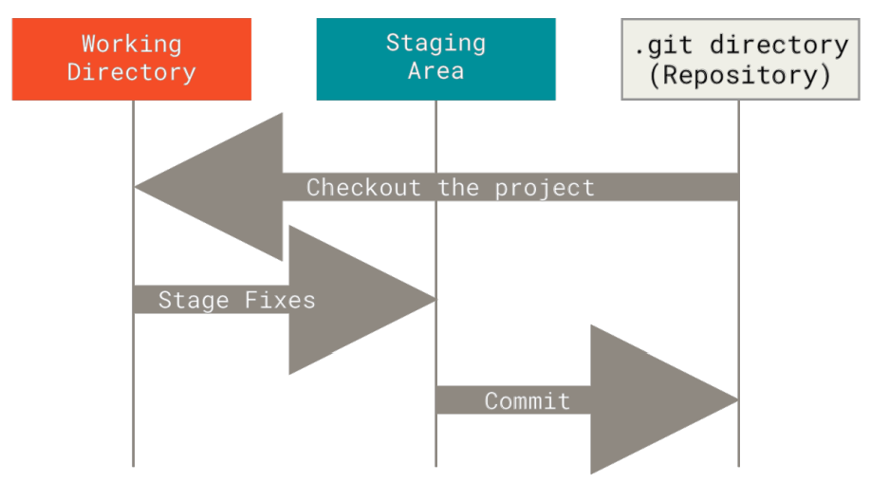
The Git States

Slide 14
Some Basic Commands
git init – initialize a empty git repository
git add . Or git add filename - Adds files or changes to the staging area.
git commit -m "Initial commit - Records changes to the repository with a message
git status - Shows the status of files in the working directory
git log - Displays a history of commits
git remote add origin https://github.com/your-username/repository-name.git - Create remote user
git push origin master - pushes the local changes to the remote repository's master branch

Slide 15
Github Collaboration
Team Member 4
Team Member 1
Github Repository (Online)
Team Member 3
Team Member 2

Slide 16
Branches
Feature Branch 4
Module 1
Feature Branch 1
Master/Main Branch for Merge all modules
Feature Branch 3
Feature Branch 2
Module 2

Slide 17
Branches Command
git branch –a : To list all branches in your repository
git branch <branch_name>: To create a new branch
git checkout <branch_name>: To switch to an existing branch
git checkout -b <branch_name>: Create and Switch Branch
git branch -d <branch_name>: To delete a branch
git push -u origin <branch_name>: push my new branch to my repo for the first time
git push origin <branch_name>: push my new branch to my repo for the first time (After first time)

Slide 18
How to do basic collaboration
git clone <repository_URL>
git checkout -b <branch_name>
Change, add and commit [Please check last class]
git push origin <branch_name>: push my new branch to my repo for the first time (After first time)
git pull <remote_name> <branch_name>

Slide 19
Thank You For Watching

