Slide 1
Problem Analysis and Requirements Specification
of
Sonali Bank Limited, Bahaddarhat Branch
Supervised By
Dr. Kaushik Deb
Professor,
Dept. of CSE, CUET
Sabiha Anan
Assistant Professor,
Dept. of CSE, CUET
Submitted By
Md. Sajidul Mowla (1804100)
Salman Farsi (1804102)
Antu Chowdhury (1804112)
Kowshik Chowdhury (1804119)
‹#›
Notes:
‹#›
*

Slide 2
Contents
Introduction
About Organization
Overview of Organization
Positional Hierarchy
Organizational Hierarchy
Management Structure
Types Of Information
Information Gathering
Requirement Specification
Contributions

Slide 3
Introduction
Problem analysis and requirements specification
To select an organization and perform analysis on their management structure and information based system

Slide 4

About Organization
Organization: Sonali Bank Limited
Established in 1972
Total branches: 1230
Location: Bahaddarhat, Chittagong

Slide 5
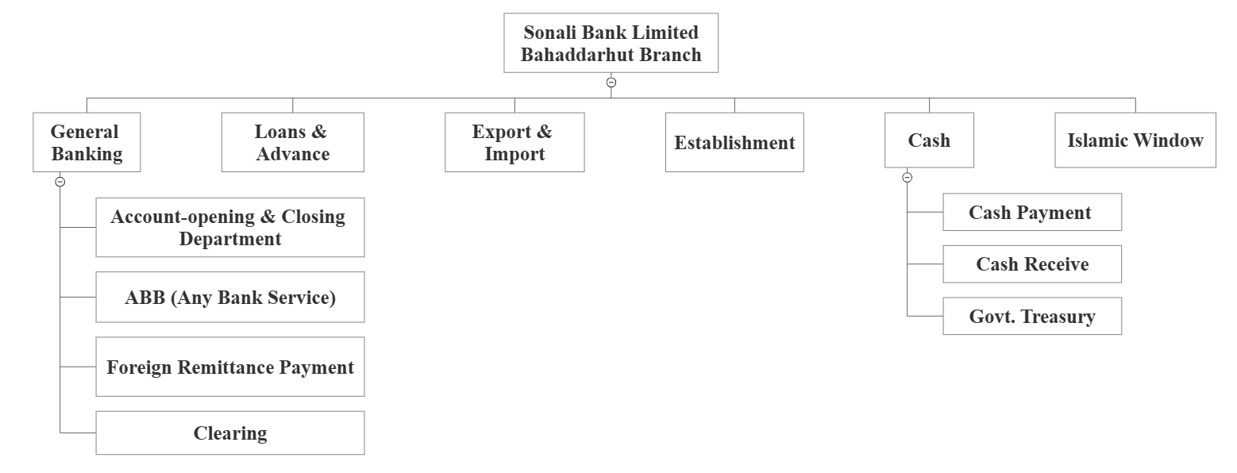
Overview of the Organization
Figure 01: Organization Structure

Slide 6
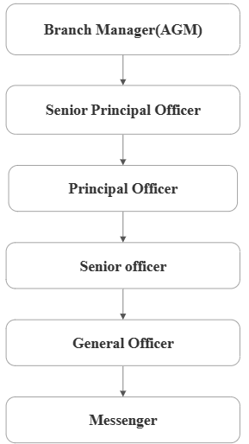
Positional Hierarchy
Figure 02: Position Hierarchy

Slide 7
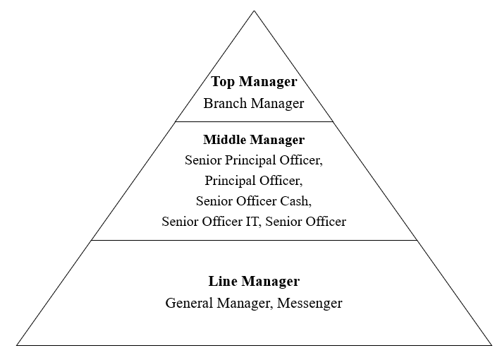
Management Structure
Figure 03: Management Level

Slide 8
Management Structure (Contd.)
Top Managers
Branch Manager
Highest position of the branch
Oversees all departmental operations within the division

Slide 9
Management Structure (Contd.)
Middle Managers
Distribute the works among general officers
Senior Principal Officer
Issues loans & prevents money laundering

Slide 10
Management Structure (Contd.)
Middle Managers (Contd.)
Handling three major department (General, Establishment, Loans & Advance)
Principal Officer
In charge of different bank-related
court cases
Provide assistance to the line managers

Slide 11
Management Structure (Contd.)
Middle Managers (Contd.)
Cash Receiving
Senior Officer Cash
Treasury Collections
Posting of Treasury information on computers

Slide 12
Management Structure (Contd.)
Middle Managers (Contd.)
Senior Officer IT
Export and Import department handling
Offering details on many loan and bank account creation schemes

Slide 13
Management Structure (Contd.)
Middle Managers (Contd.)
Cheque debit
Senior Officer
Receive credit
Clearing related works
Loan session

Slide 14
Management Structure (Contd.)
Line Managers
Officer IT
Account open & close
Cheque Book Issue

Slide 15
Management Structure (Contd.)
Line Managers (Contd.)
Officer Cash
Foreign remittance payment receive

Slide 16
Management Structure (Contd.)
Line Managers (Contd.)
Messenger
Voucher Sorting
Carrying Letters & Treasury to another branch

Slide 17
Types of Information
Operational Information
Opening and closing customer-specific savings, current, and fixed deposit accounts
Cheque book issue and pay order
Getting approval of a loan proposal
Online and SMS banking transactions and forwarding transaction data to the Head Office

Slide 18
Types of Information (Contd.)
Operational Information
Maintain intra/inter departmental transactions
Information about receiving remittance and providing allowance services like any bank service, freedom fighter etc
Keeping track of the staff's daily attendance records
Sorting vouchers and carrying letters and treasury to other branches and banks

Slide 19
Types of Information (Contd.)
Operational Information
Cash deposits/withdrawals
Information about remittance
Issuing cheque and report cheque bouncing
Attendance record of employees

Slide 20
Types of Information (Contd.)
Tactical Information
Variety of account types
Analytical record of all banking transactions
Taking care of employee leave and facilities
Recovery of classified loans (bad and loss)
Updating Right-off accounts for classified loans

Slide 21
Types of Information (Contd.)
Tactical Information
Issuing bank guarantee based on a short term notice
Monitoring the availability of resources
Providing govt. incentives to those who received loans and
got lost in business during COVID-19

Slide 22
Types of Information (Contd.)
Strategic Information
The expansion of the building will benefit workers of all ranks.
Updated technology with feasible strategies (Sonali e-Wallet)
Strategy for meeting both immediate and distant goals
Guidelines for enhancing online banking operations
Providing down-payment for customers to recover classified loans

Slide 23
Types of Information (Contd.)
Statutory Information
Annual tax filing with the government
Comprehensive annual report detailing all export and import monetary dealings
Report the quantity of remittances transferred within a fiscal year

Slide 24
Information Gathering
The following informations were acquired throughout the information gathering phase:
How many departments are there and the name of all departments in the branch?
Does the organization provide one-stop services?
Information on the system overview and management hierarchy of the branch

Slide 25
Information Gathering (Contd.)
Information about all the account types and their facilities
Facilities on varieties of loans, pension, remittance, subsidy, and allowance services
Information on the total number of staff members on the branch
Information on the activities of the employees in this branch

Slide 26
Information Gathering (Contd.)
Information about the amount of customers gets the service (daily/monthly/yearly) in the branch
Information on active website facilities, Credit & Debit card facilities, online and sms banking facilities
Information on the IT sector and server-system
Information about the impact of COVID-19 and activities for recovering the disaster

Slide 27
Information Gathering (Contd.)
Information about the amount of customers gets the service (daily/monthly/yearly) in the branch
Information on active website facilities, Credit & Debit card facilities, online and sms banking facilities
Information on the IT sector and server-system
Information about the impact of COVID-19 and activities for recovering the disaster

Slide 28
Information Gathering (Contd.)
From whom we have collected those information
Monjurul Azim - Senior Principal Officer (SPO)
Showkot Osman- Principal Officer (PO)
Milton Shikdar - Senior Officer IT (SO IT)
Basudeb Chowdhury-Senior Officer Cash (SO Cash)
Imtiaz Uddin -Officer Cash
Mong Thu Marma - Messenger

Slide 29
Requirement Specification
Staffing levels require an increase
Recruiting youthful, knowledgeable, and competent workers that are conversant with the newest systems and technologies
Increase hardware infrastructure
Additional technical and physical security
Improving One stop service

Slide 30
Contributions
Analyzed the structure and management system of an organization
Understood how each management level functions
Analyzed the necessary system requirements for the organization

Slide 31
Thank You

