Slide 1
System Analysis and Design
of
Sonali Bank Limited, Bahaddarhat Branch
Supervised By
Dr. Kaushik Deb
Professor,
Dept. of CSE, CUET
Sabiha Anan
Assistant Professor,
Dept. of CSE, CUET
Submitted By
Md. Sajidul Mowla (1804100)
Salman Farsi (1804102)
Antu Chowdhury (1804112)
Kowshik Chowdhury (1804119)
‹#›
Notes:
‹#›
*

Slide 2
Contents
Objectives
System Development Life Cycle (SDLC)
Context Diagram
Data Flow Diagram (DFD)
Logical DFD
Physical DFD

Slide 3
Objectives
To understand the procedure of data flow of Sonali Bank Bahaddarhat Branch information system
To explain the context diagram of the system and explain system overview
To discuss both logical and physical data flow diagrams of this bank system

Slide 4
System Development Life Cycle
Summarization of information system and design procedure.
Nine distinct phases
Producing high quality system
Taking user requirement
Meeting customer expectations

Slide 5
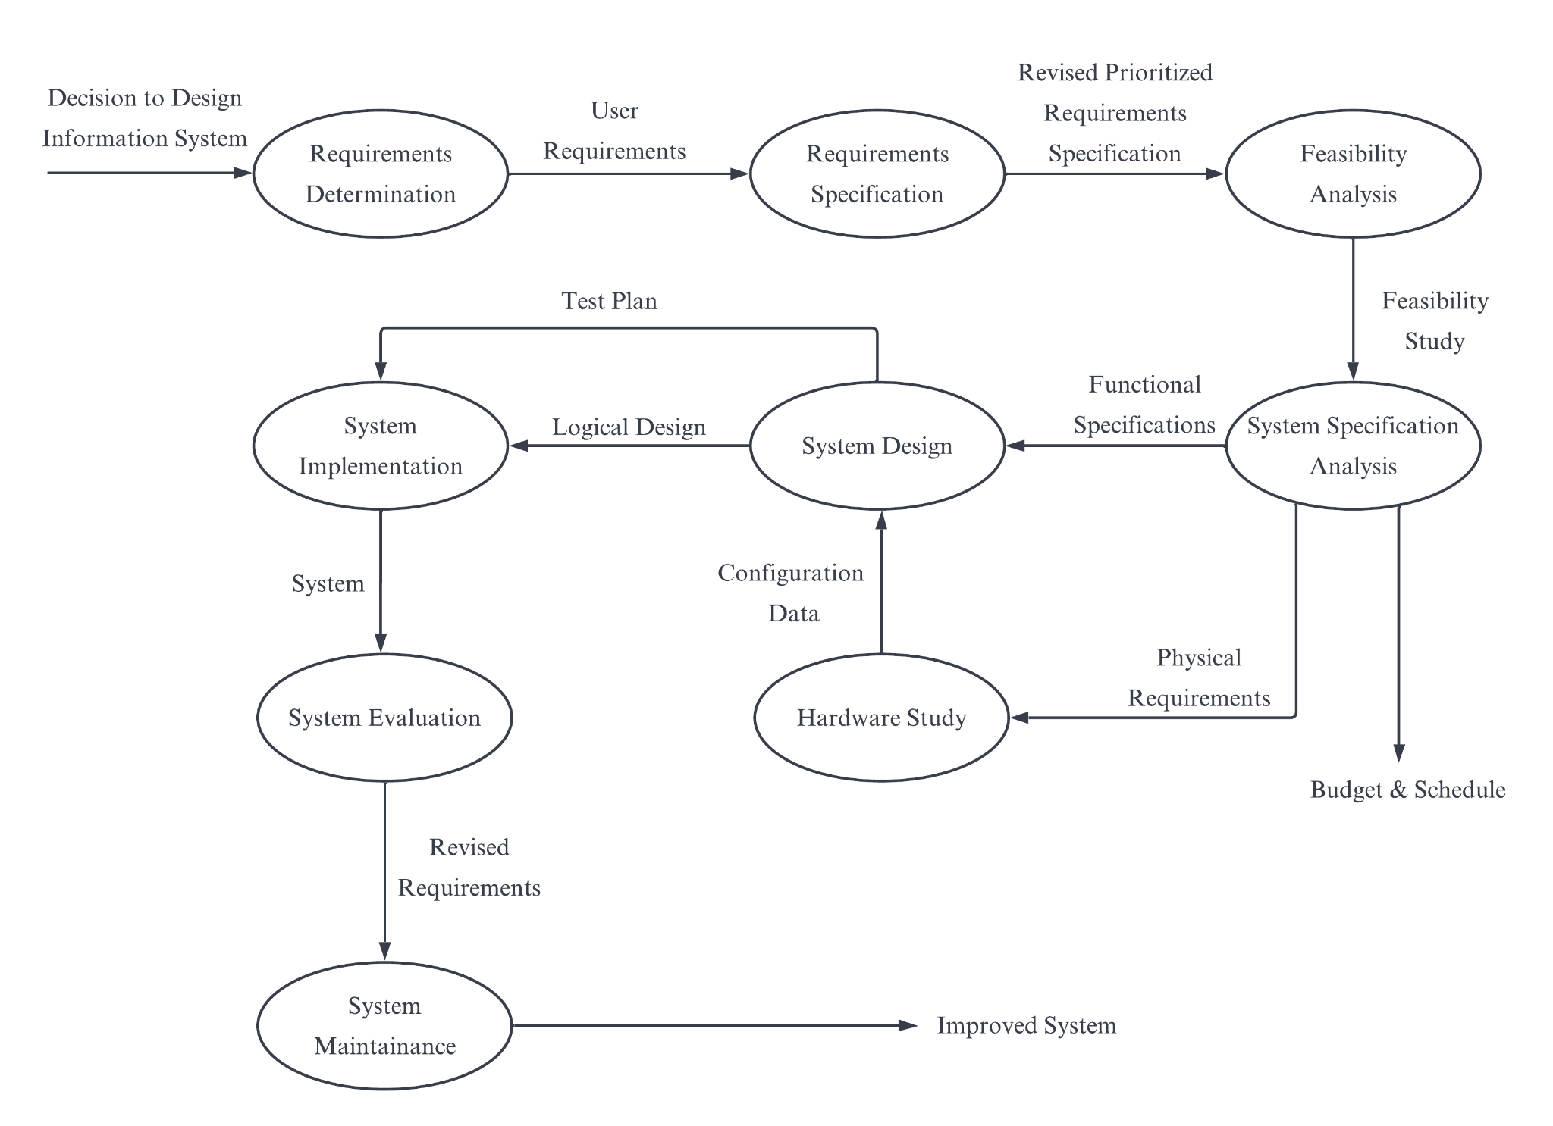
System Development Life Cycle
Figure 1: System Development Life Cycle

Slide 6
Context Diagram
Representation of entire system by one diagram
Overall information about the system
Different departments represented by entities
Different work sections visualized
Does not provide information of full processes

Slide 7
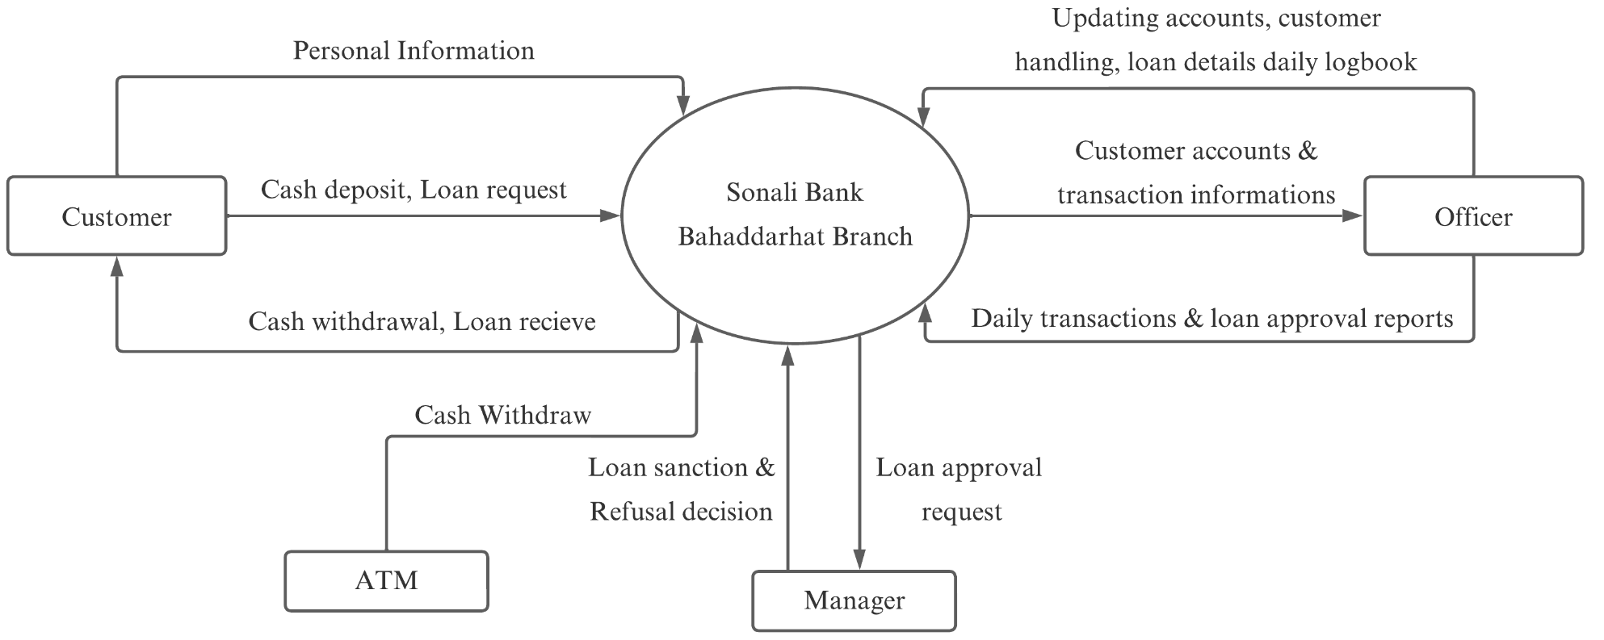
Context Diagram
Figure 2: Context Diagram

Slide 8
Data Flow Diagram
Flow and transformation of data in system
Categorized as either logical or physical
System operation explained in logical DFD
System implement explained in physical DFD

Slide 9
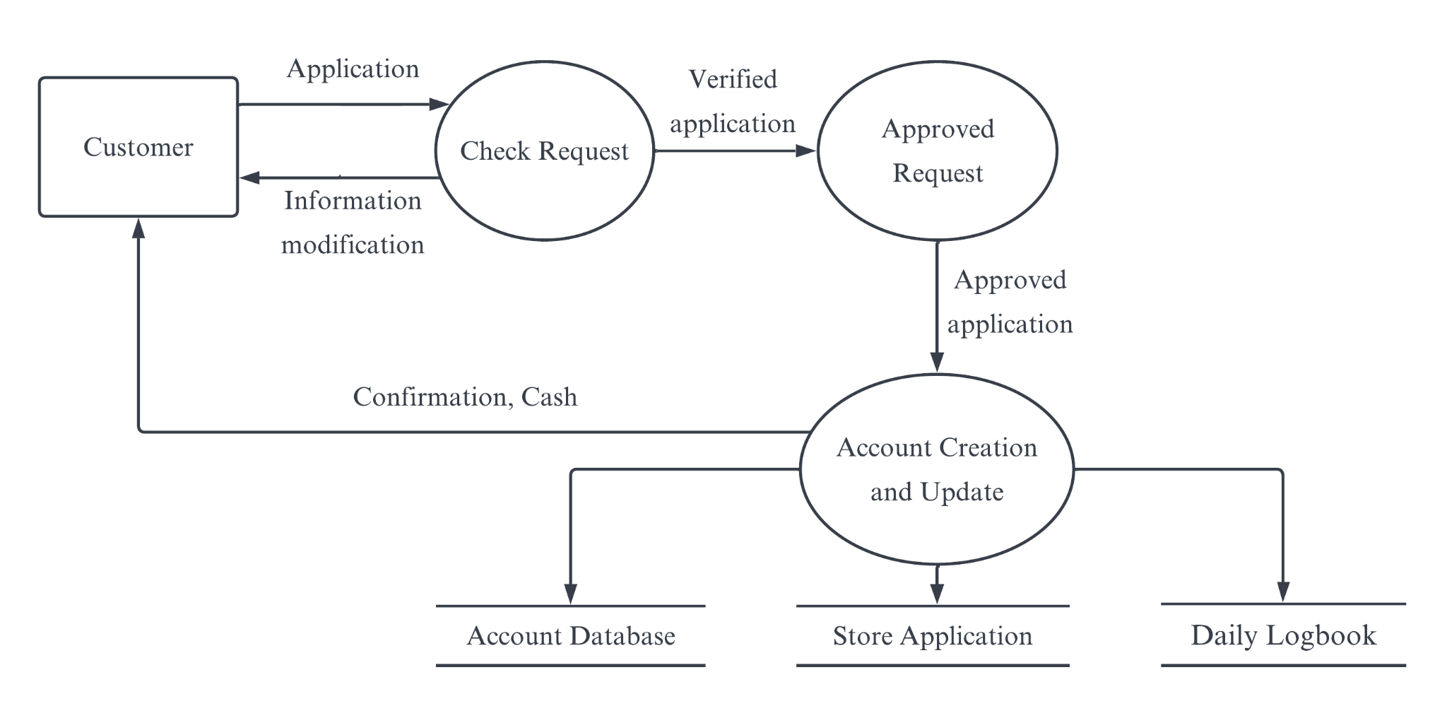
Logical DFD of Account Section
Figure 3: Logical DFD of Account Section

Slide 10
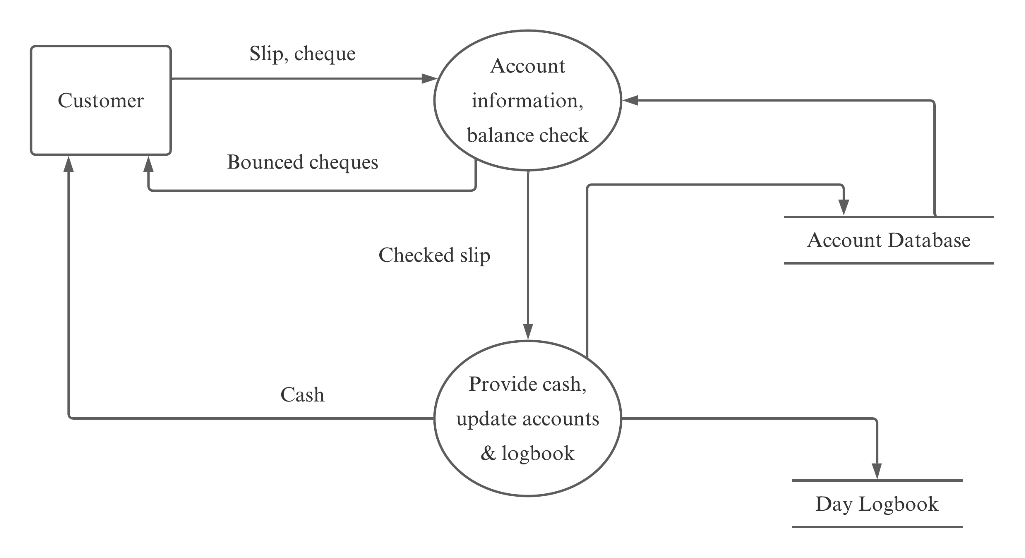
Logical DFD of Cash Section
Figure 4: Logical DFD of Cash Section

Slide 11
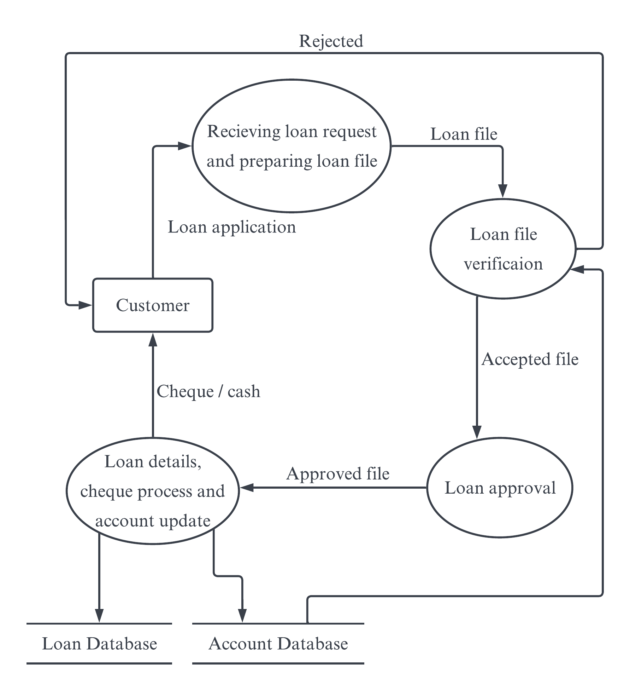
Logical DFD of Loan Section
Figure 5: Logical DFD of Loan Section

Slide 12
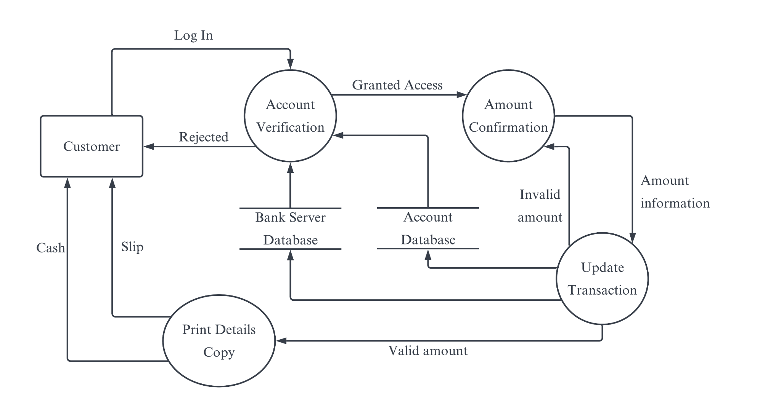
Logical DFD of ATM Section
Figure 6: Logical DFD of ATM Section

Slide 13
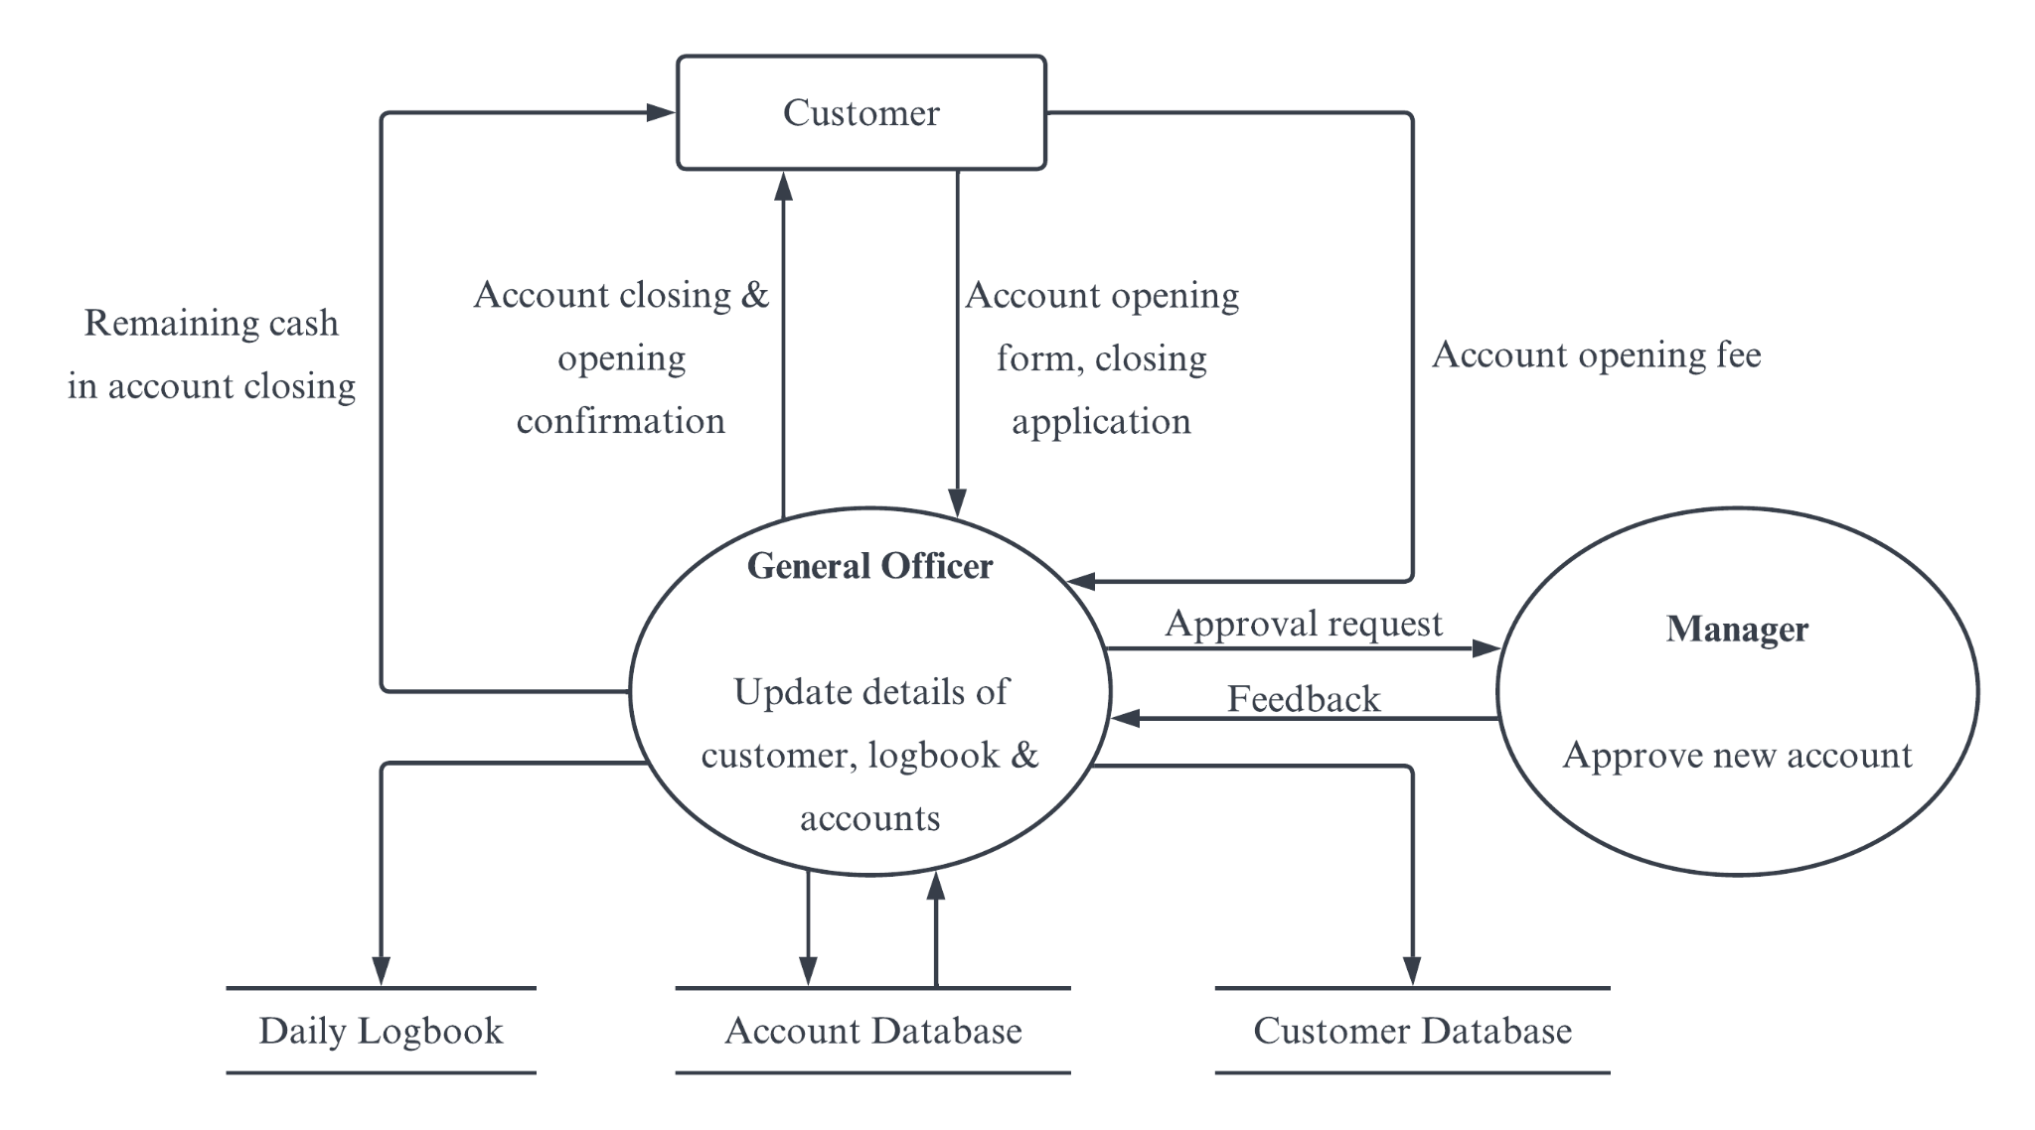
Physical DFD of Account Section
Figure 7: Physical DFD of Account Section

Slide 14
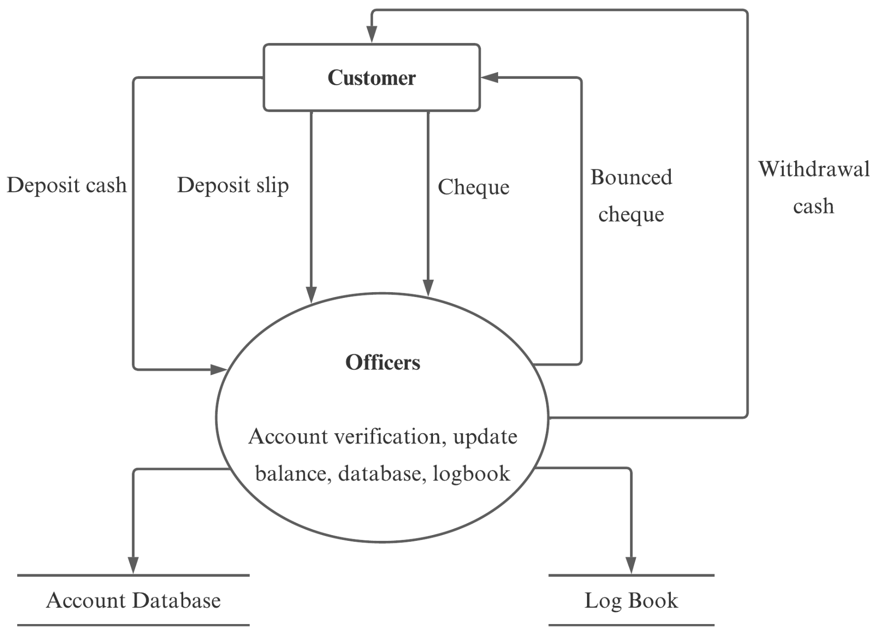
Physical DFD of Cash Section
Figure 8: Physical DFD of Cash Section

Slide 15
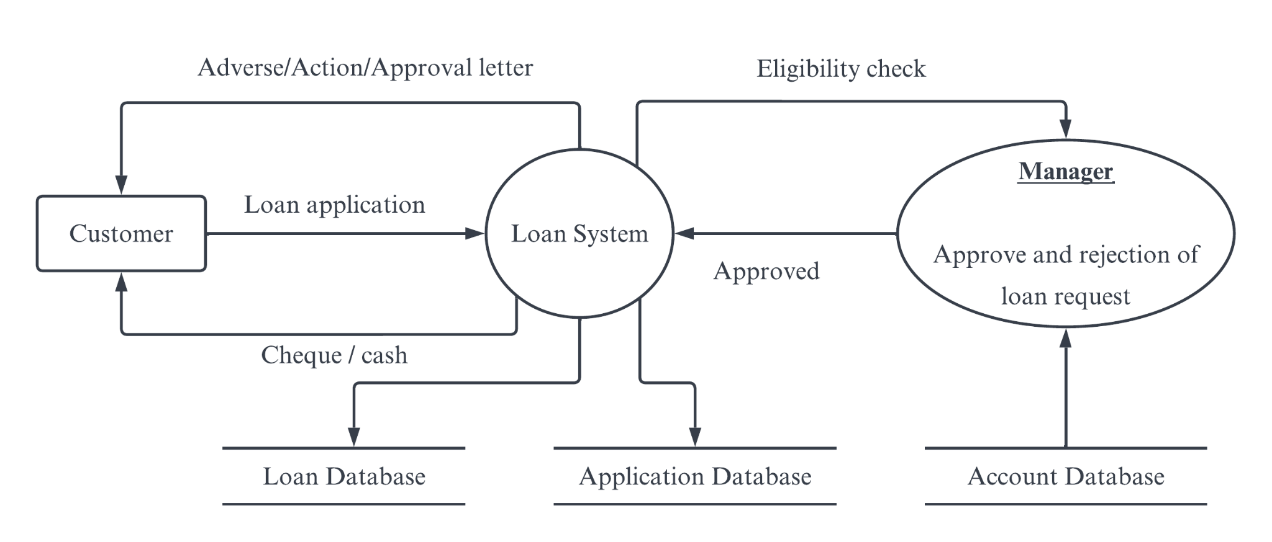
Physical DFD of Loan Section
Figure 9: Physical DFD of Loan Section

Slide 16
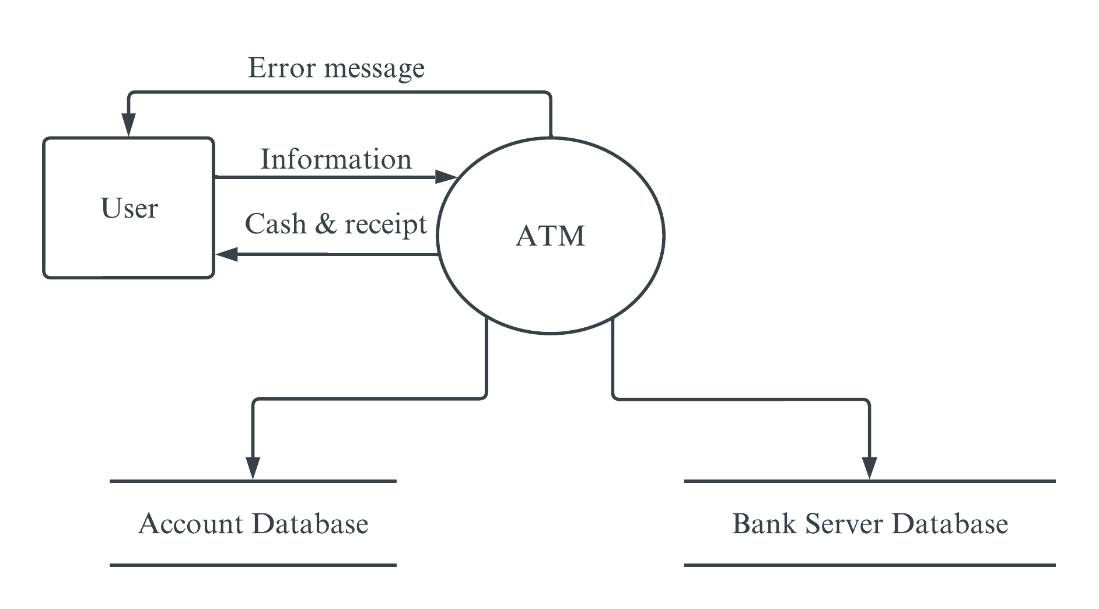
Physical DFD of ATM Section
Figure 10: Physical DFD of ATM Section

Slide 17
Conclusion
About the system development life cycle
Work done in each step
How DFD work in banking system
Data flow from one entity to other entity

Slide 18
Thank You

