Slide 1
A Hybrid Encryption Scheme for Hashed Password Storage and Retrieval
Rana salman rashid, nick Gregory, tamas aujeszky

Slide 2
Introduction
Hashing and Hybrid encryption

Slide 3
Background - Hashing
The operation of putting data of arbitrary length into a function that outputs fixed length strings (hashes)
Used for various purposes in cryptography
To quickly check whether a downloaded file is corrupted (checksum, cyclic redundancy check)
To authenticate messages
Password verification (our use case)
Also used outside of cryptography
Geometric hashing in computer graphics, e.g. proximity problems
Hash tables for quick searching: mapped value is a list where the query string can be found
Finding similar records in a database
Can be keyed or unkeyed, depending on use case
Unkeyed hashing needs to be collision-resistant
Given an input value, finding another with the same hash should require a brute-force approach
Notable cryptographic hashing algorithms: MD5, SHA-1/2/3/ (unkeyed), HMAC (keyed)

Slide 4
Background – Hybrid Encryption
Builds on the foundation of two different cryptographic concepts for exchanging messages:
Symmetric encryption
Alice and Bob share a shared secret key which is used for both encryption and decryption
Asymmetric encryption
Alice and Bob both generate public and secret/private keys, but only share their public keys with each other
The public key is used for encryption, and the secret key is used for decryption
Exploits the relative advantages of these cryptosystems:
Asymmetric encryption can be used even if Alice and Bob did not agree on a key previously
Symmetric encryption is much more efficient in practice, especially with block ciphers
The resulting cryptosystem consists of two phases:
Key encapsulation: Alice shares a key with Bob that is encrypted in an asymmetric cryptosystem
Data encapsulation: Bob decrypts the key and they use it as a shared key to encrypt and decrypt the transferred data in a symmetric cryptosystem

Slide 5
Problem Definition
Use case and system diagram

Slide 6
Use Case – Password Storage and Retrieval
Scenario: “Alice stores on and later retrieves hashed passwords from Bob”
1) Alice needs to create a hashed password
This step requires an unkeyed hash function, since she should be able to demonstrate her knowledge of the password to any parties in the future without necessarily agreeing on a key
The hash needs to be collision-resistant, since she does not want other parties to recover her password
We are using the SHA-512 hash function for this operation
2) Alice needs to transmit her hash to Bob, who can store it.
Although hashes are not long in general, we use hybrid encryption to demonstrate an efficient solution for arbitrarily long messages in case the hash output is longer than what a single block of RSA can handle
Alice uses key encapsulation to send the symmetric key to Bob and data encapsulation to send the hash
Our project uses RSA encryption for key encapsulation and AES encryption for data encapsulation
3) Alice needs to retrieve the hash from Bob
This execution of this action mirrors the previous one, using a hybrid encryption with RSA and AES

Slide 7
Operational Details - Hashing
a. Alice hashes the password: password -> |SHA-512| -> hash

Slide 8
Operational Details - Storage
a. Bob generates (pk,sk) using RSA-keygen: |KG| -> pk, sk
b. Alice requests and receives (pk) from Bob
c. Alice encrypts the symmetric key (k) using RSA and sends (k-enc) to Bob: (pk,k) -> |Enc-RSA| -> k-enc
d. Bob decrypts (k-enc): (sk,k-enc) -> |Dec-RSA| -> k
e. Alice encrypts (hash) using AES and sends (hash-enc) to Bob: (k,hash-enc) -> |Enc-AES| -> hash-enc
f. Bob decrypts (hash-enc) and stores it: (k, hash-enc) -> |Dec-AES| -> hash ---> storage

Slide 9
Operational Details - Retrieval
a. Alice generates (pk,sk) using RSA-keygen: |KG| -> pk, sk
b. Bob requests and receives (pk) from Alice
c. Bob encrypts the symmetric key (k) using RSA and sends (k-enc) to Alice: (pk,k) -> |Enc-RSA| -> k-enc
d. Alice decrypts (k-enc): (sk,k-enc) -> |Dec-RSA| -> k
e. Bob encrypts (hash) using AES and sends (hash-enc) to Alice: (k,hash-enc) -> |Enc-AES| -> hash-enc
f. Alice decrypts (hash-enc) and uses it: (k, hash-enc) -> |Dec-AES| -> hash ---> to be used

Slide 10
Application
Design motivation, User interface and running time measurements

Slide 11
Design Motivation
In any current user-friendly solutions, the same operations that this project performs are usually hidden from the eyes of the users
As a result, this project could be implemented as an input field for the password, and three buttons for hashing, storage and retrieval
This would result in a black-box solution that is also not very exciting
The decision that inspired our application design was to implement every step in a way that users can follow along
As a result, this project can also be used for educational purposes

Slide 12
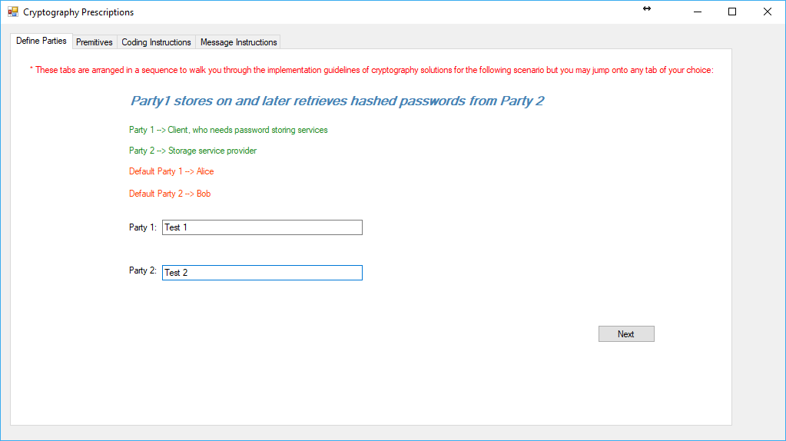
Party Definition Tab
Users can define the names of the parties in this tab
This enables them to familiarize themselves with the details on the next tab

Slide 13
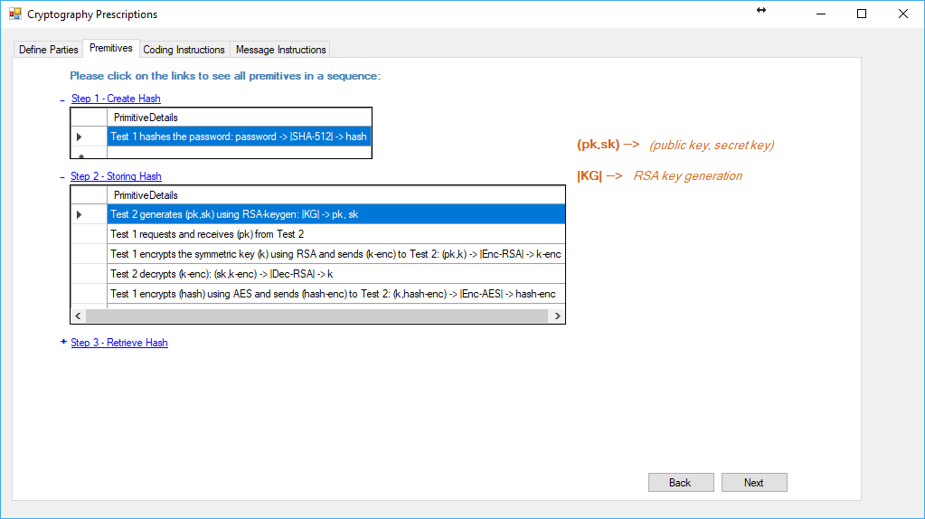
Procedure Explanation Tab
This tab contains a description of all the cryptographic primitives used in all the operations that the application performs
Data elements are also consistently named throughout these guides to facilitate user understanding

Slide 14

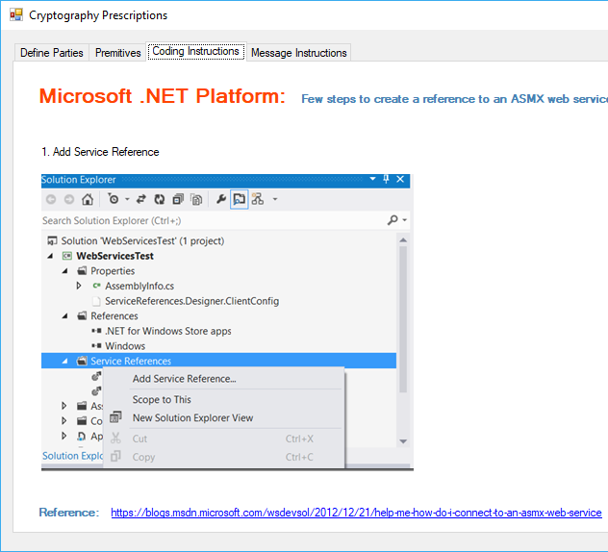
Walkthrough Tab
This tab contains a walkthrough for users who desire to implement the previously learnt steps themselves
It provides screenshots and references to online sources

Slide 15
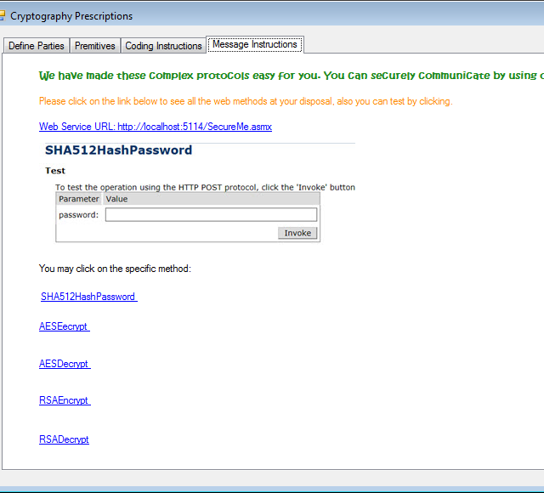
Operational Tab
This tab enables users to perform the hashing and encryption processes themselves
The outputs of the functions are made visible to users so they can follow along the process

Slide 16
Data Management

Slide 17
Running Time Measurements

Slide 18
Discussion
Use of hybrid encryption over asymmetric encryption
In the case of relatively short hashes, it might be more efficient to use RSA only. However, in our case the SHA-512 function has an output that is too long to be encoded in a single RSA-block. Therefore it is deemed more efficient to encode the hash itself with AES.
Digital signatures and key agreement
Our project operates under the assumption that although eavesdropping is possible on the channel between Alice and Bob, there is no possibility of Man-In-The-Middle attacks where an outside party might intercept and alter the messages, or send his own messages to either party.
In the case where MITM attacks are possible, existing methods for key agreements need to be implemented to make sure Alice and Bob use each other’s public key to encrypt their data. The exchange of the hash also needs to be digitally signed by the sender party to ensure it truly comes from their side.
<anything else?>

Slide 19
Thank you for your attention!
Please Feel free to ask any questions

