Slide 1
Exam 1 prep questions

Slide 2
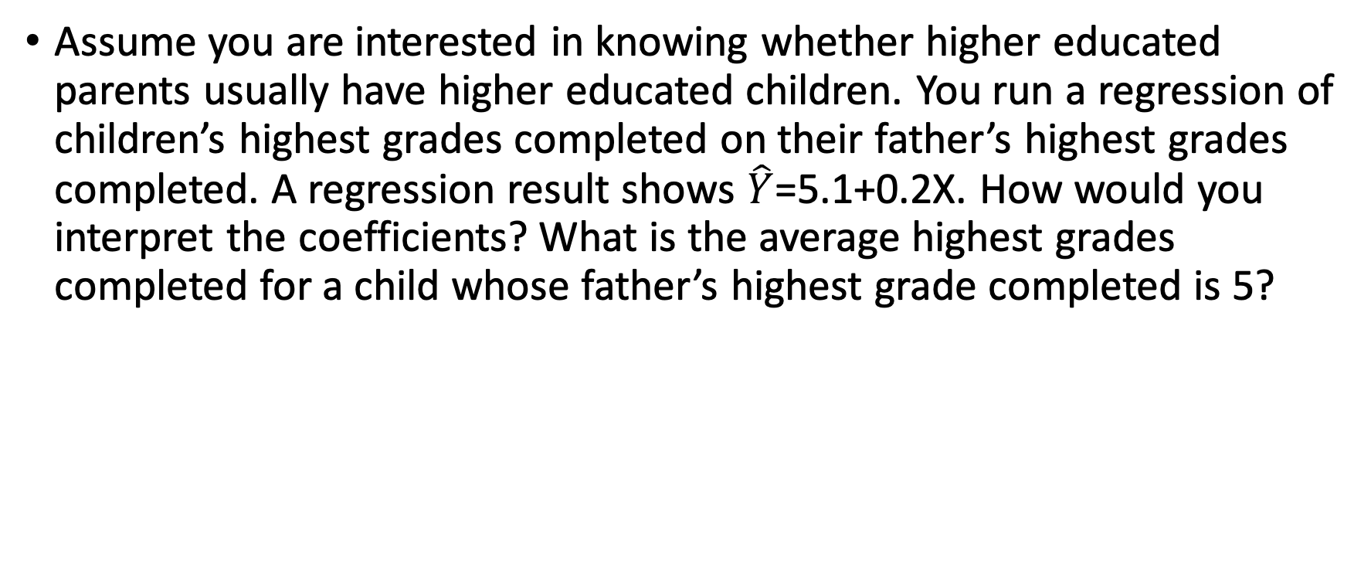
Exercise 1 (Do on your own)
Assume you are interested in knowing whether higher educated parents usually have higher educated children. You run a regression of children’s highest grades completed on their father’s highest grades completed. A regression result shows $\hat{Y}$=5.1+0.2X. How would you interpret the coefficients? What is the average highest grades completed for a child whose father’s highest grade completed is 5?

Slide 3
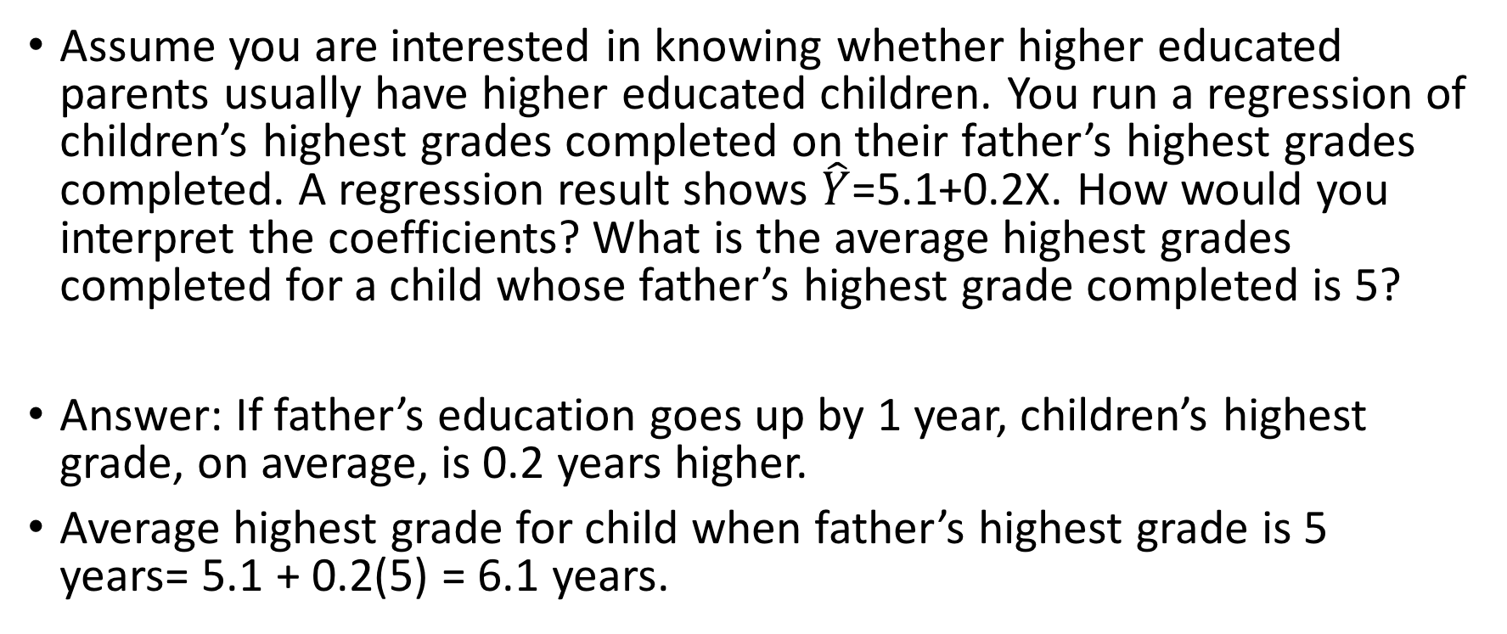
Exercise 1 (Do on your own)
Assume you are interested in knowing whether higher educated parents usually have higher educated children. You run a regression of children’s highest grades completed on their father’s highest grades completed. A regression result shows $\hat{Y}$=5.1+0.2X. How would you interpret the coefficients? What is the average highest grades completed for a child whose father’s highest grade completed is 5?
Answer: If father’s education goes up by 1 year, children’s highest grade, on average, is 0.2 years higher.
Average highest grade for child when father’s highest grade is 5 years= 5.1 + 0.2(5) = 6.1 years.

Slide 4

Exercise 2 (categorical variable: Do yourself)
After estimating whether having health insurance will increase number of doctor visit (in an year), you get a regression results: $\hat{Y}$=4.2+0.09X. Interpret $\hat{β_{0}} and \hat{β_{1}}$

Slide 5
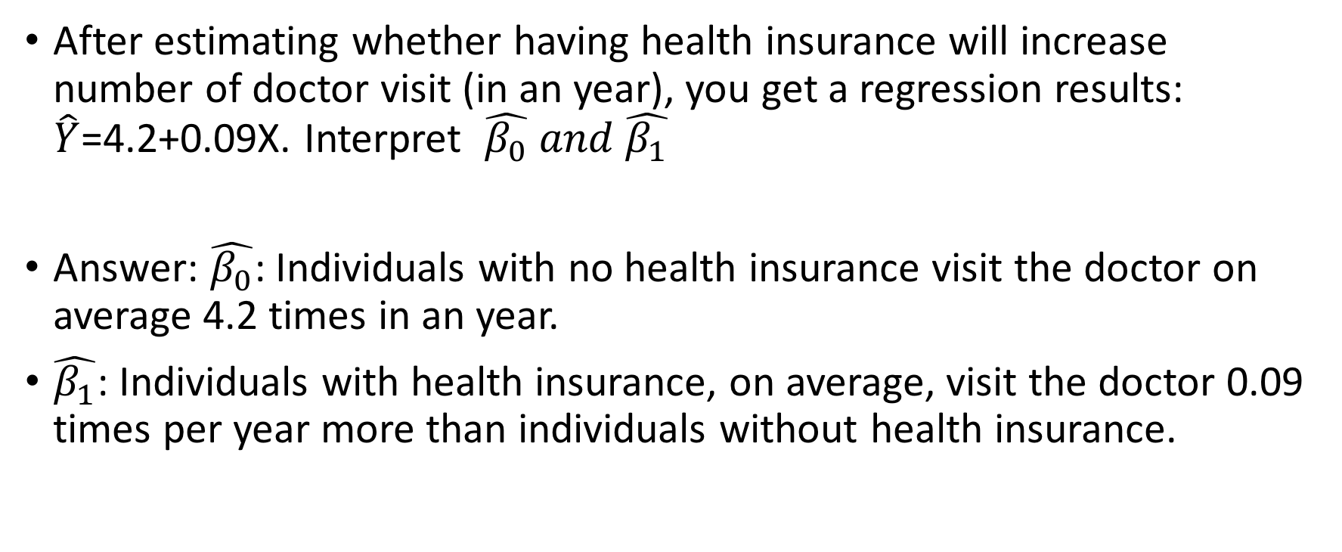
Exercise 2 (categorical variable: Do yourself)
After estimating whether having health insurance will increase number of doctor visit (in an year), you get a regression results: $\hat{Y}$=4.2+0.09X. Interpret $\hat{β_{0}} and \hat{β_{1}}$
Answer: $\hat{β_{0}}$: Individuals with no health insurance visit the doctor on average 4.2 times in an year.
$\hat{β_{1}}$: Individuals with health insurance, on average, visit the doctor 0.09 times per year more than individuals without health insurance.

Slide 6
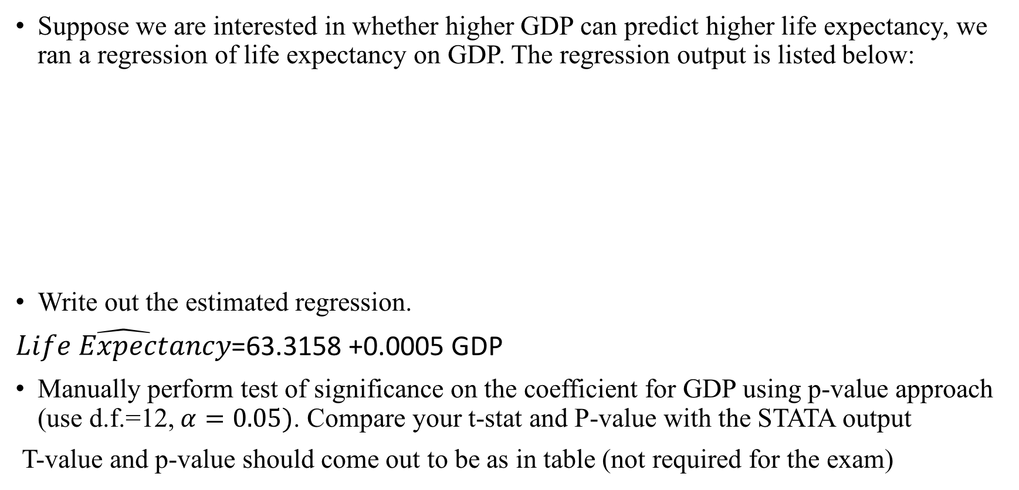
Exercise (p-value approach: Do yourself)
Suppose we are interested in whether higher GDP can predict higher life expectancy, we ran a regression of life expectancy on GDP. The regression output is listed below:
Write out the estimated regression.
$\hat{Life Expectancy}$=63.3158 +0.0005 GDP
Manually perform test of significance on the coefficient for GDP using p-value approach (use d.f.=12, $α=0.05)$. Compare your t-stat and P-value with the STATA output
T-value and p-value should come out to be as in table (not required for the exam)
 | Coefficients | standard error | t Stat | P-value | Lower 95% | Upper 95%
GDP | 0.0005 | 0.0006 | 0.8333 | 0.4242 | -0.0008 | 0.0018
Intercept | 63.3158 | 0.8629 | 73.3786 | 0.0000 | 61.6104 | 65.0212

Slide 7
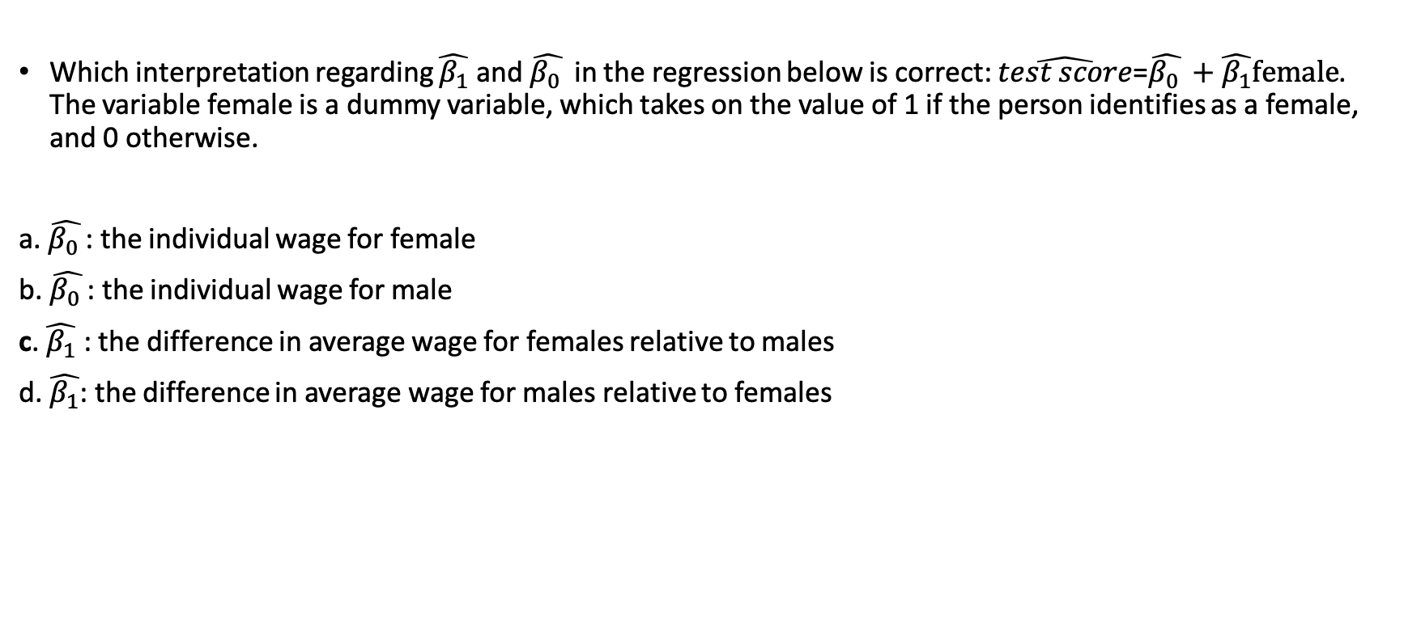
Example MCQ question
Which interpretation regarding $\hat{β_{1}}$ and $\hat{β_{0} }$ in the regression below is correct: $\hat{test score}$=$\hat{β_{0} }+\hat{β_{1}}female$. The variable female is a dummy variable, which takes on the value of 1 if the person identifies as a female, and 0 otherwise.
a. $\hat{β_{0} }$: the individual wage for female
b. $\hat{β_{0} }$: the individual wage for male
c. $\hat{β_{1}}$ : the difference in average wage for females relative to males
d. $\hat{β_{1}}$: the difference in average wage for males relative to females

Slide 8
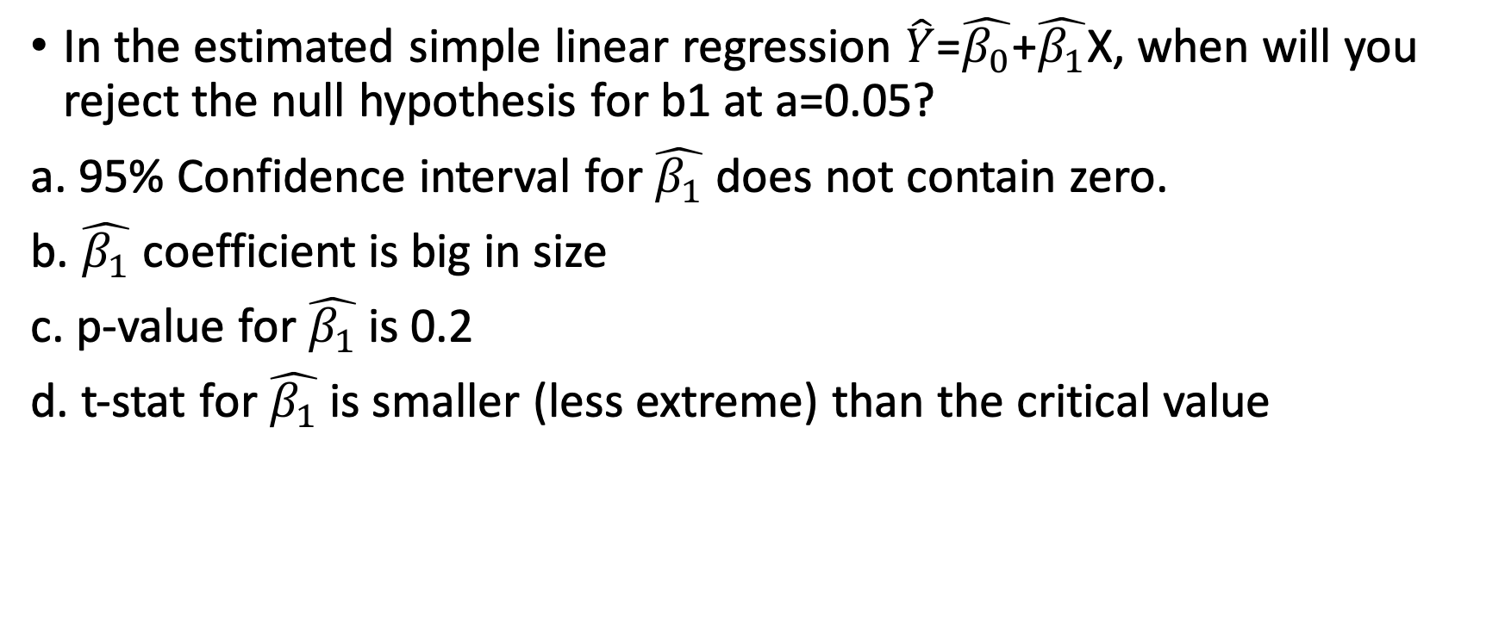
Multiple Choice Example
In the estimated simple linear regression $\hat{Y}$=$\hat{β_{0}}$+$\hat{β_{1}}$X, when will you reject the null hypothesis for b1 at a=0.05?
a. 95% Confidence interval for $\hat{β_{1}}$ does not contain zero.
b. $\hat{β_{1}}$ coefficient is big in size
c. p-value for $\hat{β_{1}}$is 0.2
d. t-stat for $\hat{β_{1}}$is smaller (less extreme) than the critical value

Slide 9
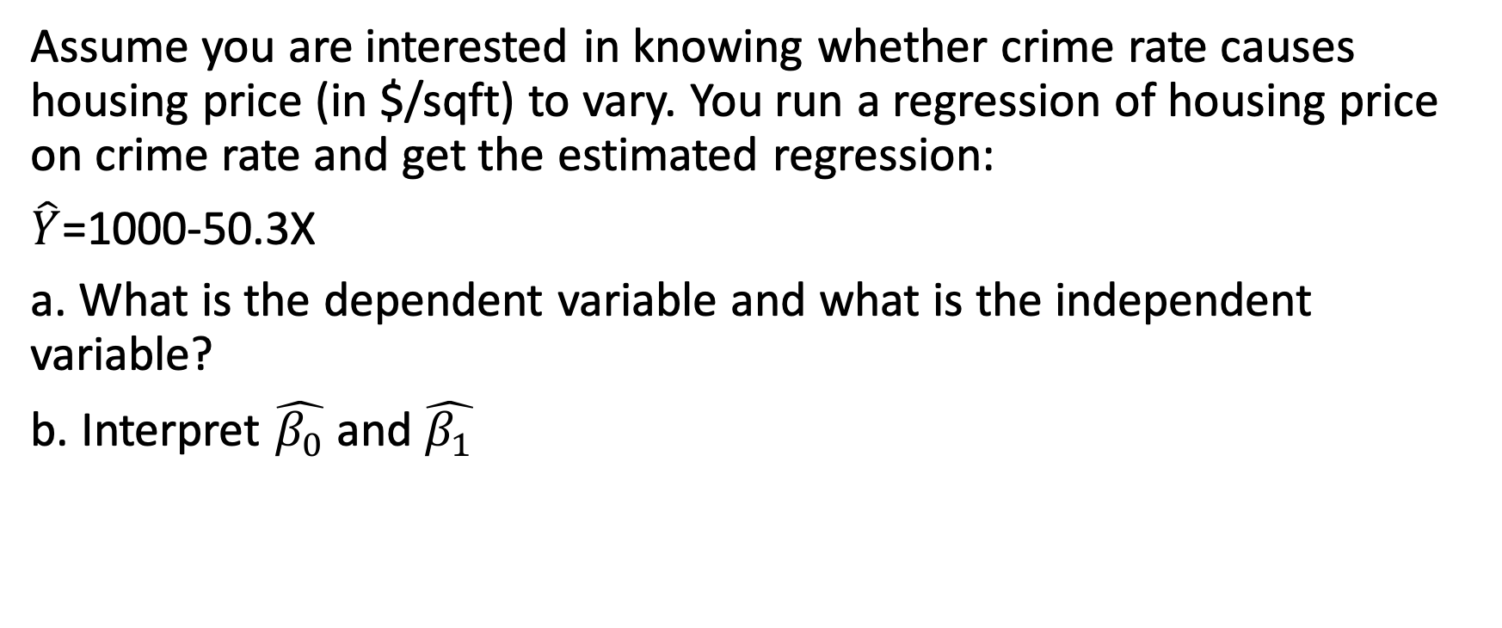
Practice Short Question
Assume you are interested in knowing whether crime rate causes housing price (in $/sqft) to vary. You run a regression of housing price on crime rate and get the estimated regression:
$\hat{Y}$=1000-50.3X
a. What is the dependent variable and what is the independent variable?
b. Interpret $\hat{β_{0}}$ and $\hat{β_{1}}$

Slide 10
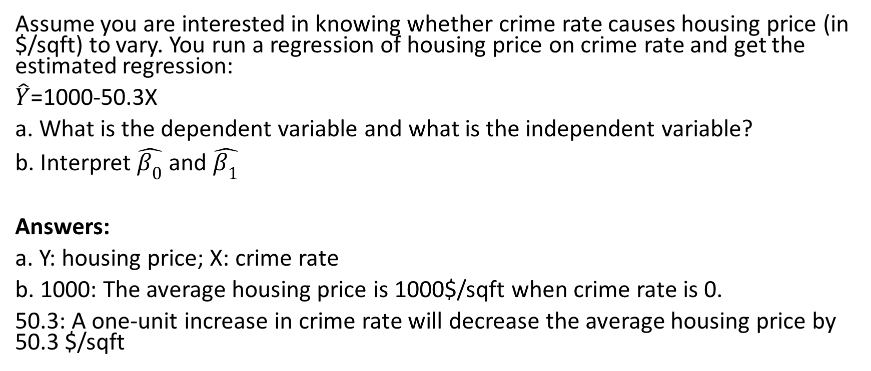
Practice Short Question
Assume you are interested in knowing whether crime rate causes housing price (in $/sqft) to vary. You run a regression of housing price on crime rate and get the estimated regression:
$\hat{Y}$=1000-50.3X
a. What is the dependent variable and what is the independent variable?
b. Interpret $\hat{β_{0}}$ and $\hat{β_{1}}$
Answers:
a. Y: housing price; X: crime rate
b. 1000: The average housing price is 1000$/sqft when crime rate is 0.
50.3: A one-unit increase in crime rate will decrease the average housing price by 50.3 $/sqft

Slide 11
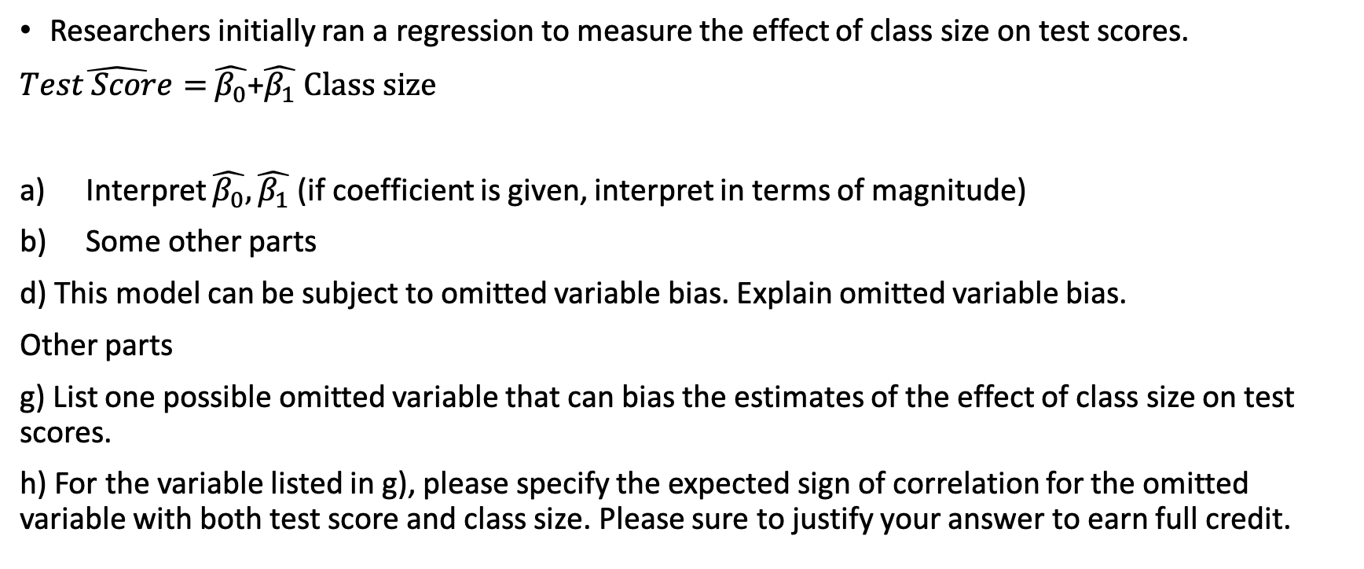
Example of part of long question
Researchers initially ran a regression to measure the effect of class size on test scores.
$\hat{Test Score= }\hat{β_{0}}$+$\hat{β_{1}} Class size$
Interpret $\hat{β_{0}}, \hat{β_{1}}$ (if coefficient is given, interpret in terms of magnitude)
Some other parts
d) This model can be subject to omitted variable bias. Explain omitted variable bias.
Other parts
g) List one possible omitted variable that can bias the estimates of the effect of class size on test scores.
h) For the variable listed in g), please specify the expected sign of correlation for the omitted variable with both test score and class size. Please sure to justify your answer to earn full credit.

