Slide 1
Lecture 16
Regression Discontinuity Design (RDD)

Slide 2
Announcements
PS4 is due on 04/15/2020

Slide 3
Outline
DID (recap)
Intro to Regression Discontinuity (RD)
What is RD?
RD’s identifying variation
An example of Sharp RD

Slide 4
Recall: Problems with OLS

Slide 5
Recall: Why don’t we just randomly assign people to control and treatment group?
What are the advantages of running a randomized control trial?
What are possible drawbacks of running a RCT?

Slide 6
Basic idea of DID
Differences-in-differences is an improved version of the before/after estimator
The DID design does a before and after comparison but uses a control group. In his study, Card compares unemployment changes in Miami to unemployment changes in Atlanta, Los Angeles, Houston and Tampa
The DID gets its name because it is the difference of two differences

Slide 7
Test the identification assumption
Unlike OLS and IV, we have an explicit test for DID’s identification assumption.
What is the assumption?
Common trends: we assume that Miami would have followed Houston’s unemployment between 1979 and 1981 if it wasn’t for the immigrants
How do we explicitly test it?
We should see Houston and Miami move together until 1980 and then diverge-show pre-trends graph. (pre-trends mean pre-treatment trends)
Note that Miami and Houston have very different unemployment rates the entire time and that’s fine as long as they are parallel

Slide 8
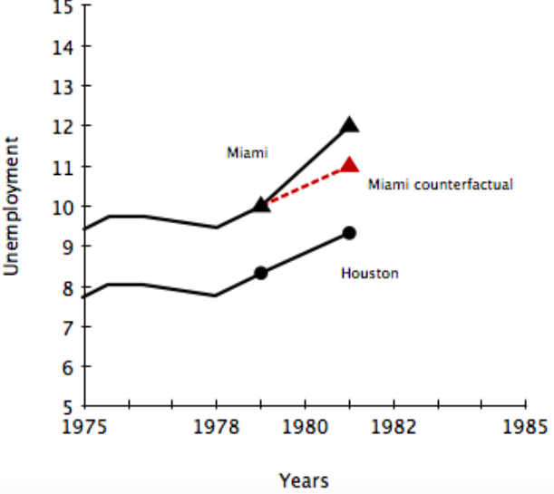
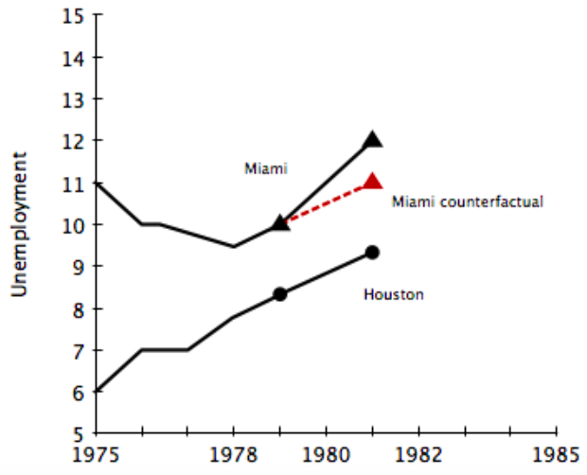
Test common trends assumption using graph
Good common trends
Bad common trends

Slide 9
Why does common trends test work?
Common trends assumption is about what would have happened in Miami if there were no treatment (immigrants)
But the test is about the trend in pre-treatment years. Why does that work?
Note this is again, an indirect test. The idea is if both states in pre-treatment years have followed parallel trends, it is very likely in the treatment years they would have followed parallel trends
Bottom line: if you fail common trends test-invalid research design-don’t use DID

Slide 10
Why DID might fail
1. Common trend assumption fails
This is the most common concern and it can be tested indirectly by looking at the pretrends
2. Simultaneous treatment effect
If something else happens at the same time in Miami, it will bias estimates
The pretrend test will not detect this problem
3. Contamination
If Houston is impacted by Miami’s labor market this will bias estimates (usually biases estimates towards zero).
The pretrend test will not detect this problem.

Slide 11
Why DID might fail
4. Policy endogeneity
If the policy was implemented in response to something, this will probably bias estimates.
e.g. If Chicago passes a new anti-violence law, we might be concerned that the laws passage was done because Chicago anticipated that crime would rise a lot next year without the policy
It will downward bias the effect of the law
The pretrend test could detect this problem, but it could also miss it
If the policy is based on previous years, the pretrend test will detect it

Slide 12
Review for quizzes
Know what DID is and its identification assumption
The regression for simple DID-know what each parameter means.
the Identification test
Why DID can fail-know examples

Slide 13
Intro to Regression Discontinuity

Slide 14
Example
Research Question: How does getting an A in the course of econometrics affect your wage?
Naïve comparison (simple OLS) doesn’t render causal effect because of omitted variable problem, such as motivation.
Use RD strategy: compare average wage of students who get 90 vs. those who get 89. (89 gets a B, and 90 gets an A).
Now are we comparing apple to apple?
Most likely, since in the narrow neighborhood of 90, students probably randomly receive 89 or 90.
Students who get 89 and those get 90 are similar in observables and unobservables

Slide 15
What is regression discontinuity design?
The main problem in establishing causality is that D=0 and D=1 are not comparable
The RD design focuses on cases in which D status is determined by an arbitrary cutoff
We compare the individuals just right of the cutoff to those just left of the cutoff
When done well, RD is one of the most convincing empirical methods in terms of causal effect
The idea is that some laws or rules leading to discontinuous changes in outcome, but subjects are similar in other aspects around the discontinuity
e.g. Course grades — 89 gets B, 90 gets A-see next slide

Slide 16
RD terminology
Running variable (also called forcing variable): this is the continuous variable which determines treatment
Cutoff: The level of the running variable at which the treatment status changes
What are the running variables and cutoffs?
Course grades — 89 gets B, 90 gets A
Grade is running variable. Cutoff is 90

Slide 17
RD identification assumption
The purpose of using RD is to mimic randomization
The identification assumption is that around the cutoff, treatment is randomly assigned
In other words, around the cutoff, we assume treatment is not tainted by omitted variables; individuals just to the left and right are like “apples to apples”
Notes:
IV, OLS with control and RD-all try to mimic RCT. Assume A is just to the right of the cutoff, and B is just to the left. A got the treatment not because A is different in B in any observed or unobserved way. It’s completely random.

Slide 18
Sharp vs. fuzzy RD
Two types of RD:
Sharp RD:
We know the exact relationship between running variable and treatment status-treatment status is completely determined by the running variable
Fuzzy RD:
There is not an exact relationship- treatment status is partially determined by the running variable
The discontinuity strongly influences treatment status, but there is “slippage” or “non-compliance”
In this case, we use the discontinuity as an instrument for treatment status
Notes:
Take the grade example, if the letter grade is determined 90% by final grade and 10% of judgment-then it’s a fuzzy RD

Slide 19
Example: Austrian unemployment benefit- Lalive 2008
Austrian government in 1988 extended unemployment insurance (UI) benefits for people over 50 living in certain regions of Austria from 30 weeks to 209 weeks.
Causal question: Does the availability of 209 weeks of benefits increase unemployment duration?
Question: Can you just compare people over 50 before and after the policy change?
What can be some omitted variables?

Slide 20
Sharp RD
Workers who are 49 only qualify for 30 weeks of unemployment insurance. Workers who are 50 qualify for 209 weeks unemployment insurance
What is the running variable and cutoff?
What is the mean comparison?
Access identification assumption:
Are 49 years old and 50 years old different in any observed or unobserved way?
What are some stories that can violate the identification assumption?
Since age perfectly predicts the maximum number of weeks unemployment, this is a sharp RD
The sharpness can be seen in a picture
Notes:
identification assumption:it’s like the IV exclusion restriction, you are trying to eliminate other difference between treatment and control so that you can attribute any difference in outcome to just UI status.

Slide 21
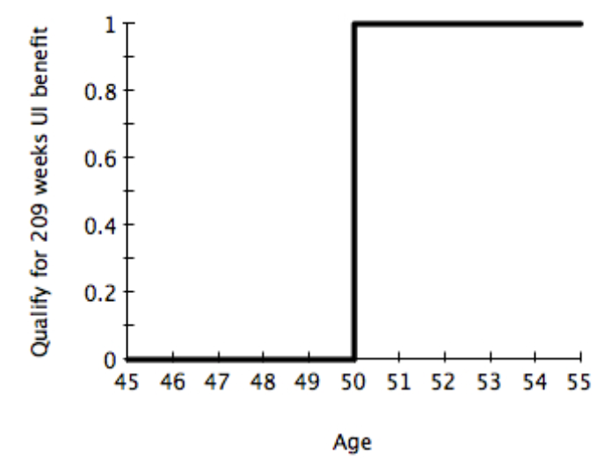
Sharp RD -“first stage”
In Sharp RD, “first stage” usually is not shown

Slide 22
Sharp RD-”reduced form”
Comparing unemployment duration for people aged 49 vs 50 tells us the impact on duration when age switched from 49 to 50
It is also the impact of unemployment benefits on duration-our causal question.
This is because we have “perfect compliance”
All we need to assume is that 49 and 50 year olds are otherwise similar-will discuss how to explicitly test this identification assumption in the next lecture
Results: average duration for 49 year olds was 13 weeks. For 50 year olds, average duration was 27 weeks.
To make this even more convincing, we can show a picture

Slide 23
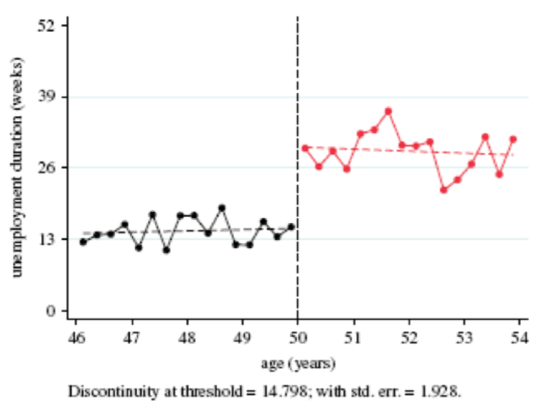
Sharp RD-”reduced form”
Compelling evidence that the policy impacted people's unemployment duration
The RD estimate is the vertical distance between the outcomes right at the cutoff

Slide 24
Exercise
Research Question: Measure the causal impact of being the current incumbent party on the probability of winning the next election. (incumbency advantage)
What is the naïve comparison? (identify Y and D)
Why is the naïve comparison not causal? (identify omitted variables)
A RD research design:
The idea: Whether or not a party is the incumbent party is a deterministic function of their vote share in the prior election.
Running variable: vote share (50.1% leads to winning, 49.9% leads to losing) in the pervious election
Question: What is the cutoff value?
What is the apple to apple comparison? Do you think it is reasonable?

Slide 25
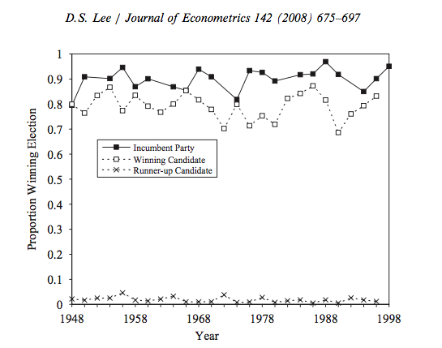
Actual Research by David Lee
This graph shows that if a party is incumbent, it is much more likely to win the next election.
The questions is “is this because of incumbency advantage or is this because the party is in fact more capable? “

Slide 26
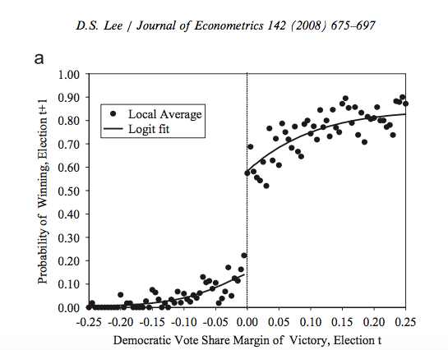
Results (note: this is a fuzzy RD)
Compare cases when Democratic Party barely lost vs. barely won in the previous election.
Their probability of wining the next election is very different.
We attribute this difference to the incumbency advantage
It is causal because parties that barely won and those barely lost are like “apple to apple”

Slide 27
Review for quizzes
Understand what RD is, why we need RD, and the identification assumption of RD
Understand two types of RD
Be able to recognize the running variable and cutoff value

