Slide 1
GIT
Source Code Management

Slide 2
Contents
Introduction to GIT and its features
GIT WorkFlow
Installation and configuration
Working Locally
Going Remote

Slide 3
Introduction to GIT
Designed by Linus Torvalds in 2005
Command Line Tool primarily
Distributed/Decentralized (most operations are local)
Unlike other SCM, every Git directory on every computer is a full-fledged repository with complete history and full version-tracking abilities, independent of network access or a central server

Slide 4
Why Command Line?
History – from beginning GIT is a command line tool
New Features – first comes in cmd line
Online Help – most online help is cmd line centric
Power – powerful and complicated actions are cmd line driven
Consistent – so many graphical clients for GIT but cmds remain same across platforms
Terminal on Linux/Mac
Git Bash on Windows
NOTE: Have a look at GUI clients for GIT.
https://git-scm.com/downloads/guis

Slide 5
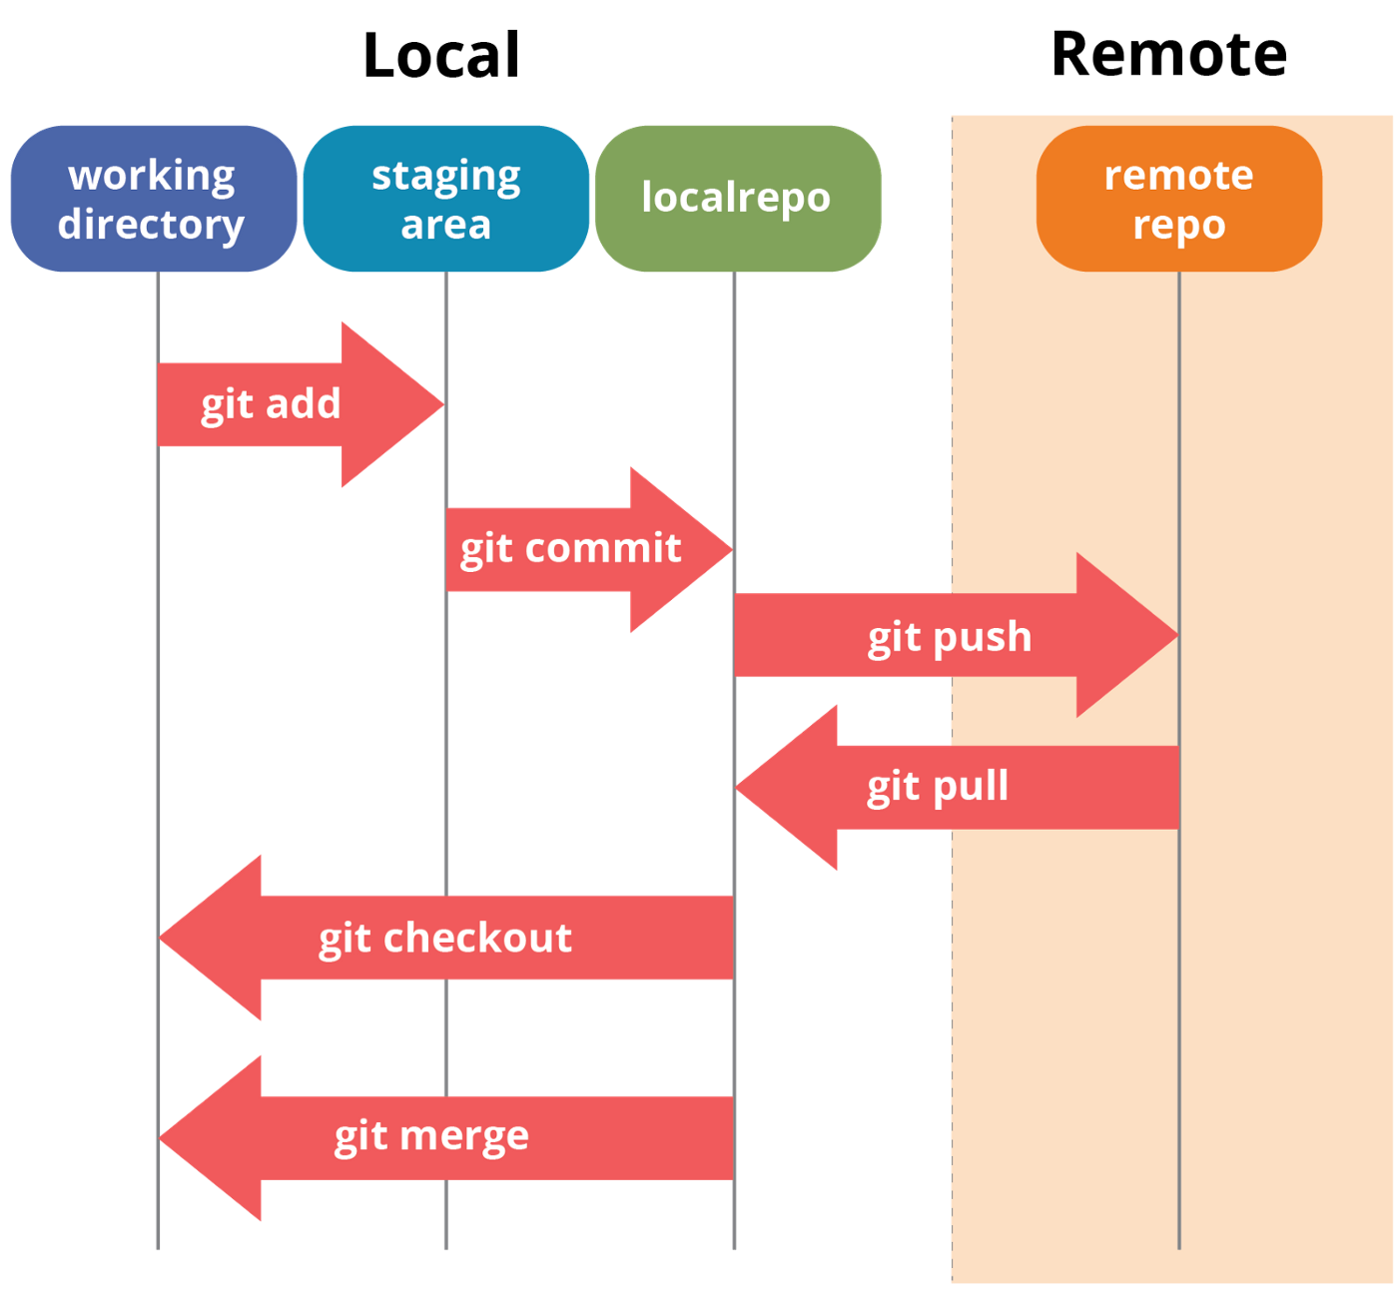
GIT Workflow

Slide 6
Installation
Download the installer from the URL: https://git-scm.com/downloads
Follow the steps to install the GIT.

Slide 7
Configuration
We need to configure GIT with some basic information such as username and email. This is done as follows.
>> git config - -global user.name “Salman Ali”
>> git config - -global user.email “SalmanAli@gmail.com”
>> git config - -global - -list
NOTE:
We can run these config commands any where in our system. These are global commands. These are irrespective of any repository
Settings can be global level or user level. Here we have done at global level
GIT will create a config file(simple text file) in our user directory that is called “.gitconfig”
You can print to see the contents of config file using cat command or open file in text editor(like notepad) in the file explorer. I am using cat command
>> cat ~/.gitconfig
This is git’s user-based config file

Slide 8
Get started…

Slide 9
Working Locally

Slide 10
1) help
Getting general help:
>> git help
Getting help about a specific Git command:
Syntax: git help command
>> git help config
In Linux: this will open man page in the same terminal
In Windows: this will open a webpage in default browser

Slide 11
We can start working with GIT Source control with a project
We can initialize an existing project
We can start from scratch

Slide 12
From Scratch

Slide 13
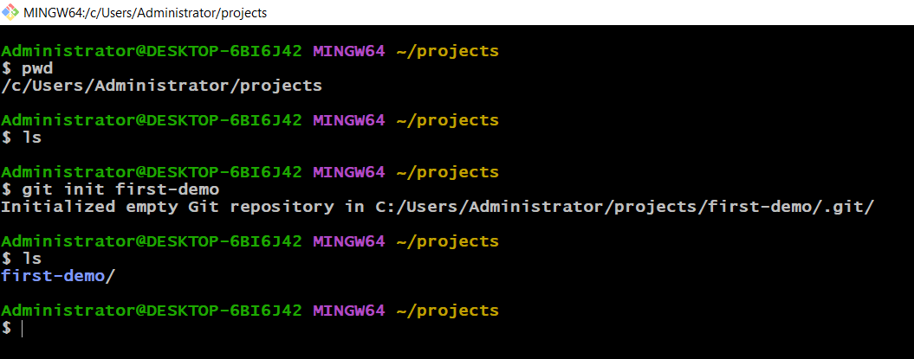
From Scratch
Create a new directory – to create projects under it
Initialize a new project by issuing the init command
Syntax: git init project-name
>> git init first-demo
Outcome:
This will create a new directory by project name. Here it is “first-demo”

Slide 14
NOTE:
Inside our project called “first-demo”, you can see a hidden sub-directory called “.git”.
This directory is where GIT manages all the different files relevant to the GIT source control.
Without this “.git” folder, you don’t have a GIT repository

Slide 15
With Existing Project

Slide 16
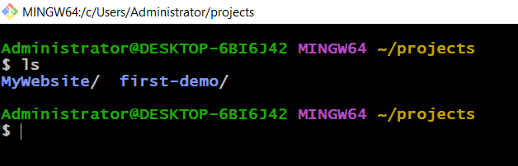
With Existing Project
Copy a ready built project into our projects directory
If you don’t have, then click on this link to download a project from internet and copy into the projects directory
I will download it, copy and rename it as “MyWebsite”

Slide 17
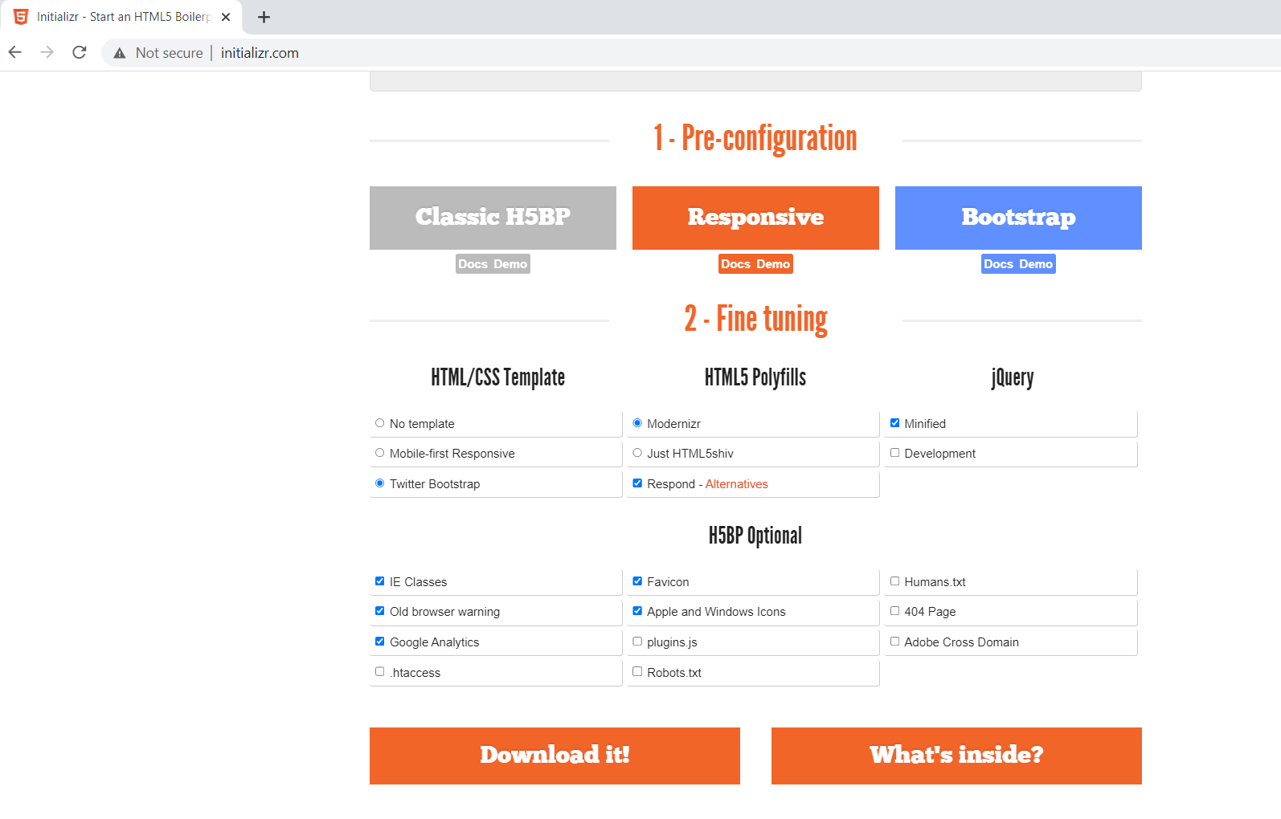
Download
Go to the URL: http://www.initializr.com/
Select Bootstrap
Select/unselect your choice of items
Click Download it

Slide 18
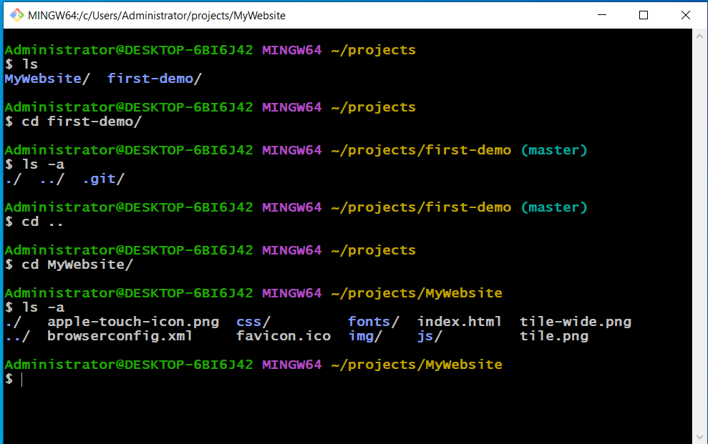
Continued…
Check whether a project is under the control of GIT or not. I mean whether project is a GIT repository or not.
We can verify this in 2 ways
Get into a project, if you see prompt change with name master in it and project has a sub-directory “.git”. Then, this project is GIT repository
Look at the output right side.
When we are inside project “first-demo”, we can see change in prompt as well as “.git” sub-directory.
When we are inside project “MyWebsite”, no change in prompt and there is no “.git” sub-directory.
Run command “git init” inside “MyWebsite” project to make it GIT repository

Slide 19
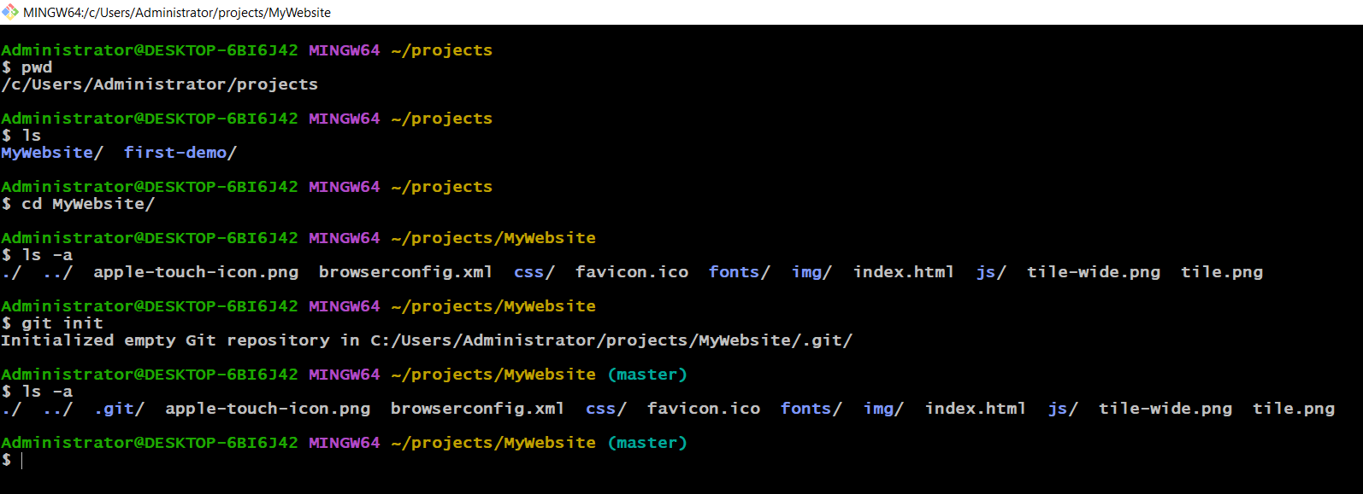
>> get init

Slide 20
First Commit

Slide 21
First Commit
There are 3 steps
Create/modify file(s) in “Work Directory”
Add to “Staging Area”
Commit to “GIT Repository”

Slide 22
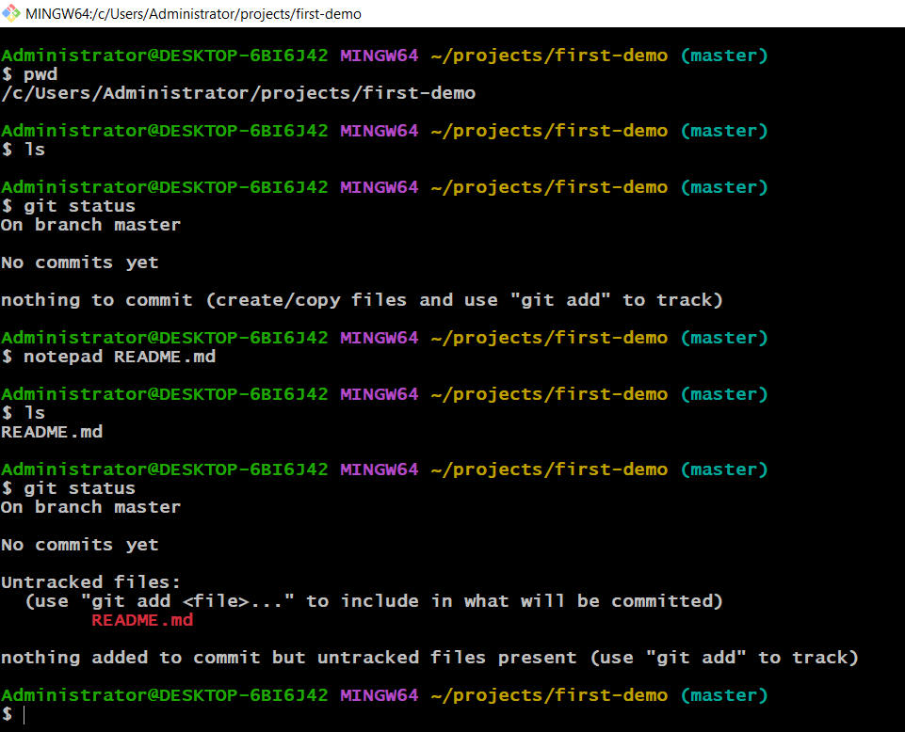
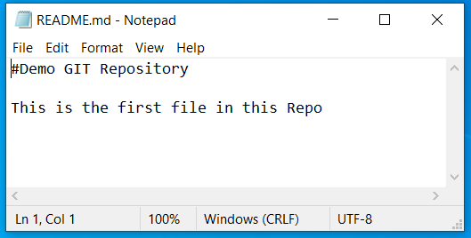
Step 1: Create/Modify in “Working Directory”
>> git status
Shows which files have been modified in the working directory vs Git's staging area
Created README.md file inside project “first-demo” as shown below

Slide 23
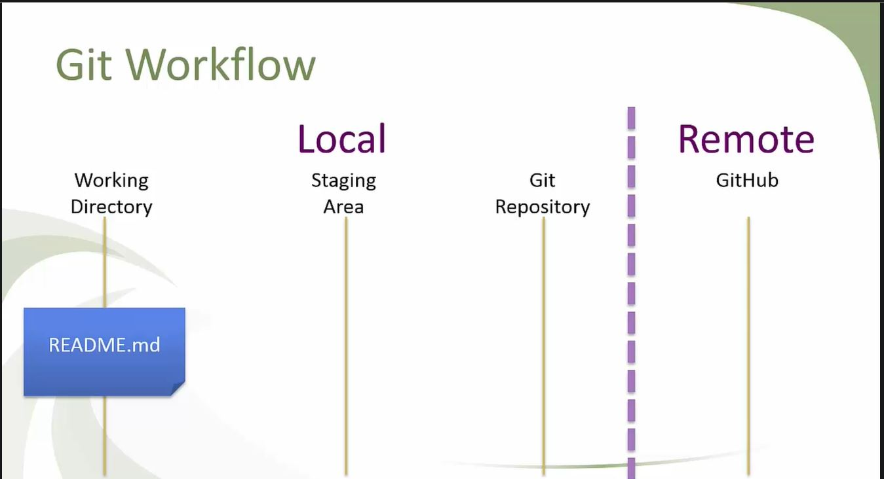
Step 1: Create or Modify file(s)

Slide 24
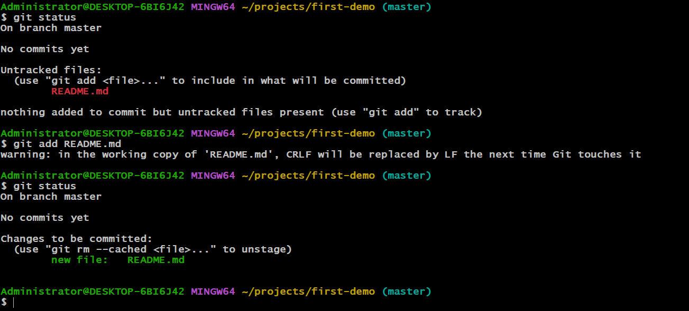
Step 2: Add to “Staging Area”
>> git add file-name
Adds the new or newly modified file-name to Git's staging area (index).

Slide 25
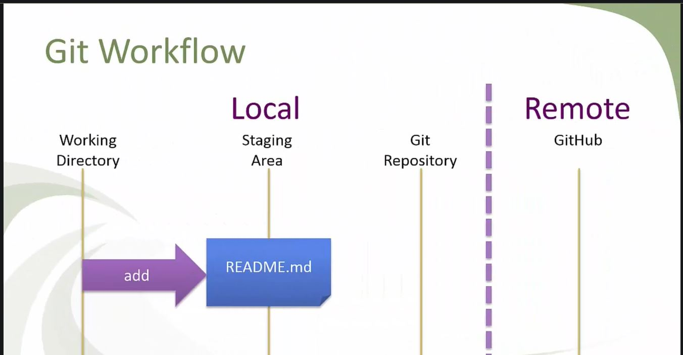
Step 2: Add to “Staging Area”

Slide 26
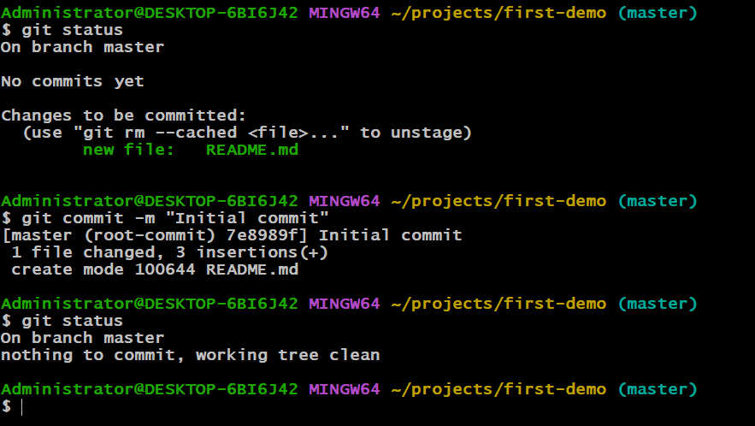
Step 3: Commit to “GIT Repository”
>> git commit -m "A really good commit message"
Commits all files currently in Git's staging area. The -m parameter allows for a commit message directly from the command line.

Slide 27
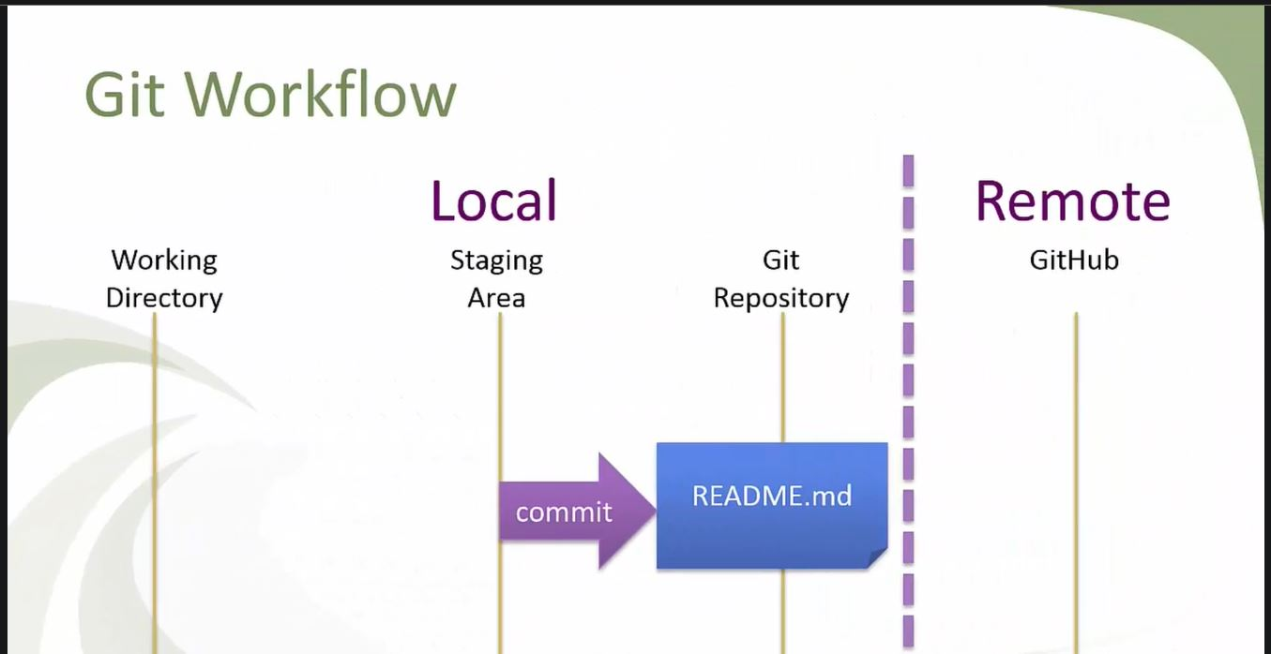
Step 3: Commit to “GIT Repository”

Slide 28
Summary till now
Initialize
Initialize project using “git init project-name”
Create/modify
Create/modify file(s) in “Working Directory”
Add
Add file(s) to “Staging Area” using “git add file-name”
Commit
Commit the file(s) to “GIT Repository” using “git commit –m “message”

Slide 29
More Practical

Slide 30
Un-stage and Restore

Slide 31
History

Slide 32
Back-out already committed Files

Slide 33
Moving Files

Slide 34
Ignoring Files

Slide 35
Summary till now
First commit
Un-stage and restore
History
Back-out already committed files
Moving files
Ignoring files

Slide 36
Going Remote

Slide 37
Going Remote
Create Github account
1
Generate ssh keys in local machine
2
Register generated ssh keys in your Github account to bind your local machine(GIT Repository) to Github account
3

Slide 38
1. Create Github account
Give valid e-mail while registering in Github because verification code is sent to e-mail to create account successfully

Slide 39
2. Generate ssh keys
Go to home directory
Create .ssh directory
Get into .ssh directory
Generate ssh keys by issuing the following command
>> ssh-keygen –t rsa –C “your-email id”
This will generate id_rsa and id_rsa.pub files
Open id_rsa.pub file in text editor and copy the ssh key in it
This key is used in next step

Slide 40
3. Bind local repo with Github account
Menu -> Settings -> SSH keys
Click on “New SSH key”. Enter title and paste ssh key generated in previous step
Run the following command
>> ssh –T git@github.com
NOTE: ssh keys are tied to your machine

Slide 41
Default Branch: Master vs Main

Slide 42
Master vs Main
From 2.28 version of git onwards, in Github, default branch is called as main.
Option 1: Change default branch in Github Repo as per local Git Repo
Option 2: Change default branch in local Git Repo as per Github Repo
To change branch after few commits
>> git branch –m main
To change branch while creating local repo
>> git init –b main MyWebsite
To config branch locally for all new local Repos
>> git config –global init.defaultBranch main

Slide 43
First Push to Remote Repo
After matching default branches between local Git Repo and Remote Github repo
Create a new empty Repo in Github
Follow the commands in the page displayed after creating new empty repo
Some of the commands are as follows
This will add github to known hosts list
>> git remote add origin “github URL to new repo”
To view mapped hosts
>> git remove –v
To push local repo to remote github repo
>> git push –u origin “default branch name”

Slide 44
Pull from Github
>> git clone “ssh github URL to repo which has to be pulled to local machine”
URL is found in code dropdown inside the github repo
>> git pull origin “default branch of Github repo”
NOTE: Doing pull before push operation is good practice. First, we should get the latest code from remote repo(someone might have submitted changes) and then push our changes

Slide 45
Access Github Repo across machines
Github Repo should be public.
If Private, then person who is accessing should get permission from the owner
Generate SSH keys in “Target machine” and add these keys into the github account of the owner
Create empty local Git Repo
Use “git clone ssh github URL to repo which has to be pulled to local machine”. This is found in code drop down in the github repo which you want to clone
(Github is in your known hosts)

Slide 46

Thanks for your patience
- By Syed Abdul Zuber

