Slide 1
EE 204 – Computer Architecture
Lecture # 10

Slide 2
Dependability
Dependability is defined as the quality of being able to be counted on or relied upon.
Service level agreements (SLAs)
Service level objectives (SLOs)

Slide 3
Mean Time to Failure (MTTF)
Mean time to failure (MTTF) is the length of time a device or other product is expected to last in operation.
MTTF is one of many ways to evaluate the reliability of pieces of hardware or other technology.
Mean time between failures (MTBF) is simply the sum of (MTTF + MTTR)

Slide 4
Fallacies and Pitfalls
Commonly held misbeliefs or misconceptions that one should avoid
Fallacies refer to misbeliefs or misconceptions
Counter examples are given to clarify
Pitfalls refer to easily made mistakes
Generalizations of principles that are true in a limited context only
Pitfall All exponential laws must come to an end.
Power Density will Constant as transistor got smaller.
Current and voltage reduced to half as linear region of transistor reduce by factor 2.
Power will be reduced by factor of 4. As P=I x V
Fallacy Multiprocessors are a silver bullet
Switch to multicore processors was because there was no other option
ILP wall and power wall were the main reasons
Exploitation of this parallelism to gain performance is the programmer’s burden
They must make their programs more parallel

Slide 5
Fallacies and Pitfalls
Pitfall Falling prey to Amdahl’s Law
Spending tremendous effort in optimizing some aspects of an architecture without measuring its usage
Pitfall A single point of failure
In fault-tolerant systems
Every component should be redundant so that no single component failure can bring down the whole system
Fallacy Benchmarks remain valid indefinitely
Usefulness of a benchmark depends on
Its ability to resist “benchmark engineering”
Targeted optimizations are attempted to show better results from a benchmark program

Slide 6
Fallacies and Pitfalls
Fallacy Hardware enhancements that increases performance also improve energy efficiency, or are at worst energy neutral.
Esmaeilzadeh et al. (2011) measured SPEC2006 on just one core of a 2.67 GHz Intel Core i7 using Turbo mode (Section 1.5). Performance increased by a factor of 1.07 when the clock rate increased to 2.94 GHz (or a factor of 1.10), but the i7 used a factor of 1.37 more joules and a factor of 1.47 more watt hours!

Slide 7
Fallacies and Pitfalls
Fallacy The rated mean time to failure of disks is 1,200,000 hours or almost 140 years, so disks practically never fail.
Fallacy Peak performance tracks observed performance.
The only universally true definition of peak performance is “the performance level a computer is guaranteed not to exceed.

Slide 8
The Role of Compilers
Goals of a compiler
Correctness
Speed of compiled code
Fast compilation
Debugging support
Interoperability among languages
Passes reduce complexity but enforces ordering of some transformations over others
Phase ordering problem is encountered
Global common sub-expression elimination
For optimized performance, register allocation is done
Classification of Optimizations
ISA has a greater impact on optimizations

Slide 9
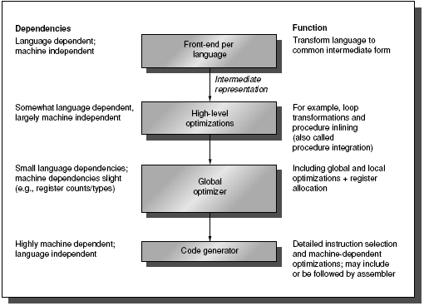
Passes of compilers

Slide 10
The Role of Compilers
Register Allocation:
How many registers are sufficient?
Allocation uses graph coloring techniques
Works well only when the number of registers is greater than 16
Optimized code gives better and accurate analysis of frequency of occurrence
How can the Architect help the Compiler Writer?
Make the frequent case fast and make the rare case correct
Instruction set properties that make it easier for a compiler to generate efficient and correct code

Slide 11
The Role of Compilers
Some desired Instruction Set properties that help the compiler writer:
Provide Regularity
Primary components of an instruction set should be orthogonal
Helps simplify code generation
2. Provide primitives, not solutions
Special features that “match” a particular semantics are rarely used
3. Simplify tradeoffs among alternatives
Cache and pipelining have made the problem more complex
4. Provide instructions that bind the quantities known at compile time as constants

Slide 12
The Role of Compilers
Compiler Support (or Lack of) for Multimedia Instructions
SIMD instructions are rarely used
SIMD instructions tend to be solutions
These are not primitive operations
Vector architecture have vector registers and their own compilers to support SIMD operations
Gather/Scatter operations add to the overhead
SIMD instructions may be found in hand-coded libraries rather than in compiled code

