Slide 1
Lecture 2 Introduction
EE-204 Computer Architecture
Fall 2018

Slide 2
Computer Architecture
Computer architecture refers to how a computer system is designed and what technologies it is compatible with.
The design of computer including CPU.
CPU, includes the arithmetic logic unit, control unit, registers, memory for data and instructions, an input/output interface and external storage functions)
Set of rules and methods that describe the functionality, organization, and implementation of computer systems.

Slide 3
Architecture & Organization (1)
Architecture is those attributes visible to the programmer
—Instruction set, number of bits used for data representation, I/O mechanisms, addressing techniques.
—e.g. Is there a multiply instruction?
Organization is how features are implemented
—Control signals, interfaces, memory technology.
—e.g. Is there a hardware multiply unit or is it done by repeated addition?

Slide 4
Structure & Function
Structure is the way in which components relate to each other
Function is the operation of individual components as part of the structure

Slide 5
Function:
General computer functions:
—Data processing
—Data storage
—Data movement
—Control

Slide 6
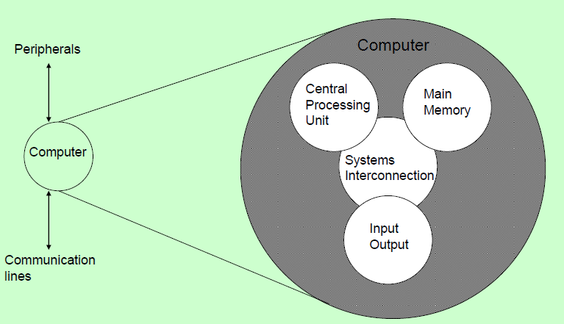
Structure -Top Level Computer

Slide 7
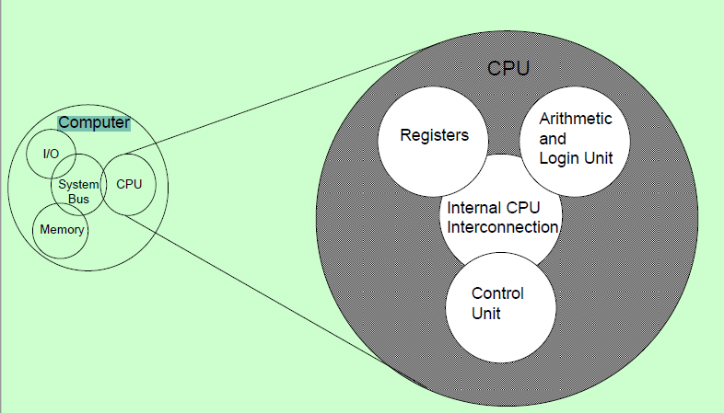
Structure -The CPU Computer

Slide 8
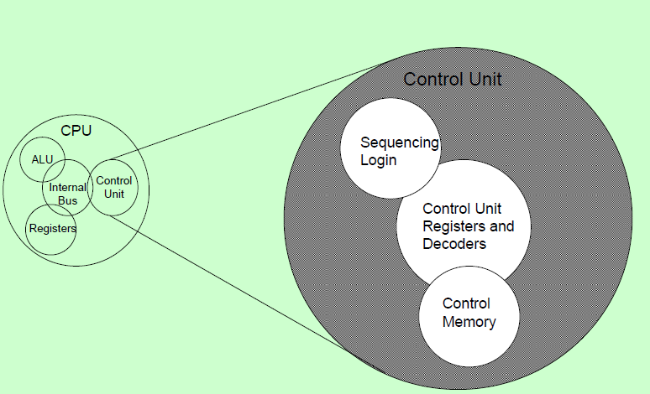
Structure -The Control Unit

Slide 9
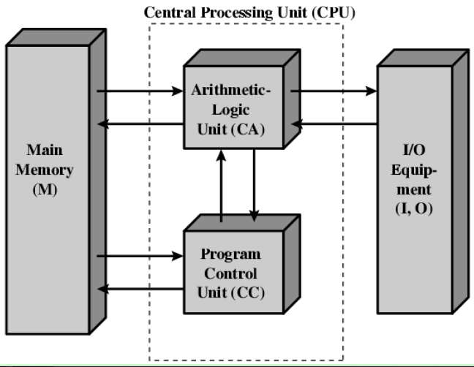
Structure of von Neumann machine

Slide 10
Structure of von Neumann machine

Slide 11
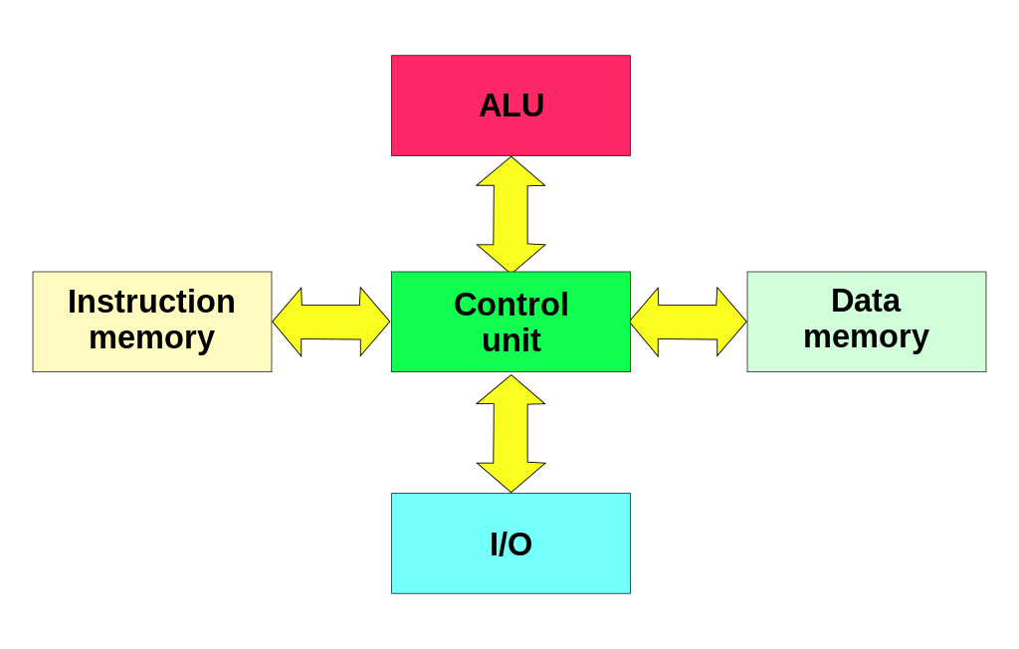
Structure of Harvard Machine

Slide 12
Von Neumann Vs. Harvard
Harvard architecture has separate data and instruction busses, allowing transfers to be performed simultaneously on both busses.
A von Neumann architecture has only one bus which is used for both data transfers and instruction fetches, and therefore data transfers and instruction fetches must be scheduled - they can not be performed at the same time.
It is possible to have two separate memory systems for a Harvard architecture.

Slide 13
Computer Architecture
The architectural designs of CPU are RISC (Reduced instruction set computing) and CISC (Complex instruction set computing).
Hardware of the Intel is termed as Complex Instruction Set Computer (CISC)
Apple hardware is Reduced Instruction Set Computer (RISC).
CISC is the design of the CPU where one instruction performs many low-level operations.
RISC is a CPU design strategy based on the insight that simplified instruction set gives higher performance when combined with a microprocessor architecture

Slide 14
CISC Vs RISC
The CISC approach attempts to minimize the number of instructions per program, sacrificing the number of cycles per instruction.
Computers based on the CISC architecture are designed to decrease the memory cost.
Instructions are complex, thus, taking multiple CPU cycles.
CISC hardware is capable of understanding and executing a series of operations.
RISC is a type of microprocessor architecture that uses highly-optimized set of instructions. RISC does the opposite, reducing the cycles per instruction at the cost of the number of instructions per program
It has a high performance advantage over CISC.
Instructions are reduced(in complexity).
One Cycle Execution Time per instruction, thus pipelining is possible.
https://cs.stanford.edu/people/eroberts/courses/soco/projects/risc/risccisc/
http://www.edgefxkits.com/blog/what-is-risc-and-cisc-architecture/

Slide 15
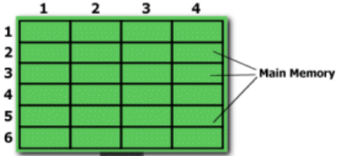
CISC Vs RISC
E.g. Multiplying two numbers in memory (2:3) and (5:2) - and then store the product back in the location 2:3
CISC Approach:
MULT 2:3, 5:2
RISC Approach:
LOAD A, 2:3
LOAD B, 5:2
PROD A, B
STORE 2:3, A
https://cs.stanford.edu/people/eroberts/courses/soco/projects/risc/risccisc/
http://www.edgefxkits.com/blog/what-is-risc-and-cisc-architecture/

Slide 16
CISC Vs RISC
CISC | RISC
Emphasis on hardware | Emphasis on software
Includes multi-clock complex instructions | Single-clock, reduced instruction only
Memory-to-memory: "LOAD" and "STORE" incorporated in instructions | Register to register: "LOAD" and "STORE" are independent instructions
Small code sizes, high cycles per second | Low cycles per second, large code sizes
Transistors used for storing complex instructions E.g. x86 | Spends more transistors on memory registers E.g. MIPS
https://cs.stanford.edu/people/eroberts/courses/soco/projects/risc/risccisc/

