Slide 1
Lecture 3 Evolution of Computer Performance
EE-204 Computer Architecture
Fall 2018

Slide 2
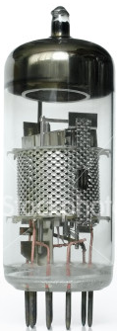
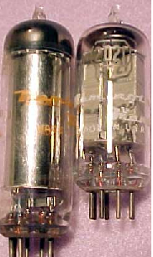
FIRST GENERATION (1945 – 1956)
Main processing device : VACUUM TUBES
KEY FEATURES:
Characterized by the use of VACUUM TUBES.
First generation computers relied on MACHINE LANGUAGE.
Input was based on PUNCHED CARDS and paper tape, and output was displayed on PRINTOUTS.

Slide 3

THE SECOND GENERATION COMPUTER (1959-1964)
Main Processing Device: TRANSISTORS
Storage Media: MAGNETIC DISK
KEY FEATURES:
Second generation computers employed a new technological innovation:
THE TRANSISTOR
Transistors had numerous advantages over vacuum tubes: they were smaller, cheaper, and gave off less heat
Second generation computers used magnetic cores as their primary memory
Programming Languages:
Assembly Language
COBOL(1959)
FORTRAN(1957)
These computers gave users a significant increase in available memory (about 20x)
Calculation speeds also increased
First operating system developed

Slide 4
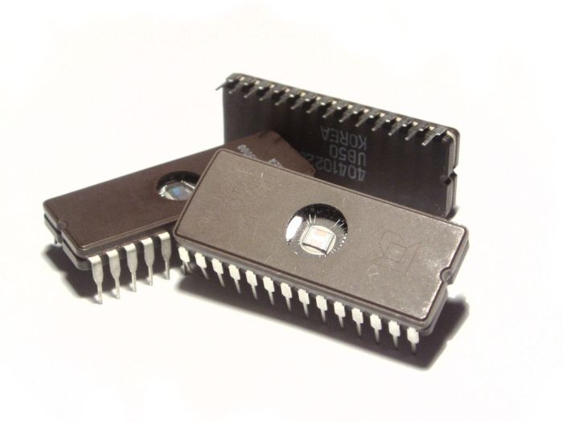
THE THIRD GENERATION COMPUTER (1964-1971)
Main Processing Device: INTEGRATED CIRCUITS(ICs)
Initiated by: JACK KILBY and ROBERT NOYCE
Data Storage: MICROCHIPS
KEY FEATURES:
Integrated Circuits replaced transistors
Semiconductor memories:
(ROMs)
(RAMs)
Introduction of Microprogramming
A variety of techniques:
Parallel Processing
Multiprocessing
OS allowed the machines to run many
applications

Slide 5
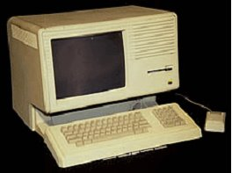
FOURTH GENERATION (1971– present)
Main processing device : ICs with VLSI(Very Large Scale Integration)
Storage media : Floppies, CDs.
KEY FEATURES:
Marcian Hoff invented the microprocessor.
The Intel 4004 chip, developed in 1971.
Apple, a personal computer company founded in 1976 by Steven Jobs and Steve Wozniak.
1971, Pascal (programming language).
Development of GUI’s, the mouse handheld devices.

Slide 6
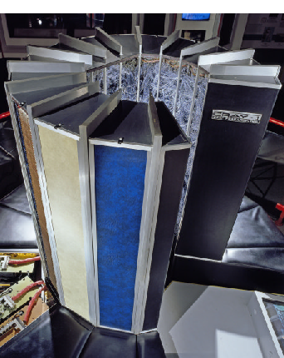
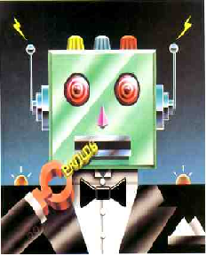
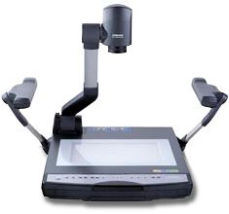
FIFTH GENERATION
Period : PRESENT AND BEYOND
Main processing device : ICS WITH PARALLEL PROCESSING
Artificial Intelligence:
Game playing
Expert Systems
Natural language
Neural networks
Robotics
KEY FEATURES:
Used in parallel processing
Used superconductors
Used in speech recognition
Used in intelligent robots
Used in artificial intelligence

Slide 7
Introduction
Computer technology has made incredible progress in the roughly 65 years since the first general-purpose electronic computer was created.
Today, less than $500 will purchase a mobile computer that has more performance, more main memory, and more disk storage than a computer bought in 1985 for $1 million.
Two Factors:
Technological improvements.
Computer architectures.
25% per year until 1970’s (Both Factors).

Slide 8
Introduction
The late 1970s saw the emergence of the microprocessor. The ability of the microprocessor to ride the improvements in integrated circuit technology led to a higher rate of performance improvement—roughly 35% growth per year.
As complexity increases there is need of simpler instruction set architecture, so RISC is evolved in early 1980s.

Slide 9
Introduction
RISC (Reduced Instruction Set Computer) architectures, in the early 1980s.
The RISC-based machines focused the attention of designers on two critical performance techniques, the exploitation of instruction level parallelism (initially through pipelining an later through multiple instruction issue) and the use of caches (initially in simple forms and later using more sophisticated organizations and optimizations).
Intel rose to the challenge, primarily by translating 80x86 instructions into RISC-like instructions internally.

Slide 10
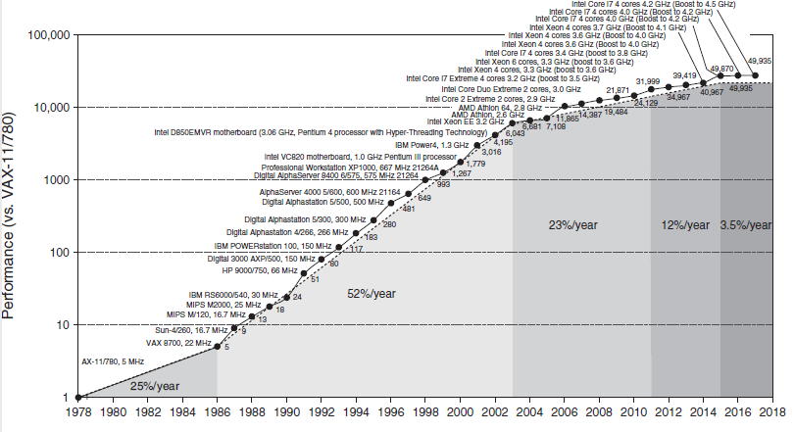
Performance Comparison

Slide 11
Moore’s Law
The second observation that ended recently is Moore’s Law.
Moore famously predicted that the number of transistors per chip would double every year, which was amended in 1975 to every two years.
That prediction lasted for about 50 years, but no longer holds.

Slide 12
Moore’s Law
For example, in the 2010 edition of this book, the most recent Intel microprocessor had 1,170,000,000 transistors. If Moore’s Law had continued, we could have expected microprocessors in 2016 to have 18,720,000,000 transistors.
Instead, the equivalent Intel microprocessor has just 1,750,000,000 transistors, or off by a factor of 10 from what Moore’s Law would have predicted.

Slide 13
Introduction Aspects of Improvements
Performance is traded with productivity
Strategy for software development has also changed
Software as a service (SaaS) is used instead of the conventional shrink-wrapped software
Nature of applications have also undergone a change
Shift from ILP (Instruction-Level Parallelism) to DLP (Data-Level Parallelism) and TLP (Thread- Level Parallelism)
There is also an extensive use of RLP (Request-Level Parallelism)
ILP has been implicit but TLP, DLP and RLP are explicit parallelism
The major burden for exploitation of this shift is on the programmers

