Slide 1
Lecture 4 Classes of Computer & ISA Principles
EE-204 Computer Architecture
Fall 2018

Slide 2
Classes of Computer
Five different computing markets characterized by
Applications
Requirements
Computing Technologies
Personal Mobile Devices (PMDs)
Desktop computers
Servers
Cluster/Warehouse-scale Computers
Embedded Computers
Important characteristics of each of the classes

Slide 3
Personal Mobile Devices (PMDs)
Collection of wireless devices with multimedia user interfaces
Cost is of prime concern
There should be a limited total power consumption
Applications are mostly web-based and media-oriented
Responsiveness and predictability are the key characteristics
Real-time performance requirements are high
Minimize memory and use energy efficiently
Code size should be optimal
Data size is application dependent

Slide 4
Desktop Computing
Largest market
Optimized in price/performance
More than half of desktops today are battery-operated laptop computers
Newest, highest performance and cost-reduced microprocessors first appear in desktop computers
Well characterized in terms of applications and benchmarking

Slide 5
Servers
Provides larger scale and more reliable file and computing services
Backbone of large-scale enterprise computing
Servers are characterized by
Dependability/Availability
Scalability
Throughput

Slide 6
Cluster/Warehouse-Scale Computers
Clusters are collections of desktop computers or servers connected by local area networks to act as a single large computer
Due to growth of SaaS
A large cluster is referred to as warehouse- scale computer (WSC)
Power and cooling are essential aspects
Availability is important
Emphasizes interactive applications, large-scale storage, dependability and high bandwidth

Slide 7
Embedded Computers
Computers lodged in other devices
Largest range of processing power and cost
Price is the key factor in the design of these computers
Many of the factors discussed with PMDs also apply to embedded computers

Slide 8
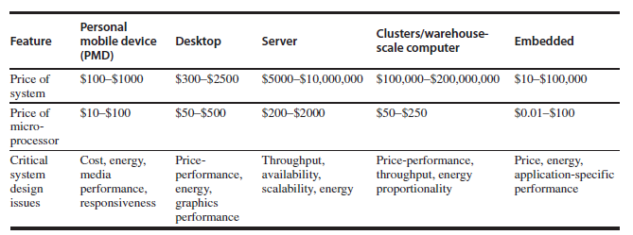
Classes of Computer

Slide 9
Classes of Parallelism
Parallelism is present at multiple levels
Parallelism in application
DLP: Many data items can be operated on at the same time
TLP: Tasks of work are created that can operate in parallel
Computer hardware can exploit these parallelism in four ways

Slide 10
Classes of Parallelism
Instruction-Level Parallelism
Exploits data-level parallelism
Pipelining and speculative execution
Vector Architectures and Graphic Processor Units
Exploits DLP by applying a single instruction on a collection of data in parallel
3. Thread-Level Parallelism
Exploits DLP or TLP in a tightly coupled hardware model that allows interaction among parallel threads
4. Request-Level Parallelism
Exploits parallelism among largely decoupled tasks specified by the programmer or the OS

Slide 14
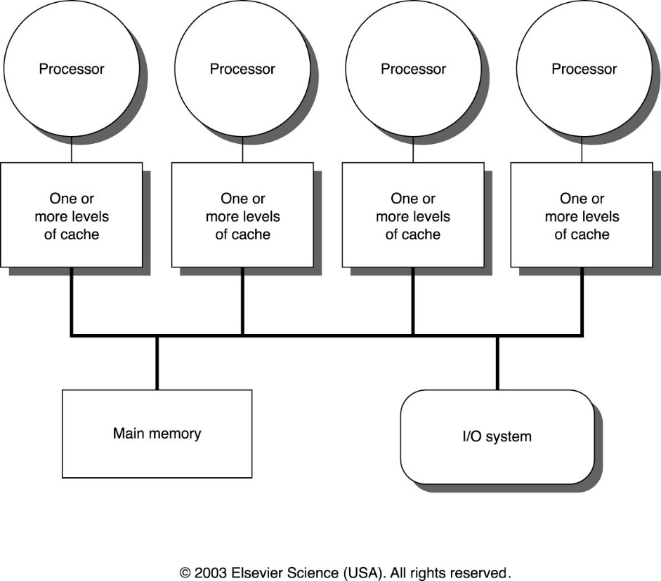
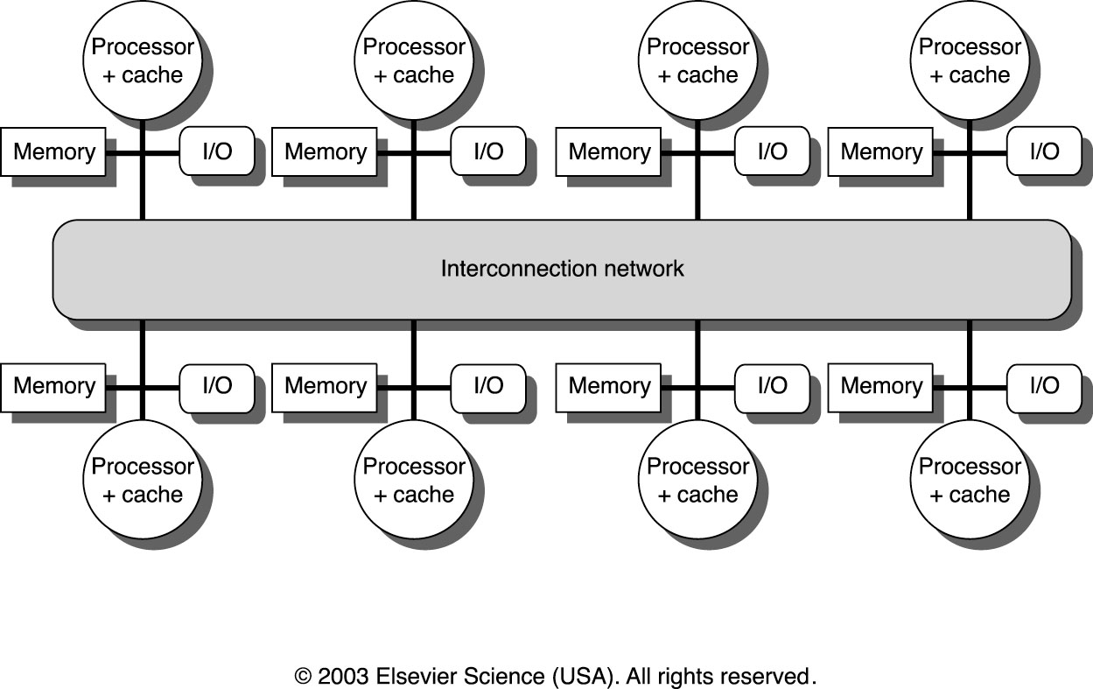
MIMD Multiprocessors
Centralized Shared Memory Distributed Memory

Slide 15
Instruction Set Architecture (ISA)
Serves as an interface between software and hardware.
Provides a mechanism by which the software tells the hardware what should be done.
High level language code : C, C++, Java, Fortran,
compiler
Assembly language code: architecture specific statements
assembler
Machine language code: architecture specific bit patterns
software
instruction set
hardware

Slide 16
Instruction Set Architecture
Instruction set architecture is the structure of a computer that a machine language programmer (or a compiler) must understand to write a correct program for that machine.
Instruction set specifies the processor’s functionality.
What operations it supports
What storage mechanisms it has & how they are accessed
How the programmer/compiler communicates programs to processor.

Slide 17
1. Class of ISA
Nearly all ISAs today are classified as general-purpose register architectures where the operands are either registers or memory locations.
The 80x86 has 16 general-purpose registers and 16 that can hold floating-point data, while RISC-V has 32 general-purpose and 32 floating-point registers
The two popular versions of this class are:
Register-Memory ISAs.
Load-Store ISAs.

Slide 18
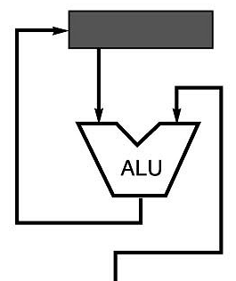
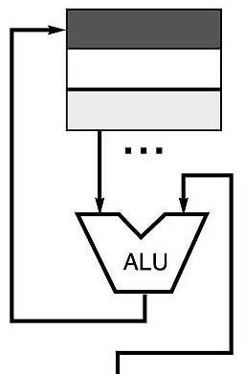
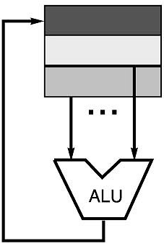
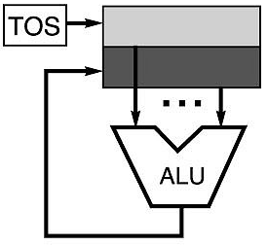
Code Sequence C = A + B for Four Instruction Sets
Stack | Accumulator | Register (register-memory) | Register (load-store)
Push A Push B Add Pop C | Load A Add B Store C | Load R1, A Add R1, B Store C, R1 | Load R1,A Load R2, B Add R3, R1, R2 Store C, R3
memory
memory
acc = acc + mem[C]
R1 = R1 + mem[C]
R3 = R1 + R2

Slide 19
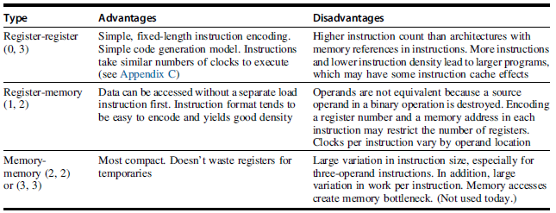
Advantage/Disadvantages

