Slide 1
Lecture 5 ISA Principles
EE-204 Computer Architecture
Fall 2018

Slide 2
Instruction Set Architecture (ISA)
Serves as an interface between software and hardware.
Provides a mechanism by which the software tells the hardware what should be done.
High level language code : C, C++, Java, Fortran,
compiler
Assembly language code: architecture specific statements
assembler
Machine language code: architecture specific bit patterns
software
instruction set
hardware

Slide 3
Instruction Set Architecture
Instruction set architecture is the structure of a computer that a machine language programmer (or a compiler) must understand to write a correct program for that machine.
Instruction set specifies the processor’s functionality.
What operations it supports
What storage mechanisms it has & how they are accessed
How the programmer/compiler communicates programs to processor.

Slide 4
1. Class of ISA
Nearly all ISAs today are classified as general-purpose register architectures where the operands are either registers or memory locations.
The 80x86 has 16 general-purpose registers and 16 that can hold floating-point data, while RISC-V has 32 general-purpose and 32 floating-point registers
The two popular versions of this class are:
Register-Memory ISAs.
Load-Store ISAs.

Slide 5
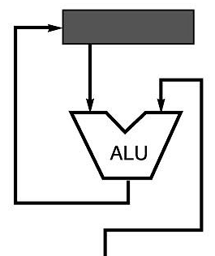
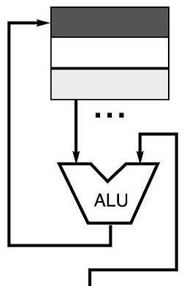
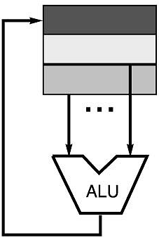
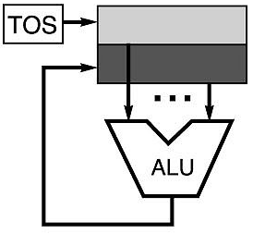
Code Sequence C = A + B for Four Instruction Sets
Stack | Accumulator | Register (register-memory) | Register (load-store)
Push A Push B Add Pop C | Load A Add B Store C | Load R1, A Add R1, B Store C, R1 | Load R1,A Load R2, B Add R3, R1, R2 Store C, R3
memory
memory
acc = acc + mem[C]
R1 = R1 + mem[C]
R3 = R1 + R2

Slide 6
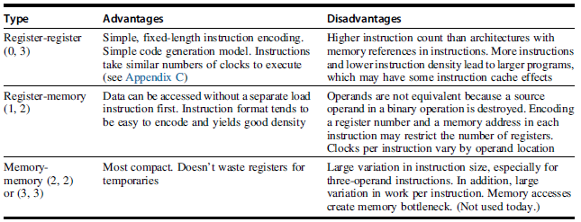
Advantage/Disadvantages

Slide 7
2. Memory Addressing
How memory addresses are interpreted and how are these specified?
Interpreting memory addresses
Byte Addressing is used
Access is for
Bytes, Halfword(HW), Word (W) and Doubleword (DW)
Ordering of bytes within a word

Slide 8
Interpreting Memory Addresses
Little Endian
Puts the byte with address x..x000 at the least significant position in the double word
DEC VAX, RISC, Intel
Address of the data is the address of the LSB
Big Endian
Puts the byte with address x..x000 at the most significant position in the double word
IBM 360, Motorola 680x0
Address of data is the address of the MSB

Slide 9
Memory Alignment
Why would someone design a computer with alignment restrictions?
Misalignment causes hardware complications, because the memory is typically aligned on a multiple of a word or double-word boundary.
A misaligned memory access may, therefore, take multiple aligned memory references.

Slide 10
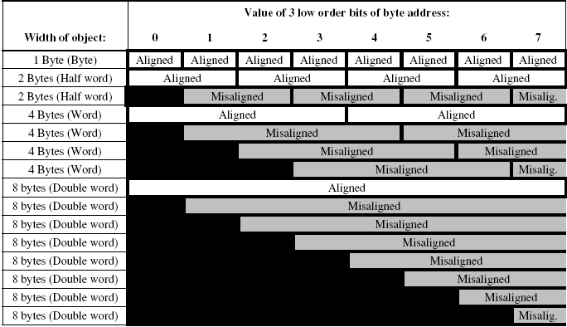
Aligned and misaligned addresses for byte addressed computers

Slide 11
Memory Addressing:
Effective address is the address of a location in memory
Given an address, we now know what bytes to access in memory. In this subsection we will look at addressing modes—how architectures specify the address of an object they will access.

Slide 12
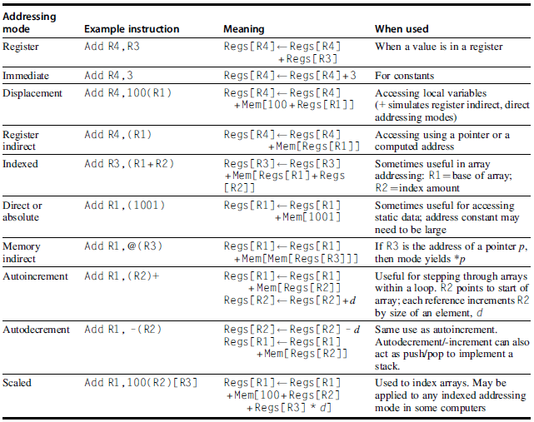

Slide 13
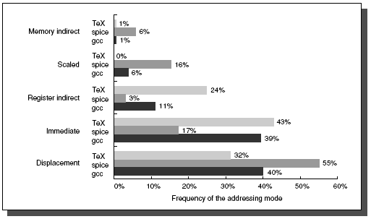
Summary of the use of memory addressing modes

Slide 14
3 Type and Size of operands
How is the type specified in instructions? Two options:
Encoding the type of operand in the op-code is the most used method
Tags can be attached to data that can be interpreted by the hardware
Tagged data computers are obsolete
Byte
Half-word (HW)
Word (W)
Single Precision Floating-Point
Double Precision Floating-Point

Slide 15
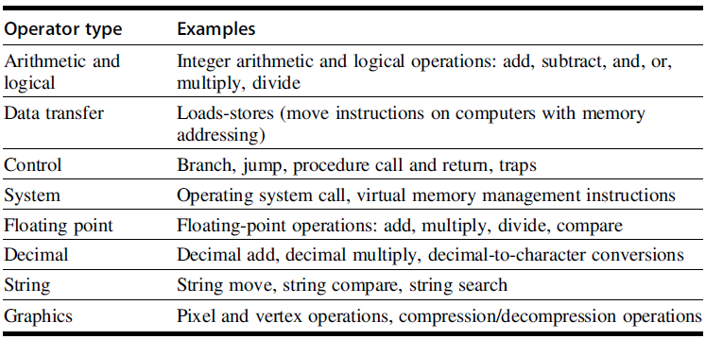
Operations in the Instruction Set

Slide 16
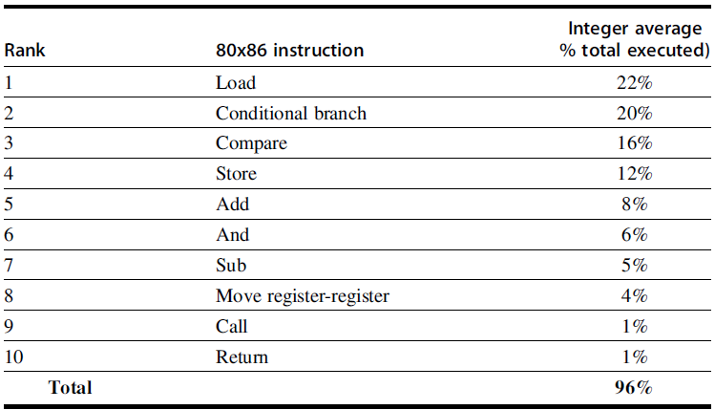
The top 10 instructions for 80x86

