Slide 1
Lecture 6 ISA Principles
EE-204 Computer Architecture
Fall 2018

Slide 2
3 Type and Size of operands
How is the type specified in instructions? Two options:
Encoding the type of operand in the op-code is the most used method
Tags can be attached to data that can be interpreted by the hardware
Tagged data computers are obsolete
Byte
Half-word (HW)
Word (W)
Single Precision Floating-Point
Double Precision Floating-Point

Slide 3
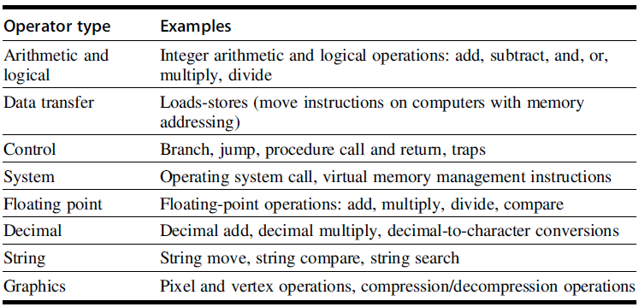
4 Operations in the Instruction Set

Slide 4
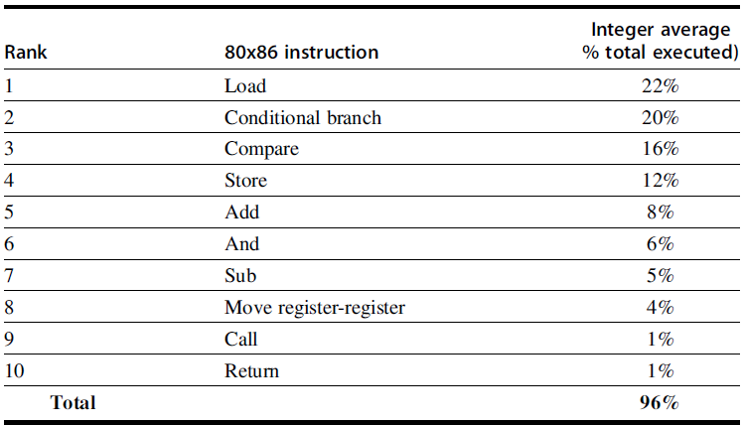
The top 10 instructions for 80x86

Slide 5
5 Instructions for Control Flow
Unconditional jump
Jump instruction
Conditional jump
Branch instruction
Four different types of control flow instructions
Conditional branches
Jumps
Procedure Calls
Procedure Returns
Relative Frequency of each of the above events
Conditional branches dominate with the highest frequency of occurrence

Slide 6
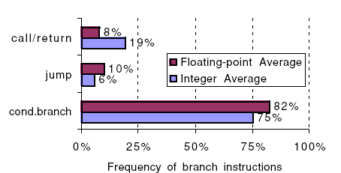
Breakdown of control flow instructions into three classes

Slide 7
Addressing Modes for Control Flow Instructions
Specifying the destination address
PC-relative method
Provides position independence
For targets not known at compile time
Use register indirect addressing mode
Also useful for four other features
Case or switch statements of programming languages
Virtual functions or methods in object-oriented languages
High-order functions or function pointers in languages
Dynamically shared libraries
PC-relative target address: 4 to 8 bits
75% of all branch are in forward direction

Slide 8
Conditional Branch Options
How to specify branch conditions?
Three techniques are used to specify branch condition
Properties of branch
A large number of comparisons are simple tests
A large number of comparisons are with zero

Slide 9
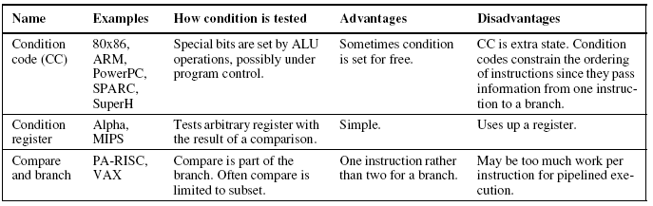
The major methods for evaluating branch conditions

Slide 10
Condition Code
CF - carry flag
PF - parity flag
ZF - zero flags
SF - sign flag
OF - overflow flag

Slide 11
Condition Register
mov r4, #10
loop_label:
bl do_something
sub r4, r4, #1
cmp r4, #0
bne loop_label

Slide 12
Compare and Brach
beq $6, $8, there (branch if equal)
bne $6, $8, here (branch if not equal)

Slide 13
Procedure Invocation Options
Return Address?
Save in a special link register or save in a GPR or on runtime stack
Saving of other registers?
There are two basic conventions in use to save registers:
Caller saving
Callee saving

Slide 14
Caller saving Vs. Callee saving
Caller saving means that the calling procedure must save the registers that it wants preserved for access after the call, and thus the called procedure need not worry about registers.
Callee saving is the opposite: the called procedure must save the registers it wants to use, leaving the caller unrestrained.

Slide 15
Example
Suppose we have a procedure P1 that calls procedure P2, and both procedures manipulate the global variable x.
If P1 had allocated x to a register, it must be sure to save x to a location known by P2 before the call to P2.
In the cases where either convention could be used, some programs will be more optimal with callee save and some will be more optimal with caller save.

Slide 16
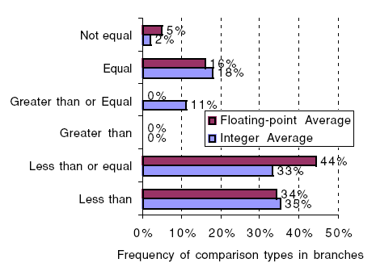
Frequency of different types of compares in conditional branches

Slide 17
Encoding an Instructions Set
Three popular choices for encoding of instruction sets
Variable length
Fixed length
Hybrid

Slide 18
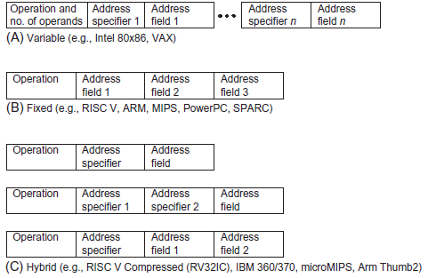
More than 3 operands—some CISC machines permit a variety of addressing modes that allow more than 3 operands (registers or memory accesses), such as the VAX "POLY" polynomial evaluation instruction.

Slide 19
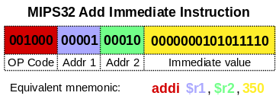
Just an Example

