Slide 1
EE 204 – Computer Architecture
Lecture # 8

Slide 2
Today’s Topic
Why measure performance?
Defining a metric for performance
Computer Performance
Response time and throughput
Execution time as a metric
Workloads and Benchmarks
Amdahl Law with Examples

Slide 3
What is Performance?
One computer is faster than another, what do we mean?
User of a desktop computer may say a computer is faster when a program runs in less time.
An Amazon.com administrator may say a computer is faster when it completes more transactions per hour.

Slide 4
Why measure performance? (1)
To understand
Why a piece of software performs as it does?
Why one instruction set can be implemented to perform better than another?
How some hardware feature affects performance?
Ref. Ch # 4 - Computer Organization Design by Patterson and Hennessey

Slide 5
Why measure performance? (2)
Hardware performance is key to the effectiveness of an entire system of hardware and software.
How fast the software will run on the computer?
Different performance metrics may be appropriate for different type of applications.
Different aspects of a computer system may be the most significant in determining overall performance.
Ref. Ch # 4 - Computer Organization Design by Patterson and Hennessey

Slide 6
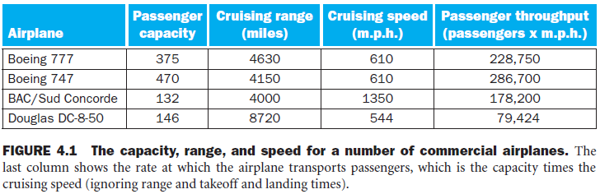
Defining a metric for performance
Ref. Ch # 4 - Computer Organization Design by Patterson and Hennessey

Slide 7
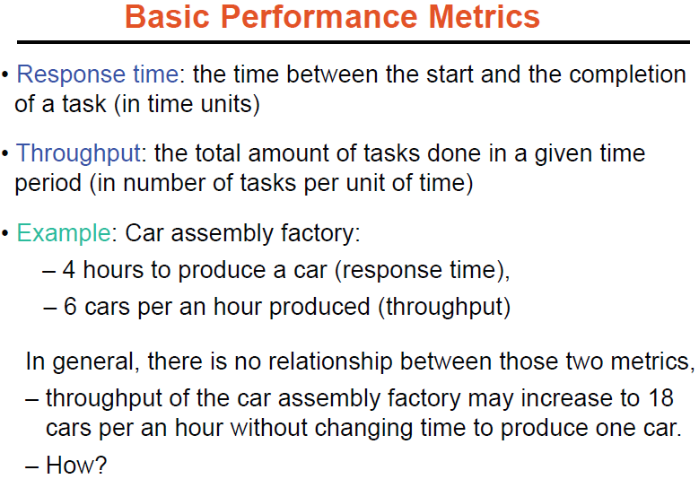

Slide 8
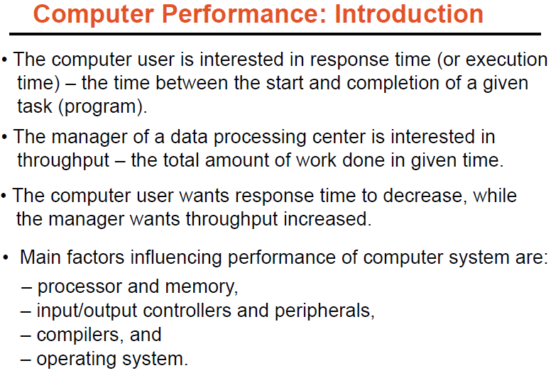

Slide 9
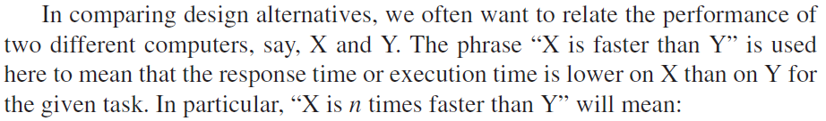


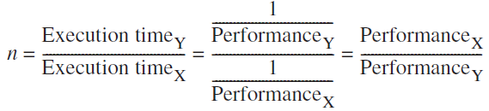
Execution time or Response time
The only consistent and reliable measure of performance is the execution time of real programs, all other alternatives eventually become misleading.

Slide 10
Response time vs CPU time
Response time is the total time to complete a task, including disk accesses, memory accesses, input/output (I/O) activities, operating system overhead—everything.
CPU time is the time the processor is computing, not including the time waiting for I/O or running other programs.

Slide 11
Workloads
Workloads are the mixture of programs and operating system commands that users run on a computer.
Computer users who routinely run the same programs would be the perfect candidates to evaluate a new computer.
To evaluate two computer systems, a user would simply compare the execution time of the workload on the two computers.

Slide 12
Benchmarks
Benchmarks are programs specifically chosen to measure performance. They form (synthesize) a workload that the user hopes will predict the performance of the actual workload.
Different classes and applications of computers will require different types of benchmarks.
A collections of benchmark applications, called benchmark suites, are a popular measure of performance of processors with a variety of applications.

Slide 13
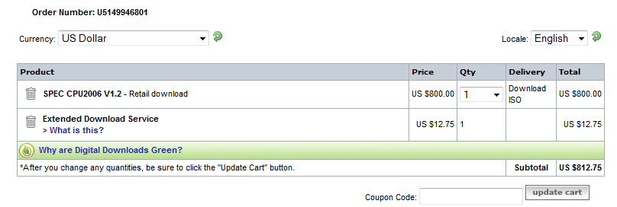
Benchmark Suites
Phoronix Test Suite
An Automated, Open-Source Testing Framework
http://www.phoronix-test-suite.com/

Slide 14
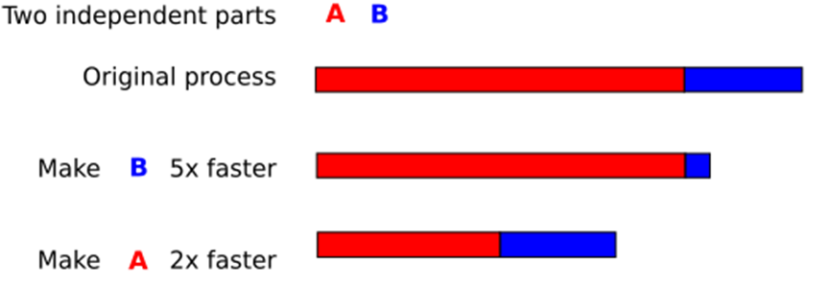
Amdahl’s Law (1)
The law states that the performance improvement to be gained from using some faster mode of execution is limited by the fraction of the time the faster mode can be used.

Slide 15
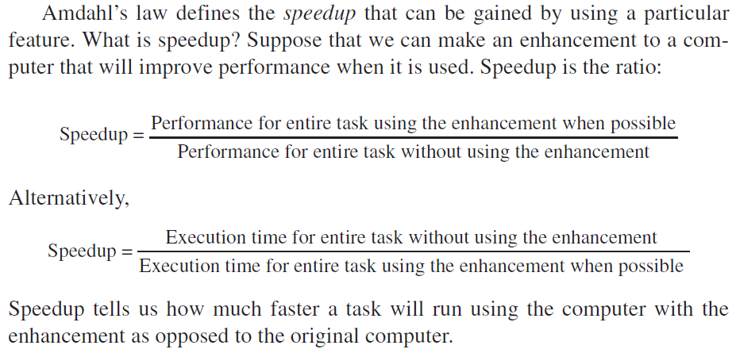
Amdahl’s Law – Speedup (1)

Slide 16
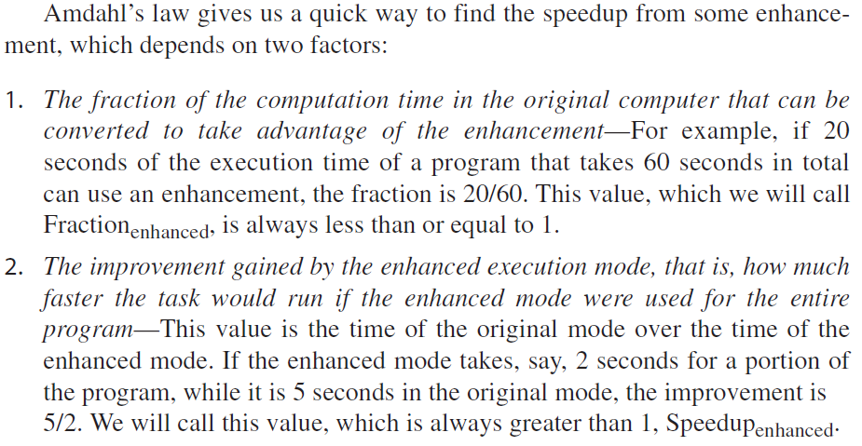
Amdahl’s Law – Speedup (2)

Slide 17
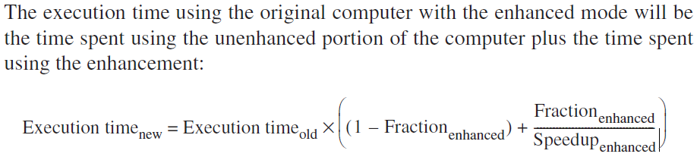
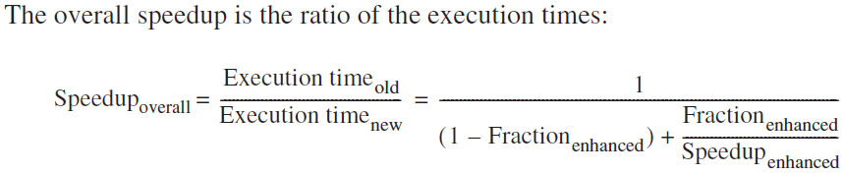
Amdahl’s Law – Speedup (3)

Slide 18
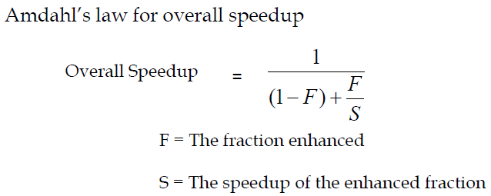
Amdahl’s Law – Speedup (4)

Slide 19
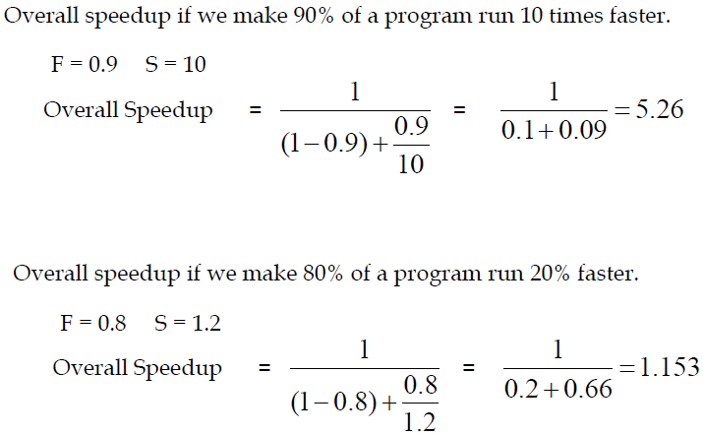
Amdahl’s Law – Examples (1)
http://www.cs.iastate.edu/~prabhu/Tutorial/CACHE/CompPerf.pdf

Slide 20
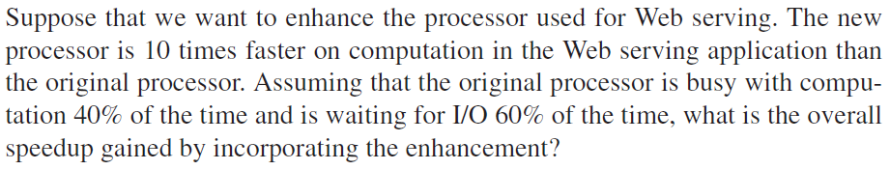
Book Example

Slide 21
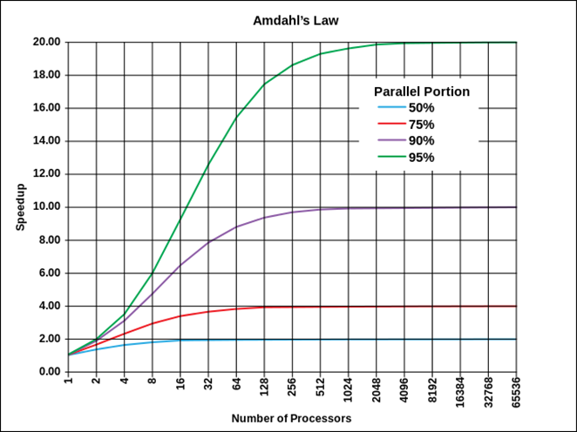
Amdahl’s Law - Wikipedia
The speedup of a program using multiple processors in parallel computing is limited by the time needed for the sequential fraction of the program.
If a program needs 20 hours using a single processor core, and a particular portion of 1 hour cannot be parallelized, while the remaining promising portion of 19 hours (95%) can be parallelized, then speedup is limited up to 20×.
http://en.wikipedia.org/wiki/Amdahl's_law

