Slide 1
EE 204 – Computer Architecture
Lecture # 9

Slide 2
Today’s Topic
CPU Performance Equation
Analysis of CPU time
Basic Performance Equation
Analysis of Basic Performance Equation
Calculating Instruction Count
Calculating CPI
Examples
BIG Picture – Processor Performance Equation
How Basic Performance Equation is affected by Algorithm, Compiler, Programming Language, Instruction Set Architecture?

Slide 3
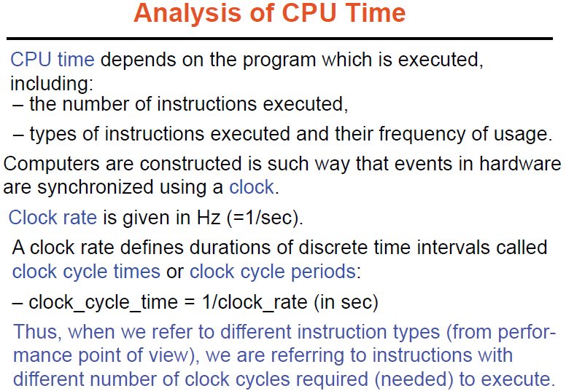
* CPU time also called CPU execution time

Slide 4

CPU (Execution) Time and its Factors
X
Hardware designer can improve performance by reducing either the length of the clock cycle or the number of clock cycles required for a program.
The designer often faces a trade-off between the number of clock cycles needed for a program and the length of each cycle. Many techniques that decrease the number of clock cycles also increase the clock cycle time.
Ref. Ch # 4 - Computer Organization Design by Patterson and Hennessey

Slide 5

Basic Performance Equation
X
X
X
Therefore three factors effect CPU time:
Instruction count of the executing program
CPI (Average Clock cycles Per Instruction. e.g. ADD, MOV, MUL)
Clock cycle time (Clock rate = 1 / Clock cycle time)
Ref. Ch # 4 - Computer Organization Design by Patterson and Hennessey

Slide 6
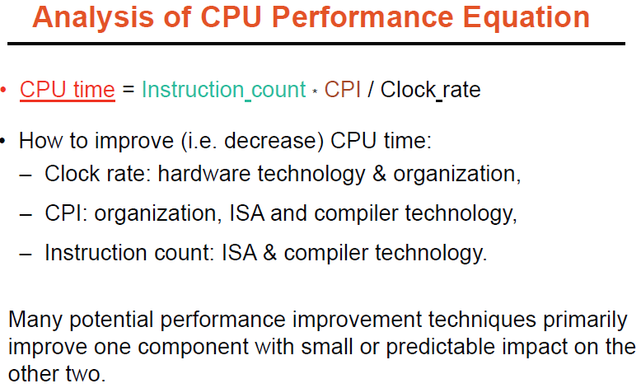

Slide 7
Calculating Instruction Count
Use of software tools to profile the execution on actual processor.
Different simulation techniques and queuing theory could be used to obtain values for components of the execution (CPU) time.
Modern processors have on-chip hardware counters to record a variety of measurements, including the number of instructions executed, CPI, and often, the sources of performance loss.
Ref. Ch # 4 - Computer Organization Design by Patterson and Hennessey

Slide 8
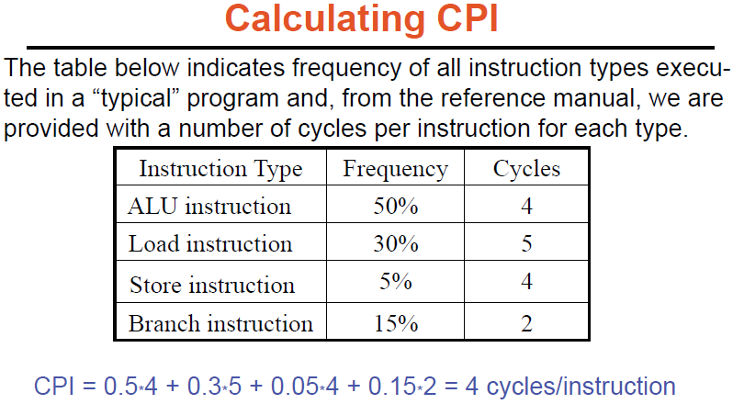

Slide 9
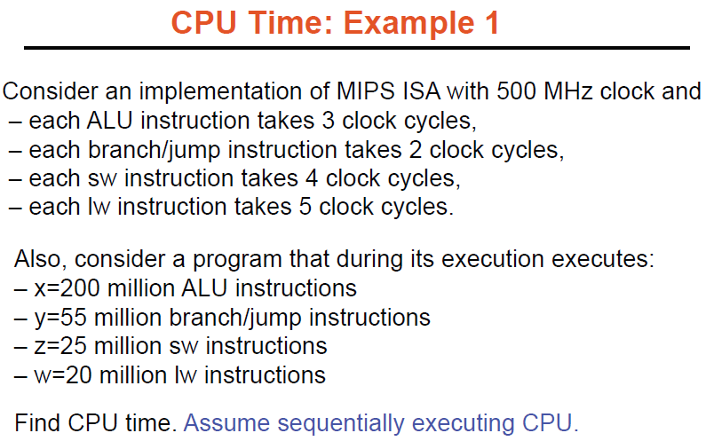

Slide 10
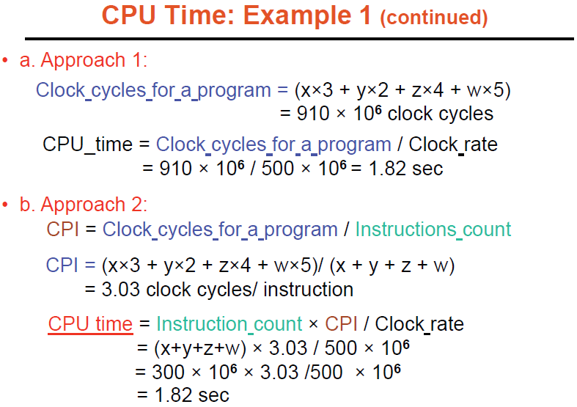

Slide 11
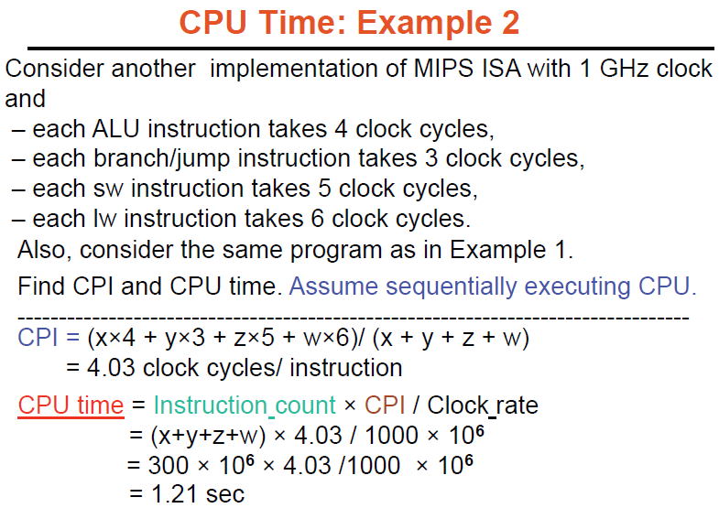

Slide 12
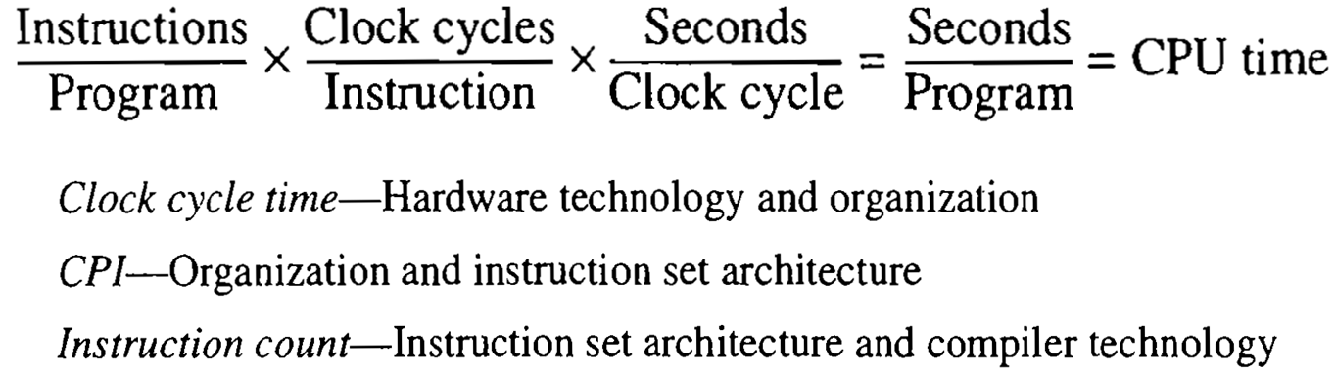
Processor Performance Equation– The BIG Picture

Slide 13
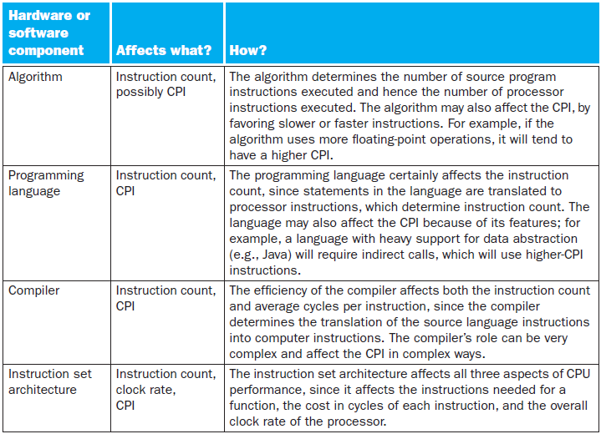

Slide 14
Principle of Locality
The principle of locality states that programs access a relatively small portion of their address space at any instant of time, just as you accessed a very small portion of the library’s collection.

Slide 15
Types of Locality
Temporal locality (locality in time): If an item is referenced, it will tend to be referenced again soon. If you recently brought a book to your desk to look at, you will probably need to look at it again soon.
Spatial locality (locality in space): If an item is referenced, items whose addresses are close by will tend to be referenced soon. For example, books on the same topic are shelved together in the library to increase spatial locality.

Slide 16
Dependability
Dependability is defined as the quality of being able to be counted on or relied upon.
Service level agreements (SLAs)
Service level objectives (SLOs)

Slide 17
Mean Time to Failure (MTTF)
Mean time to failure (MTTF) is the length of time a device or other product is expected to last in operation.
MTTF is one of many ways to evaluate the reliability of pieces of hardware or other technology.
Mean time between failures (MTBF) is simply the sum of (MTTF + MTTR)

Slide 18

Availiability
$$\text{Module} \text{availability}=\frac{\text{MTTF}}{\text{MTTF}\text{ +}\text{MTTR}}$$

