Slide 1

Instruction Set Principles Appendix A
Classifying ISA
Design alternatives available to the instruction set architect
Role of Compiler
The RISC-V ISA

Slide 2
Instruction Set Principles and Examples
Putting It All Together: RISC-V Architecture
Recommendations of all the previous subsections are considered
RISC-V can have both 32 and 64 bits instruction set.
64-bit GPR machine with Load/Store architecture
RISCV emphasizes the basic principles of RISC architecture
A simple load/store instruction set
Design for pipelining efficiency
Efficiency as a compiler target
Easy to understand architecture

Slide 3
The RISC-V Architecture
Registers for RISC-V
Thirty two 64-bit Registers – integer registers
R0, R1, …, R31 Content of R0 = 0
Thirty two Floating-Point Registers: F0, F1, .., F31
Can be used both as single precision and double precision registers
Special registers
Can transfer to and from the general purpose registers
Data Types for RISC-V
8, 16, 32 and 64-bit integers
32 and 64-bit IEEE Floating-Point format
All operands for ALU operations have 64-bit operands

Slide 4
The RISC-V Architecture
Any other size operands are either sign or zero-extended
Addressing Modes for RISC-V Data Transfers
Immediate and displacement modes with 12-bit fields
Register Indirect mode addressing can be obtained by placing zero at 12 bits displacement field.
Byte addressable memory with 64-bit address
A mode bit allows the software to select Little or Big Endian Mode
All memory accesses need not to be aligned
RISC-V Instruction Format
All instructions are 32 bit fixed length
Primary op-code is 7-bits
Addressing mode is encoded in the op-code

Slide 5
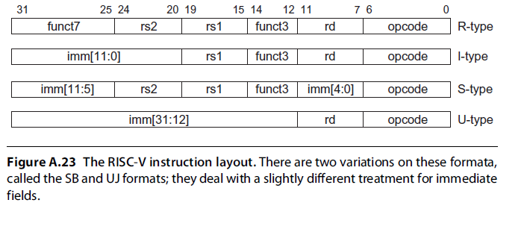
Instruction layout for RISC-V

Slide 6
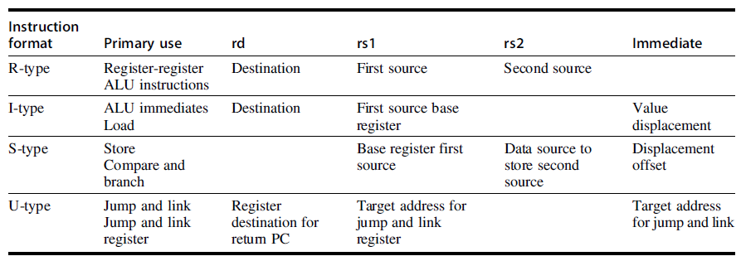

Slide 7
The RISC-V Architecture
Operations in RISC-V
Supports Simple operations
Four classes of instructions
ALU Operations
Branches and Jumps
Loads and Stores
Floating-point Operations
Description language is used to describe operations
RISC-V Control Flow Instructions
All branches are conditional
Set instructions for compare
Use condition register to specify branch conditions
Jump and Jump-and-Link instructions
R31 is the link register

Slide 8
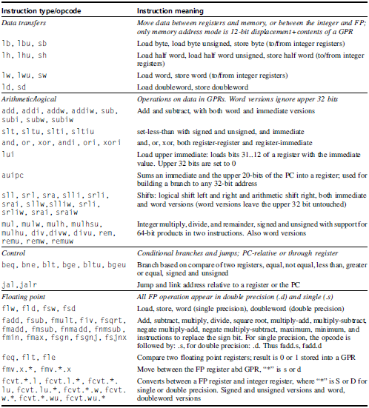
Subset of the Instructions in RV64G

Slide 9
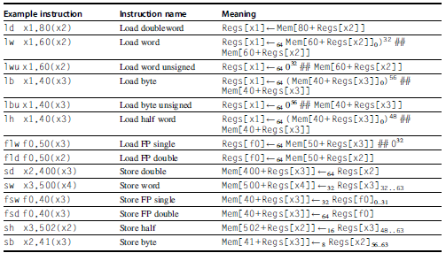
RV64G Load/Store Instructions

Slide 10
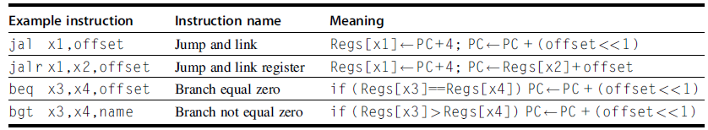
RISC-V Control Flow Instructions

Slide 11
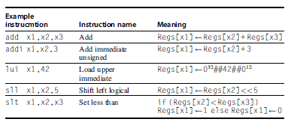
RISC-V ALU Instructions

Slide 12
Fallacies and Pitfalls
Fallacy #1: There is such a thing as a typical program
Programs vary widely in how they use an instruction set
Fallacy #2: An architecture with flaws cannot be successful
80x86 is a typical counter-example
Fallacy #3: You can design a flawless architecture
All architecture involve trade-offs
Pitfall #1: Designing a “high-level” instruction set feature specifically oriented to support a high-level language structure
Most often the instructions are overkill

Slide 13
Fallacies and Pitfalls
Pitfall #2: Innovating at the instruction set architecture to reduce code size without accounting for the compiler
Compilers may not follow the designer’s strategy
Concluding Remarks
ISA changes in 90s
Address size doubles
Optimization of conditional branches via conditional execution
Optimization of cache performance via prefetch
Support for multimedia
Faster floating-point operations

