Slide 1
Pipelined Processor Design
EE 204
Computer Architecture
Computer Science Department
FAST-NU Karachi

Slide 2
Pipelining Stages
IF (Instruction Fetch Cycle)
Send contents of PC to memory
Fetch current instruction from memory
Update PC by adding 4
ID (Instruction Decode/ Register Fetch Cycle)
Decode operation code
Fetch registers given by the source specifiers
Do equality test for a possible branch
Sign-extend the immediate field
Compute (possible) branch target address

Slide 3
Pipelining Stages
EX (Execution/Effective Address Cycle)
ALU operates on operands
Any one of the following operations is performed
Memory reference instruction
Effective address is calculated
Register-Register ALU instruction
Performs ALU operation on operands
Register-immediate ALU instruction
Performs operations on operand and sign- extended immediate data

Slide 4
Pipelining Stages
MEM (Memory Access Cycle)
Active only for load/store instructions
Load: Read operand from memory
Store: Store a register content into memory
WB (Write Back Cycle)
Register-Register ALU instructions or Load instructions are the only active instructions
Writes the result from ALU
Writes the fetched operand into the corresponding register

Slide 5
Looking At The Big Picture
Overall the most time that an non-pipelined instruction can take is 5 clock cycles. Below is a summary:
    Branch - 2 clock cycles
    Store - 4 clock cycles
    Other - 5 clock cycles
EX: Assuming branch instructions account for 12% of all instructions and stores account for 10%, what is the average CPI of a non-pipelined CPU?
ANS: 0.12*2+0.10*4+0.78*5
= 4.54

Slide 6
The Classical RISC 5 Stage Pipeline
In an ideal case to implement a pipeline we just need to start a new instruction at each clock cycle.
Unfortunately there are many problems with trying to implement this. Obviously we cannot have the ALU performing an ADD operation and a MULTIPLY at the same time. But if we look at each stage of instruction execution as being independent, we can see how instructions can be “overlapped”.

Slide 7
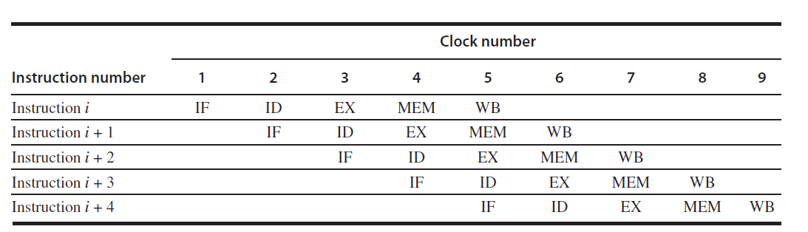
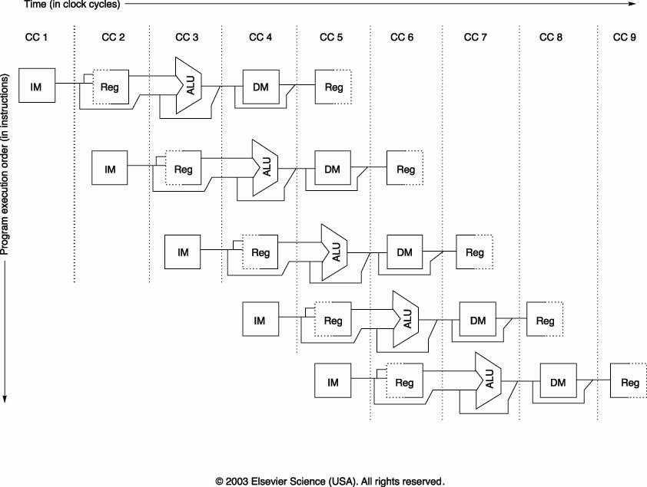

Slide 8
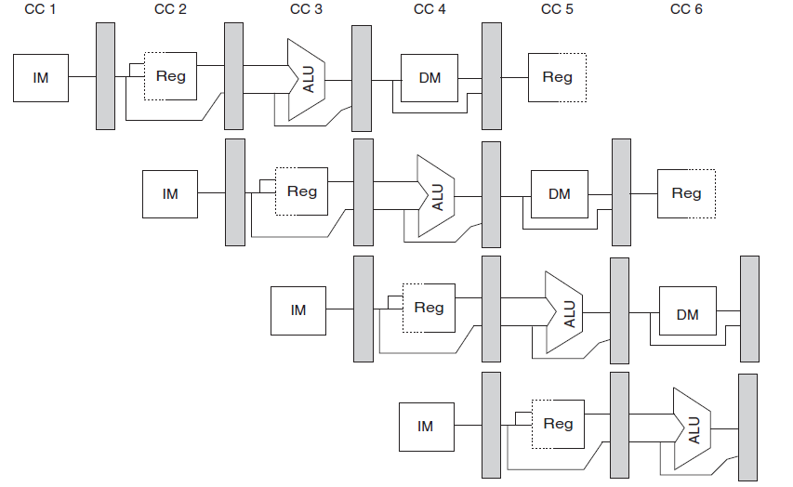

Slide 9
Problems With The Previous Figure
The memory is accessed twice during each clock cycle. This problem is avoided by using separate data and instruction caches.
It is important to note that if the clock period is the same for a pipelined processor and an non-pipelined processor, the memory must work five times faster.
Another problem that we can observe is that the registers are accessed twice every clock cycle. To try to avoid a resource conflict we perform the register write in the first half of the cycle and the read in the second half of the cycle.

Slide 10
Problems With The Previous Figure (continued)
We write in the first half because therefore an write operation can be read by another instruction further down the pipeline.
A third problem arises with the interaction of the pipeline with the PC. We use an adder to increment PC by the end of IF. Within ID we may branch and modify PC. How does this affect the pipeline?
The use if pipeline registers allow the CPU of have a memory to implement the pipeline. Remember that the previous figure has only one resource use in each stage.

Slide 11
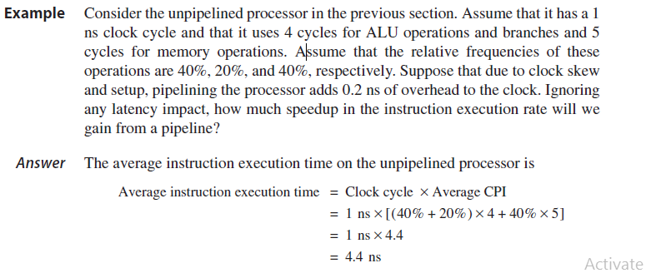
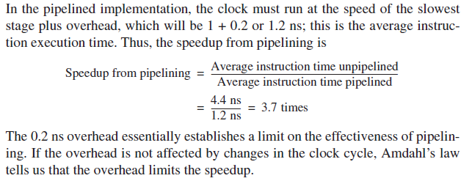

Slide 12
Pipeline Hazards
The performance gain from using pipelining occurs because we can start the execution of a new instruction each clock cycle. In a real implementation this is not always possible.
Another important note is that in a pipelined processor, a particular instruction still takes at least as long to execute as non-pipelined.
Pipeline hazards prevent the execution of the next instruction during the appropriate clock cycle.

Slide 13
Types Of Hazards
There are three types of hazards in a pipeline, they are as follows:
    Structural Hazards: are created when the data path hardware in the pipeline cannot support all of the overlapped instructions in the pipeline.
    Data Hazards: When there is an instruction in the pipeline that affects the result of another instruction in the pipeline.
    Control Hazards: The PC causes these due to the pipelining of branches and other instructions that change the PC.

Slide 14
Dealing With Structural Hazards
Structural hazards result from the CPU data path not having resources to service all the required overlapping resources.
Suppose a processor can only read and write from the registers in one clock cycle. This would cause a problem during the ID and WB stages.
Assume that there are not separate instruction and data caches, and only one memory access can occur during one clock cycle. A hazard would be caused during the IF and MEM cycles.

Slide 15
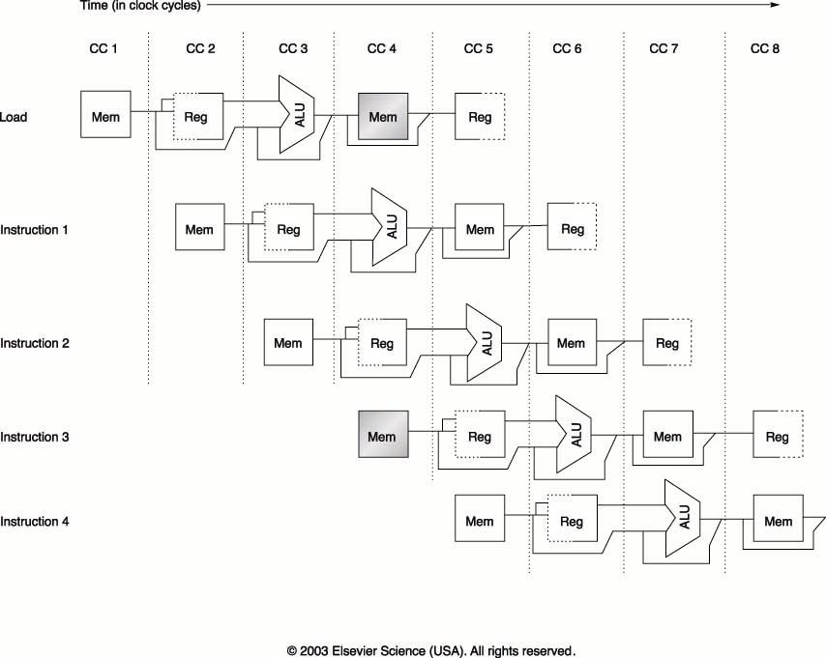

Slide 16
Dealing With Structural Hazards
A structural hazard is dealt with by inserting a stall or pipeline bubble into the pipeline. This means that for that clock cycle, nothing happens for that instruction. This effectively “slides” that instruction, and subsequent instructions, by one clock cycle.
This effectively increases the average CPI.
EX: Assume that you need to compare two processors, one with a structural hazard that occurs 40% for the time, causing a stall. Assume that the processor with the hazard has a clock rate 1.05 times faster than the processor without the hazard. How fast is the processor with the hazard compared to the one without the hazard?

