Slide 1
Pipelined Processor Design
EE 204
Computer Architecture
Computer Science Department
FAST-NU Karachi

Slide 2
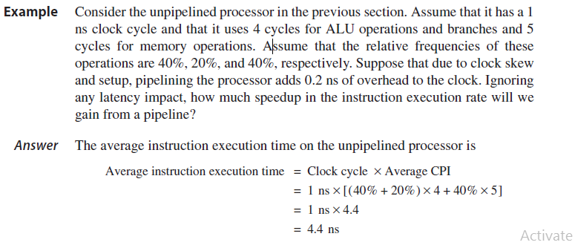
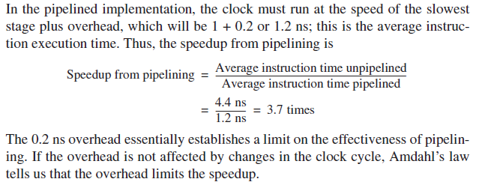

Slide 3
Dealing With Structural Hazards
A structural hazard is dealt with by inserting a stall or pipeline bubble into the pipeline. This means that for that clock cycle, nothing happens for that instruction. This effectively “slides” that instruction, and subsequent instructions, by one clock cycle.
This effectively increases the average CPI.
EX: Assume that you need to compare two processors, one with a structural hazard that occurs 40% for the time, causing a stall. Assume that the processor with the hazard has a clock rate 1.05 times faster than the processor without the hazard. How fast is the processor with the hazard compared to the one without the hazard?

Slide 4
Dealing With Structural Hazards (continued)
CPI no haz
Clock cycle time no haz
Speedup =
x
CPI haz
Clock cycle time haz
1
1
Speedup =
x
1+0.4*1
1/1.05
= 0.75

Slide 5
Pipeline Hazards
Hazards: situations that would cause incorrect execution
  If next instruction were launched during its designated clock cycle
Structural hazards
  Caused by resource contention
  Using same resource by two instructions during the same cycle
Data hazards
  An instruction may compute a result needed by next instruction
  Hardware can detect dependencies between instructions
Control hazards
  Caused by instructions that change control flow (branches/jumps)
  Delays in changing the flow of control
Hazards complicate pipeline control and limit performance

Slide 6
Structural Hazards
Problem
  Attempt to use the same hardware resource by two different
  instructions during the same cycle
Example
  Writing back ALU result in stage 4
  Conflict with writing load data in stage 5
Structural Hazard
Two instructions are attempting to write the register file during same cycle
lw $6, 8($5)
IF
ID
EX
MEM
WB
ori $4, $3, 7
IF
ID
EX
WB
Instructions
sub $5, $2, $3
IF
ID
EX
WB
sw $2, 10($3)
IF
ID
EX
MEM
  CC1
  CC2
  CC3
  CC4
  CC5
  CC6
  CC7
  CC8
  CC9
  Time

Slide 7
Resolving Structural Hazards
Serious Hazard:
  Hazard cannot be ignored
Solution 1: Delay Access to Resource
  Must have mechanism to delay instruction access to resource
  Delay all write backs to the register file to stage 5
    ALU instructions bypass stage 4 (memory) without doing anything
Solution 2: Add more hardware resources (more costly)
  Add more hardware to eliminate the structural hazard
  Redesign the register file to have two write ports
    First write port can be used to write back ALU results in stage 4
    Second write port can be used to write back load data in stage 5

Slide 8
Next . . .
Pipelining versus Serial Execution
Pipelined Datapath
Pipelined Control
Pipeline Hazards
Data Hazards and Forwarding
Load Delay, Hazard Detection, and Stall Unit
Control Hazards
Delayed Branch and Dynamic Branch Prediction

Slide 9
Data Hazards
Dependency between instructions causes a data hazard
The dependent instructions are close to each other
  Pipelined execution might change the order of operand access
Read After Write – RAW Hazard
  Given two instructions I and J, where I comes before J …
  Instruction J should read an operand after it is written by I
  Called a data dependence in compiler terminology
  I: add $1, $2, $3 # r1 is written
  J: sub $4, $1, $3 # r1 is read
  Hazard occurs when J reads the operand before I writes it

Slide 10
Example of a RAW Data Hazard
Time (cycles)
CC1
CC2
CC3
CC4
CC5
CC6
CC7
CC8
value of $2
10
10
10
10
10/20
20
20
20
sub $2, $1, $3
IM
Reg
ALU
DM
Reg
and $4, $2, $5
IM
Reg
ALU
DM
Reg
Program Execution Order
or $6, $3, $2
IM
Reg
ALU
DM
Reg
add $7, $2, $2
IM
Reg
ALU
DM
Reg
sw $8, 10($2)
IM
Reg
ALU
DM
Result of sub is needed by and, or, add, & sw instructions
Instructions and & or will read old value of $2 from reg file
During CC5, $2 is written and read – new value is read

Slide 11
Solution 1: Stalling the Pipeline
Time (in cycles)
CC1
CC2
CC3
CC4
CC5
CC6
CC7
CC8
value of $2
10
10
10
10
10/20
20
20
20
sub $2, $1, $3
IM
Reg
ALU
DM
Reg
Instruction Order
and $4, $2, $5
IM
bubble
bubble
Reg
ALU
DM
Reg
or $6, $3, $2
IM
Reg
ALU
DM
The and instruction cannot fetch $2 until CC5
  The and instruction remains in the IF/ID register until CC5
Two bubbles are inserted into ID/EX at end of CC3 & CC4
  Bubbles are NOP instructions: do not modify registers or memory
  Bubbles delay instruction execution and waste clock cycles

Slide 12
Solution 2: Forwarding ALU Result
The ALU result is forwarded (fed back) to the ALU input
  No bubbles are inserted into the pipeline and no cycles are wasted
ALU result exists in either EX/MEM or MEM/WB register
Time (in cycles)
CC1
CC2
CC3
CC4
CC5
CC6
CC7
CC8
sub $2, $1, $3
IM
Reg
ALU
DM
Reg
and $4, $2, $5
IM
Reg
ALU
DM
Reg
Program Execution Order
or $6, $3, $2
IM
Reg
DM
Reg
ALU
add $7, $2, $2
IM
Reg
ALU
DM
Reg
sw $8, 10($2)
IM
Reg
ALU
DM

Slide 13
Load Delay
Unfortunately, not all data hazards can be forwarded
  Load has a delay that cannot be eliminated by forwarding
In the example shown below …
  The LW instruction does not have data until end of CC4
  AND instruction wants data at beginning of CC4 - NOT possible
Time (cycles)
CC1
CC2
CC3
CC4
CC5
CC6
CC7
CC8
lw $2, 20($1)
IF
Reg
DM
Reg
However, load can forward data to second next instruction
ALU
Program Order
and $4, $2, $5
IF
Reg
ALU
DM
Reg
or $6, $3, $2
IF
Reg
ALU
DM
Reg
add $7, $2, $2
IF
Reg
ALU
DM
Reg

Slide 14
Stall the Pipeline for one Cycle
Freeze the PC and the IF/ID registers
  No new instruction is fetched and instruction after load is stalled
Allow the Load instruction in ID/EX register to proceed
Introduce a bubble into the ID/EX register
Load can forward data to next instruction after delaying it
Time (cycles)
CC1
CC2
CC3
CC4
CC5
CC6
CC7
CC8
lw $2, 20($1)
IM
Reg
ALU
DM
Reg
Program Order
and $4, $2, $5
IM
bubble
Reg
ALU
DM
Reg
or $6, $3, $2
IM
Reg
ALU
DM
Reg

Slide 15
Compiler Scheduling
Compilers can schedule code in a way to avoid load stalls
Consider the following statements:
  a = b + c; d = e – f;
Slow code:
  lw $10, ($1) # $1 = addr b
  lw $11, ($2) # $2 = addr c
  add $12, $10, $11 # stall
  sw $12, ($3) # $3 = addr a
  lw $13, ($4) # $4 = addr e
  lw $14, ($5) # $5 = addr f
  sub $15, $13, $14 # stall
  sw $15, ($6) # $6 = addr d
Fast code: No Stalls
  lw $10, 0($1)
  lw $11, 0($2)
  lw $13, 0($4)
  lw $14, 0($5)
  add $12, $10, $11
  sw $12, 0($3)
  sub $15, $13, $14
  sw $14, 0($6)

Slide 16
Write After Read – WAR Hazard
Instruction J should write its result after it is read by I
Called an anti-dependence by compiler writers
I: sub $4, $1, $3 # $1 is read
J: add $1, $2, $3 # $1 is written
Results from reuse of the name $1
Hazard occurs when J writes $1 before I reads it
Cannot occur in our basic 5-stage pipeline because:
  Reads are always in stage 2, and
  Writes are always in stage 5
  Instructions are processed in order

Slide 17
Write After Write – WAW Hazard
Instruction J should write its result after instruction I
Called an output-dependence in compiler terminology
I: sub $1, $4, $3 # $1 is written
J: add $1, $2, $3 # $1 is written again
This hazard also results from the reuse of name $1
Hazard occurs when writes occur in the wrong order
Can’t happen in our basic 5-stage pipeline because:
  All writes are ordered and always take place in stage 5
WAR and WAW hazards can occur in complex pipelines
Notice that Read After Read – RAR is NOT a hazard

