Slide 1
Pipelined Processor Design
EE 204
Computer Architecture
Computer Science Department
FAST-NU Karachi

Slide 2
Write After Read – WAR Hazard
Instruction J should write its result after it is read by I
Called an anti-dependence by compiler writers
I: sub $4, $1, $3 # $1 is read
J: add $1, $2, $3 # $1 is written
Results from reuse of the name $1
Hazard occurs when J writes $1 before I reads it
Cannot occur in our basic 5-stage pipeline because:
  Reads are always in stage 2, and
  Writes are always in stage 5
  Instructions are processed in order

Slide 3
Write After Write – WAW Hazard
Instruction J should write its result after instruction I
Called an output-dependence in compiler terminology
I: sub $1, $4, $3 # $1 is written
J: add $1, $2, $3 # $1 is written again
This hazard also results from the reuse of name $1
Hazard occurs when writes occur in the wrong order
Can’t happen in our basic 5-stage pipeline because:
  All writes are ordered and always take place in stage 5
WAR and WAW hazards can occur in complex pipelines
Notice that Read After Read – RAR is NOT a hazard

Slide 4
Next . . .
Pipelining versus Serial Execution
Pipelined Datapath
Pipelined Control
Pipeline Hazards
Data Hazards and Forwarding
Load Delay, Hazard Detection, and Stall Unit
Control Hazards
Delayed Branch and Dynamic Branch Prediction

Slide 5
Control Hazards
Branch instructions can cause great performance loss
Branch instructions need two things:
  Branch Result Taken or Not Taken
  Branch target
    PC + 4 If Branch is NOT taken
    PC + 4 + 4 × immediate If Branch is Taken
Branch instruction is decoded in the ID stage
  At which point a new instruction is already being fetched
For our pipeline: 2-cycle branch delay
  Effective address is calculated in the ALU stage
  Branch condition is determined by the ALU (zero flag)

Slide 6
Four Compiler Based Techniques
The simplest scheme to handle branches is to flush the pipeline.
A higher-performance, and only slightly more complex, scheme is to treat every branch as not taken.
An alternative scheme is to treat every branch as taken.
A fourth scheme, which was heavily used in early RISC processors is called delayed branch.

Slide 7
2-Cycle Branch Delay
Next1 thru Next2 instructions will be fetched anyway
Pipeline should flush Next1 and Next2 if branch is taken
Otherwise, they can be executed if branch is not taken
cc1
cc2
cc3
cc4
cc5
cc6
cc7
beq $5,$6,label
IF
Reg
ALU
Next1 # bubble
IF
Reg
Bubble
Bubble
Bubble
Next2 # bubble
IF
Bubble
Bubble
Bubble
Bubble
label: branch target instruction
IF
Reg
ALU
MEM

Slide 8
Delayed Branch
Define branch to take place after the next instruction
If no independent instruction is found
  Compiler fills delay slot with a NO-OP
beq $s1,$s0,label
add $t2,$t3,$t4
label:
Delay Slot
beq $s1,$s0,label
label:
. . .
add $t2,$t3,$t4

Slide 9

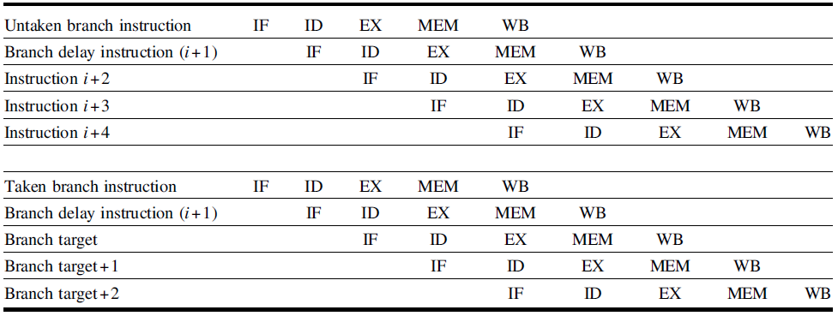
Delayed Branch
  For Example:

Slide 10
Reducing the Delay of Branches
Branch delay can be reduced from 2 cycles to just 1 cycle
Branches can be determined earlier in the Decode stage
  Next PC logic block is moved to the ID stage
  A comparator is added to the Next PC logic
    To determine branch decision, whether the branch is taken or not
Only one instruction that follows the branch will be fetched
If the branch is taken then only one instruction is flushed
We need a control signal to reset the IF/ID register
  This will convert the fetched instruction into a NOP

Slide 11
Next . . .
Pipelining versus Serial Execution
Pipelined Datapath
Pipelined Control
Pipeline Hazards
Data Hazards and Forwarding
Load Delay, Hazard Detection, and Stall Unit
Control Hazards
Delayed Branch and Dynamic Branch Prediction

Slide 12
Branch Hazard Alternatives
Predict Branch Not Taken (modified datapath)
  Successor instruction is already fetched
  About half of RISC branches are not taken on average
  Flush instructions in pipeline only if branch is actually taken
Delayed Branch
  Define branch to take place AFTER the next instruction
  Compiler/assembler fills the branch delay slot.
Dynamic Branch Prediction
  Can predict backward branches in loops ⇒ taken most of time
  However, branch target address is determined in ID stage
  Must reduce branch delay from 1 cycle to 0, but how?

Slide 13
Zero-Delayed Branch
Disadvantages of delayed branch
  Branch delay can increase to multiple cycles in deeper pipelines
  Branch delay slots must be filled with useful instructions or no-op
How can we achieve zero-delay for a taken branch?
  Branch target address is computed in the IF stage
Solution
  Check the PC to see if the instruction being fetched is a branch
  Store the branch target address in a branch buffer in the IF stage
  If branch is predicted taken then
    Next PC = branch target fetched from branch target buffer
  Otherwise, if branch is predicted not taken then Next PC = PC+4

Slide 14
Branch Target and Prediction Buffer
The branch target buffer is implemented as a small cache
  Stores the branch target address of recent branches
We must also have prediction bits
  To predict whether branches are taken or not taken
  The prediction bits are dynamically determined by the hardware
Branch Target & Prediction Buffer
Inc
Addresses of Recent Branches
Target
Addresses
Predict
Bits
mux
low-order bits used as index
PC
predict_taken
=

Slide 15
Dynamic Branch Prediction
Prediction of branches at runtime using prediction bits
  One or few prediction bits are associated with a branch instruction
Branch prediction buffer is a small memory
  Indexed by the lower portion of the address of branch instruction
The simplest scheme is to have 1 prediction bit per branch
We don’t know if the prediction bit is correct or not
If correct prediction …
  Continue normal execution – no wasted cycles
If incorrect prediction (misprediction) …
  Flush the instructions that were incorrectly fetched – wasted cycles
  Update prediction bit and target address for future use

Slide 16
2-bit Prediction Scheme
Prediction is just a hint that is assumed to be correct
If incorrect then fetched instructions are flushed
1-bit prediction scheme has a performance shortcoming
  A loop branch is almost always taken, except for last iteration
  1-bit scheme will mispredict twice, on first and last loop iterations
2-bit prediction schemes work better and are often used
  A prediction must be wrong
  twice before it is changed
  A loop branch is mispredicted
  only once on the last iteration
Predict
Taken
Not Taken
Predict
Taken
Taken
Taken
Taken
Not Taken
Not
Taken
Not Taken
Not
Taken
Not Taken
Taken

Slide 17
Pipeline Hazards Summary
Three types of pipeline hazards
  Structural hazards: conflicts using a resource during same cycle
  Data hazards: due to data dependencies between instructions
  Control hazards: due to branch and jump instructions
Hazards limit the performance and complicate the design
  Structural hazards: eliminated by careful design or more hardware
  Data hazards are eliminated by forwarding
  However, load delay cannot be eliminated and stalls the pipeline
  Delayed branching can be a solution when branch delay
  Branch prediction can reduce branch delay to zero
  Branch misprediction should flush the wrongly fetched instructions

