Slide 1
Pipelined Processor Design
EE 204
Computer Architecture
Computer Science Department
FAST-NU Karachi

Slide 2
Dynamic Branch Prediction
Prediction of branches at runtime using prediction bits
  One or few prediction bits are associated with a branch instruction
Branch prediction buffer is a small memory
  Indexed by the lower portion of the address of branch instruction
The simplest scheme is to have 1 prediction bit per branch
We don’t know if the prediction bit is correct or not
If correct prediction …
  Continue normal execution – no wasted cycles
If incorrect prediction (misprediction) …
  Flush the instructions that were incorrectly fetched – wasted cycles
  Update prediction bit and target address for future use

Slide 3
2-bit Prediction Scheme
Prediction is just a hint that is assumed to be correct
If incorrect then fetched instructions are flushed
1-bit prediction scheme has a performance shortcoming
  A loop branch is almost always taken, except for last iteration
  1-bit scheme will mispredict twice, on first and last loop iterations
2-bit prediction schemes work better and are often used
  A prediction must be wrong
  twice before it is changed
  A loop branch is mispredicted
  only once on the last iteration
Predict
Taken
Not Taken
Predict
Taken
Taken
Taken
Taken
Not Taken
Not
Taken
Not Taken
Not
Taken
Not Taken
Taken

Slide 4
Pipeline Hazards Summary
Three types of pipeline hazards
  Structural hazards: conflicts using a resource during same cycle
  Data hazards: due to data dependencies between instructions
  Control hazards: due to branch and jump instructions
Hazards limit the performance and complicate the design
  Structural hazards: eliminated by careful design or more hardware
  Data hazards are eliminated by forwarding
  However, load delay cannot be eliminated and stalls the pipeline
  Delayed branching can be a solution when branch delay
  Branch prediction can reduce branch delay to zero
  Branch misprediction should flush the wrongly fetched instructions

Slide 5
How Is Pipelining Implemented?
A Simple Implementation of RISC V:
Instruction fetch cycle (IF):
IR ←Mem[PC];
NPC ←PC + 4;
Instruction decode/register fetch cycle (ID):
A ←Regs[rs1];
B ←Regs[rs2];
Imm sign-extended immediate field of IR;

Slide 6
How Is Pipelining Implemented?
Execution/effective address cycle (EX):
1. Memory reference:
ALUOutput ← A + Imm
2. Register-register ALU instruction:
ALUOutput ← A func B
3. Register-Immediate ALU instruction:
ALUOutput ← A op Imm;
4. Branch:
ALUOutput ←NPC + (Imm << 2);
Cond (A == B)

Slide 7
How Is Pipelining Implemented?
Memory access/branch completion cycle (MEM):
LMD ← Mem[ALUOutput]
Mem[ALUOutput] ←B
Write-back cycle (WB):
Regs[rd] ←ALUOutput;
Regs[rd] ←LMD;

Slide 8
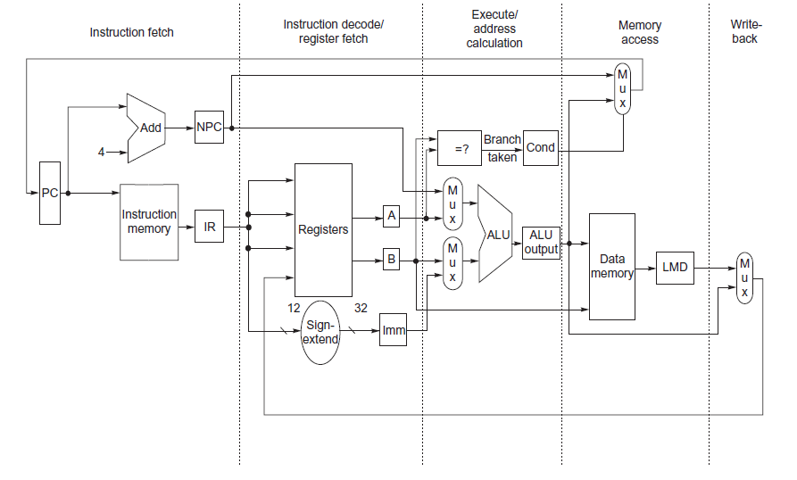
RISC-V Datapaths

Slide 9
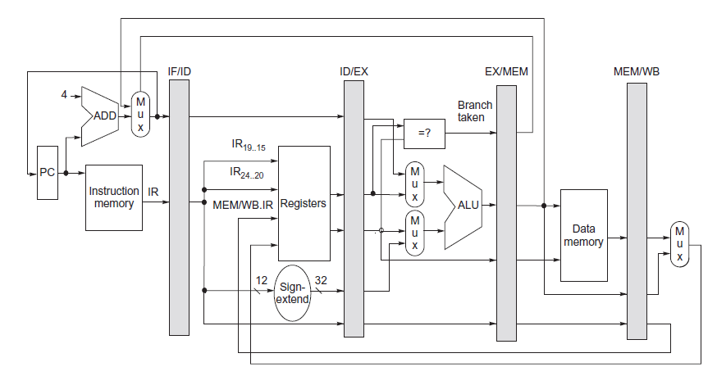
RISC-V Pipeline

Slide 10
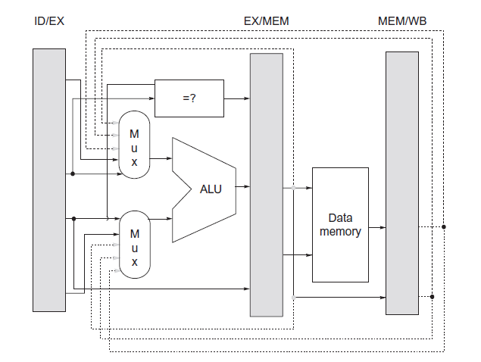
RISC-V Forwarding

