Slide 1
Pipelined Processor Design
EE 204
Computer Architecture
Computer Science Department
FAST-NU Karachi

Slide 2
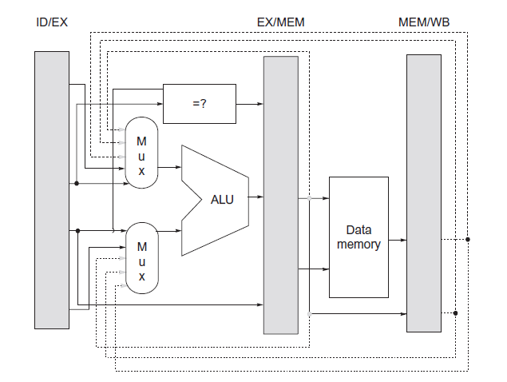
RISC-V Forwarding

Slide 3
What Makes Pipelining Hard to Implement?
Exceptions: When the instruction order is changed in unexpected ways
Challenges raised by different instruction sets
Dealing with Exceptions
Overlapped execution of instructions make exception handling more difficult to implement
Types of Exceptions and Requirements
I/O device request
Invoking an OS system service from a user program
Tracing instruction execution
Breakpoint (programmer requested interrupt)
Integer arithmetic overflow
FP arithmetic anomaly
Page fault

Slide 4
What Makes Pipelining Hard to Implement?
Misaligned memory access
Memory protection violation
Using an undefined or unimplemented instruction
Hardware malfunctions
Power failure
Names of common exceptions vary among different architectures
The requirements on exceptions can be characterized on five semi-independent axes
Synchronous versus asynchronous
If the event occurs at the same place every time the program is executed with the same data and memory allocation, it is said to be synchronous

Slide 5
What Makes Pipelining Hard to Implement?
Asynchronous events are caused by devices external to the processor and memory (except hardware malfunction)
User requested versus coerced
User maskable versus user non-maskable
Within versus between instructions
Whether the event prevents instruction completion by occurring in the middle of execution or whether it is recognized between instructions
Resume versus terminate
If the program execution stops after the interrupt, it is a terminating event
Most difficult exception to handle
Exceptions that occur within an instruction and are expected to be resumed

Slide 6
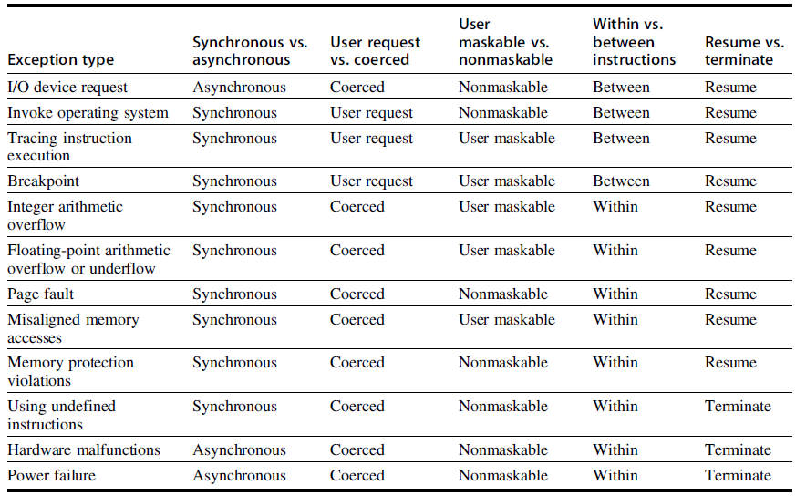
Five categories are used to define actions needed for different exception types

Slide 7
What Makes Pipelining Hard to Implement?
Restart-able processors
If a processor’s pipeline provides to it the ability to handle the exception and restart the program without affecting its correctness and execution
Stopping and Restarting Execution
Most difficult exceptions have two properties
They occur within instructions
They must be restartable
When an exception occurs, save the pipeline state by the following steps
Force a trap instruction into the pipeline on the next IF
Until the trap is taken, turn off all writes for the faulting instruction and for all instructions that follow in the pipeline

Slide 8
What Makes Pipelining Hard to Implement?
Prevents any state changes for instructions that will not be completed until the exception is handled
After the exception handling routine receives control, it immediately saves the PC of the faulting instruction
Problem with delayed branches
Save as many PCs as the length of the delay slot plus one
A pipeline is said to have precise exception, if the pipeline can be stopped so that the preceding instructions (faulting instructions) are completed and those after it can be restarted from scratch
Simpler for integer instructions but is complex to maintain for floating point instructions

Slide 9
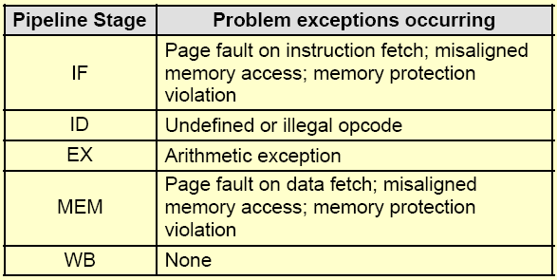
Exceptions that may occur in RISC-V pipeline

Slide 10
What Makes Pipelining Hard to Implement?
Instruction Set Complications
When an instruction is guaranteed to complete, it is said to be committed
RISC-V writes at the end of integer pipeline
End of MEM or beginning of WB cycle
Precise exceptions are easy to implement and straightforward for RISC-V integer pipeline
Processors that write in the early stages of pipeline
Rollback the instruction or write is deferred till the end
Memory state changes?
String copy operations of VAX and Intel 80x86
States are kept in registers so that restoration is possible

Slide 11
What Makes Pipelining Hard to Implement?
Some processors may need extra states to be saved
Condition code and its setting time creates more problems
Condition code is also treated as an operand
Instruction taking varying number of cycles to execute
Pipeline the micro-instruction execution
Micro-instructions are simple instructions used in sequence to implement a more complex instruction set
Used in the Intel processors to give it RISC like characteristic
Simpler instruction sets avoid many of the complications

