Slide 1
Pipelined Processor Design
EE 204
Computer Architecture
Computer Science Department
FAST-NU Karachi

Slide 2
Pipeline for Multicycle Operations
Extend RISC-V Pipeline to Handle Multicycle Operations
Basic approach and design alternatives
Performance measurements of a RISC-V FP pipeline
Same pipeline of RISC-V with two changes for FP instructions
EX cycle is repeated as many times as needed to complete the operation
There are multiple floating-point functional units
Assume 4-separate functional units
Main integer unit: Handles loads, stores, integer ALU operations and branches
FP and integer multiplier
FP adder: Handles FP add, subtract and conversion
FP and integer divider

Slide 3
Pipeline for Multicycle Operations
If the execution stages of functional units are not pipelined
EX stage has number of clock delays larger than 1
Allow pipelining of some stages and allow multiple ongoing operations
Latency and initiation interval or repeat interval
Latency: The number of intervening cycles between an instruction that produces a result and an instruction that uses the result
Initiation or repeat interval: The number of cycles that must elapse between issuing two operations of the same type
Latencies and initiation intervals for the given functional units

Slide 4
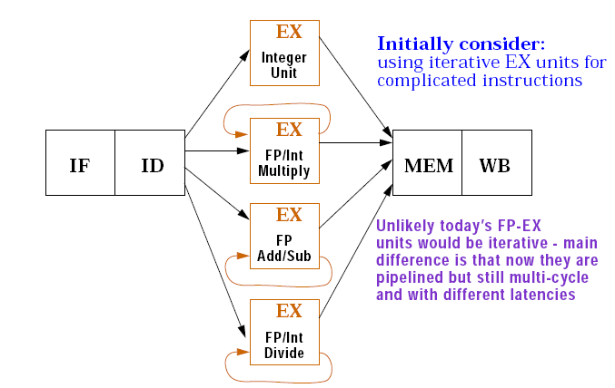
RISC-V pipeline with three additional functional units

Slide 5
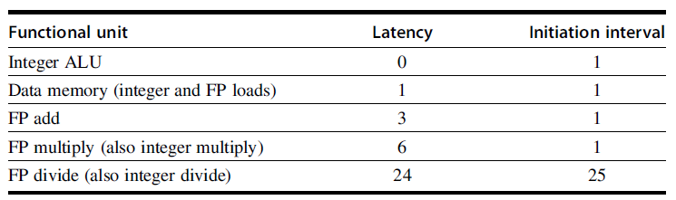
Latencies and Initiation Intervals for Functional Units

Slide 6
Pipeline for Multicycle Operations
The latency and repeat interval added will result in pipelining of some functional units
Additional pipeline registers are introduced and modification of the connections to those registers are done
A1/A2, A2/A3, A3/A4, etc.
Hazards and Forwarding in Longer Latency Pipelines
A number of different aspects to the hazards detection and forwarding logic
Structural hazards can occur because the divide unit is not fully pipelined
Since instructions have varying running times, the number of register writes per cycle may be larger than 1
WAW hazards are possible but WAR hazard is not possible

Slide 7
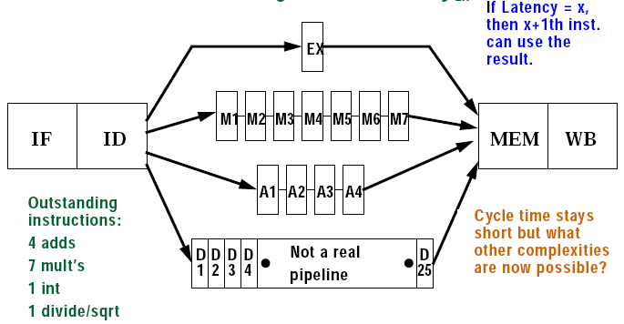
A pipeline that supports multicycle FP operations

Slide 8
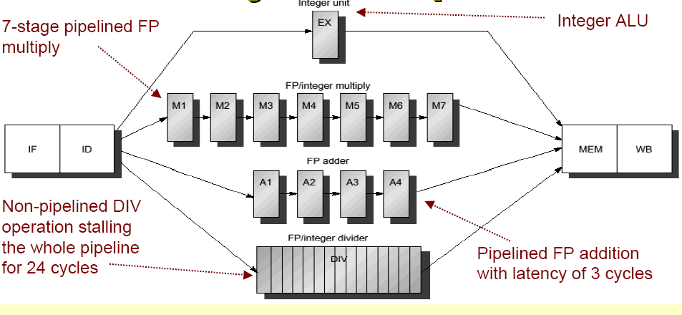
Multicycle FP operations

Slide 9
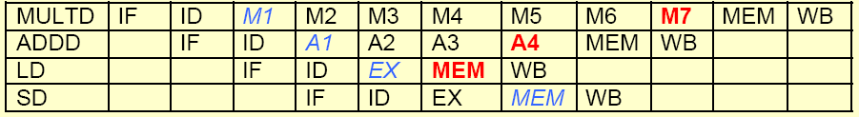
Pipeline timing of a set of independent instructions

Slide 10
Pipeline for Multicycle Operations
4. Instructions can complete in a different order than issued, causing problems with exceptions
5. Stalls for RAW hazards will be more frequent because of longer latency of operations
Potential impact of RAW hazards
Problems arising from writes
Since floating point register file has only one write port, it may result in higher number of structural hazards
Increase the number of write ports
Additional write port will be used rarely
Structural hazard is acceptable
Implement Interlock to handle the above
There are two ways to implement this interlock

Slide 11
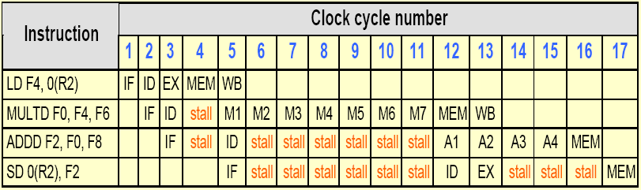
FP code showing stalls arising from RAW hazards

Slide 12
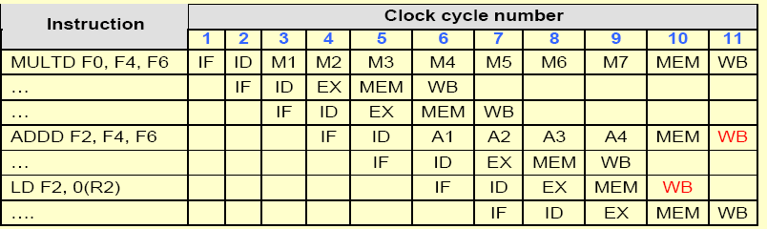
Three instructions want to perform WB to FP register file simultaneously

